Slide 1
COMP3511
Lab 01: Introduction to the Lab Environment
REN, Zhenghang (zrenak@cse.ust.hk)

Slide 2
Lab Tutorial
Short introduction to Linux
How to login your lab environment
How to use your lab environment (with demo)
After this tutorial you should be able to:
Login/logout lab server
Interact with OS in lab server: change directory, list directory files, create files, edit files, save files, delete files……

Slide 3
Lab Environment
Linux environment (contrast to Windows and MacOS you are familiar with)
Accessed remotely via SSH in terminal
Beware! Don’t store large files on your lab environment

Slide 4
Activate Your CSD Account
https://cssystem.cse.ust.hk/UGuides/activation.html
Every student involved in CS course will get a CSD PC account.
The account needs activation before login.

Slide 5
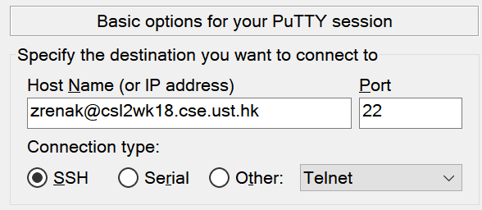
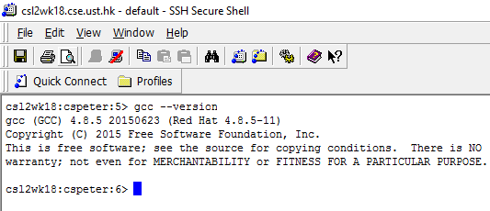
Getting Started (in Windows)
Enter a machine name (csl2wkXX.cse.ust.hk, where XX=01-40)
Use SSH(Secure SHell client)or Putty(https://www.putty.org)
Host Name (address): csl2wkXX.cse.ust.hk (where XX=01..40)
ITSC username (e.g. cspeter)
Port Number: 22
Save config
Enter your ITSC username

Slide 6
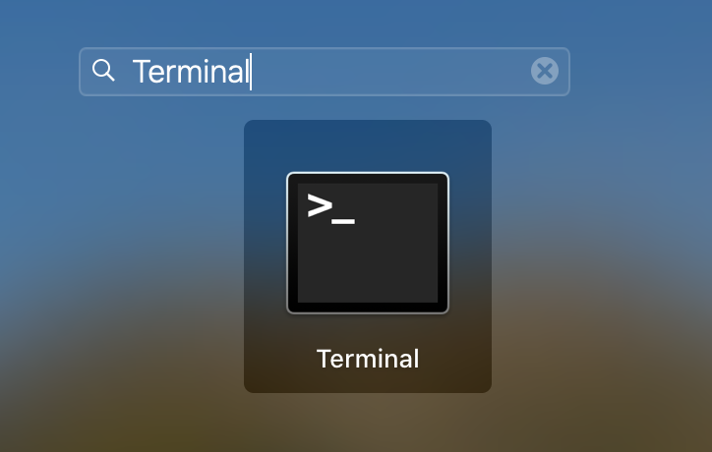
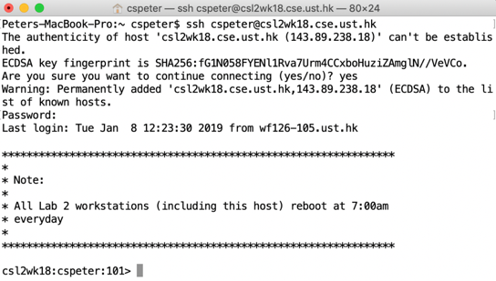
Getting Started (in Mac/Linux)
In Mac, open Terminal and then type in the ssh command
ssh [Your ITSC username]@csl2wkXX.cse.ust.hk (where XX=01..40)
In Linux, there should be a similar terminal software (e.g. Konsole, GNOME terminal)

Slide 7
Try login

Slide 8
What is Linux?
An UNIX-like operating system
Open-source, easy to customize
A popular choice of programmers
The shell, although difficult to learn at the beginning, has proven to be productive and convenient for programmers
Closer environment to the servers where applications are hosted on
A popular choice for servers
Even Microsoft Azure is based on Linux

Slide 9
Why learn Linux?
To manage a server for your application
To use powerful tools like Kali Linux for cyber security studies
To use cloud computing services
To use containers (Docker, Kubernetes)
For this course: Linux offers simple and uniform lab environment

Slide 10
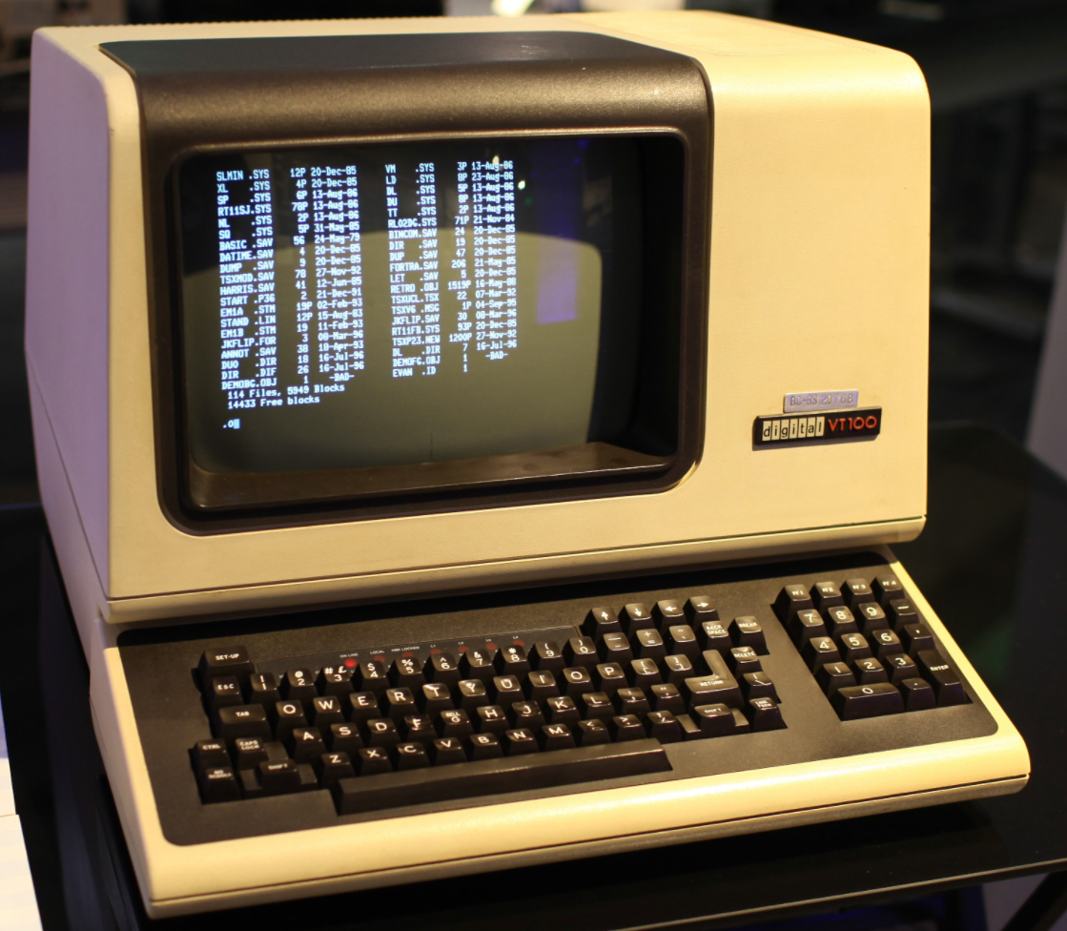
The Terminal
The piece of hardware that allows you to interact with the computer
The monitor
The keyboard
A computer was connected to multiple terminals for sharing
Computers were expensive
Now terminal refers to the Text UI program
A virtual terminal
Emulating text I/O of early terminals

Slide 11
Shell
The piece of software that provides text interaction with the computer
Linux uses bash as the default shell
There are other shells, e.g. sh, csh, zsh, ……
csh is the default shell in Lab 2
You can customize the shell by editing ~/.cshrc_user
Users tell the computer what to do with commands
Shell commands are programs that do specific tasks
Commands may or may not give text feedback
Some commands accept arguments

Slide 12
Shell vs Terminal
The terminal is the GUI window that you see on the screen. It takes commands and shows output. (input and output module)
The shell is the software that interprets and executes the various commands that we type in the terminal.

Slide 13
Interaction with Linux OS
Shell Commands
Directory
List/Change directory
Create, Rename, Move, Remove
File
Check file contents
Create, Rename, Edit, Move, Remove
Getting Help

Slide 14
Shell Commands
Example shell commands
ls lists files under a directory
cd changes the working directory to somewhere else
pwd shows current directory
Clear the output: clear
Example command arguments
Arguments can be a character or a word
Character arguments can stack together
ls –a -l or in short ls -al
‘a’ shows hidden files, ‘l’ list detailed information of files
Each command is different, consult the manual or help
man ls
ls --help

Slide 15
Essential Shell Commands
ls | cd | cat
rm | mkdir | rmdir
pwd | echo | whoami
less | more | man
info | touch | exit
Use the key <Tab> to auto-complete commands
Use arrow keys (up and down) to find previously used commands
Use argument --help on any command to show their usage
Use man (a command) to show detailed command description
E.g. man less

Slide 16
Advanced Usage: Pipe
Pipe abstracts the connection from one command's output to another command's input
Example
cat holidays.txt | grep Christmas
General Syntax
command 1 | command 2 | command 3 | ……
Produce outputs
Take outputs

Slide 17
Other Examples of Pipe
cat file1.txt | sort
Read the content of file1.txt and sort lines
cat file2.txt | head -4
Read the content of file2.txt and show the first four lines
ls | wc -l
Count the number of files
ps –aux | sort –nrk 3,3 | head –n 5
Get process state list and sort with reverse order. Then show the top five from the list

Slide 18
Directory - Path
An absolute path specifies the path of the file starting from the root (/) directory
Relative path using dot(.) and dotdot (..)
. indicates the current directory
.. indicates the directory in the upper level
Example:
../test.txt
It means the file text.txt located in the upper level

Slide 19
Related commands
pwd
Print the absolution path of the current path
ls
List out the content in the current working directory
Examples:
ls –l
List out the detailed information about the current directory
ls –lh
List out the detailed information, with a human readable format
ls /home
List out the content of the home directory

Slide 20
Related commands
cd
Change directory
Examples:
cd ..
Change the current directory to the upper level
cd .
Change the current directory to the current directory
Nothing will happen
cd /etc/init.d/
Change the current directory to /etc/init.d/
cd ~
Change the current directory back to your home directory

Slide 21
Directory management
Creating directories
mkdir <arg1> <arg2> … <argn>
Renaming and moving directories
mv <source> <destination>
Copying directories
cp -r <source> <destination>

Slide 22
Directory management
Creating directories
mkdir <arg1> <arg2> … <argn>
Renaming and moving directories
mv <source> <destination>
Copying directories
cp -r <source> <destination>
Remove directories
rmdir <dir1> <dir2> … <dirN>
All directories must be empty
If not empty: rm –r <dir1> <dir2> … <dirN>

Slide 23
File management
Create an empty file or update its timestamp
touch <file>
It will be useful if you would like to change the last modified date of a file for some reasons
Remove files
rm <file1> <file2> … <fileN>
Remove ALL files recursively
rm * -rf
Don’t do this if you are root user and in the root directory

Slide 24
View a text file
There are 3 commands to view a text file
cat <filename>
more <filename>
less <filename>
There are 2 commonly used command-line editors (nano and vim)
nano <filename>
vim <filename>

Slide 25
Command line editors (nano/vi)
nano
Commands:
Arrow keys: Navigate the editor
Ctrl+X: exit nano
Ctrl+O: write output
Ctrl+K: (multiple times), each time it cut one line
Ctrl+U: Paste the copied lines from Ctrl+K
vim
Commands:
ESC+i: Enter insert mode
ESC+dd: delete a line of text
ESC+4y: copy 4 lines
ESC+p: paste lines
ESC+wq!: exit and save
ESC+q!: exit but not save

Slide 26
Tutorials of using Nano/Vi
There are many good online tutorials for nano/vi:
Nano: https://www.tecmint.com/learn-nano-text-editor-in-linux/
Vi: https://www.tutorialspoint.com/unix/unix-vi-editor.htm

Slide 27
Text Editing in Terminal with vim
vim is a powerful tool for text editing in Unix
To edit or create a file, use vim <filename>
Now create a new file: vim main.c
When you first enter vim, you are in command mode, where every key serves as a command, not an input
vim have different modes: command mode, input mode, visual mode
<Esc> will lead vim back to command mode
Press <i> to enter input mode, write the following Hello World for C

Slide 28
Text Editing in Terminal with VI
#include <stdio.h>
int main(){
printf("Hello, World!\n");
return 0;
}
After you finished, press <Esc> to go back to command mode
Press :w to save your file
Press :q to quit VI
Alternatively, you can use :wq to finish both action
Back in the Terminal,
Use gcc main.c to compile
Use ./a.out to run the Hello World
In this example, ./ refers to the current working directory

Slide 29
Editing within vim
When in command mode, these commands will enter input mode
<i> inserts at the current position
<a> inserts one character after current position
<o> inserts at a newline after current line
Replace mode:
<r> replace the current character with the next you enter, will not change mode
<insert> enters replace mode

Slide 30
Editing within vim
When in command mode,
<yy> copies one line
<dd> cuts one line
<10yy> copies 10 lines, <10dd> cuts 10 lines
Notes:
yy

Slide 31
Linux File System
Hierarchical structure from the root directory /
Your user folder (home) has alias of ~
cd or cd ~ go back to home directory
Your shell records a working directory
The directory you are at right now
Your working directory is always home when you launch the shell
You can show your current working directory with pwd

Slide 32
Try something!
Login your account.
In your home folder:
Create directory named “intro”
Change to “intro” directory as working directory
Create a file named “helloworld” using vim or nano
Write the file with contents: “hello world”
Save the file and exit editor
View the contents of file using cat, more, or less
Remove the intro directory
Logout

Slide 33
Thanks!

