Slide 1
COMP3511 Lab2
C/C++ programming in Linux
Ren, Zhenghang
zrenak@cse.ust.hk

Slide 2
Contents
Review of Core Concepts of C language with Demo
Workflow with Suggestions
Coding
Compiling
Debugging
C Programming in Linux Environment (including summary of first two chapters and review of computer organizations, including I/O subsystem. Basic concepts of process and threads)

Slide 3
Why C ?
Most of the operating systems are written in C^{[1]}
Precise control on the underlying hardwares
[1] The benefits and costs of writing a POSIX kernel in a high-level language (OSDI ‘18)

Slide 4
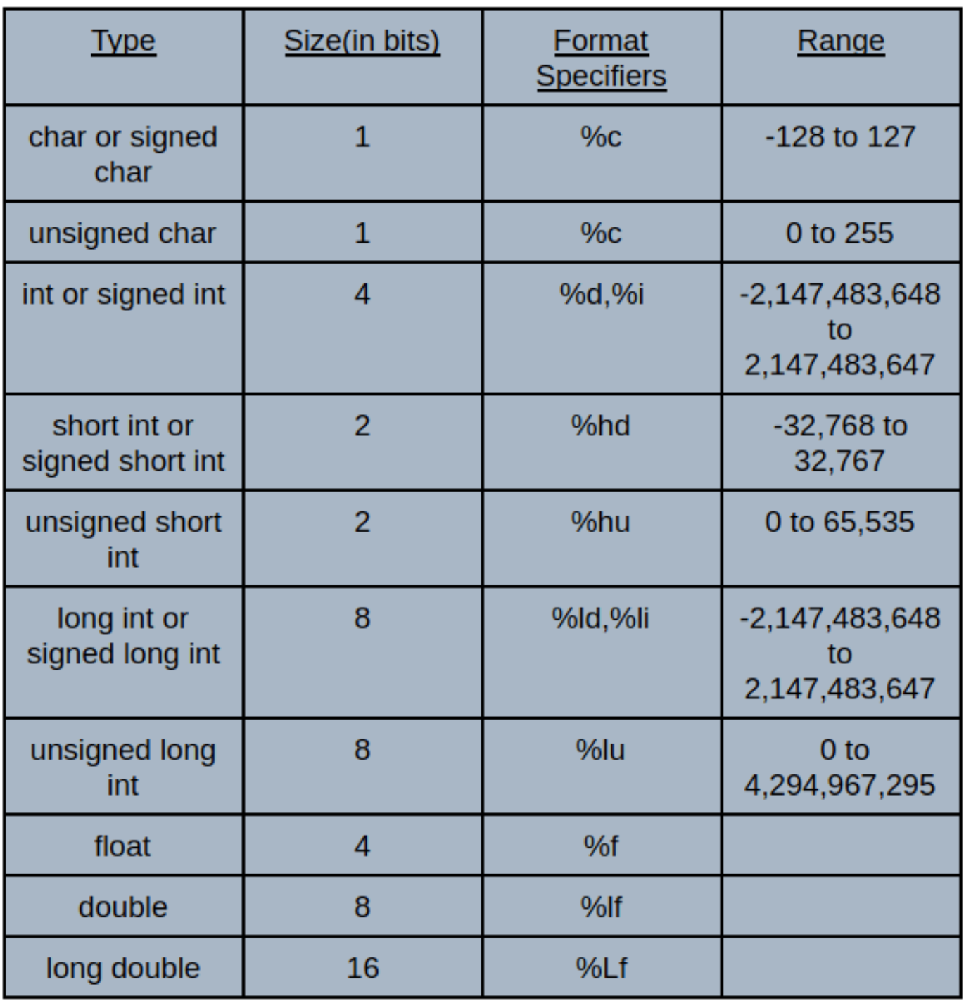
Basic Data Types
All C data types have fixed size in bits
Primary data types
Derived data types (pointers, arrays, functions…)
User defined data types
Notes:
Source: https://codedec.com/tutorials/data-types-in-c/

Slide 5
Quick Demos

Slide 6
[Demo] Swapping Two Intergers
#include <stdio.h>
int outer_a = 7;
int b = 1;
void swapInt(int *a, int *b)
{
int tmp = *a;
*a = *b;
*b = tmp;
}
int main()
{
int a = outer_a;
int b = 100 + 200 / 10 - 3 * 10;
printf("Before: %d %d\n", a, b);
swapInt(&a, &b);
printf("After : %d %d\n", a, b);
return 0;
}

Slide 7
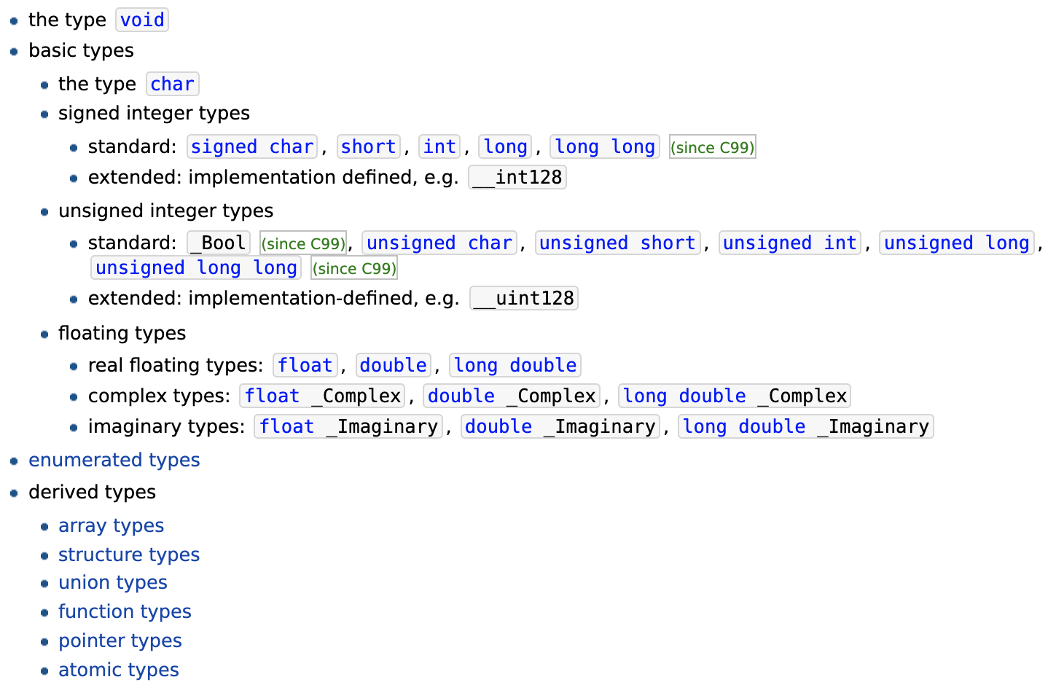
[Case study] Swapping Two Integers
#include <stdio.h>
int outer_a = 7;
int b = 1;
void swapInt(int *a, int *b)
{
int tmp = *a;
*a = *b;
*b = tmp;
}
int main()
{
int a = outer_a;
int b = 100 + 200 / 10 - 3 * 10;
printf("Before: %d %d\n", a, b);
swapInt(&a, &b);
printf("After : %d %d\n", a, b);
return 0;
}
Things you still need to know
What data type³ you can use and when to declare a type
[3] https://en.cppreference.com/w/c/language/type

Slide 8
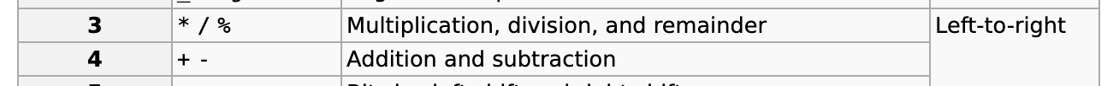
[Case study] Swapping Two Integers
#include <stdio.h>
int outer_a = 7;
int b = 1;
void swapInt(int *a, int *b)
{
int tmp = *a;
*a = *b;
*b = tmp;
}
int main()
{
int a = outer_a;
int b = 100 + 200 / 10 - 3 * 10;
printf("Before: %d %d\n", a, b);
swapInt(&a, &b);
printf("After : %d %d\n", a, b);
return 0;
}
Things you still need to know
What data type you can use and when to declare a type
What operators you can have
and their precedence and associativity⁴
[4] https://en.cppreference.com/w/c/language/operator_precedence

Slide 9
[Case study] Swapping Two Integers
#include <stdio.h>
int outer_a = 7;
int b = 1;
void swapInt(int *a, int *b)
{
int tmp = *a;
*a = *b;
*b = tmp;
}
int main()
{
int a = outer_a;
int b = 100 + 200 / 10 - 3 * 10;
printf("Before: %d %d\n", a, b);
swapInt(&a, &b);
printf("After : %d %d\n", a, b);
return 0;
}
Things you still need to know
What data type you can use and when to declare a type
What operators you can have
and their precedence and associativity
What are the scope (lifetime) and visibility of your variables
on code block basis; shadow principle

Slide 10
[Case study] Swapping Two Integers
#include <stdio.h>
int outer_a = 7;
int b = 1;
void swapInt(int *a, int *b)
{
int tmp = *a;
*a = *b;
*b = tmp;
}
int main()
{
int a = outer_a;
int b = 100 + 200 / 10 - 3 * 10;
printf("Before: %d %d\n", a, b);
swapInt(&a, &b);
printf("After : %d %d\n", a, b);
return 0;
}
Things you still need to know
What data type you can use and when to declare a type
What operators you can have
and their precedence and associativity
What are the scope (lifetime) and visibility of your variables
on code block basis; shadow principle
How to format a string for printf()⁵
other examples:
char ch = 'A';
printf("%c\n", ch);
float a = 12.67;
printf("%f\n", a);
printf("%e\n", a);
A
12.670000 1.267000e+01
[5] http://www.cplusplus.com/reference/cstdio/printf/

Slide 11
[Case study] Swapping Two Integers
#include <stdio.h>
int outer_a = 7;
int b = 1;
void swapInt(int *a, int *b)
{
int tmp = *a;
*a = *b;
*b = tmp;
}
int main()
{
int a = outer_a;
int b = 100 + 200 / 10 - 3 * 10;
printf("Before: %d %d\n", a, b);
swapInt(&a, &b);
printf("After : %d %d\n", a, b);
return 0;
}
Of course, you also need to know about pointers—the spirit of C
why pointers: arguments are passed by value
what is a pointer: the address (in virtual memory) of a variable
related syntax:
* (indirection/dereference opeartor):
when used in declaring a variable
indicating that the variable is a pointer

Slide 12
[Case study] Swapping Two Integers
#include <stdio.h>
int outer_a = 7;
int b = 1;
void swapInt(int *a, int *b)
{
int tmp = *a;
*a = *b;
*b = tmp;
}
int main()
{
int a = outer_a;
int b = 100 + 200 / 10 - 3 * 10;
printf("Before: %d %d\n", a, b);
swapInt(&a, &b);
printf("After : %d %d\n", a, b);
return 0;
}
Of course, you also need to know about pointers—the spirit of C
why pointers: arguments are passed by value
what is a pointer: the address (in virtual memory) of a variable
related syntax:
* (indirection/dereference opeartor):
when used in declaring a variable
indicating that the variable is a pointer
when used as operators in an expression
referring to the value pointed by the pointer

Slide 13
[Case study] Swapping Two Integers
#include <stdio.h>
int outer_a = 7;
int b = 1;
void swapInt(int *a, int *b)
{
int tmp = *a;
*a = *b;
*b = tmp;
}
int main()
{
int a = outer_a;
int b = 100 + 200 / 10 - 3 * 10;
printf("Before: %d %d\n", a, b);
swapInt(&a, &b);
printf("After : %d %d\n", a, b);
return 0;
}
Of course, you also need to know about pointers—the spirit of C
why pointers: arguments are passed by value
what is a pointer: the address (in virtual memory) of a variable
related syntax:
* (indirection/dereference opeartor):
when used in declaring a variable
indicating that the variable is a pointer
when used as operators in an expression
referring to the value pointed by the pointer
& (address-of opeartor):
fetching the address of a variable (resulting in a pointer)

Slide 14
Bridging C++ to C
Utility in C
Counterpart in C++
Part 2

Slide 15
Struct
Utility in C
Counterpart in C++
You can declare a composite data type whose components are physically grouped in memory
struct IntPair {
public:
IntPair(): first(0), second(0) {}
int sum() {return first+second; }
private:
int first, second;
};
struct IntPair {
int first, second;
};
int IntPair_sum(struct IntPair pair)
{
return pair.first + pair.second;
}
As opposed to C, C++:
Do not need separated functions
Can have access modifiers
Part 2

Slide 16
Dynamic Memory
Utility in C
Counterpart in C++
You can allocate and release heap memory on demand using malloc⁶ / free defined in <stdlib.h>
int *intVar = new int;
int *intArr = new int[100];
IntPair *intPair = new IntPair;
delete intVar;
delete [] intArr;
delete intPair;
int *intVar = malloc(sizeof(int));
int *intArr = malloc(sizeof(int)*100);
struct IntPair *intPair =
malloc(sizeof(struct IntPair));
free(intVar);
free(intArr);
free(intPair);
As opposed to C, C++:
Use new/delete operators
Part 2
[6] http://www.cplusplus.com/reference/cstdlib/malloc/

Slide 17
I/O
Utility in C
Counterpart in C++
Use scanf ⁷ / printf defined in <stdio.h>
int age;
string name;
cout << "Enter your name: " ;
cin >> name ;
cout << "Enter your age: " ;
cin >> age;
int age;
char name[100];
printf("Enter your name: ");
scanf("%s", name);
printf("Enter your age: ");
scanf("%d", &age);
As opposed to C, C++:
Use cin, cout defined in <iostream>
Part 2
[7] http://www.cplusplus.com/reference/cstdio/scanf/

Slide 18
File I/O
Use fopen/ fscanf⁸ / fprintf / fclose defined in <stdio.h>
Utility in C
Counterpart in C++
#include <fstream>
using namespace std;
int main()
{
int a, b;
ifstream fin("input.txt");
fin >> a >> b ;
fin.close();
int result = a + b;
ofstream fout("output.txt");
fout << "The sum of " << a << " & "
<< b << " is " << result << endl;
fout.close();
return 0;
}
#include <stdio.h>
int main()
{
int a, b;
FILE *fin = fopen("input.txt", "r");
fscanf(fin, "%d %d", &a, &b);
fclose(fin);
int result = a + b;
FILE *fout = fopen("output.txt","w");
fprintf(fout, "The sum of %d & %d is %d\n",
a, b, result);
fclose(fout);
return 0;
}
As opposed to C, C++:
Use fin, fout defined in <ifstream> <ofstream>
Part 2
[8] http://www.cplusplus.com/reference/cstdio/fscanf/

Slide 19
String Manipulation
You can manipulate string like files using sscanf defined in <string.h>
String in C++⁹
String in C is a NULL-terminated Character array
You can copy a string using strcpy in <string.h>
#include <stdio.h>
#include <string.h>
int main()
{
char line[100], linuxText[20], machineName[20], kernelText[50];
int kernelMajor, kernelMinor;
strcpy(line, "Linux csl2wk19 3.10.0-327.3.1.el7.x86_64");
sscanf(line, "%s %s %s", linuxText, machineName, kernelText);
sscanf(kernelText, "%d.%d", &kernelMajor, &kernelMinor);
printf("Version: %d.%d\n", kernelMajor, kernelMinor);
return 0;
}
#include <stdio.h>
#include <string.h>
int main()
{
char str[100];
strcpy(str, "Hello World!");
int i = 0;
while ( str[i] != '\0' && i < 100)
i++;
printf("Last char: %c\n", str[i-1]);
return 0;
}
index
0
12
99
str
H
e
l
l
o
W
o
r
l
d
!
\0
…
Part 2
[9] https://www.cplusplus.com/reference/string/string/

Slide 20
Workflow with Suggestions

Slide 21

The Minimal Workflow
Code at remote host:
vi/vim [source code files]
Code at local desktop:
First using desktop editors
Then upload the files via
scp, SFTP, Git, etc.
Minimized Compilation
gcc [source code files] –o [output file]
Advanced topics
Linking external libraries
Generating debugging information
Using Make for automation [Demo]
Running
./[output file]
Debugging
Using GDB [Demo]
Will be discussed in Part 3
code
compile
run/test

Slide 22

[Manual 1] Upload via SFTP
Filezilla Client can be used to upload and download files from machines which support SFTP
Please DO NOT install Filezilla Server
Part 3

Slide 23
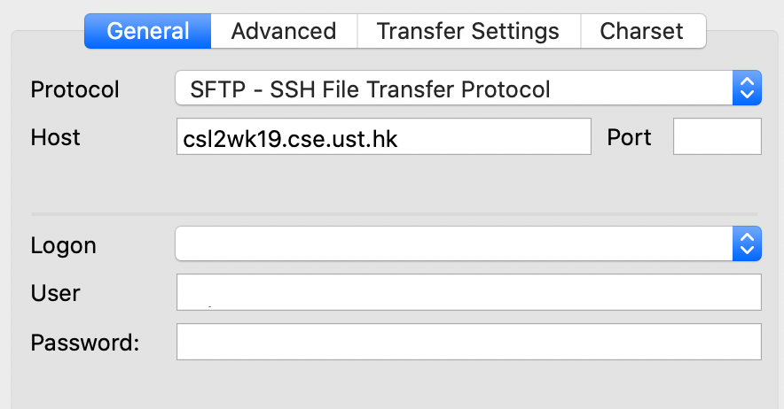
[Manual 1] Upload via SFTP (Cont.)
Enter a machine name (csl2wkXX.cse.ust.hk, where XX=01-40)
Choose SFTP as the transfer protocol
Setting up a Site Manager
File > Site Manager…
Press the “New site” button and give an appropriate name (e.g. CS Linux Lab Machine)
Press the “Connect” button
Next time, you just need to select the site you created and then press the “Connect” button
Enter your username and password
Part 3

Slide 24
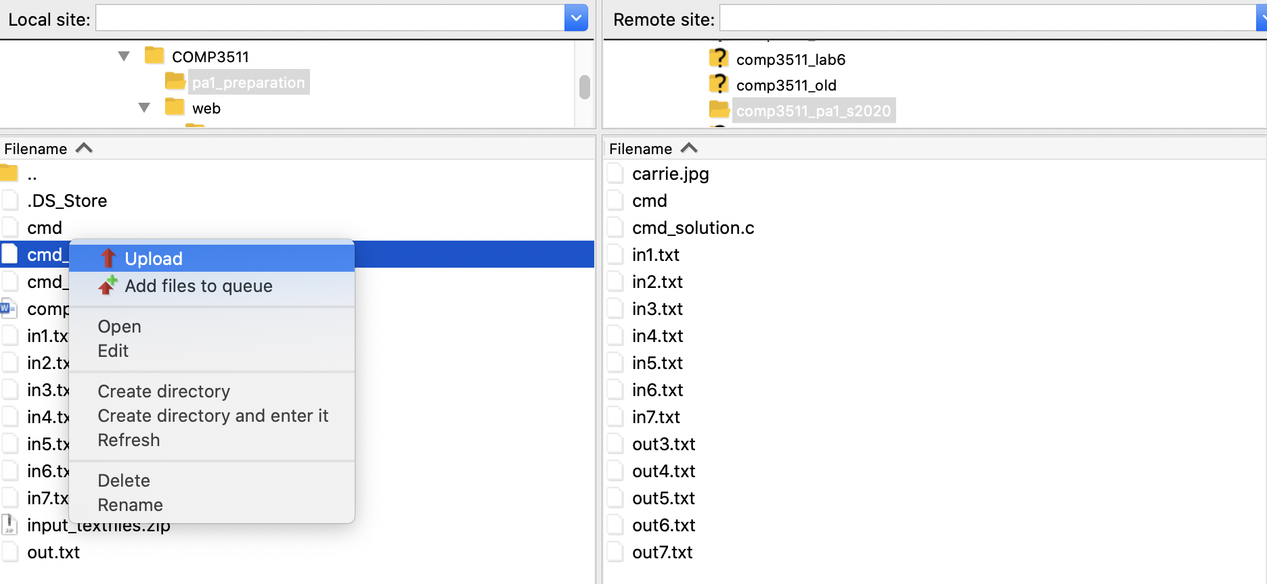
[Manual 1] Upload via SFTP (Cont.)
Choose a directory in a local machine and a remote machine (Linux)
Right-click a file. Choose Upload/Download
Part 3

Slide 25
The Complete Pipeline
Code at remote host:
vi/vim [source code files]
Code at local desktop:
First using desktop editors
Then upload the files via
scp, SFTP, Git, etc.
Minimized Compilation
gcc [source code files] –o [output file]
Advanced topics
Linking external libraries
Generating debugging information
Using Make for automation [Demo]
Running
./[output file]
Debugging
Using GDB [Demo]
code
compile
run/test
Part 3

Slide 26
Advanced Compilation Options
Specify external libraries (-l) to link
e.g. gcc foo.c –o foo –lmath
“math” refers to the C math library, which gcc does not link to automatically
it is used when we our code needs to includes <math.h>
Generating information for debugging (-g)
e.g. gcc buggy.c –o buggy –g
(so that later you can execute “gdb swap”)
Part 3

Slide 27
The Complete Pipeline
Code at remote host:
vi/vim [source code files]
Code at local desktop:
First using desktop editors
Then upload the files via
scp, SFTP, Git, etc.
Minimized Compilation
gcc [source code files] –o [output file]
Advanced topics
Linking external libraries
Generating debugging information
Using Make for automation [Demo]
Running
./[output file]
Debugging
Using GDB [Demo]
code
compile
run/test
Part 3

Slide 28
Using Make for Automation
The make utility is a program to automate the compilation and execution of programs
Advanced usage⁹ of make is tricky
In this course, we only need to learn the basics
Makefile is a configuration file to instruct the make utility how to compile and run the programs
Makefile consists of multiple rules. The syntax is as follows:
Target: pre-requisites
<TAB> command 1 to build the target
<TAB> command 2 to build the target
…
Part 3
[9] https://www.gnu.org/software/make/manual/

Slide 29
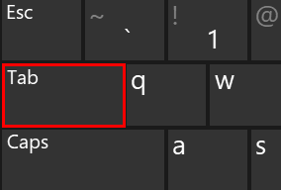
Using Make for Automation (Cont.)
[Demo] Compile multiple programs
Suppose you want to compile 2 executable programs (hello and io_console)
You can create a minimal Makefile with the following 4 rules:
all: hello io_console
hello: hello.c
gcc -o hello hello.c
io_console: io_console.c
gcc -o io_console io_console.c
clean:
rm -f hello io_console
Tabs MUST be used,
Spaces are not allowed
Part 3

Slide 30
Using Make for Automation (Cont.)
Expected results
$> ls hello.c io_console.c Makefile
Makefile hello.c io_console.c
$> make clean
rm -f hello io_console
$> make
gcc -o hello hello.c
gcc -o io_console io_console.c
$> ./hello
Hello World!
$> ./io_console
Enter your name:
Part 3

Slide 31
Learning makefile
https://makefiletutorial.com

Slide 32
The Complete Pipeline
Code at remote host:
vi/vim [source code files]
Code at local desktop:
First using desktop editors
Then upload the files via
scp, SFTP, Git, etc.
Minimized Compilation
gcc [source code files] –o [output file]
Advanced topics
Linking external libraries
Generating debugging information
Using Make for automation [Demo]
Running
./[output file]
Debugging
Using GDB [Demo]
code
compile
run/test
Part 3

Slide 33
(gdb) l
1 #include <stdio.h>
2
3 int main()
4 {
5 int arr[5];
6 int i;
7 for (i=0;i<5;i++)
8 arr[i] = i;
9 for (i=0;i<=5;i++)
(gdb) break 9
Breakpoint 1 at 0x400544: file buggy.c, line 9.
(gdb) run
Starting program: /homes/cspeter/test/buggy
Breakpoint 1, main () at buggy.c:9
9 for (i=0;i<=5;i++)
(gdb) p arr
$1 = {0, 1, 2, 3, 4}
(gdb) p i
$2 = 5
Using GDB
GDB stands for GNU Debugger
Make sure that the file is compiled with “-g”
Usage
Enter: gdb [program file]
Quit: quit or Ctrl+D
List program: list
Set breakpoint: break
Run until stop: run [args]
Print variable: print [variable name]
Part 3

Slide 34
Using GDB
If no breakpoint is set, “run” will execute to the end
Otherwise, it will stop at the first breakpoint it meets.
To continue, you have 3 options:
continue: GDB will continue executing until the next break point
next: GDB will execute the next line as a single instruction (even if it is a function call)
step: GDB will execute the next line, if it is a function call, it will step into it
Part 3

Slide 35
Using GDB
[Demo] Debugging buggy
#include <stdio.h>
int main() {
int arr[5];
int i;
for (i=0;i<5;i++)
arr[i] = i;
for (i=0;i<=5;i++)
printf("%d\n", arr[i]);
return 0;
}
Part 3

Slide 36
Learning GDB
https://www.cs.cmu.edu/~gilpin/tutorial/

Slide 37
C Programming in Linux OS
Review of first two chapters
More Details in I/O subsystem
Process, Threads and Address Space

Slide 38
Chapter 1 Summary
To best utilize the fast CPU, modern OSes employ multiprogramming, which allows many jobs to be in memory at the same time, thus ensuring that the CPU always has a job to execute
Multitasking can be considered an extension of multiprogramming wherein CPU scheduling (to be discussed in Chapter 5) can rapidly switch CPU between executing different processes, providing users with a fast response time, which is important for interactive types of jobs
Operating systems provide mechanisms for protecting. Protection measures the control of the resource (hardware and software) access available in computer systems.
Virtualization is a technology that allows an OS to run as an application within another OS. It involves abstracting hardware into several different execution environments – each referred as a virtual machine.
The virtual machine or VM creates an illusion for multiple processes in that each process “thinks” that it runs on a dedicate CPU with its own memory.

Slide 39
A Von Neumann Architecture
A processing unit that contains an arithmetic logic unit (ALU) and processor registers
A control unit that contains an instruction register (IR) and program counter (PC)
Memory that stores data and instructions – along with caches
External mass storage (not shown in the figure)
Input and output mechanisms
Notes:
Merge Slides 18-19 together

Slide 40
Instruction Fetch/Decode/Execute
The instruction cycle
Memory
Processor
next
PC:
Instruction fetch
instruction
Decode
decode
Registers
Execute
ALU
data

Slide 41
Chapter 2 Summary
The three primary approaches for interacting with an operating system are (1) command interpreters (CLI or Shell), (2) graphical user interfaces, and (3) touchscreen interfaces
System calls provide services made available by an operating system, where programmers use a system call’s application programming interface (API) for accessing system-call services. The standard C library provides the system-call interface for UNIX and Linux
Operating systems include a collection of system programs that provide utilities to users – so users can use the operating system services
A linker combines several relocatable object modules into a single binary executable file. A loader loads the executable file into memory, where it becomes eligible to run on an available CPU
An operating system is designed with specific goals in mind. These goals ultimately determine the operating system’s policies. An operating system implements these policies through specific mechanisms

Slide 42
I/O Subsystems
There are two main jobs of a computer: (1) computing on CPU and (2) I/O operation on a variety of I/O devices - in many cases, the main job is the I/O operation, e.g., word processor, web surfing, database queries
I/O devices vary greatly in their function and speed, e.g., a mouse, a hard disk, a flash drive, and a robot – need different ways to manage them
The basic I/O hardware elements include ports, buses, and device controllers, which accommodate a wide variety of I/O devices
Device drivers – the OS software encapsulates device details - presents a uniform device-access interface – abstraction, to I/O subsystem, similar to system calls that provide a standard interface between an application and the operating system

Slide 43
I/O Subsystem Functions
Buffering - storing data temporarily while it is being transferred
Caching - faster device holding copy of data
A cache here refers to a region of fast memory that holds copies of data
The difference between a buffer and a cache is that a buffer may hold the only existing copy of a data item, whereas a cache, by definition, only holds a copy on faster storage of an item that resides elsewhere
Spooling - hold output for a device which does not allow interleaved data, e.g., printers
It coordinates concurrent output, usually for slow peripheral devices
The term "spool" originates with the Simultaneous Peripheral Operations On-Line (IBM)

Slide 44
I/O Hardware
A variety of I/O devices – storage, transmission, and human-interface
Common concepts – signals from I/O devices interface with computer
Port – connection point for device, and bus for shared access
PCI bus common in PCs and servers, PCI Express (PCIe)
Expansion bus connects relatively slow devices
Controller (host adapter) – electronics that operate port, bus, device
It contains processor, microcode, private memory, bus controller

Slide 45
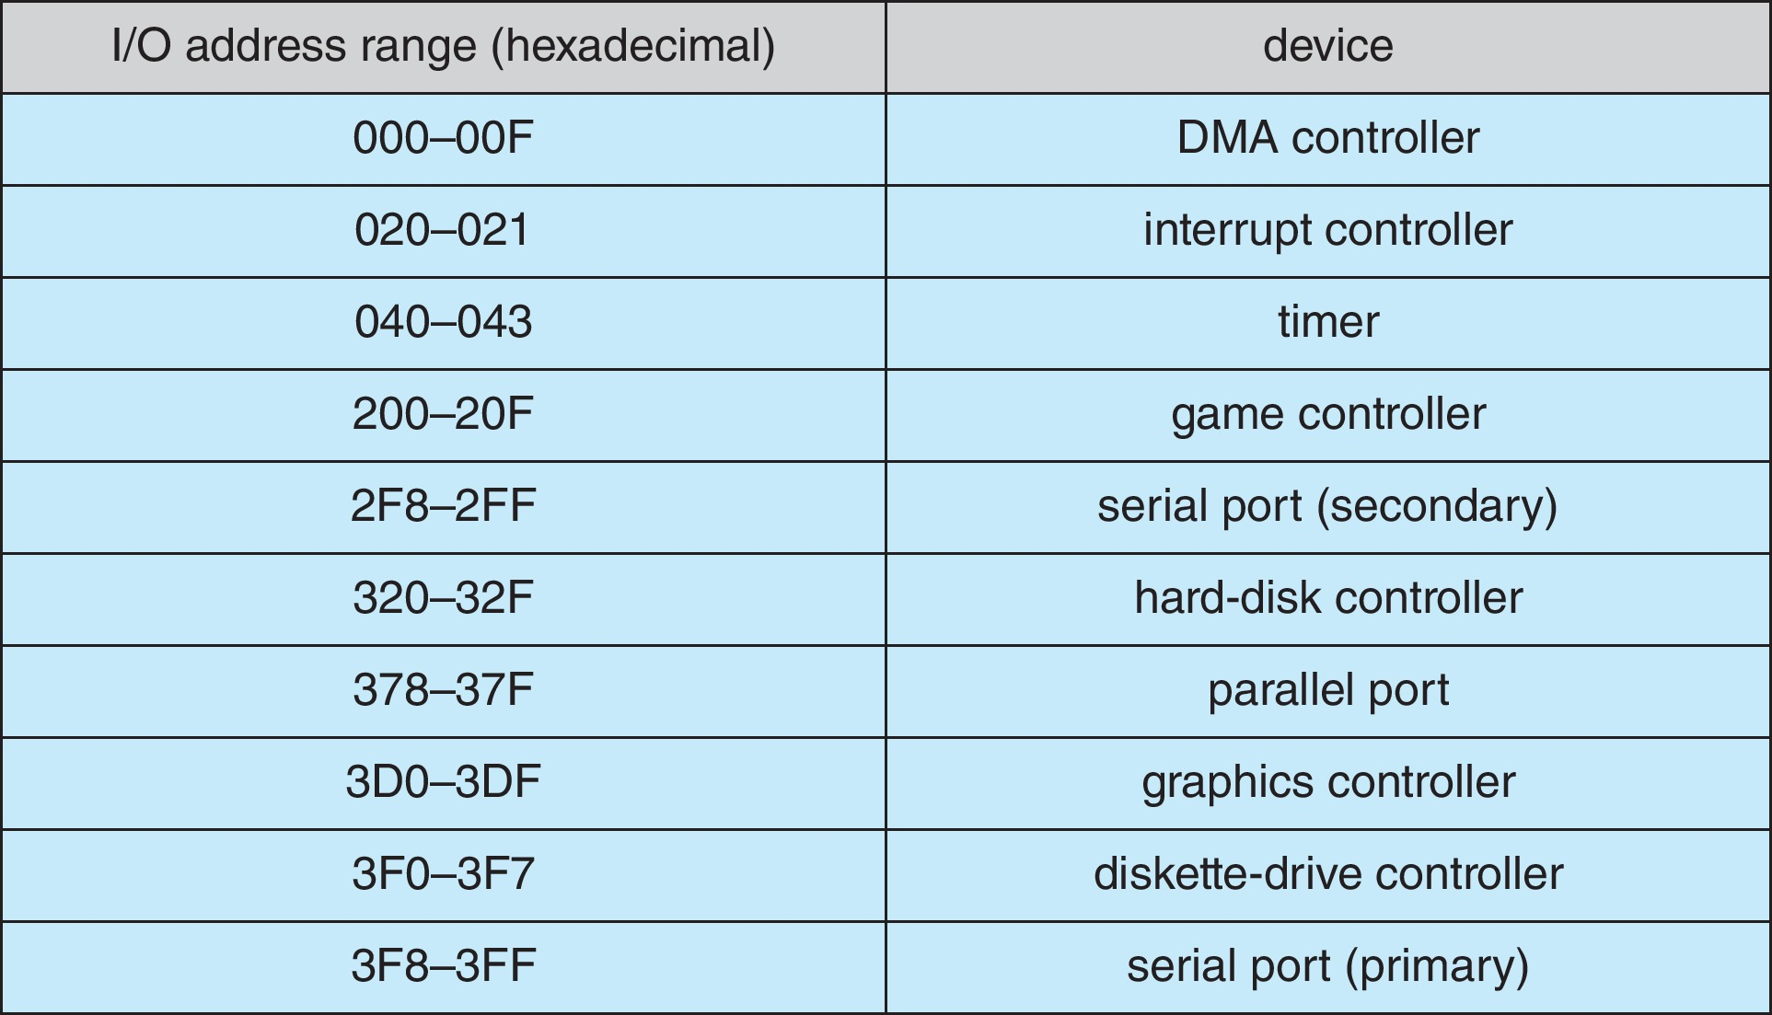
I/O Hardware (Cont.)
Devices usually have registers where device driver places commands, addresses, and data to write, or read data from registers after execution
Data-in register, data-out register, status register, control register
Devices have addresses, used by I/O instructions

Slide 46
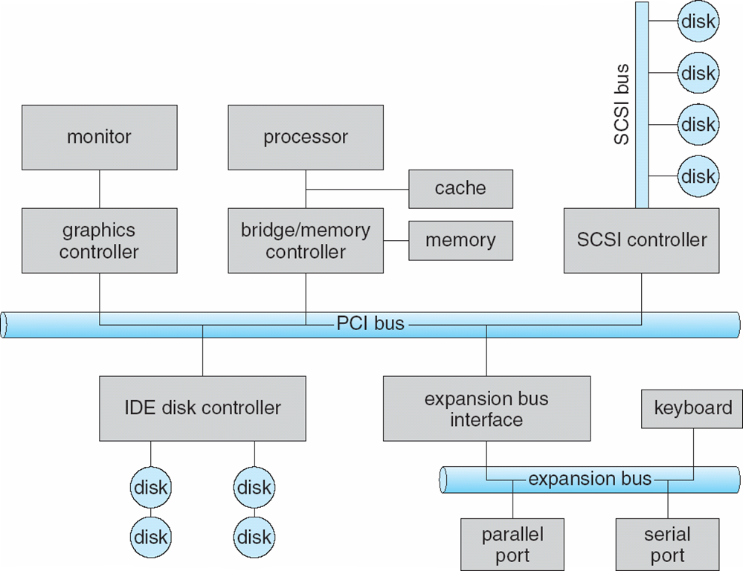
A Typical PC Bus Structure

Slide 47
Interrupts
Interrupt enables the CPU to respond to asynchronous events, e.g., a device controller becomes ready for service. It has a few desirable features:
The ability to defer interrupt handling during critical processing – maskable vs. nonmaskable
To dispatch to the proper interrupt handler (OS kernel routine) for a specific device
Multilevel interrupts needed to distinguish between high- and low-priority interrupts, esp. when there are multiple concurrent interrupts
Get the OS attention directly (separately from I/O requests), for activities such as page faults and errors such as division by zero – traps or software generated interrupt

Slide 48
Interrupts (Cont.)
Most CPUs have two interrupt request lines
One is nonmaskable interrupt, for events such as memory errors, power failure
The other is maskable interrupt, for it can be turned off by the CPU before the execution of critical instruction sequences that must not be interrupted. This is used by device controllers to request service
Interrupt vector a table containing memory addresses of interrupt handlers
Interrupt mechanism is also used for a variety of exceptions
This includes arithmetic errors such as dividing by zero, illegal memory access, or attempting to execute a privileged instruction from user mode
System call executes via trap to trigger kernel to execute request
A trap or called a software interrupt, is given a relatively low interrupt priority compared with those assigned to device interrupts
It implements a system of interrupt priority levels
This enables the CPU to defer the handling of low-priority interrupts while allowing a high-priority interrupt to preempt execution of a low-priority interrupt.
Multi-CPU systems can process interrupts concurrently

Slide 49
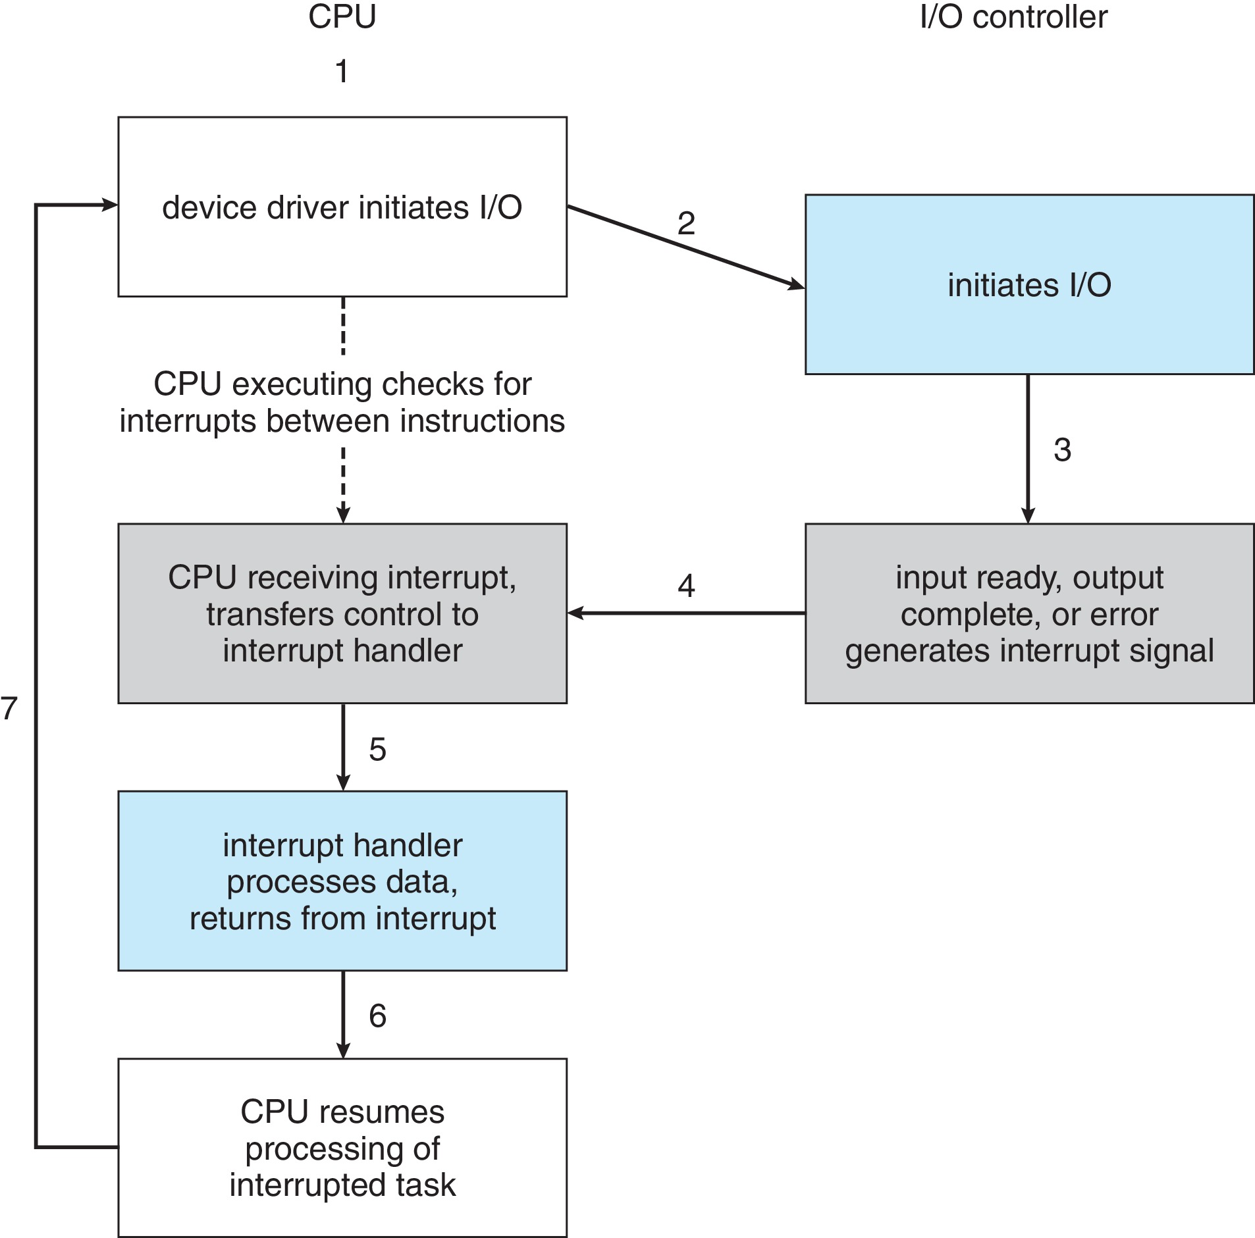
Interrupt-Driven I/O Cycle

Slide 50
Interrupt Vector
Address and properties of each interrupt handler
interrupt number (i)
intrpHandler_i () {
….
}
Interrupt vector is a table containing memory addresses of interrupt handlers

Slide 51
Direct Memory Access
Programmed I/O - use an CPU to monitor device status and to feed data into a controller register one byte at a time (for handling slow devices)
DMA controller is used to avoid programmed I/O (one byte at a time) for large data movement (e.g., a disk drive) - bypasses CPU to transfer data directly between I/O device and the memory
OS writes DMA command block into memory
Source and destination of the transfer
Read or write mode, a count of the number of bytes to be transferred
Writes location of command block to DMA controller
The DMA controller proceeds to operate the memory bus directly - momentarily prevent CPU from accessing main memory
When done, interrupts to signal completion
DMA is standard in all modern computers, from smartphones to mainframes

Slide 52
Six Step Process to Perform DMA Transfer

Slide 53
System Call and API
System Calls are programming interfaces to the services provided by the OS – not directly accessed by application programs
Application Program Interface (API) specifies a set of functions that are available to application programmers, including the parameters passed to the function and return values it may expect
There is a need for separating API and underlying system call:
Program portability by using API, in which API can remain the same across different OSes or different platforms
To hide the complex details in system calls from users

Slide 54
System Call Types
Process control: end, abort, create, terminate, allocate and free memory.
File management: create, open, close, delete, read file etc.
Device management
Information maintenance
Communication

Slide 55
Process
Process – An OS abstraction of a running program. A process can be described by its state: the contents of memory in its address space, the contents of CPU registers (including the program counter and stack pointer, among others), and information about I/O (such as open files to be read or written).
The OS provides system calls for operations on processes, typically, including creation, termination, and other useful calls
A process list – an kernel data structure OS manages to contain information about all processes currently in the system.

Slide 56
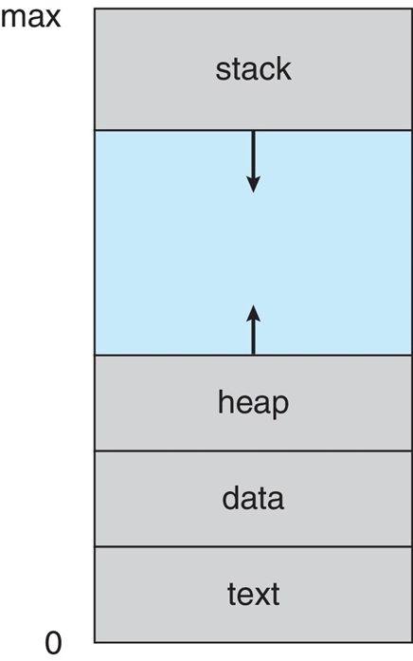
Address Space
Address Space – the address space of a process contains all of the memory state of the running program
This is the abstraction that the OS provides to the running program – this allows CPU to deal with this space address instead of the actual physical memory (to be discussed later)
In a multiprogram OS, multiple programs reside inside memory, each program can be loaded at some arbitrary physical address(es)
Another abstraction called virtual memory with virtual address will be introduced
In a multi-threaded process, threads share code (program), data and I/O (files to be accessed)

Slide 57
Threads within a Process
If a process has a single thread of execution - a single unique execution context fully describes the state, i.e., the current activity of the thread
A thread is executing on a processor (CPU) when it is resident in processor (CPU) registers
Most modern operating systems allow a process to have multiple threads of execution and thus to perform more than one task at a time.
A web browser might have one thread display images or text while another thread retrieves data from the network
Threads within a process share code, data, I/O and files
On multicore systems, multiple threads of a process can run in parallel on different CPU cores

Slide 58
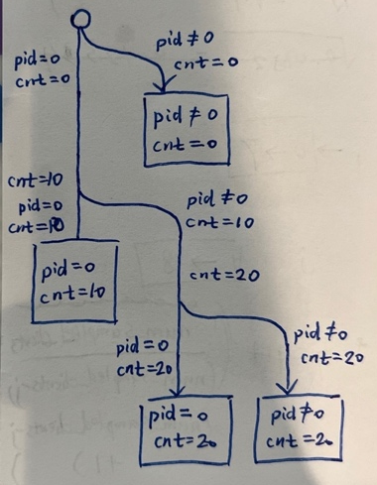
Problems of fork() Function
int main(){ pid_t pid = fork(); int cnt = 0; if (pid == 0) { cnt += 10; pid = fork(); if (pid != 0) { cnt += 10; pid = fork(); } } printf("%d \n", pid); printf("%d \n", cnt); return 0; }
fork() creates a child progress.
The child process gets 0
The parent process gets the process id of the child process
How many times will this code print none zero process ID (pid)? Please elaborate.
Answer: 2.
How many ‘0’ will this code print? Please elaborate. (Note that we do not consider those 0’s, if any, that are contained in non-zero numbers.)
Answer: 3.
How many ‘10’ will this code print? Please elaborate.
Answer: 1.
Explanation: The result of the program can be shown as the figure.

Slide 59
Fill in the missing blanks so that the following program will always display the following output:
The value x in process 3 is 1
The value x in process 2 is 1
The value x in process 1 is 1
#include <stdio.h>
#include <unistd.h>
#include <sys/wait.h>
// fflush(stdout): ensure the output is printed on the console
int main() {
int x = 0;
if (BLANK1) {
x = x + 1;
BLANK2;
printf("The value x in process 1 is %d\n", x);
fflush(stdout);
} else if ( BLANK3 ) {
x = x + 1;
BLANK4;
printf("The value x in process 2 is %d\n", x);
fflush(stdout);
} else {
x = x + 1;
printf("The value x in process 3 is %d\n", x);
fflush(stdout);
}
return 0;
}

Slide 60
#include <stdio.h>
#include <unistd.h>
#include <sys/wait.h>
// fflush(stdout): ensure the output is printed on the console
int main() {
int x = 0;
if ( fork() ) { // fork()>0 is also okay
x = x + 1;
wait(0); // wait(NULL) is also okay
printf("The value x in process 1 is %d\n", x);
fflush(stdout);
} else if ( fork() ) { // fork()>0 is also okay
x = x + 1;
wait(0); // wait(NULL) is also okay
printf("The value x in process 2 is %d\n", x);
fflush(stdout);
} else {
x = x + 1;
printf("The value x in process 3 is %d\n", x);
fflush(stdout);
}
return 0;
}

