Slide 1

DNSCHK: IN NEED OF A WORTHY AND DESCRIPTIVE POST-COLON TITLE
Bernard Dickens III Richard A. Alvarez Henry Hoffmann (?)

Slide 2



Downloading on the Internet
server responds with resource
browser requests resource
download complete
Notes:
Downloading resources over the internet is a remarkably simple and painless process for application developers and end users alike

Slide 3
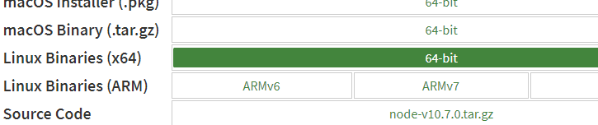


Downloading on the Internet (cont.)
Browser requests server resource
Server responds with resource
Browser completes download
server responds with resource
browser requests resource
1
2
3
download complete

Slide 4

Downloading is Risky
server responds with resource
browser requests resource
download complete
Notes:
As most are aware these days, downloading content over the internet is risky

Slide 5
Downloading is Risky (cont.)
Respond with what?
Compromised resource
Corrupted resource
Valid but incorrect resource
Request from whom?
DNS spoofing/phishing
Compromised network
Malicious/compromised server/software
server responds with resource
browser requests resource
download complete
Notes:
Essentially:
how do we know we’re talking to whom we expect?
How do we know we’re receiving exactly what we asked for?

Slide 6
Downloading is Risky (cont.)
Respond with what?
Compromised resource
Corrupted resource
Valid but incorrect resource
Request from whom?
DNS spoofing/phishing
Compromised network
Malicious/compromised server/software
Addressed with HTTPS,
HSTS, DNSSEC, etc
server responds with resource
browser requests resource
download complete
Notes:
HTTPS, PKI, DNSSEC, et cetera work together to address end-to-end authenticity validation and confidentiality concerns between browser and server

Slide 7
Downloading is Risky (cont.)
Respond with what?
Compromised resource
Corrupted resource
Valid but incorrect resource
Request from whom?
DNS spoofing/phishing
Compromised network
Malicious/compromised server/software
Addressed with HTTPS,
HSTS, DNSSEC, etc
server responds with resource
browser requests resource
Addressed with
HTTPS? Checksums?
download complete
Notes:
HTTPS is thought to address the “compromised resource” problem by preventing MITM attacks and the like
Checksums are small codes generated based on the resource that can be queried alongside response payload to verify resource integrity

Slide 8
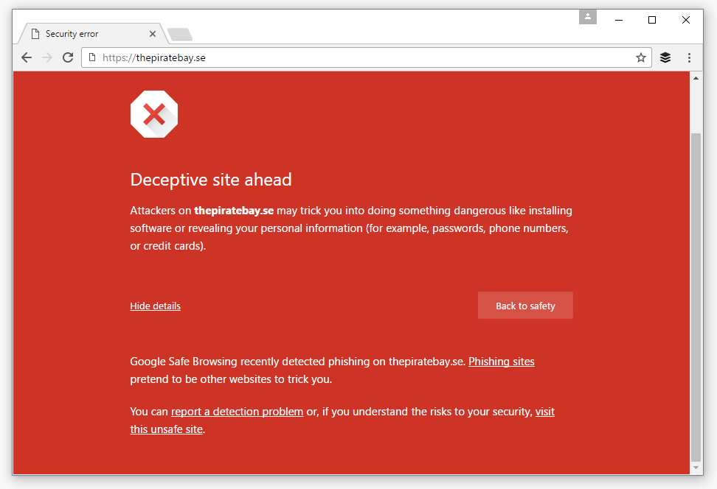
HTTPS IS Not A SOLUTION
Transport Layer Security (HTTPS) provides end-to-end connection validation
The who is validated, not the what (the payload)!
HTTPS-protected compromised distribution networks plague industry…

Slide 9
Attackers In The Wild
“Linux Mint hacked: Malware-infected ISOs linked from official (https protected) site” (The Register, Feb 2016)
The incident is a reminder of the value of checking MD5 (checksums) for critical downloads.
It is also important to ensure (checksums) come from a trusted source, rather than one modified by hackers.

Slide 10
Attackers In The Wild
“Linux Mint hacked: Malware-infected ISOs linked from official (https protected) site” (The Register, Feb 2016)
The incident is a reminder of the value of checking MD5 (checksums) for critical downloads.
It is also important to ensure (checksums) come from a trusted source, rather than one modified by hackers.
“Hacker explains how he put backdoor in hundreds of Linux Mint downloads” (ZDNet, Feb 2016)
The hacker changed the legitimate checksum on the download page with the checksum of the backdoored version.
“Who the f--k checks those (checksums) anyway?” the hacker said.

Slide 11
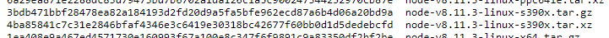
Checksums Are Not A Solution
Checksums (in this context) are MD5/SHAX hashes used to verify resource integrity by comparing to a computed hash

Slide 12
Checksums Are Not A Solution
Checksums (in this context) are MD5/SHAX hashes used to verify resource integrity by comparing to a computed hash
Checksums alone do not cover the entire threat surface
“Hackers hid malware in CCleaner software” (The Verge, 2017)
“Compromised phpMyAdmin download reinforces importance of verifying checksums” (ExtremeTech, 2012)
“Mac users installing popular DVD ripper get nasty backdoor instead” (ArsTechnica, 2017)
Notes:
Despite the relatively widespread use of checksums by publishers and content distributors, the types of security breaches that checksums would otherwise prevent occur frequently all over the internet
This is because checksums, while mathematically valid (and, in this case,) cryptographic constructions, by themselves are not anything close to a complete solution

Slide 13
What’s Wrong With Checksums?
Checksums provide good integrity protection but are:
Costly for developers to deploy securely
Annoying for end users to locate and authenticate
Prohibitively onerous for end users to validate
“Who the f--k checks those (checksums) anyway?” —Mint Hacker

Slide 14
What’s Wrong With Checksums?
Checksums provide good integrity protection but are:
Costly for developers to deploy securely
Annoying for end users to locate and authenticate
Prohibitively onerous for end users to validate
“Who the f--k checks those (checksums) anyway?” —Mint Hacker
Similar problems plague PGP/OpenPGP
Like with PGP, the problem with checksums for validation is not the math but the difficulty experienced by users

Slide 15
DNS(SEC) To The Rescue?!
The Domain Name System (DNS) is a secure (DNSSEC) decentralized data store mapping domain names to data
Any data. Not just IP!

Slide 16
DNS(SEC) To The Rescue?!
The Domain Name System (DNS) is a secure (DNSSEC) decentralized data store mapping domain names to data
Any data. Not just IPs!
DNS can be leveraged together with checksums to address:
Deploy cost—No secondary server or special distribution scheme for deploying resources alongside checksums
End-user apprehension—No additional effort required by the end user to locate or authenticate checksums or validate the resource they just downloaded
Notes:
Leveraging DNS’s high availability and high performance properties, we can eliminate the cost of securely deploying checksums
Leveraging DNS’s simple structure, we can automate the checksum validation process

Slide 17
The Complete Solution: DNSCHK
DNSCHK is a browser extension that fully automates the checksum resource validation process
DNSCHK does not require any additional user effort
No interface changes; downloads appear as normal
No performance degradation; file is downloaded normally
The DNSCHK protocol can likewise be implemented in FTP clients, file sharing applications, mobile apps, elsewhere
With a simple addition to their build process, developers and publishers can easily deploy resources that DNSCHK will validate non-interactively
Notes:
Taken together, we approach a more complete solution to the problem of validating what we get back: DNSCHK

Slide 18
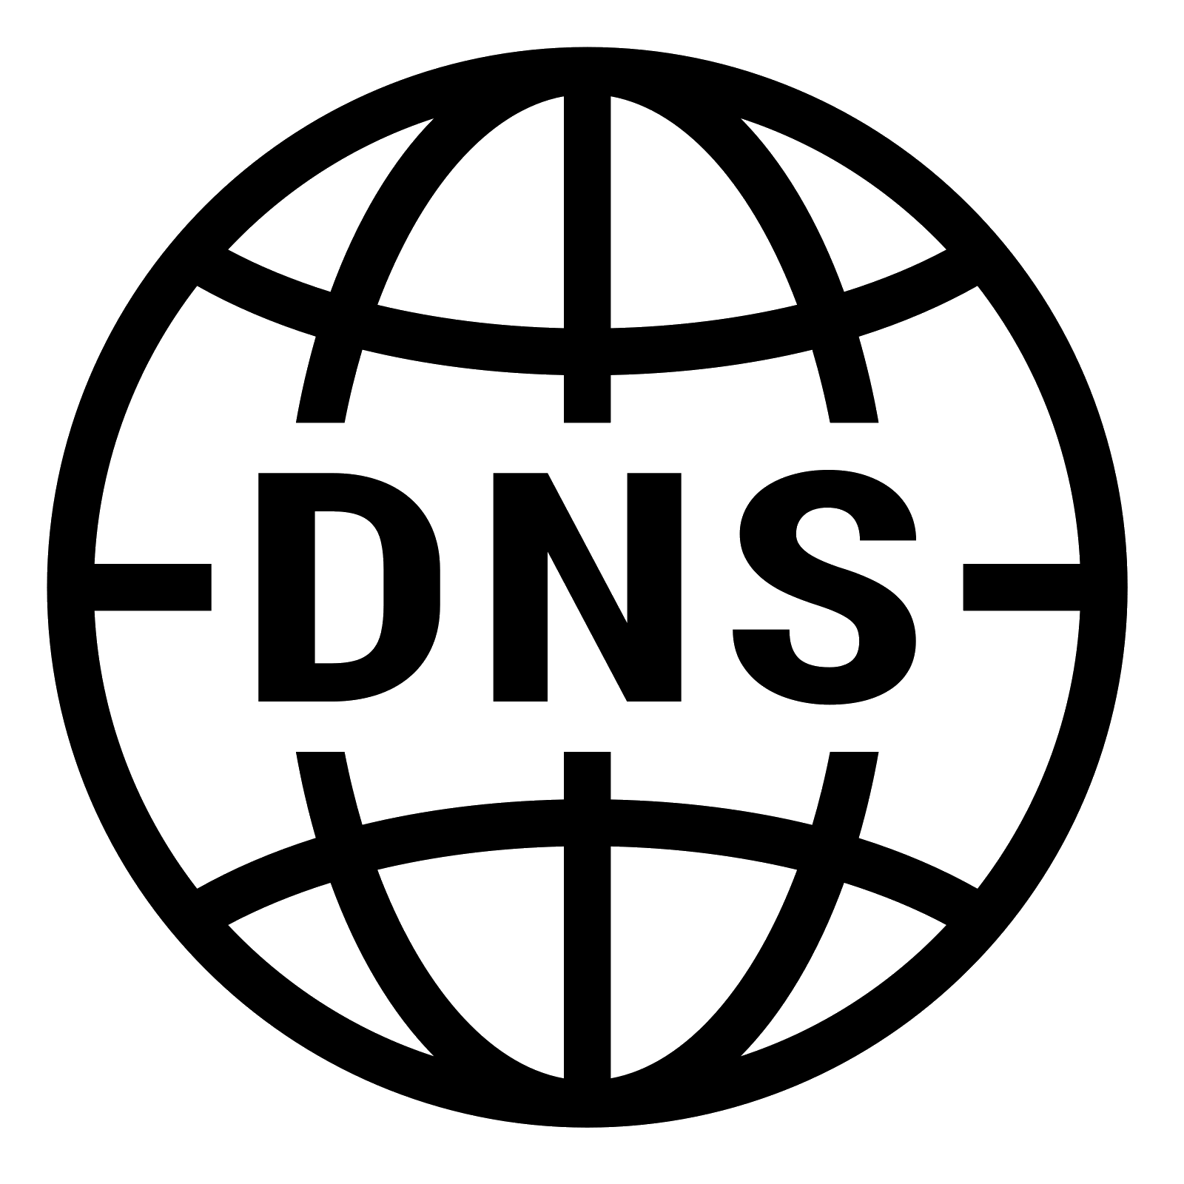
Downloading With DNSCHK
server responds with resource
browser requests resource
browser calculates ri
browser requests ah
browser calculates nah
download error
validate:
ah == nah
download complete
Notes:
Downloading resources over the internet is a remarkably simple and painless process for application developers and end users alike
A core facet of DNSCHK is that downloads remain simple and painless, despite the added checksum validation functionality

Slide 19

Downloading With DNSCHK (cont.)
Browser requests resource
Server responds w/ resource
Browser calculates Resource Identifier
server responds with resource
browser requests resource
1
2
3
browser calculates ri
browser requests ah
browser calculates nah
download error
validate:
ah == nah
download complete

Slide 20

Downloading With DNSCHK (cont.)
Browser requests Authoritative Hash (AH) from DNS using RI
Browser finishes download, yields Non-Authoritative Hash (NAH)
Browser compares NAH to AH to determine resource validity ?
server responds with resource
browser requests resource
browser calculates ri
4
browser requests ah
5
browser calculates nah
download error
6
validate:
ah == nah
download complete

Slide 21
Threat Model
Adversary controls server/returns compromised resource
Adversary alters Resource Identifier
Adversary does not alter Resource Identifier
Adversary controls DNS zone(s)/returns compromised AH
Adversary (transiently) controls both server and DNS zone(s)

Slide 22
Threat 1: Compromised Resource
Adversary can influence or even completely control the content distribution mechanism in any way
Adversary can get the user to download a compromised resource of their choice either on the server or elsewhere
Adversary does not have access to relevant DNS zone(s)
Mitigation:
If adversary does not alter RI: any corruption will be detected by DNSCHK during NAH validation
If adversary does alter RI: RI will a) not exist in DNS zone or b) exist as a valid record but fail NAH validation

Slide 23
Threat 2: Compromised ah
Adversary can get the DNS system to return any valid response of their choice
Adversary does not have access to relevant content distribution mechanism
In this scenario, the adversary can potentially force NAH validity failures and accomplish denial of service
Mitigation:
DNSSEC ensures validity and authenticity of DNS responses
The adversary does not have the ability to deliver a malicious payload in this scenario

Slide 24
Threat 3: Total Compromise
Adversary can influence or even completely control the content distribution mechanism in any way
Adversary can get the user to download a compromised resource of their choice either on the server or elsewhere
Adversary also has full control over relevant DNS zone(s)
Partial mitigation:
Local cache; 1-to-1 mapping between RIs and AHs
Distributed “shared memory”

Slide 25
The Implacable Adversary
What if both DNS and the content distribution mechanism are compromised by an adversary?
Through corporate espionage and sabotage “Elon Musk Accuses Tesla Employee of Sabotage” (NYT, 2018)
Through leaking of server private keys or credentials OpenSSL 'Heartbleed' vulnerability (CVE-2014-0160)
Through zero-day or other unknown vulnerability Meltdown, Spectre (CVE-2017-5715, CVE-2017-5754)

Slide 26
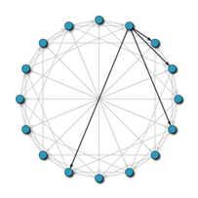
A Distributed Defense?
A Distributed Hash Table (DHT) provides a lookup service similar to DNS
Can also be configured to act as offline backup/cache
Notes:
Distributed key-value store

Slide 27
A Distributed Defense?
A Distributed Hash Table (DHT) provides a lookup service similar to DNS
Can also be configured to act as offline backup/cache
Clients can leverage DHT “shared memory” to detect some DNS checksum aberrations for popular resources
The DNSCHK protocol stipulates a 1-to-1 relation between resource identifiers and authoritative resource hashes
To defeat the DHT, an adversary is forced to release a new version of the victim software, which is highly visible and easy to detect

Slide 28
Why Not PKI?
Public Key Infrastructure describes the infrastructure used to manage digital certificates and facilitate encryption
Using PKI to sign a resource with a secure private key provides superior authenticity and resource integrity protection compared to a checksum
Using PKI instead of checksums still places the prohibitively onerous burden of manual resource validation on the user
Effective use of PKI requires trust in third-party servers for public key availability to end users

Slide 29
Research Goals
✔ Investigate DNSCHK threat model
✔ Identify additional requirements, potential impact on DNS
--- Implement prototype DNSCHK browser extension
Target browsers: Firefox, Chrome/Opera
--- Develop proper use cases and motivating examples
Browser, FTP plugin, HotCRP demo, phishing demo, etc
--- Measure observed impact (storage, bandwidth) on DNS
--- Explore offline/cache/shared memory defense with DHT

Slide 30
Questions?
Bernard Dickens III Richard A. Alvarez Henry Hoffmann (?)
(DNSCHK LOGO HERE)
https://github.com/morty-c137-prime/DNSCHK

