Slide 1
Week2 Project
Peiyi Xu
2022.1.14

Slide 2
Problem 1
Compare the conditional distribution of the Multivariate Normal, to the OLS equations.
Are these values the same? Why?
Use the data in problem1.csv to prove your answer empirically.

Slide 3
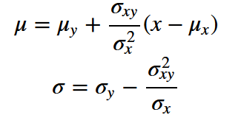
Solution 1 Case 1 Conditional Distribution of the Multivariate Normal
We assume that the (x, y) datapoints in problem1.csv are independent variables under the same bivariate normal distribution.

Slide 4


Case 2 OLS
We assume that y can be explained by x using regression
and all assumptions of OLS are satisfied.
Then

Slide 5
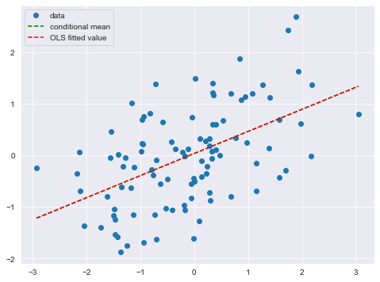
Conclusion: Same mean, Different variance
sigma_1 = 0.657, sigma_2 = 0.664

