Slide 1
Feasibility of applying Deep Q-Learning Based Variable Speed Limit on I-35
Tongge Huang

Slide 2
Introduction
Congestion
Big Impact of economic growth
$1450 cost per person per year of fueling and time (USDOT)
Emission: High frequency of start/stop
High variance of speed at shockwave
Secondary accident
Variable Speed Limit (increase the capacity of the road cost a lot and not feasible):
VSL has been proven to improve the safety and traffic flow condition by reducing the variance of speed
Purpose of this study:
Feasibility of applying VSL on the I-35, Des Moines.
Compare the network performance between static speed limit and RL based variable speed limit

Slide 3
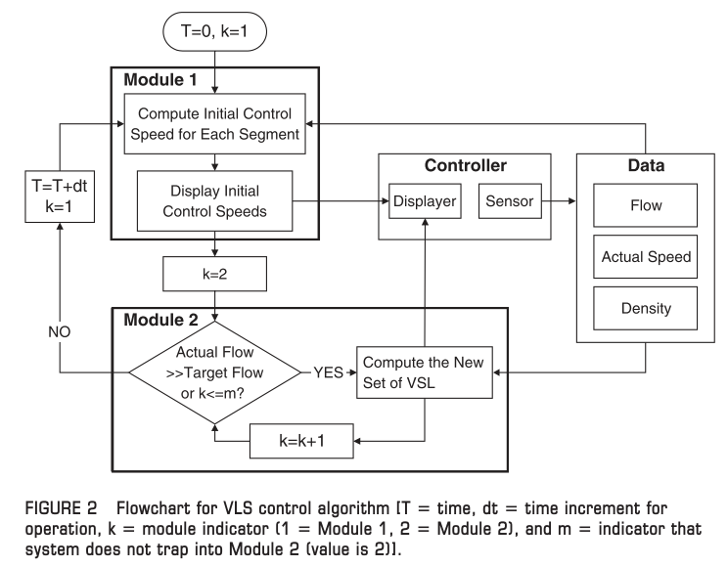
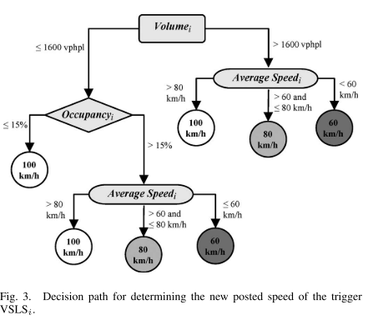
Literature Review (VSL)
Allaby, et al (2007) presented the evaluation result of VSLS for urban freeway in Toronto, ON, Canada. The tree decision methods are used for testing. The result shows that the big benefit on safety was achieved while the Travel time increased. Both improvement of safety and travel time are attainable.
Chang, at al (2011) presented real world field experiments based on road way sensor and well-calibrated license plate recognition system. Proper speed control in real time can improve recurrent congestion by achieve higher throughput and stable traffic condition.
Allaby, et al (2007)
Chang (2011), Lin, et al (2007)

Slide 4
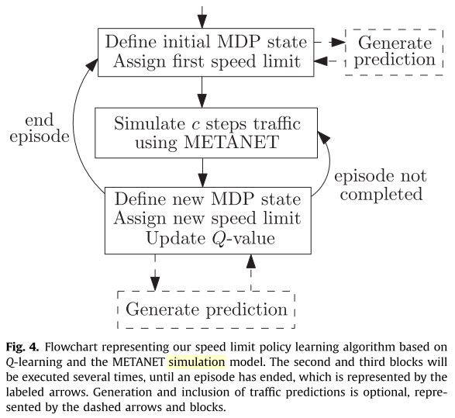
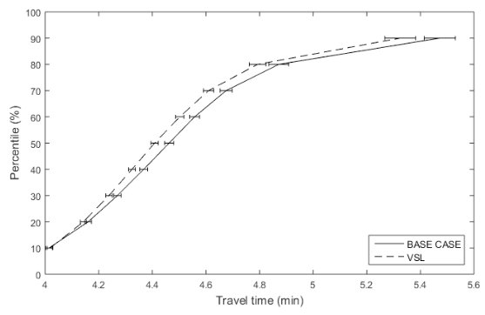
Literature Review (VSL, RL Approach, CV envs)
Zhu, et al (2014) formulated the dynamic speed limit problem as the MDP problem. The link based information used. The case study on Sioux Falls network is presented. The result shows the travel time and emissions are reduced by around 18% and 20%.
Walraven, et al (2016) defined MDP for optimize traffic flow using METANET simulator and solved by Q-learning. Taking traffic predictions into account. The resulting policies reduce traffic congestion under high traffic demand a lot.
Grumert , et al (2017) Taking the advantages of connected vehicle environment, the enhanced VSL system can be achieved. The estimate of the traffic condition using for VSL now is based on the data from downstream detector while the connected vehicle can provide the continues information to the infrastructure.
Walraven, et al (2016)
Grumert , et al (2017)

Slide 5
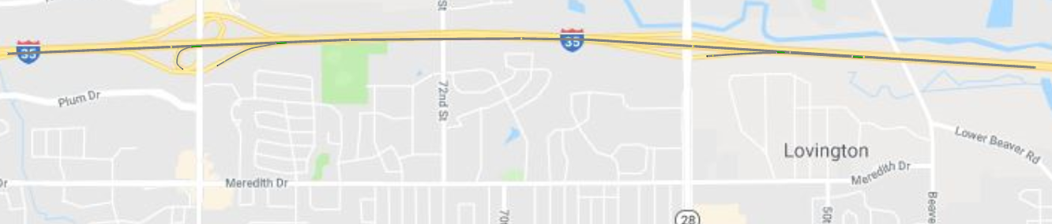

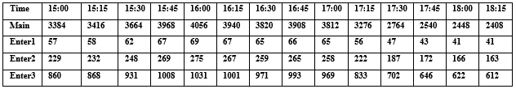
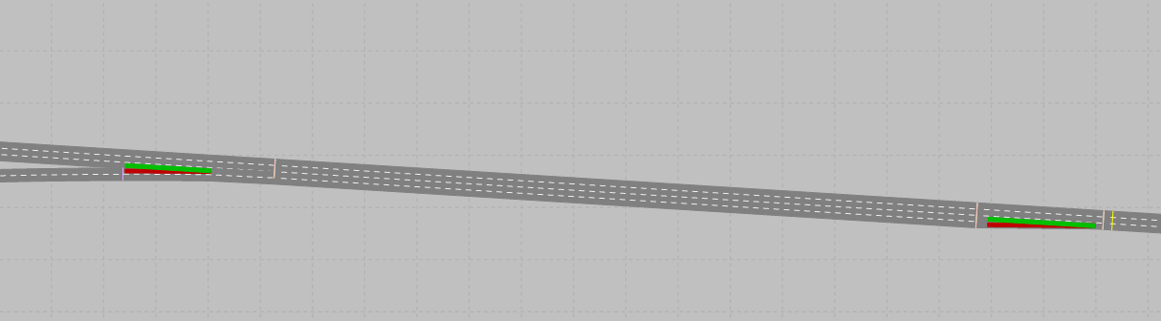
Environment & Simulation setup
Interest area:
I-35, Des Moines
3:00 pm-6:30 pm, May 25, 2018
Dynamic speed limit:
50mph to 85mph
Fixed speed limit:
65 mph (main)
65 mph, 65 mph, 50 mph (On Ramp)
Dynamic volume input:
Downstream: EB to 86th STREET-EB
Upstream: I-35/80 EB @ Iowa 28
Ramp: Interpolated
Data Collection points:
8 detectors located at the end of the link
Input:
Volume: change per 15minutes based on real world data
Speed: change per 5 minutes
Sim random seed: random per simulation
Output:
Data Collection
Network Performance
S1
S2
S3
S4
S5
S6
S7
S8
I-35/80 EB @ Iowa 28
EB to 86th STREET-EB
Dynamic Speed Limit
Fixed Speed Limit (65 mph)

Slide 6
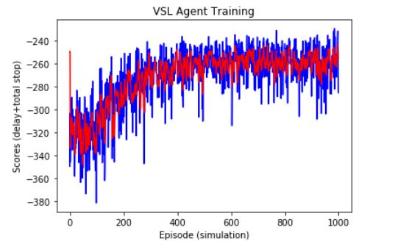
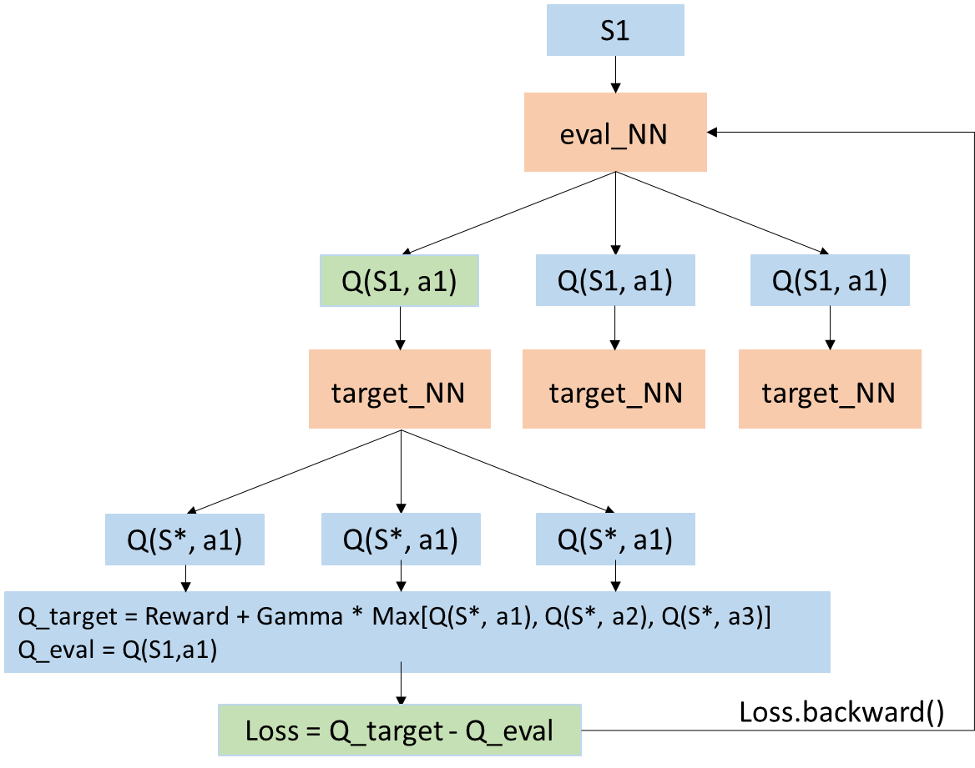
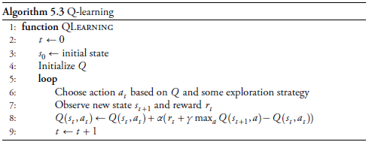
Methodology
Reinforcement Learning:
Learn a way to select best option based on experiences
Q Learning:
Find out a look up table
Algorithm:
Level of Service
Volume, speed
Density bins = [0, 11, 18, 26, 35, 45, 100]/lane/mile
Deep Q Learning:
8**8 possible states in the study case
Replace look up table (Q table) by Neural Net
How?
 | a1 | a2 | …
S1 | q(S1,a1) | q(S1,a2) | …
S2 | q(S2,a1) | … | …
… | … | … | …

Slide 7
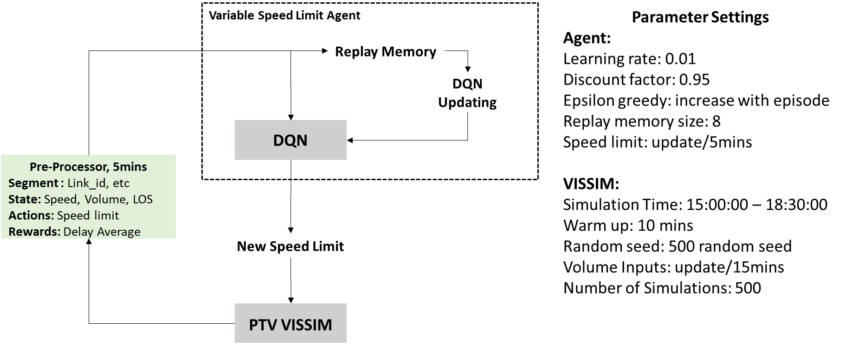
Methodology-flowchart
MDP:

Slide 8
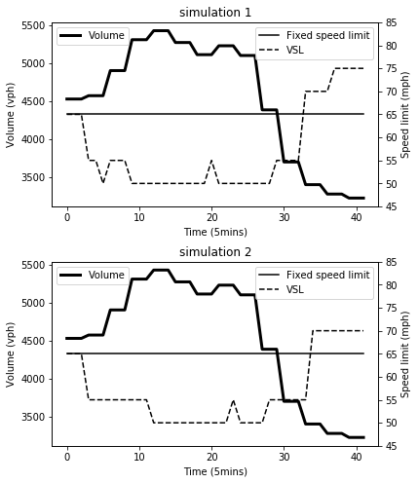
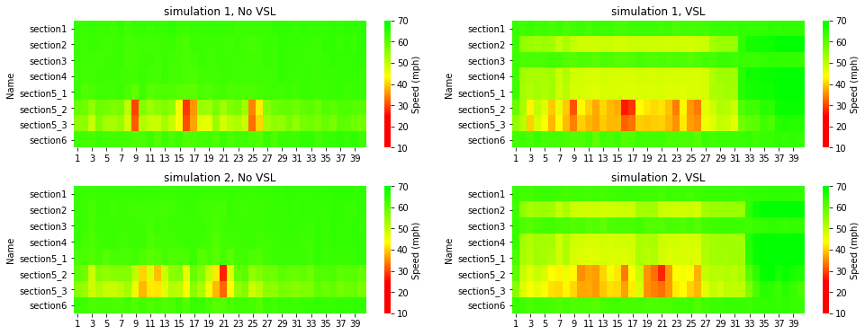
Result- Speed Decision and Smoothing
Use the trained model for 2 new random simulations
Speed Decisions
Speed Distribution

Slide 9
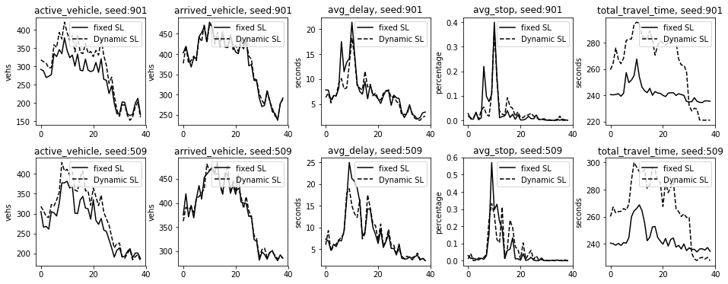
Result- Network Performance
Network Performance Distribution

Slide 10
Reflection
DQN is the useful algorithm for optimal decision making under uncertainty
No significant benefits of applying VSL control on I-35, Des Moines.
Potential ability to smooth the traffic and reduce bottleneck.
Potential ability to improve emission and safety.
More detailed simulation settings.

Slide 11
Reference
Chang, G.-L., S. Park, and J. Paracha. Intelligent Transportation System Field Demonstration. Transportation Research Record: Journal of the Transportation Research Board, Vol. 2243, 2011, pp. 55–66. https://doi.org/10.3141/2243-07.
Allaby, P., B. Hellinga, and M. Bullock. Variable Speed Limits: Safety and Operational Impacts of a Candidate Control Strategy for Freeway Applications. IEEE Transactions on Intelligent Transportation Systems, Vol. 8, No. 4, 2007, pp. 671–680. https://doi.org/10.1109/TITS.2007.908562.
Zhu, F., and S. V. Ukkusuri. Accounting for Dynamic Speed Limit Control in a Stochastic Traffic Environment: A Reinforcement Learning Approach. Transportation Research Part C: Emerging Technologies, Vol. 41, 2014, pp. 30–47. https://doi.org/10.1016/j.trc.2014.01.014.
Walraven, E., M. T. J. Spaan, and B. Bakker. Traffic Flow Optimization: A Reinforcement Learning Approach. Engineering Applications of Artificial Intelligence, Vol. 52, 2016, pp. 203–212. https://doi.org/10.1016/j.engappai.2016.01.001.
Khondaker, B., and L. Kattan. Variable Speed Limit: A Microscopic Analysis in a Connected Vehicle Environment. Transportation Research Part C: Emerging Technologies, Vol. 58, 2015, pp. 146–159. https://doi.org/10.1016/j.trc.2015.07.014.
Kochenderfer, M. J. Decision Making Under Uncertainty: Theory and Application. MIT press. 6. Volume 38, 114–115. https://ieeexplore.ieee.org/document/8536567/.
USDOT Federal Highway Administration https://ops.fhwa.dot.gov/publications/fhwahop17003/fhwahop17003.pdf

Slide 12
S1
eval_NN
Variable Speed Limit Agent
Q(S1, a1)
Q(S1, a1)
Q(S1, a1)
Replay Memory
DQN
Updating
target_NN
target_NN
target_NN
DQN
Pre-Processor, 5mins
Segment : Link_id, etc
State: Speed, Volume, LOS
Actions: Speed limit
Rewards: Delay Average
Q(S*, a1)
Q(S*, a1)
Q(S*, a1)
Q_target = Reward + Gamma * Max[Q(S*, a1), Q(S*, a2), Q(S*, a3)]
Q_eval = Q(S1,a1)
New Speed Limit
Loss = Q_target - Q_eval
Loss.backward()
PTV VISSIM

Slide 13
Variable Speed Limit Agent
Parameter Settings
Agent:
Learning rate: 0.01
Discount factor: 0.95
Epsilon greedy: increase with episode
Replay memory size: 8
Speed limit: update/5mins
VISSIM:
Simulation Time: 15:00:00 – 18:30:00
Warm up: 10 mins
Random seed: 500 random seed
Volume Inputs: update/15mins
Number of Simulations: 500
Replay Memory
DQN
Updating
DQN
Pre-Processor, 5mins
Segment : Link_id, etc
State: Speed, Volume, LOS
Actions: Speed limit
Rewards: Delay Average
New Speed Limit
PTV VISSIM

