Slide 1
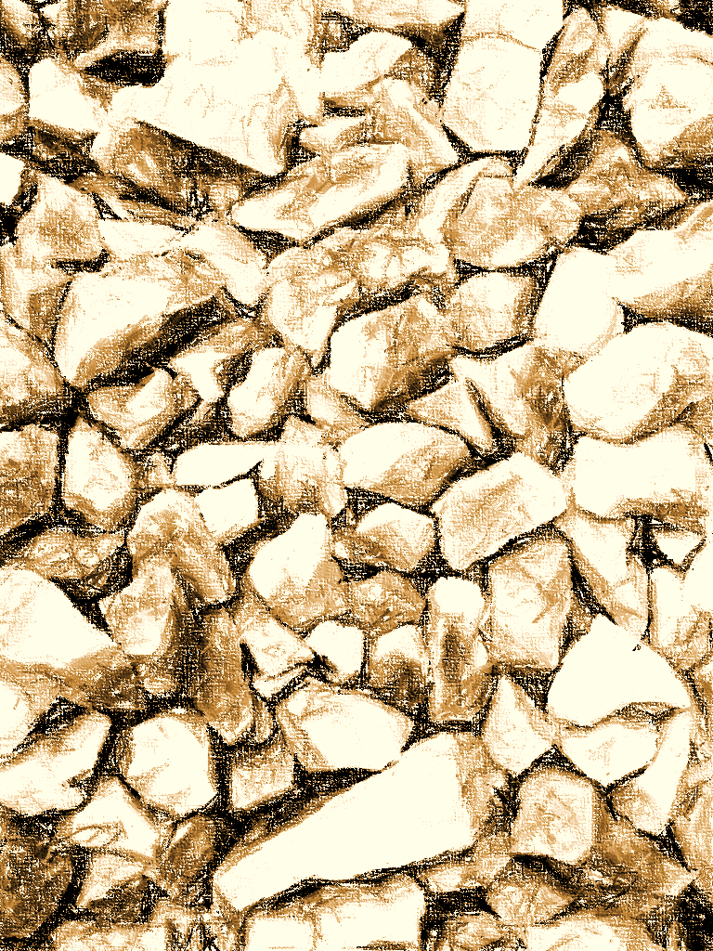

R Companion for Introduction to Data Mining
by Michael Hahsler

