Slide 1
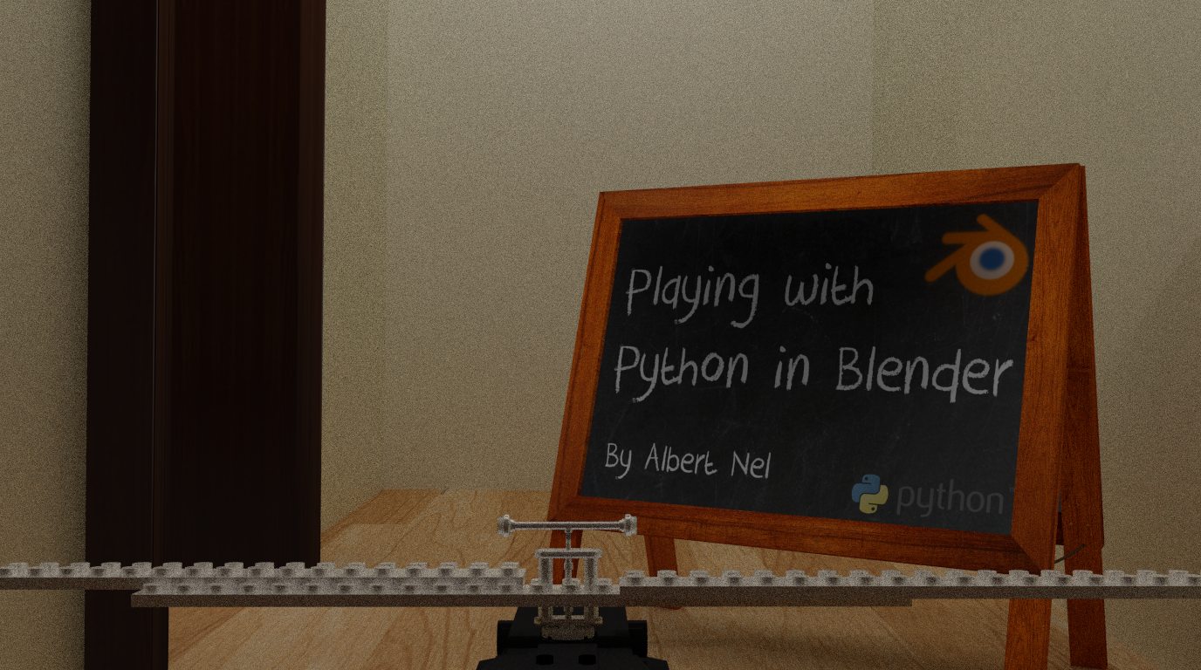
PyConZA_2014

Slide 2
Playing with Python in Blender

Slide 3
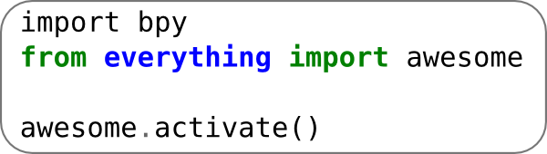

Time to look at some scripts!

Slide 4

Lotto Droid

Slide 5
Lotto Droid
Notes:
Ok, so lets quickly have a look at this file in blender.
First off, you will see the scene has only one ball.
This is the main one that will be duplicated for the rest. All the materials have
already been created and saved as a single user (That just means that even if its not applied to any
objects, that it will still be saved in the file. If you dont do that, then it deletes
it when you close the file.
This funny box thing at the bottom is the piece that will catch the balls for us once
we run the animation.
You can see looking at the screen that the text editor is here on the side. so lets
move the cursor to the screen and hit alt+p. .,... And there you have it
All the balls placed neatly in aline.
If I change over to viewport render, then you can see that the textures are all applied,
and that the numbers are in mixed order. This is just so that all the same color balls dont end up
together. That wouldn't look right.
Ok, so lets run the animation, and there you see all the balls fall into the container.
So now we just select a frame where they all already settled
We can select all the balls and apply their location and rotation. This just makes them stay in the position for us.
Now we just hide layer 2 and there you go.
All the balls in a neat little bundle in a nice random order.
I did end up rotating some balls so I could see the numbers on them
Ok, lets check the code for this

Slide 6
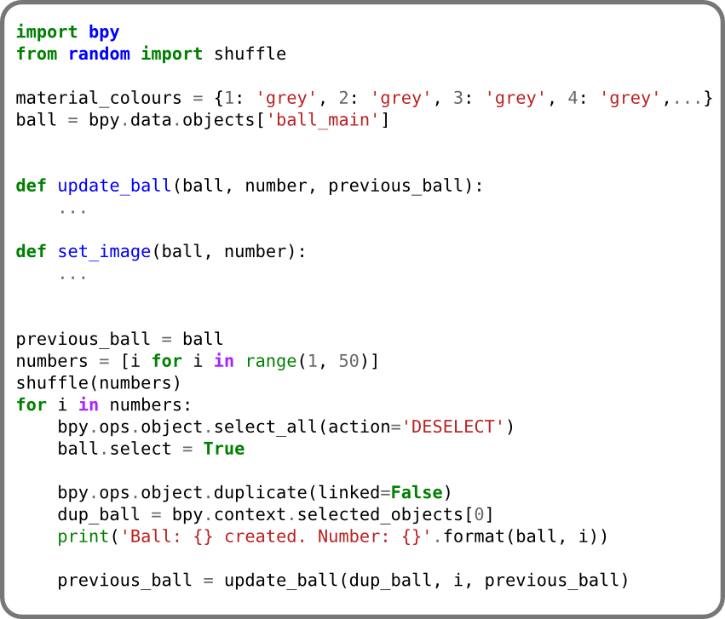
Lotto Droid

Slide 7
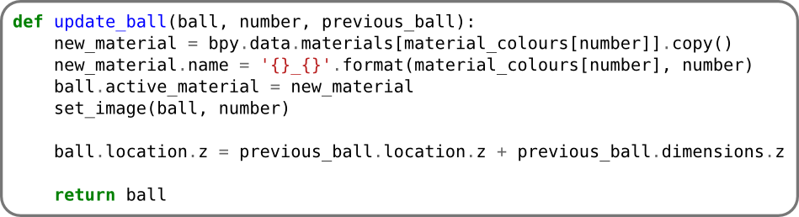
Lotto Droid

Slide 8

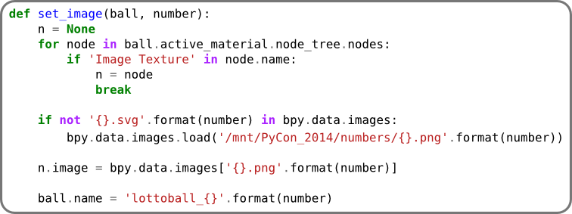
Lotto Droid

Slide 9

LSD Logo

Slide 10

LSD Logo

Slide 11
LSD Logo

Slide 12
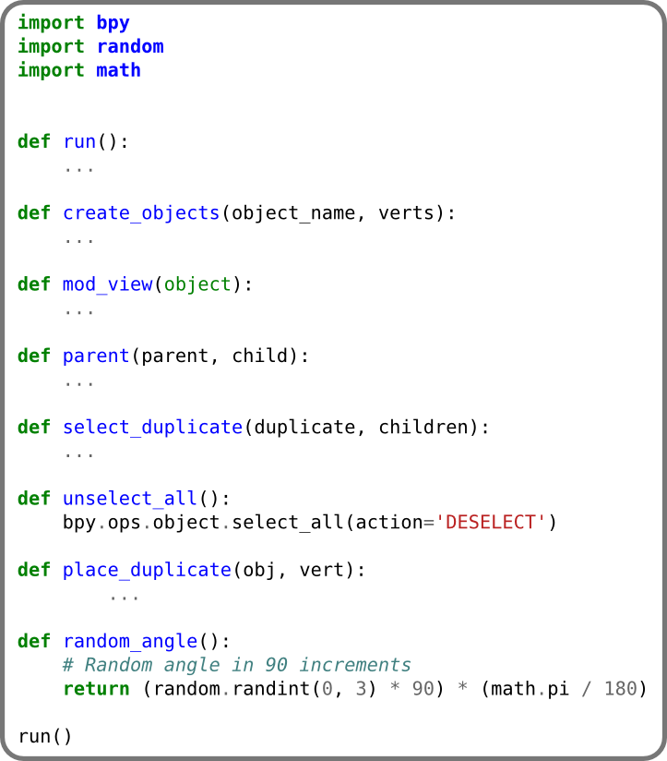
LSD Logo

Slide 13
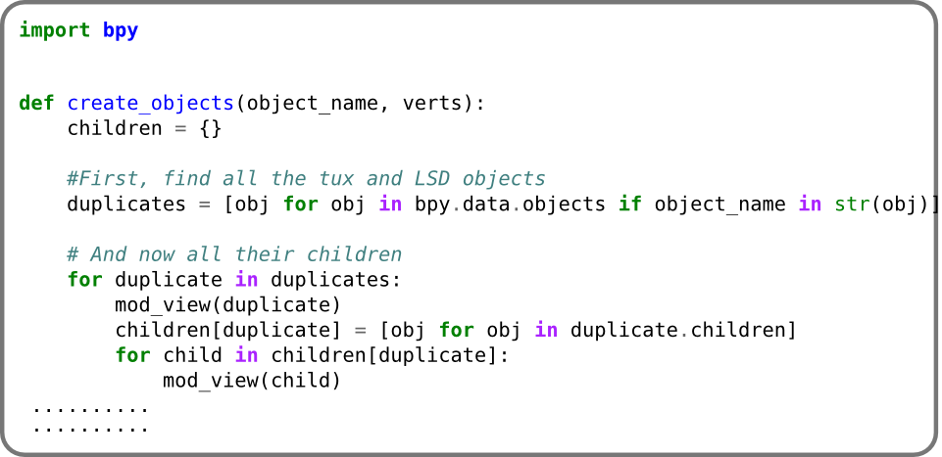
LSD Logo

Slide 14
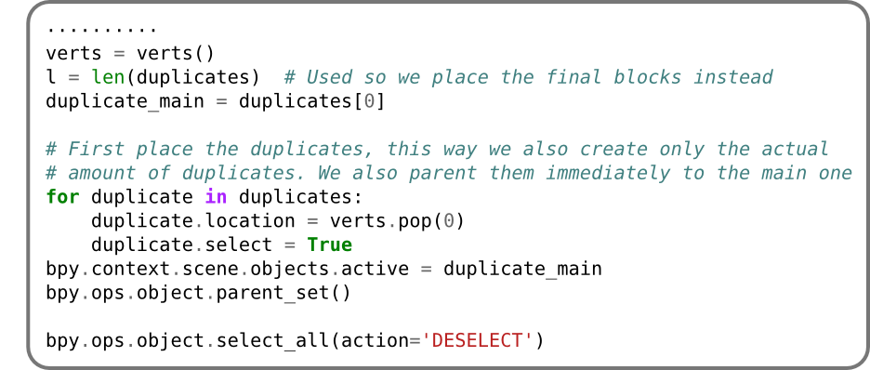
LSD Logo

Slide 15
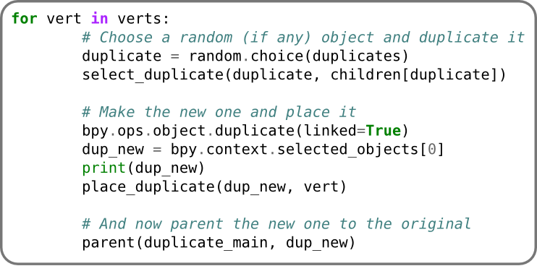
LSD Logo

Slide 16
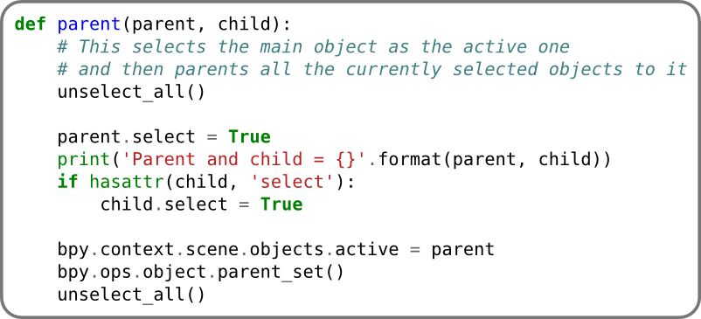
LSD Logo

Slide 17
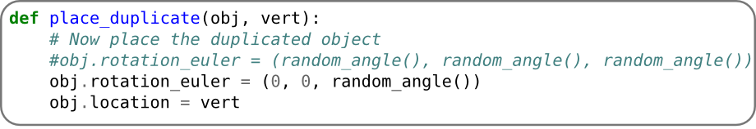
LSD Logo

Slide 18
LSD Logo
Notes:
Ok, so lets have a look at the blend file quick
So first off, you will see there are a few items in the screen, and if you look at the names, you will see they are called LSD and tux.
As you can imagine, the ones called LSD will make up the LSD text, and the tux will make up the penquin. Also note, there ar emultiple ones with the same name, only including a number suffix.
I wrote the script so that it would find all items by the names, and then also drill down and find all children objects. That was added so all the children of the item is also duplicated, ie, the bubbles.
So if we run the script quick we will see what happens.
There we go, now we have a logo created from the new objects.
Sooo, lets have a look at the code. This is a slightly longer script, but it aint got nuttin on the last one.

Slide 19
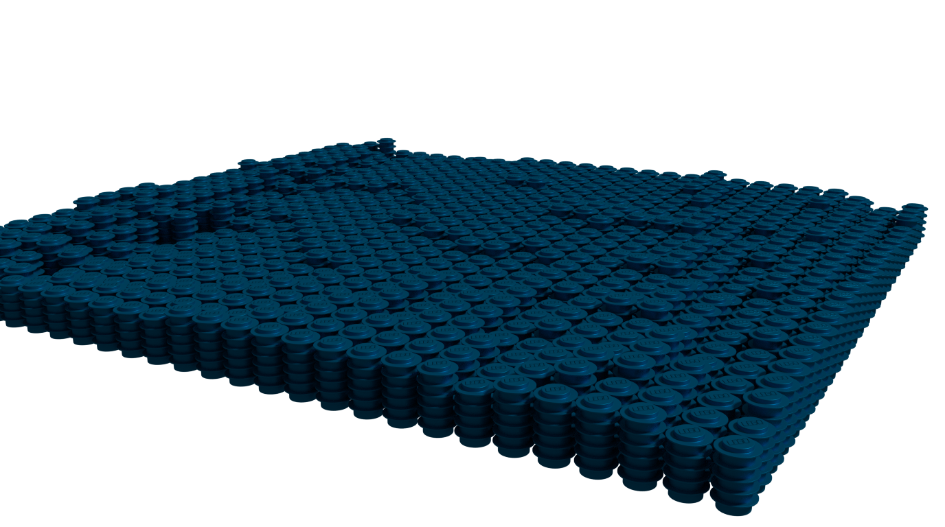
Lego water

Slide 20
Lego water

Slide 21
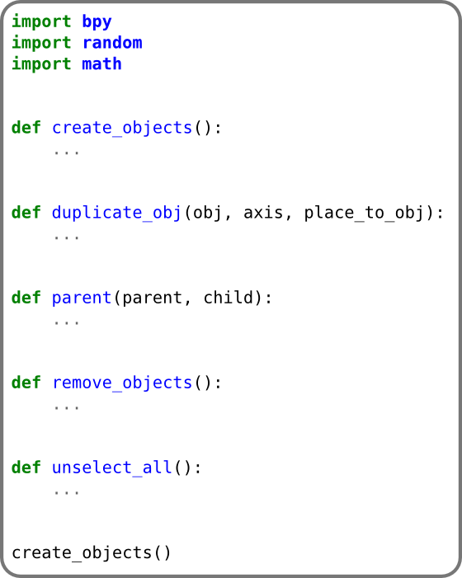
Lego water

Slide 22
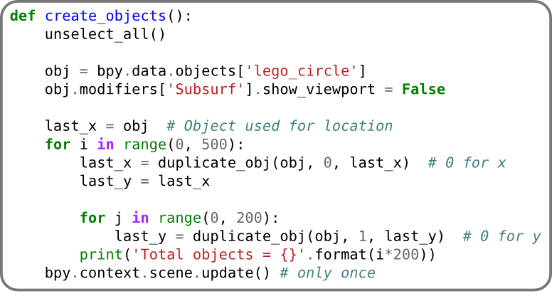
Lego water

Slide 23
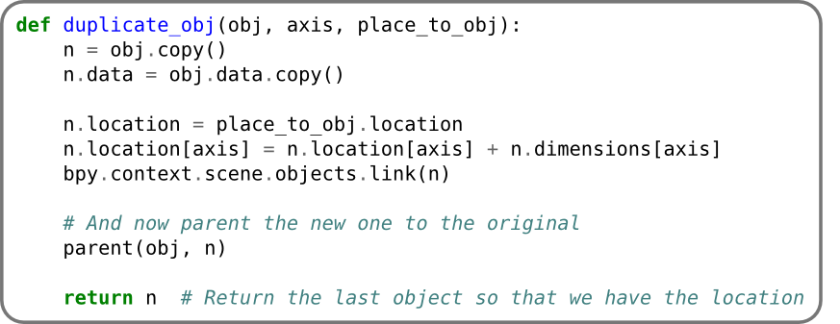
Lego water

Slide 24
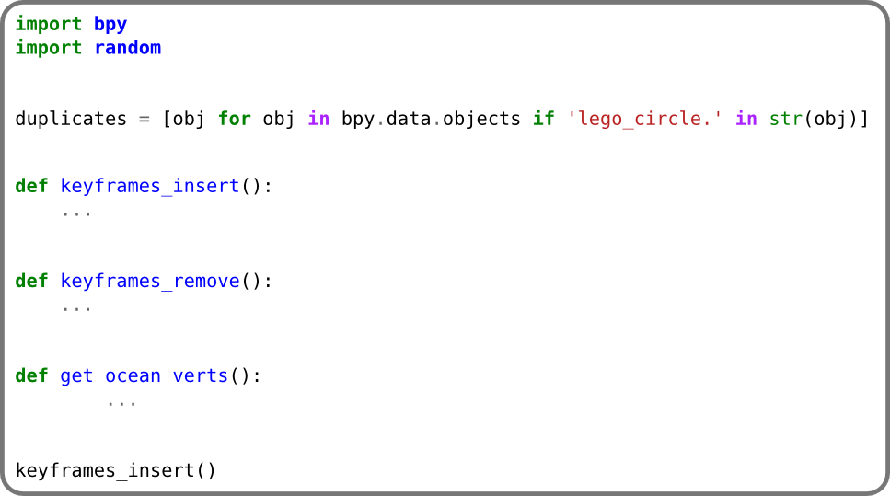
Lego water (water impression)

Slide 25
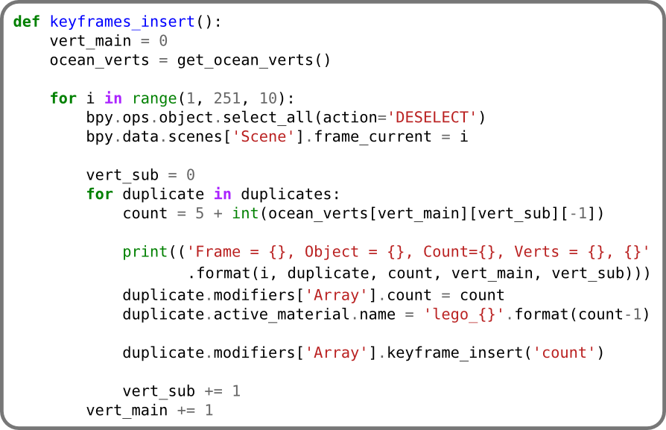
Lego water (water impression)

Slide 26
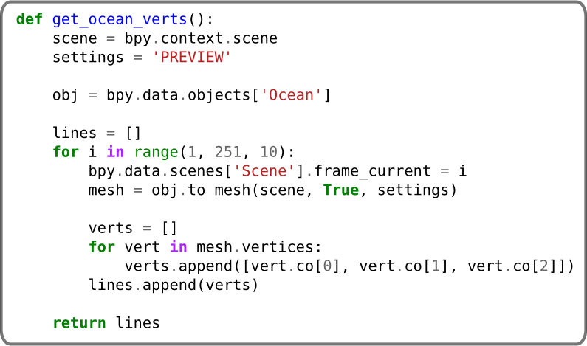
Lego water (water impression)

Slide 27

Application Modules
Context Access (bpy.context)
Data Access (bpy.data)
Operators (bpy.ops)
Types (bpy.types)
Utilities (bpy.utils)
Path Utilities (bpy.path)
Application Data (bpy.app)
Application Handlers (bpy.app.handlers)
Application Translations (bpy.app.translations)
Property Definitions (bpy.props)

Slide 28
Standalone Modules
Math Types & Utilities (mathutils)
Geometry Utilities (mathutils.geometry)
KDTree Utilities (mathutils.kdtree)
Noise Utilities (mathutils.noise)
Freestyle Data Types & Operators (freestyle)
OpenGL Wrapper (bgl)
Font Drawing (blf)
GPU functions (gpu)
Audio System (aud)
Extra Utilities (bpy_extras)
BMesh Module (bmesh)

Slide 29
Game Engine Modules
Game Types (bge.types)
Game Logic (bge.logic)
Rasterizer (bge.render)
Video Texture (bge.texture)
Game Keys (bge.events)
Physics Constraints (bge.constraints)

Slide 30
Context Access (bpy.context)
Read Only
Global Context
Screen Context
View3D Context
Buttons Context
Image Context
Text Context
Clip Context
Sequencer Context
bpy.context.area.type = "VIEW_3D"

Slide 31
Data Access (bpy.data)
This module is used for all blender/python access.
Actions
Armatures
Brushes
Cameras
Curves
Fonts
Groups
Lamps
Meshes
node_groups
Objects
Scenes
Screens
textures....

Slide 32
bpy.ops
Provides python access to calling operators
Action, Anim, Armature, Boid, Brush, Buttons, Camera, Clip,
Cloth, Console, Constraint, Curve, Cycles, Dpaint, Ed,
Export Anim, Export Mesh, Export Scene, File, Fluid, Font,
Gpencil, Graph, Group, Image, Import Anim, Import Curve,
Import Mesh, Import Scene, Info, Lamp, Lattice, Logic,
Marker, Mask, Material, Mball, Mesh, Nla, Node, Object,
Outliner, Paint, Particle, Pose, Poselib, Ptcache, Render,
Rigidbody, Scene, Screen, Script, Sculpt, Sequencer, Sketch,
Sound, Surface, Text, Texture, Time, Transform, Ui, Uv,
View2D, View3D, Wm, World

Slide 33
Types (bpy.types)
Types are used for the property descriptions
Action
Anim
Armature
Cycles
Compositor nodes
Modifiers (Deforms, generators...)
Mesh (Color, Loops, verts, faces...)
Material and texture Nodes
...

Slide 34
Utilities (bpy.utils)
This module contains utility functions specific to blender but not associated with blenders internal data.
blend_paths
escape_identifier
register_class
resource_path
unregister_class
load_scripts
modules_from_path
...

Slide 35
Path Utilities (bpy.path)
This module has a similar scope to os.path, containing utility functions for dealing with paths in Blender.
abspath
basename
clean_name
display_name
display_name_from_filepath
ensure_ext
is_subdir
...

Slide 36
Application Data (bpy.app)
This module contains application values that remain unchanged during runtime.
Debug: events, ffmeg, freestyle, handlers, python, value
driver_namespace
tempdir
background
translations
build: branch, cflags, commit time and date, cxxflags
Version
handlers

Slide 37
Application Handlers (bpy.app.handlers)
This module contains callbacks
frame_change_post, frame_change_pre
game_post, game_pre
load_post, load_pre
render_cancel, render_complete, render_post, render_pre
save_post, save_pre
scene_update_post, scene_update_pre
Persistant (Callback function persists between sessions)

Slide 38
bpy.app.translations
This object contains some data/methods regarding internationalization in Blender, and allows every py script to feature translations for its own UI messages.
locale
locales
contexts_C_to_py
Contexts
locale_explode

Slide 39
bpy.props
This module defines properties to extend blenders internal data, the result of these functions is used to assign properties to classes registered with blender and can’t be used directly.
BoolProperty, BoolVectorProperty
CollectionProperty
EnumProperty
FloatProperty, FloatVectorProperty
IntProperty, IntVectorProperty
PointerProperty, RemoveProperty
StringProperty

Slide 40

Credits
Special thanks to Blendswap.com for some blender models.
stuart.t - Lego Helicopter - 16909
mStuff - Rope - 72615
Smeagain - Office chair - 73454
DennisH2010 - Laptop - 69924
SebastL - Chest - 47993
cellikai - door and frame - 47489
voodoc - leaf chair - 67190
Xuton - everything else

Slide 41
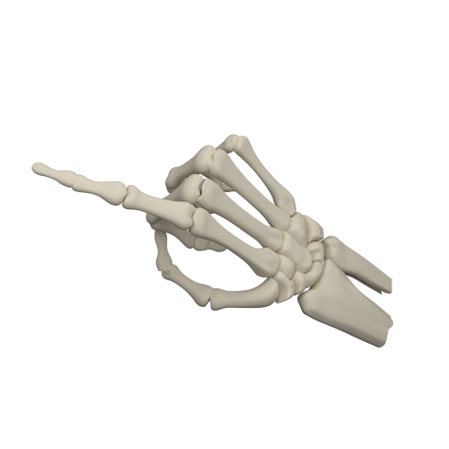
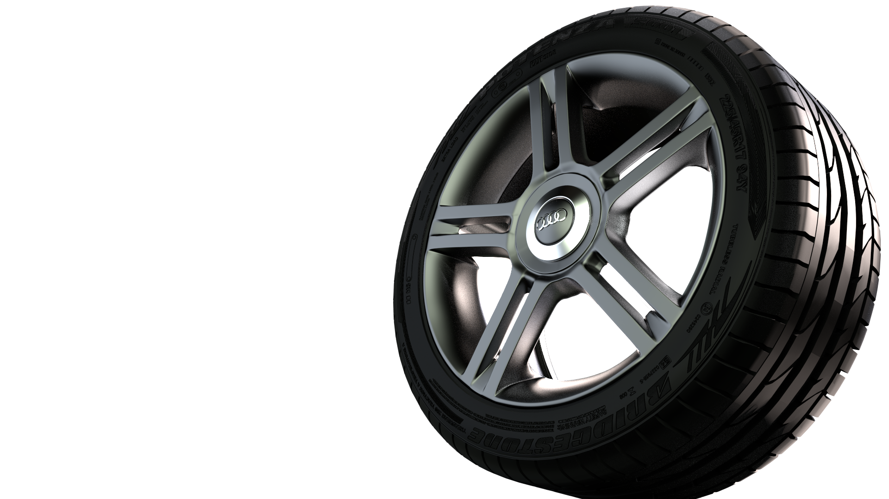
the_end()
Albert Nel
Get the blend files with the scripts from this talk @
https://github.com/Xuton

