Slide 1
伽利略(Galileo)系统

Slide 2
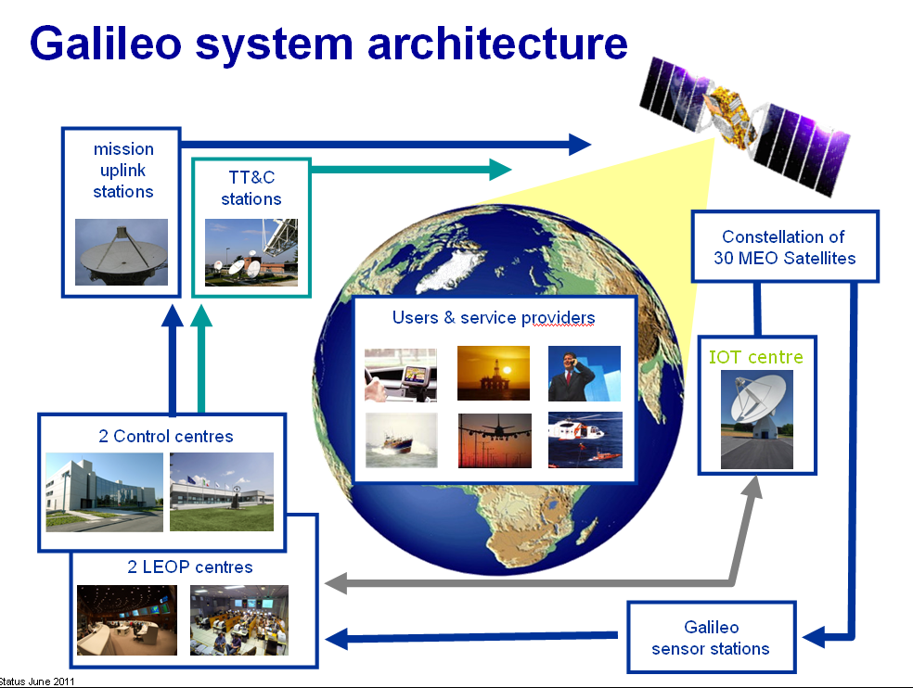
系统构成
由空间段、地面段、用户三部分组成。
Notes:
TT&C:Telemetry, Tracking and Command station
During the In-Orbit Validation (IOV) phase, the system is assessed through tests, the operation of two experimental satellites and a reduced constellation of four operational satellites and their ground infrastructure. The first two Galileo satellites were launched into the first orbital plane on 21 October 2011, followed by another two in the second orbital plane in 2012.
The Full Operational Capability (FOC) phase consists of the deployment of the remaining ground and space infrastructure, including an intermediate initial operational capability phase with 18 satellites in operation (the four IOV satellites plus 14 others). By 2015, 18 satellites should be in place, followed by the rest in 2020. The full system will consist of 30 satellites, control centres in Europe and a network of sensor stations and uplink stations installed around the globe.

Slide 3
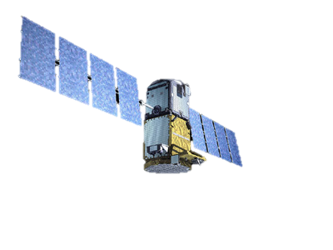
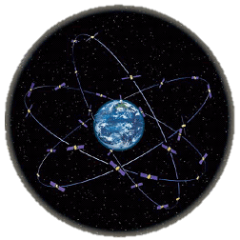
空间段
设计：三个轨道上的30颗中等高度轨道卫星（MEO）构成，每个轨道面10颗卫星（ 9颗工作， 1颗备用）；轨道面倾角56度；轨道高度23 222km ，运行周期14h 。
调整后：三个轨道上的30颗中等高度轨道卫星（MEO）构成，24颗工作卫星，6颗备用卫星，采用Walker24/3/1星座，轨道面倾角56度；轨道半径29599.8km ，运行周期14h4min42s
Notes:
左下角为GIOVE-B在轨示意图 。2011年10月，发射
satellites in space
https://gssc.esa.int/navipedia/index.php/Galileo_Space_Segment
https://www.gsc-europa.eu/galileo/system

Slide 4
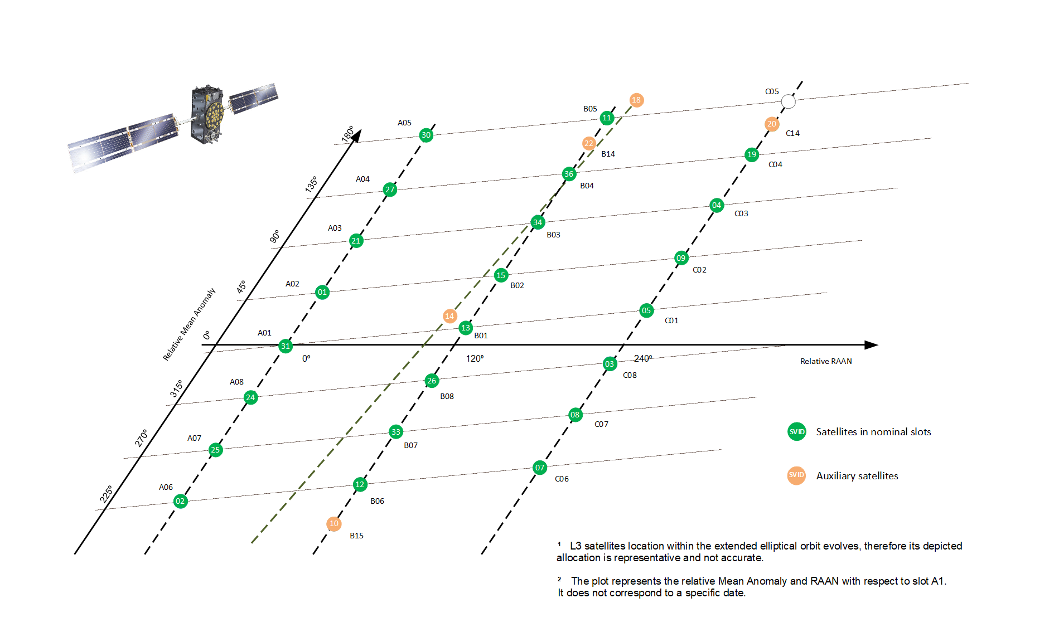
正常轨道卫星
辅助卫星

Slide 5
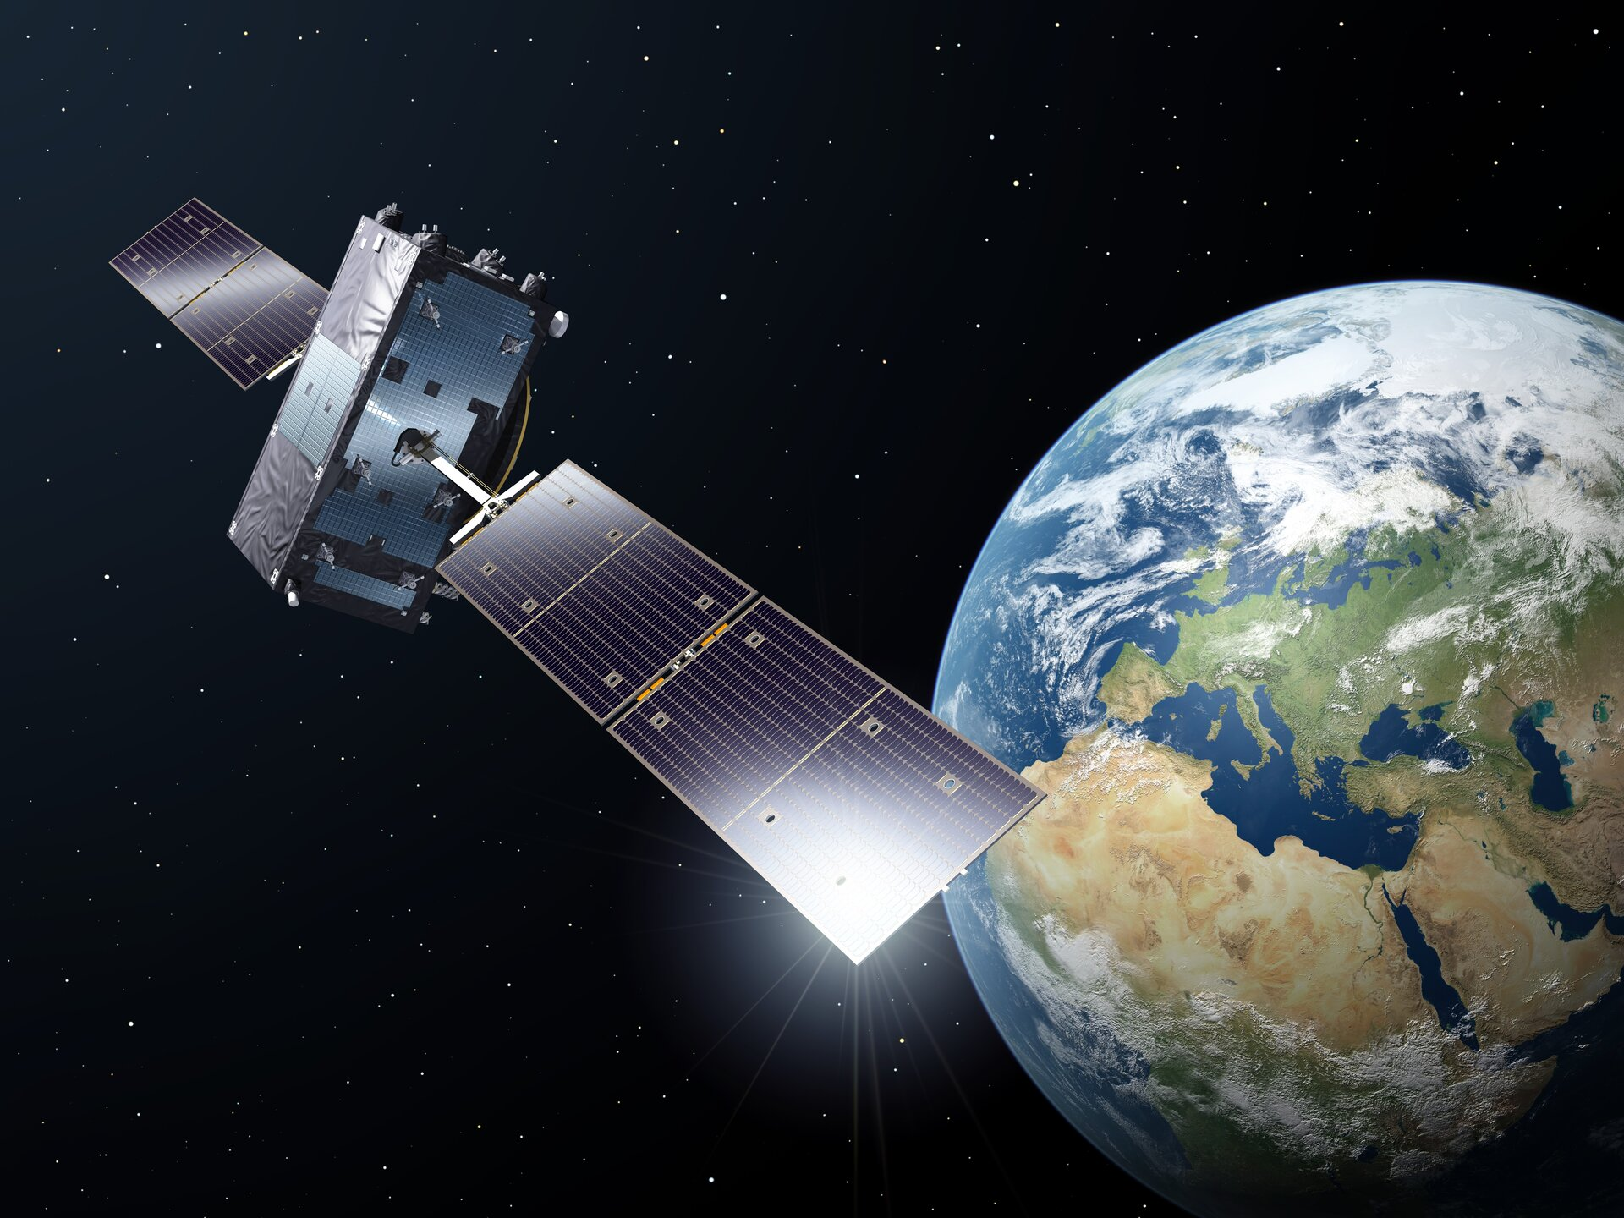
卫星组成
L波段天线：传输1200-1600 MHz的导航信号；
SAR（搜救）天线：接收并转发搜救信号；
C波段天线：接收上行链路数据；
S波段天线：
Notes:
Satellite components
https://www.esa.int/Applications/Navigation/Galileo/Galileo_satellites
Two S-band antennas are part of the telemetry, tracking and command subsystem. They transmit housekeeping data about the payload and spacecraft to ground control and, in turn, receive commands to control the spacecraft and operate the payload. The S-band antennas also receive, process and transmit ranging signals that measure the satellite's altitude to within a few metres.

Slide 6
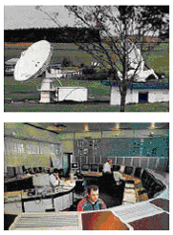

地面段
包括全球地面控制段、全球地面任务段、全球域网、导航管理中心、地面支持设施、地面管理机构。
Notes:
意大利Telespazio卫星地面站控制GIOVE-B运行
Ground Control Segment (GCS)

Slide 7
用户段
用户端主要就是用户接收机及其等同产品，伽利略系统考虑将与GPS、GLONASS的导航信号一起组成复合型卫星导航系统，因此用户接收机将是多用途、兼容性接收机。

Slide 8
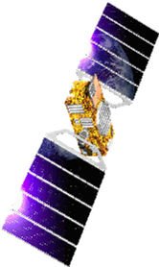
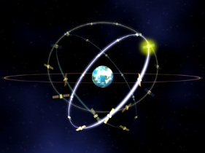

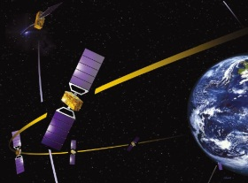


Galileo Implementation Plan
Full Operational Capability
27 (+3) Galileo satellites
2013
In-Orbit Validation
4 IOV satellites plus ground segment
2010
Galileo System Testbed v2
2 initial test satellites
2005
Galileo System Testbed v1
Validation of critical algorithms
2003
Notes:
GSTB V1 objectives
GPS measurements collected world-wide by a network of stations and processed off-line to verify GALILEO Timing, Navigation and Integrity concepts
Successful completion in December 2004 with the provision of validated prototype algorithms and models to the Ground Mission Segment IOV Phase CDE1 Contract
GSTB V2 objectives
Experimental GALILEO Satellite programme
Precursor of the IOV Phase
Securing GALILEO filings and validating on-board technology in the MEO radiation environment
IOV Objectives
Verification of all space, ground and user components, including their interfaces, prior to full system deployment
Analysis of system performance with the view to refine the FOC system prior to full system deployment
Verification of the adequacy of the siting requirements
Verification of Navigation Processing
Verification of integrity processing regarding the establishment of SISA and IF confidence levels, characterisation of feared events and TTA analysis
UERE budget characterisation
Deployment risk reduction
Verification of operational procedures
FOC

Slide 9

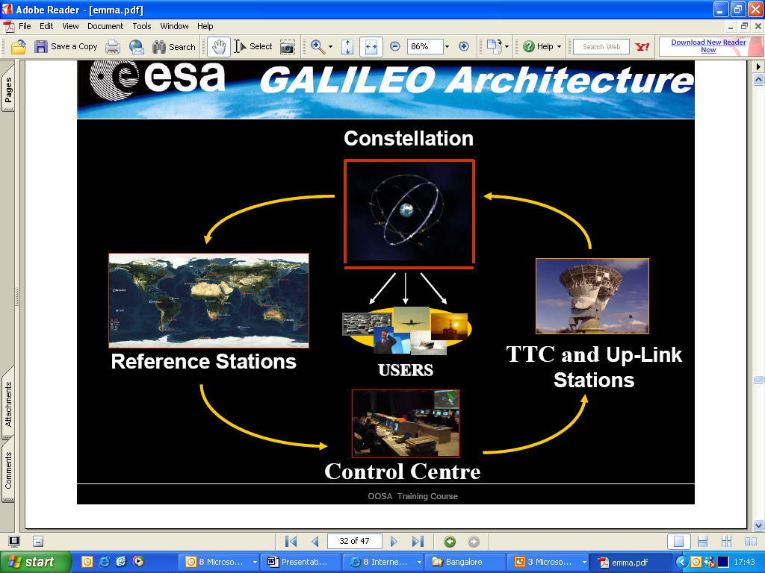
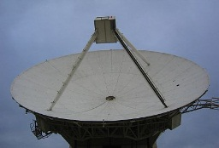
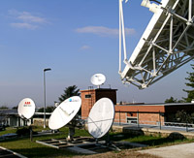
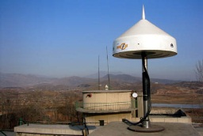
Galileo IOV vs FOC
 | Component | IOV Phase | FOC Phase
 | Satellites | 4 | 27(+3)
 | Control Centres | 1 | 3
 | Mission Uplink Stations | 5 | 9
 | TT&C Stations | 2 | 5
 | Sensor Stations | 20 | 30-40
IOV (In Orbit Validation), FOC (Full Operational Capability)
Notes:
ESA will launch the first four operational satellites using two separate launchers. The first two satellites will be placed in the first orbital plane and the second in the second orbital plane. These four satellites, plus part of the ground segment, will then be used to validate the Galileo system as a whole, using advanced system simulators. Then, the next two satellites will be launched into the third orbital plane. Once the Galileo system has been validated, the final stage will be to build up the rest of the constellation by completing it on all its three orbital planes. This will then require several launches with Ariane-5 or Soyuz from the Europe’s Space Port in French Guyana. Galileo will then be fully operational, providing its services to a wide variety of users throughout the world.

Slide 10

IOV Ground Segment Sites
Svalbard ULS/GSS
Alaska GSS
Kiruna TTC
Redu GSS
Urumchi GSS
Washington GSS
Fucino GSS
S. Korea GSS
Riyadh GSS
Hawaii GSS
Kourou
TTC/ULS/GSS
New Caledonia
ULS/GSS
Reunion ULS/GSS
Papeete ULS/GSS
Easter Island GSS
Cordoba GSS
South Africa GSS
Perth GSS
Troll GSS
Sensor Stations
Up-Link stations
TT&C stations
Control Centres

Slide 11
伽利略系统应用和服务
基本服务有：导航、 定位、授时
特殊服务： 搜索与救援(SAR功能)。
扩展应用服务系统： GNS在飞机导航和着陆系统中的应用、铁路安全运行调度、海上运输系统、陆地车队运输调度、精准农业

Slide 12
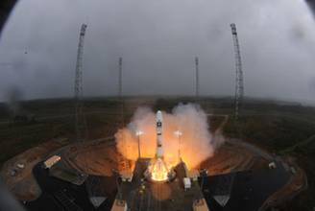
Galileo进展
2005.12.28-首颗实验卫星“GIOVE-A”(焦韦-A )顺利发射升空
第二颗实验卫星“Giove-B”于2008年4月27日搭乘俄罗斯“联盟”号运载火箭顺利升空
2011年10月21日发射2颗工作卫星
2012年10月12日发射第二组组两颗卫星
2015.3.27,发射第7、8颗
2015年12月17日发射第11颗和第12颗卫星
2016年11月18日，以一箭四星方式发射4颗，卫星数量达到18颗，12月15日启动初始服务。
2020年完成满星座部署
2016年12月15日，欧洲委员会(EC)正式宣布Galileo初始服务启动

