Slide 1

Credit Scoring Analysis
Team 1
Ting-kai Liu, 001306707
Xuyang Li, 001409590
Xing Dong, 001718652

Slide 2
Overview
The purpose of the project is to understand and implement a big data service for financial service. We will build several machine learning models to predict the probability that someone will experience financial distress in the next two years. After that, we will evaluate and compare their performance.

Slide 3



Use cases
Banker can input the financial data to see if a person is qualify for new loan or credit card application.
System runs financial records data (machine learning) model and predict the possibility of past due delinquency.
Banker can visualize the credit score from different charts based on the predict outcomes and then make decision.
p.c. https://icons8.com/license
Notes:
Banker can input the financial data to see if a person is qualify for new loan or credit card application.
System runs financial records data (machine learning) model and predict the possibility of past due delinquency.
Banker can visualize the credit score from different charts based on the predict outcomes and make decision.

Slide 4
Methodology
Data Ingestion:
Overview and explore the data.
Transform and clean the data with Scala.
Machine learning model:
Using Logistic Regression algorithm to define our first model.
Using Random Forest algorithm to define our second model.
Evaluate the model performace by AUC, runtime, etc.
Graphical user interface:
Using web pages to give the user an interface to query our model.

Slide 5
Data sources
SeriousDlqin2yrs: Person experienced 90 days past due delinquency or worse
RevolvingUtilizationOfUnsecuredLines: Total balance on credit cards and personal lines of credit except real estate and no installment debt like car loans divided by the sum of credit limits
NumberOfTime30-59DaysPastDueNotWorse: Number of times borrower has been 30-59 days past due but no worse in the last 2 years.
NumberRealEstateLoansOrLines: Number of mortgage and real estate loans including home equity lines of credit
NumberOfDependents: Number of dependents in family excluding themselves (spouse, children etc.)
https://www.kaggle.com/c/GiveMeSomeCredit/data
Total number of train set: 150,000; Test set: 101,503
NumberOfOpenCreditLinesAndLoans: Number of Open loans (installment like car loan or mortgage) and Lines of credit (e.g. credit cards)
DebtRatio: Monthly debt payments, alimony, living costs divided by monthly gross income
NumberOfTimes90DaysLate: Number of times borrower has been 90 days or more past due.
NumberOfTime60-89DaysPastDueNotWorse: Number of times borrower has been 60-89 days past due but no worse in the last 2 years.
Notes:
personal historical financial records

Slide 6
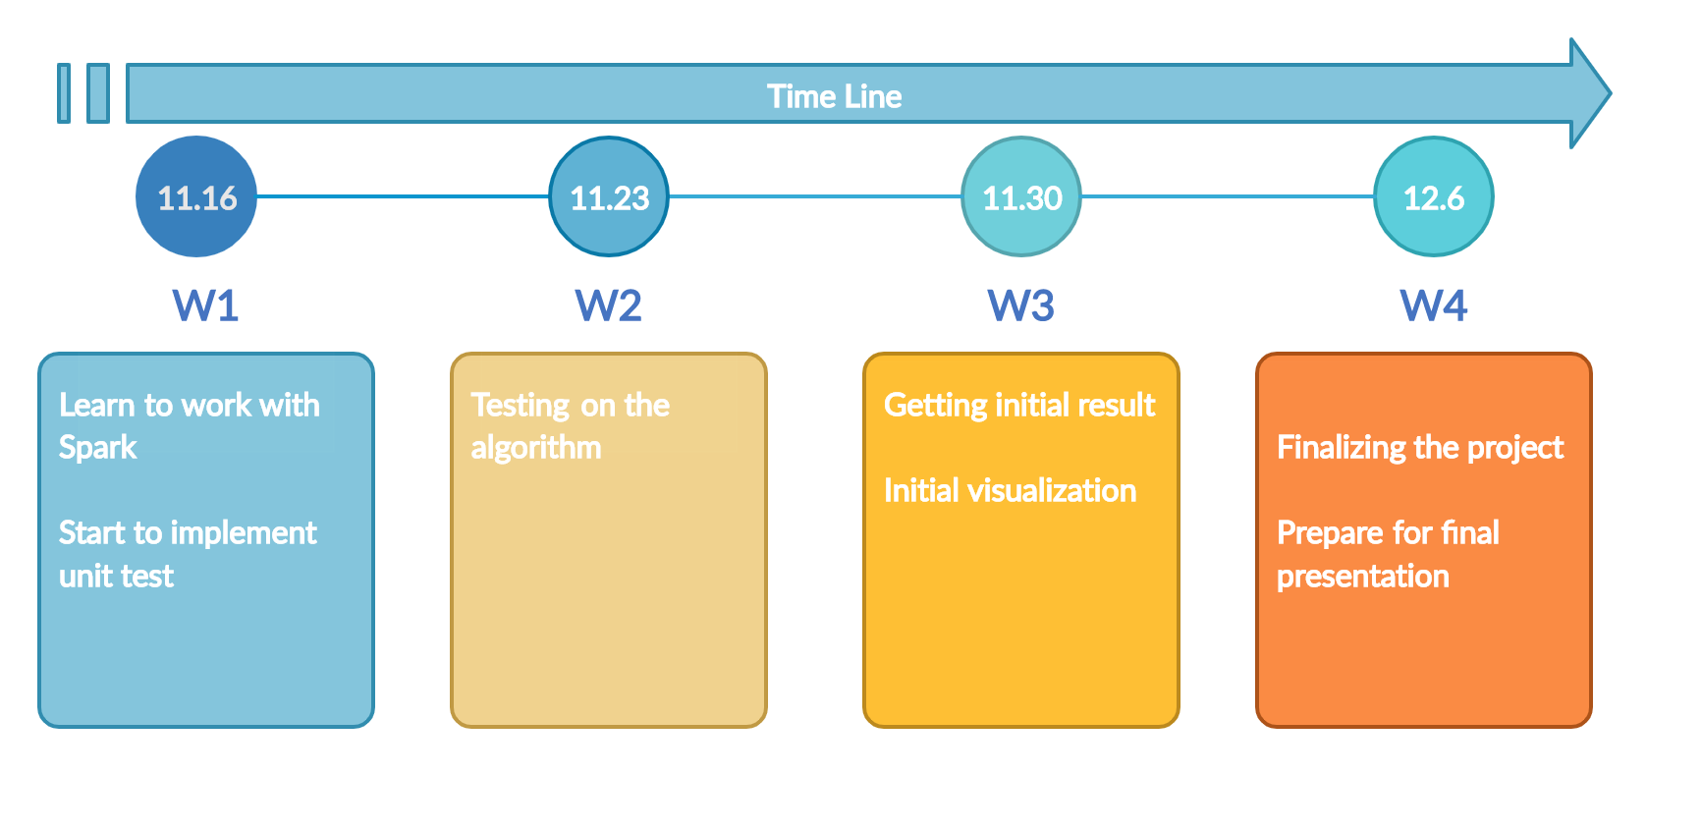
Milestones

Slide 7



Program Details
Repository: https://github.com/XuyangL/CSYE7200FinalProject
Code Language: Scala
Framework: Apache Spark, Play
p.c. https://icons8.com/license

Slide 8



Acceptance criteria
Level 1: The data digestion service should be executed within 5 seconds.
Level 2: An Spark SQL query should be executed within 5 seconds.
Level 3: The AUC value for each machine learning model should be greater than 80%.
p.c. https://icons8.com/license

Slide 9



Goals
Analyzing the financial data to discover the pattern of each financial attributes, check the relationship between the attributes.
Building machine learning models to predict the possibility, reduce the resource and time for making a decision.
Implement a graphical user interface for banker to query the data easily.
p.c. https://icons8.com/license
Notes:
Analyzing the financial data to discover the pattern of each financial attributes, check the relationship between the attributes.
Building machine learning models to predict the possibility, reduce the resource and time for making a decision.
Implement a graphical user interface for banker to query the data easily.

Slide 10
Thank you!

