Slide 1
Credit Scoring Analysis
Final Presentation
Team 1
Ting-kai Liu, 001306707
Xuyang Li, 001409590
Xing Dong, 001718652

Slide 2
Project Overview
The purpose of the project is to understand and implement a big data service for financial services. We built a random forest and a logistic regression ML model by using Apache Spark to predict the probability that someone will experience financial distress in the next 90 days. Then, we used the trained ML models in the Play framework to predict real data from the user and allow the user to decide on that data.

Slide 3
Dataset
Dataset Link: https://www.kaggle.com/c/GiveMeSomeCredit/data
Total number of row: 150,000; train set: 70% of data; test set: 30 % of data
Our goal is to predict the probability that someone will experience financial distress in the next 90 days

Slide 4
Methodology
Apache Spark
Load data with spark session
Rename column and explore the dataset, fill up missing value with spark sql
Upsample the data to deal with imbalance problem
Train and test machine learning models
Save the machine learning models
Play framework
Load the machine learning models in the Play
Accept user input record, call the machine learning models to get the results
Display the results in web pages and save the decision on each record

Slide 5
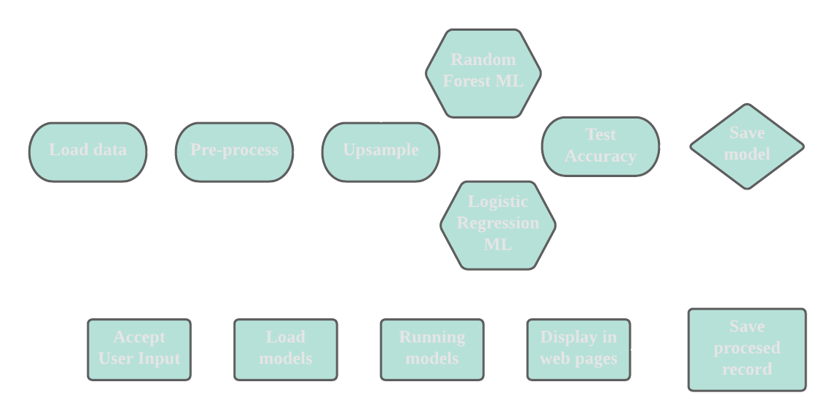
Methodology

Slide 6
User Cases
User can input the financial data to see if a person is qualify for new loan or credit card application.
System runs financial records data (machine learning) model and predict the possibility of past due delinquency.
User can visualize the credit score from different charts based on the predict outcomes and then make decision.
(New!) All processed records get stored and user can view the records afterwards

Slide 7
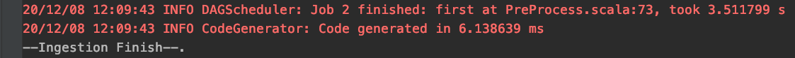
Acceptance criteria
2
1
Level 1: The data digestion service should be executed within 5 seconds.
Level 2: The time for getting the prediction results from machine learning models is within 5 seconds. ( Please see our play demonstration )
Level 3: The AUC value for each machine learning model should be greater than 80%.
3

Slide 8
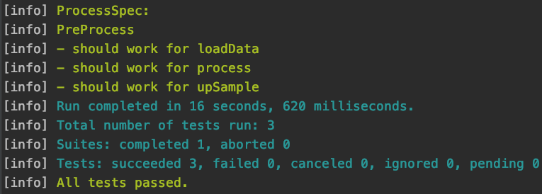
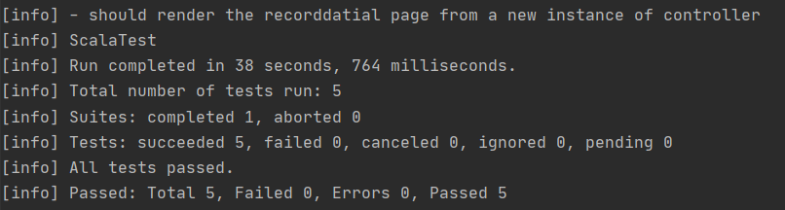
Unit Test
Apache Spark:
Play Framework

Slide 9
Time for the Demo！

Slide 10
Future Improvements
Apache Spark:
Add more machine learning models and compare the performance between them
Get more data to improve the imbalance problem
Play framework:
Add a register and login to the system
Save the processed record into a database like MongoDB or MySQL instead of in the memory

Slide 11
Thanks for Listenning!

