Slide 1

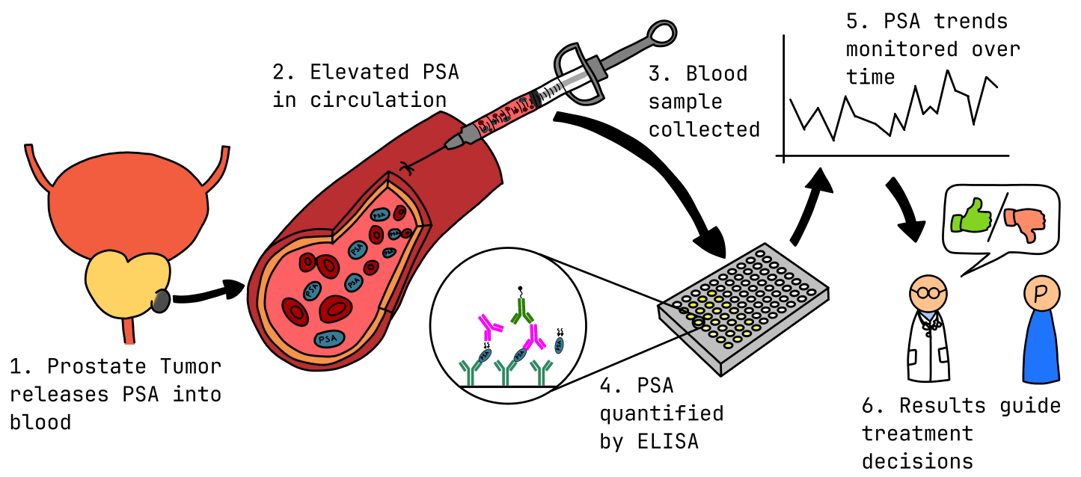
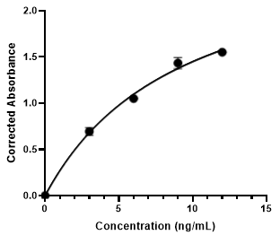
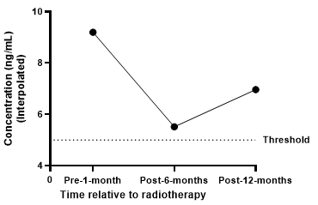
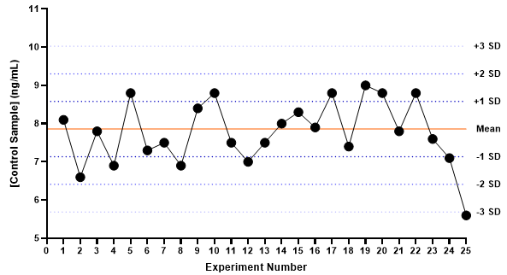
Monitoring Prostate Cancer Response via PSA Sandwich ELISA
Elwood Fong | 510444907
1
INTRODUCTION
Prostate-specific antigen (PSA) is a prostate-derived biomarker extensively used for screening and longitudinal monitoring of prostate cancer (Feltes Benitez et al., 2025). We quantified serum PSA by sandwich ELISA -using a standard curve to interpolate unknowns -to evaluate response to radiation therapy in a 60-year-old patient across pre-, 6-, and 12-month samples (Ramos et al., 2001). Tracking PSA trends post-radiotherapy - such as PSA bounce or sustained rises above nadir - provides critical insights into treatment response and recurrence risk (Liaqat et al., 2023). See Figure 1 for the clinical rationale for PSA screening and monitoring.
Figure 1. PSA screening schematic. Prostate releases PSA into blood, measured by ELISA, enabling monitoring of treatment response.
A
B
2
METHODS
96-well sandwich ELISA on anti-PSA–coated strips. After blocking, standards (1.5–12 ng/mL) and patient sera (duplicate wells) were incubated, followed by HRP-conjugated detector. TMB was developed and stopped with 1 M HCl; OD450 with 540-nm reference was blank-subtracted. A 4-point nonlinear (4PL) standard curve was fitted and unknowns interpolated. Assay performance was monitored with Levey–Jennings charts and Westgard rules using historical QC mean ± SD. Graphs (standard curve, longitudinal PSA, QC) were produced in GraphPad from plate-reader exports.
Figure 2. (A) PSA standard curve (1.5, 3.0, 6.0, 12.0 ng/mL. ng/mL), mean ± SD; 4PL fit for interpolation. (B) Patient PSA (mean ± SD) versus radiotherapy timeline; dotted 5 ng/mL threshold.
Notation: error bars = SD; n = replicates; 4PL = four-parameter logistic; QC = quality control.
3
RESULTS
Corrected OD450–540 from PSA standards (1.5–12 ng/mL) generated a 4PL calibration curve (Figure 2A). Patient absorbances were interpolated to concentrations (Figure 2B). PSA fell from ~9.3 ng/mL pre-treatment to ~5.1 ng/mL at 6 months, then rose to ~6.9 ng/mL at 12 months (positivity threshold 5 ng/mL). The
Figure 3. Levey–Jennings QC: historical mean 7.86 ± 0.72 ng/mL; run 25 = 5.6 ng/mL (−3 SD, 1₃s breach).
concurrent QC control was 5.6 ng/mL versus historical 7.86 ± 0.72 ng/mL, breaching the 1₃s rule on the Levey–Jennings chart (Figure 3). Thus, this batch is out-of-control and patient values are not reportable pending repeat QC.
4
CONCLUSION
5
REFERENCES
Because QC failed (1₃s), this batch is invalid; therapy effectiveness cannot be concluded. If confirmed after repeat testing, PSA fell from ~9.3 to ~5.1 ng/mL at 6 months, then rose to ~6.9 at 12 months—remaining above the 5 ng/mL threshold—suggesting partial response with persistent disease. Next steps: repeat QC and remeasure; trend PSA every 3 months; confirm with an independent assay; consider imaging and urology review.
Feltes Benitez, N., Lozano, J., Forero, C.G., Colomer, M.C., Paredes Rubio, S. & Jovell‑Fernandez, E. (2025) ‘PSA bounce: understanding temporal fluctuations in prostate cancer after external radiotherapy’, Clinical and Translational Oncology, 27, pp. 3154–3162.
Ramos, C.L., Bastos, A.C., Fernandes, K.F., & Oliveira, S.C. (2001) ‘Development and validation of a quantitative ELISA for the measurement of prostate‑specific antigen (PSA)’, Analytica Chimica Acta, 427, pp. 115–123.
Liaqat, M., Kamal, S. & Fischer, F. (2023) ‘Illustration of association between change in prostate-specific antigen (PSA) values and time to tumor status after treatment for prostate cancer patients: a joint modelling approach’, BMC Urology, 23, Article no. 202.

