Slide 1

Game recommender (Steam games)
Game Recommender is a
1
Game Recommender is a Content Based Game Recommendation System with Steam API: Association using Cosine Similarity Algorithm
It aims to create a python program that aids and guides people who seek to find new games that are related to the ones they play. The project will mostly target the young demographic and the data that is needed will be collected from Steam API.
By: Dela Cruz Sunga Gonzales, em

Slide 2
Game Recommender is a
It aims to create a python program that aids and guides people who seek to find new games that are related to the ones they play. The project will mostly target the young demographic and the data that is needed will be collected from Steam API.
Game Recommender is a Content Based Game Recommendation System with Steam API: Association using Cosine Similarity Algorithm

Slide 3
This system
Suggests games to users based on their likes and gaming patterns.
we selected an algorithm that best suits text analysis.
We used data from Steam,
We'll be working with two datasets: user and game data. This blog will go over these in greater depth.

Slide 4
Firstly
We first need to preprocess the game dataset described in the dataset section with all the useful information to give as input to the recommender algorithm
Then
We decided to only keep relevant games ranging to only 5000 in the game dataset simply because there are certain games that are not significant enough to consider recommending to the user
Finally
We create some new columns by merging numerous columns to obtain the optimal combination of information to offer us the best potential recommendation system.

Slide 5
The cosine similarity matrix is then created using the frequency matrix. The function takes a game title as a string and the cosine similarity matrix established before as inputs.
We can create a cosine similarity matrix for the recommender system. To begin, we generate a frequency matrix for each game and each word in the chosen column (column name).

Slide 6


using the cosine similarity matrix,
we calculate the similarity score for each recommended game and rank them from most similar to least similar.

Slide 7
we utilize the 'make recommendation for user’ function
This function combines the recommendations generated by the 'get recommendations' function for each game, maintaining the recommendations with the best reviews (extracted from the game dataset).

Slide 8
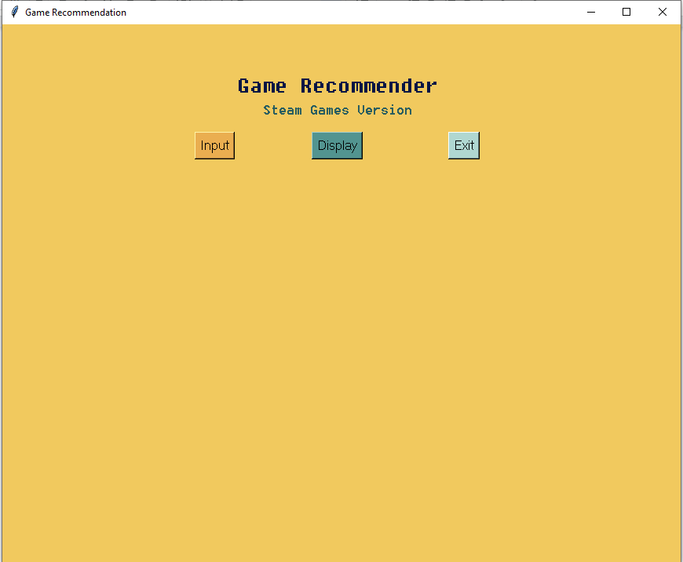

the initial interface of the program we created in python. It is very simple, before the user can display recommended games, the user must press the input button first and a window will appear.

Slide 9
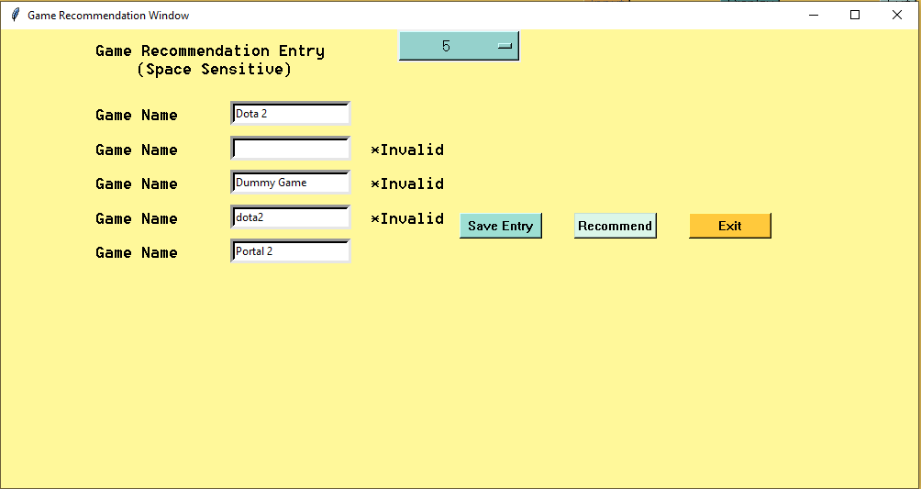
the user will be notified if their input is invalid (has invalid spaces, duplicates or the game not being in the dataset used).

Slide 10
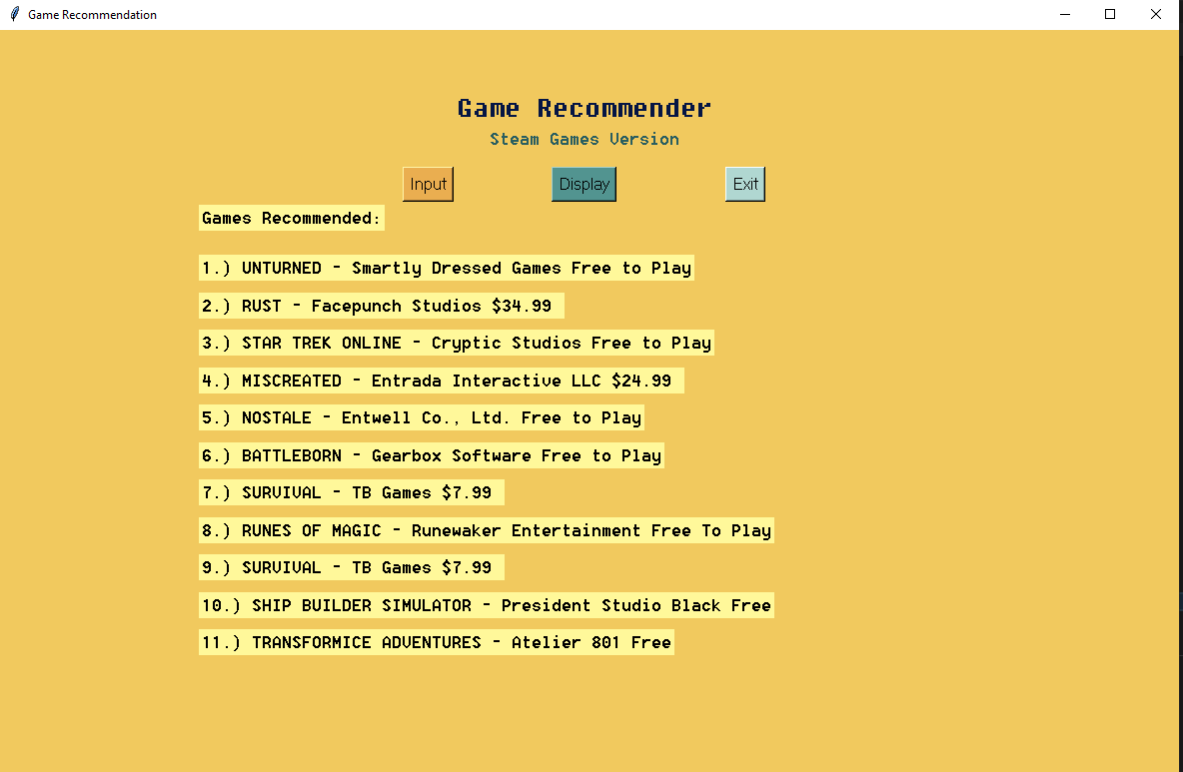
When the inputs are valid, after pressing the recommend button, the user can now press the display button which will recommend a number of games based on the inputs the user put in the input window that was closed

Slide 11
According to Jiawei Han and Jian Pei (2012), the similarity between two inner product space vectors is measured by cosine similarity.

Slide 12

Thousands of characteristics can be used to characterize a document, each of which records the frequency of a specific word (such as a keyword) or phrase in the document. As a result, a term-frequency vector is used to represent each document as an object. For example, we see a document containing five instances of the word FPS, while GORE does not occur at all. The word GORE is absent from the entire document, as indicated by a count value of 0 and FPS has a value of 5. Such data can be highly asymmetric

Slide 13


To our conclusion, the cosine similarity algorithm proved to be useful in associating documents, in our case, csv files— one user data set from the input, one game data set from the steam api csv and one csv from game reviews of that api.
We further narrowed it down to less than 6000 games to get relevant games and also pre-process it in a much more optimal time. Due to the nature of the project, we could say that this recommendation system has a potential to be a base program for a more improved recommendation application if enough time was given.

Slide 14
Many improvements can be done if sufficient utilities can also be accessed, this includes unrestricted knowledge of programming that involves actual creation of applications.
The application has areas that are lacking in terms of functionality and design but in light of that, the recommendation system can be used by users who are in need of crude recommendations or just simply want to have a pocket recommender at their disposal.

Slide 15
If the chance persists we will make an integration of the recommender that will be a hybrid recommender
as our recent investigations prove that it is more plausible to use multiple algorithms in recommending products so as to have many evaluation metrics. Particularly, we would like to put apriori algorithm that is also under the association rule for collaborative filtering.

Slide 16




Team Presentation
Rick Gavin A. Dela Cruz
BSCS 3-C
Richard Andrei B. Suñga
BSCS 3-C
Ella Monique T. Gonzales
BSCS 3-C

