Slide 1
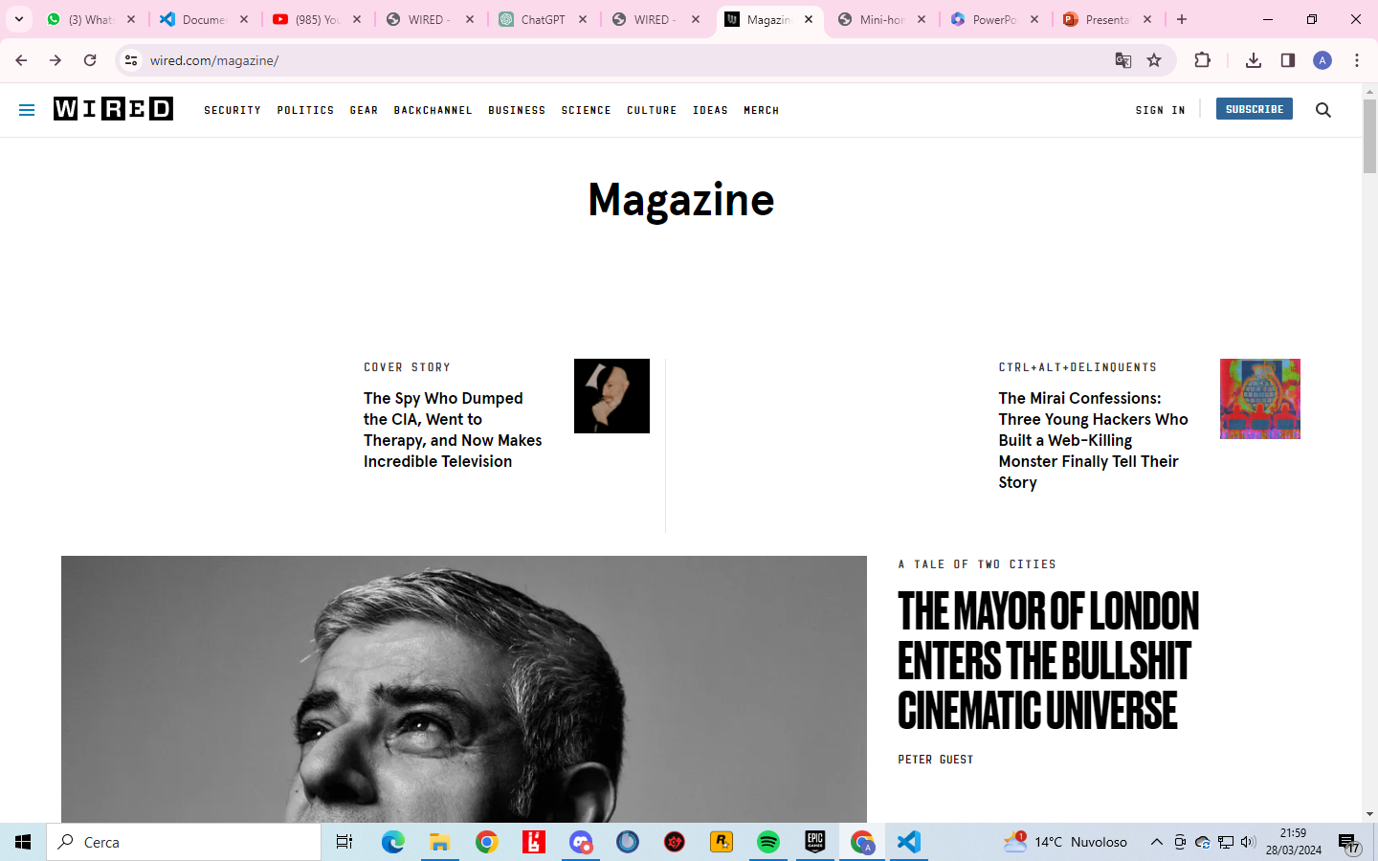
Primo mhw1 https://www.wired.com/magazine/

