Slide 1

Customer Churn Prediction using Random Forest
WGU D603 - RFN1 Task 1
Glenn Dalbey
Notes:
"Good [morning/afternoon/evening] everyone. My name is [Your Name], and today I will be presenting my data mining project on Customer Churn Prediction using the Random Forest classification model. This project is part of the WGU D603 - RFN1 Task 1. The goal of this project is to develop a predictive model that can help telecommunications companies identify customers at high risk of churning, allowing them to take proactive steps to retain those customers."

Slide 2

Introduction
• Purpose: Predict customer churn using Random Forest.
• Question: Can we predict high-risk churn customers based on service usage, contract details, and demographics?
• Goal: Develop a model with at least 80% accuracy to enable proactive retention strategies.
Notes:
"Customer churn is a major concern for telecommunications companies. The goal of this project is to predict customer churn based on service usage, contract details, and demographic information. By leveraging machine learning, specifically Random Forest classification, we aim to develop a model that can predict churn with at least 80% accuracy. This will help businesses implement targeted retention strategies and reduce revenue loss."

Slide 3
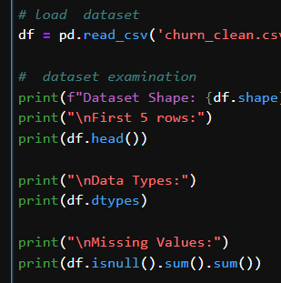
Dataset Overview
• Data Source: Telecommunications customer data.
• Features Used:
- Continuous: Tenure, MonthlyCharge, Bandwidth_GB_Year, Outage_sec_perweek.
- Categorical: Contract, InternetService, PaperlessBilling, PaymentMethod, OnlineSecurity, TechSupport, StreamingTV, StreamingMovies.
• Target Variable: Churn (Yes/No).
Notes:
Script: "To build our churn prediction model, we used a telecommunications dataset containing customer information, service usage data, and contract details. We classified the dataset features into two types: continuous and categorical. Continuous features include tenure, monthly charges, bandwidth usage, and outage frequency, while categorical features include contract type, internet service type, billing method, and additional services like online security and tech support. The target variable is churn, which indicates whether a customer left the service."

Slide 4

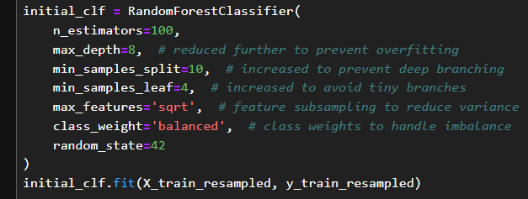
Methodology
• Chosen Algorithm: Random Forest.
• Reasons:
- Handles both categorical & numerical data.
- Reduces overfitting with ensemble learning.
- Provides feature importance.
• Libraries Used:
- Pandas, NumPy, Scikit-learn, Matplotlib, Seaborn, Imbalanced-learn.
Notes:
Script: "For this project, i chose the Random Forest algorithm. Random Forest is an ensemble learning method that builds multiple decision trees and combines their predictions for better accuracy and reduced overfitting. It is particularly useful for this dataset because it can handle both categorical and numerical variables, manage high-dimensional data, and provide insights into feature importance. We used Python libraries such as Pandas for data handling, Scikit-learn for model training, Matplotlib and Seaborn for visualization, and Imbalanced-learn to address data imbalance."

Slide 5
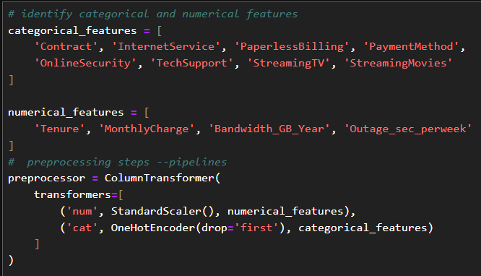
Data Preparation
• Handling missing values & outliers.
• Encoding categorical features.
• Normalizing continuous features.
• Addressing class imbalance using SMOTE.
• Splitting data into training (60%), validation (20%), test (20%).
Notes:
Script: "Before training our model, we needed to clean and preprocess the data. This included handling missing values, encoding categorical variables, normalizing continuous variables, and addressing the class imbalance. Since churn cases were underrepresented, we used the Synthetic Minority Over-sampling Technique (SMOTE) to balance the classes. Finally, we split the data into training, validation, and test sets, ensuring that each subset maintained the original class distribution."

Slide 6
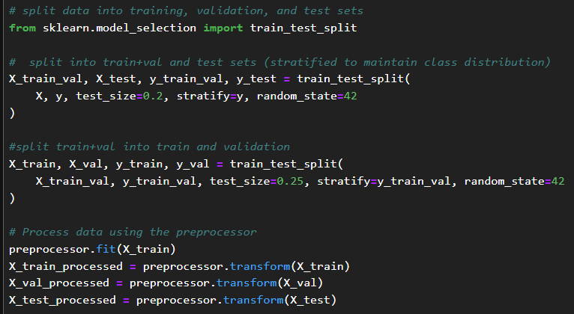
Model Development
• Initial Random Forest Model:
- Base parameters to prevent overfitting.
- Evaluated using accuracy, precision, recall, F1-score, AUC-ROC.
• Hyperparameter Tuning:
- Grid Search with k-fold cross-validation.
- Best parameters: {'n_estimators': 200, 'max_depth': 20, 'min_samples_split': 2, 'min_samples_leaf': 1}.
Notes:
Script: "We first trained a baseline Random Forest model with default parameters and evaluated its performance. Next, we performed hyperparameter tuning using Grid Search with k-fold cross-validation to optimize the model. The best-performing parameters were 200 estimators, a maximum depth of 20, and specific values for minimum samples per split and per leaf. These adjustments improved the model’s ability to generalize and make more accurate predictions."

Slide 7
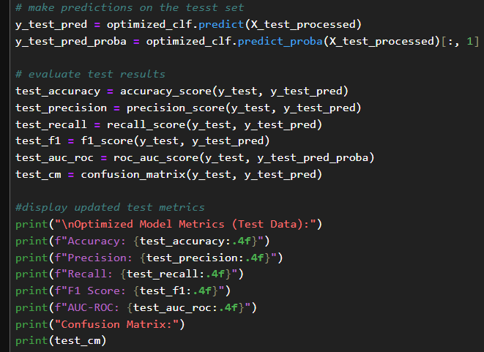
Model Performance Comparison
• Initial Model (Validation):
- Accuracy: 87.1%
- Precision: 71.2%
- Recall: 86.0%
- F1 Score: 77.9%
- AUC-ROC: 94.1%
• Optimized Model (Test):
- Accuracy: 89.7%
- Precision: 79.8%
- Recall: 82.1%
- F1 Score: 80.9%
- AUC-ROC: 95.3%
Notes:
Script: "Here, we compare the performance of the initial and optimized models. The initial model achieved an accuracy of 87.1%, a precision of 71.2%, and an F1 score of 77.9%. After optimization, the model's accuracy increased to 89.7%, precision improved to 79.8%, and the F1 score rose to 80.9%. The slight decrease in recall suggests the model became more precise in identifying true churn cases while reducing false positives."

Slide 8
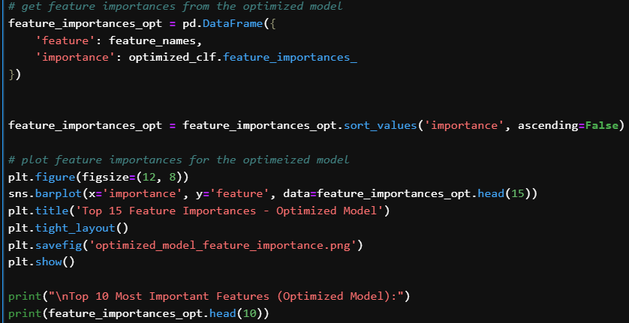
Results & Key Insights
• Key Influencing Factors:
- Tenure, Bandwidth_GB_Year, MonthlyCharge.
- Contract type significantly affects churn.
• Business Implications:
- Identifies high-risk customers early.
- Enables targeted retention strategies.
- Efficient resource allocation.
Notes:
Script: "The analysis revealed that certain features strongly influence churn. Customers with shorter tenure, higher monthly charges, and higher bandwidth usage are more likely to leave. Contract type also plays a crucial role—month-to-month contracts have the highest churn rate. This insight allows businesses to focus on high-risk customers by offering retention incentives, better service plans, and personalized engagement strategies."

Slide 9
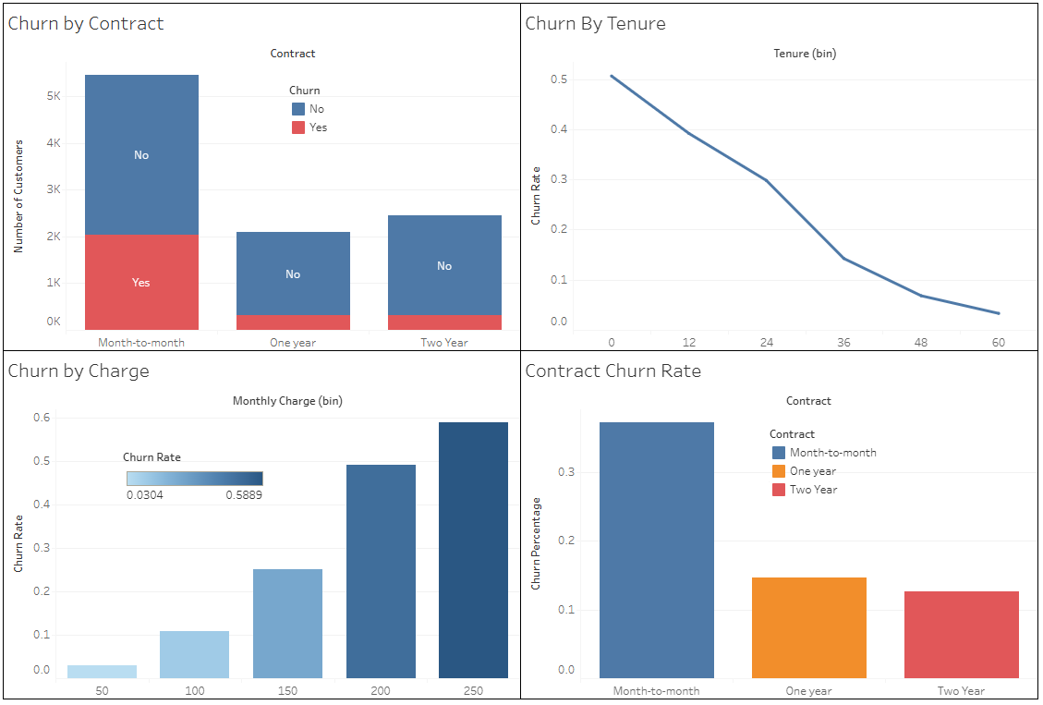
Tableau Dashboard
Notes:
script: "In this section, we will integrate a Tableau dashboard to visualize churn trends. This dashboard will include interactive charts displaying churn rates by tenure, contract type, and monthly charges, helping business decision-makers identify key areas for intervention. The dashboard will enhance the interpretability of our model’s predictions and support strategic decision-making."

Slide 10
Limitations & Future Work
• Model Limitations:
- Potential data drift over time.
- External factors (market trends, economy) not included.
• Future Improvements:
- Implement real-time monitoring & retraining.
- Include additional behavioral factors.
- Explore deep learning-based models.
Notes:
Script: "While our model performs well, there are some limitations. Customer behavior evolves over time, and factors influencing churn may change due to market dynamics, pricing strategies, or external events. Additionally, our model does not incorporate sentiment analysis from customer reviews, which could provide deeper insights into dissatisfaction. Future improvements include real-time monitoring, periodic retraining, and the inclusion of additional behavioral factors."

Slide 11

Conclusion & Recommendations
• Deploy model for proactive churn prevention.
• Develop targeted retention offers for at-risk customers.
• Improve customer engagement through better service quality.
• Regularly update the model with new data for accuracy.
Notes:
Script: "In conclusion, our optimized Random Forest model successfully predicts customer churn with nearly 90% accuracy. To maximize business impact, we recommend deploying the model for monthly churn predictions, implementing targeted re
tention strategies, and continuously monitoring its performance. By acting on these insights, telecommunications companies can improve customer satisfaction and reduce revenue loss due to churn.“
Question 1:
"Why did you choose Random Forest over other classification models like Logistic Regression or Support Vector Machines?"
Answer: "I chose Random Forest because it handles both categorical and numerical data efficiently, reduces overfitting through ensemble learning, and provides feature importance insights. While Logistic Regression is great for linear relationships, Random Forest is better suited for capturing complex interactions between variables, which is essential for churn prediction."
Question 2:
"How did you handle the imbalance in the dataset since the churn class was underrepresented?"
Answer: "To address class imbalance, I used the Synthetic Minority Over-sampling Technique (SMOTE), which generates synthetic data points for the minority class. This prevents the model from being biased toward the majority class while ensuring that it learns patterns from both churned and non-churned customers."
Question 3:
"What was the most influential feature in predicting customer churn?"
Answer: "The most important feature in our model was Tenure—meaning how long a customer has been with the company. Customers with shorter tenures were significantly more likely to churn. Other important factors included Bandwidth Usage per Year, Monthly Charges, and Contract Type, with month-to-month contracts having the highest churn rates."
Question 4:
"How would a telecommunications company implement this model in a real-world scenario?"
Answer: "A telecom company can integrate this model into their customer management system to regularly predict churn risk for each customer. Customers with a high churn probability can then be targeted with retention strategies such as personalized discounts, better service plans, or loyalty rewards to prevent them from leaving."
Question 5:
"What are some limitations of this model that should be considered before deploying it?"
Answer: "One limitation is data drift, where customer behaviors change over time, making the model less effective if not updated regularly. Another limitation is that external factors, such as competitor promotions or economic conditions, are not included in the dataset. To mitigate this, the model should be retrained periodically with the latest data."
Question 6:
"Can this model be applied to industries other than telecommunications?"
Answer: "Absolutely! Any subscription-based business, such as streaming services, insurance providers, or SaaS companies, can benefit from a churn prediction model. By analyzing customer behavior and identifying high-risk customers, businesses can take proactive measures to reduce attrition."
Question 7:
"How did hyperparameter tuning improve the model's performance?"
Answer: "Hyperparameter tuning optimized key parameters such as the number of trees, tree depth, and sample splits, which helped balance bias and variance. This resulted in a more stable model with higher accuracy and precision while reducing overfitting."
Question 8:
"If you had more time, what additional features would you include in your model?"
Answer: "I would incorporate customer sentiment analysis from support tickets or social media, as dissatisfaction often leads to churn. Additionally, competitor pricing and promotions could be factored in to understand how external factors impact churn."
Bonus "Tricky" Question
Question 9:
"If we used deep learning instead of Random Forest, how would that change the model?"
Answer: "Deep learning models like neural networks could potentially capture more complex relationships in the data. However, they require more computational power, more data, and are often less interpretable than Random Forest. Since our dataset is structured and tabular, Random Forest remains an efficient and effective choice."

