Slide 1



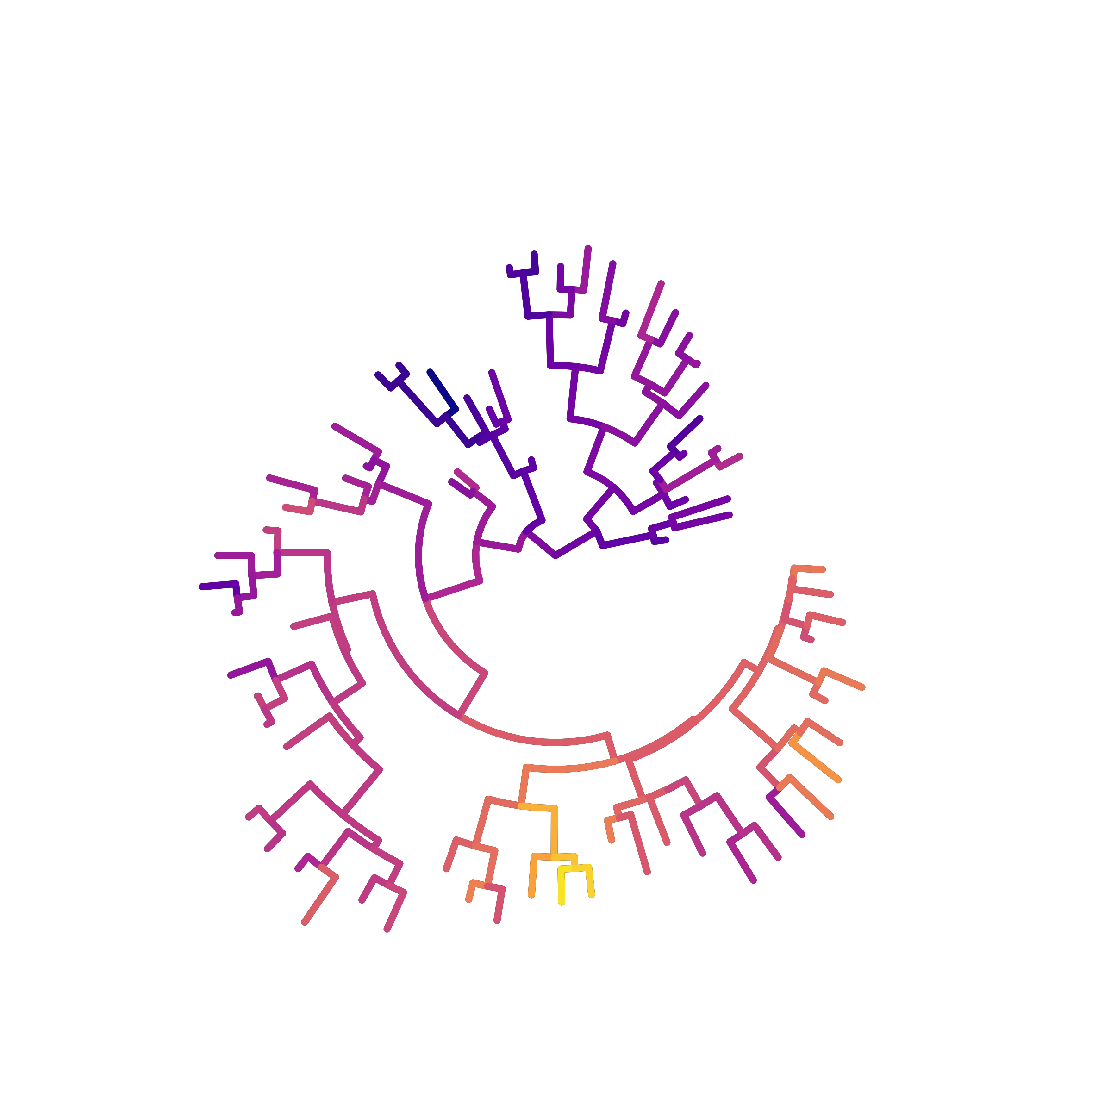
1. Broad Motivation
2. This Study Design
3. Future Application
Sparse toxicity tests
Inputs
Outputs
Potential integration into food web risk assessment
Species
Sensitivity
Body mass
Functional feeding group
Phylogeny
Chemical-use group
Phylogenetic signal
Structured sensitivity patterns
Uncertainty
FFG1
…
Chemicals
FFG2
FFG3
Most species-chemical combinations remain unmeasured.
FFG4
FFG5
FFG6
Step 1. Quantify phylogenetic signal
Step 2. Test Bayesian hierarchical models with explicit phylogenetic effects
Quantify phylogenetic signal in species sensitivity within each taxonomic group for each chemical
H1: Global Allometry
H2: FFG Baselines
H3: FFG Allometry
FFG1
FFG1
FFG2
FFG2
Sensitivity
…
…
FFG6
FFG6
Body Mass
Body Mass
Body Mass

Slide 2
1. Broad Motivation
2. This Study Design
3. Future Application
Sparse toxicity data
Inputs
Outputs
Integration into food web risk assessment
Species
Sensitivity
Body mass
Functional group
Phylogeny
Chemical-use group
Phylogenetic signal
Structured sensitivity
Uncertainty
FG1
…
Chemicals
FG2
FG3
Most species-chemical combinations are untested.
FG5
FG4
FG6
Step 1. Quantify phylogenetic signal
Step 2. Fit Bayesian phylogenetic hierarchical models
Estimate phylogenetic signal in sensitivity for each chemical
H1: Global allometry
H2: FG-specific
baseline
H3: FG-specific
allometry
FG1
FG1
FG2
FG2
Sensitivity
…
…
FG6
FG6
Body Mass
Body Mass
Body Mass

