Slide 1



Title:
Blinkit Sales Data Analysis Name:
Promit Sur
College:
Narula Institute of Technology, Agarpara (7th Semester)

Slide 2
Acknowledgement
I would like to extend my deepest gratitude to Mr. Satyaki Das, my guide, whose unwavering support, patient guidance, and belief in my potential gave me the confidence to push beyond my limits. This project would not be what it is without his mentorship — thank you for always being a source of inspiration. I’m also incredibly thankful to Classroom, the institution that became my learning ground, giving me the space and tools to turn curiosity into creation. To my family, your love, encouragement, and faith in me carried me through every late night, every frustrating error, and every small win, I couldn’t have done this without you. And to my friends and peers, thank you for being my sounding board, my hype crew, and my sanity check. This journey wasn’t just about data, it was about the people who made it meaningful.
This project is as much yours as it is mine. Thank you for being a part of the journey.

Slide 3
Table of
Contents:
Section | Slide No.
Acknowledgement | 2
Table of Contents | 3
Objective / Problem Statement | 4
Dataset Overview | 5 – 6
Tools Used | 7
Methodology | 8
Basic Level Questions (Q1–Q10) | 9 – 18
Intermediate Questions (Q11–Q20) | 19 – 28
Advanced-Level Questions (Q21–Q30) | 29 – 38
Expert-Level Questions (Q31–Q40) | 39 – 48
Key Findings | 49
Conclusion | 50
GitHub Repository Link | 51
References | 52
Thank You / Contact Info | 53
blinkit
India's last minute app

Slide 4
Objective / Problem Statement
Goal:
The primary goal of this project was to build a comprehensive data analytics solution using Power BI to derive actionable insights from Blinkit’s operational datasets. The focus was to enable data-driven decisions across key business areas such as customer behavior, order patterns, inventory management, marketing campaign effectiveness, delivery performance, and customer satisfaction.
Key Questions Addressed:
What are the monthly order trends across customer segments and regions?
How efficient is delivery performance (on-time vs delayed)?
Which products lead in orders, revenue, and inventory turnover?
What’s the breakdown and sentiment of customer feedback?
Where are stock shortages or inefficiencies occurring?
Can we forecast future trends in orders and inventory?

Slide 5
Dataset Overview
Dataset Name:
Blinkit Sales Dataset
Source:
Kaggle
Total Files:
11 CSV/Excel Files

Slide 6
Dataset
Overview:
Dataset Name | Rows × Columns | Key Columns for Analysis
blinkit_orders.csv | 5000 × 10 | order_id, customer_id, order_date, store_id
blinkit_order_items.csv | 5000 × 4 | order_id, product_id, quantity, price
blinkit_customers.csv | 2500 × 11 | customer_id, name, email, segment, pincode
blinkit_customer_feedback.csv | 5000 × 8 | feedback_id, customer_id, category, sentiment
blinkit_products.csv | 268 × 10 | product_id, product_name, category_id, price
blinkit_inventory.csv | 75172 × 4 | product_id, stock_level, stock_received_date
blinkit_inventoryNew.csv | 18105 × 4 | product_id, stock_received, damaged_stock
blinkit_delivery_performance.csv | 5000 × 8 | order_id, promised_time, actual_time, distance
blinkit_marketing_performance.csv | 5400 × 11 | campaign_id, campaign_name, spend, revenue_generated
Category_Icons.xlsx | 11 × 2 | category_id, icon_url
Rating_Icon.xlsx | 5 × 3 | rating, emoji
blinkit
India's last minute app

Slide 7
Tools Used:
Power Bi
GitHub for repository management

Slide 8
Methodology
Data Cleaning (Power Query):
Removed duplicates from blinkit_customers.
Handled null values in delivery and feedback tables.
Merged stock_1 and stock_2 into inventory_new.
Standardized column names and data types.
Visualization Approach:
Created bar, line, pie, funnel, scatter, KPI, matrix charts.
Used slicers, filters, and bookmarks for interactivity.
Added DAX measures for metrics like ROAS, CLV, Gross Profit.

Slide 9

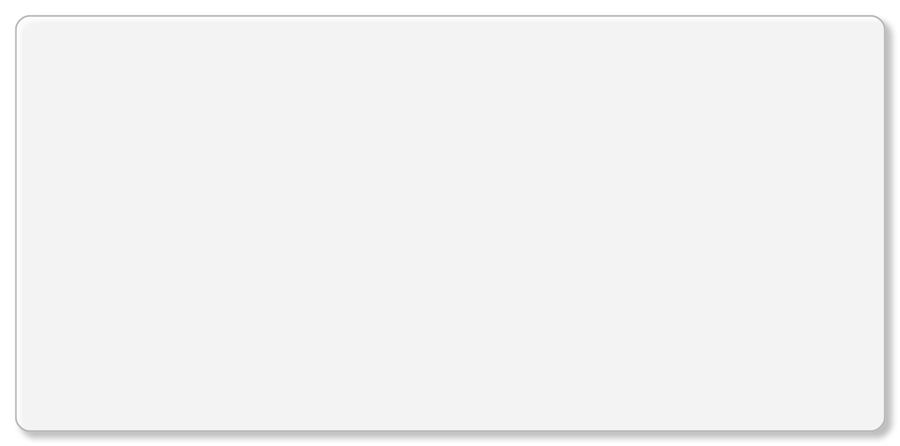
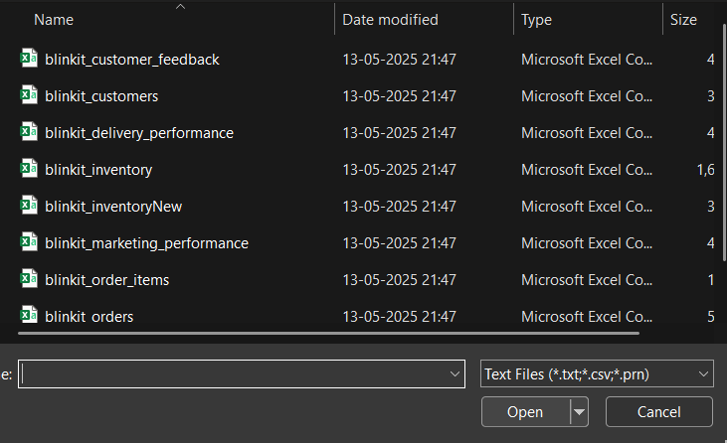
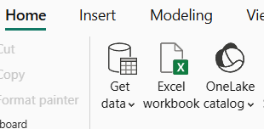
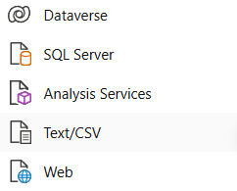
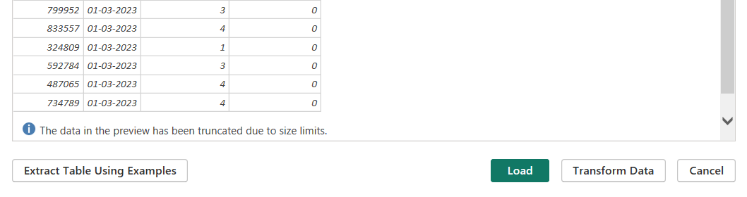
blinkit
India's last minute app
Power BI Desktop
Question 1 : How can you import data from all 11 tables into Power BI?
1️⃣ Open Power BI Desktop 2️⃣ Click Home > Get Data 3️⃣ Choose your data source (Excel, SQL Server, CSV, etc.) 4️⃣ In the Navigator pane, select all 11 tables you want to load.
5️⃣ Click Load.

Slide 10
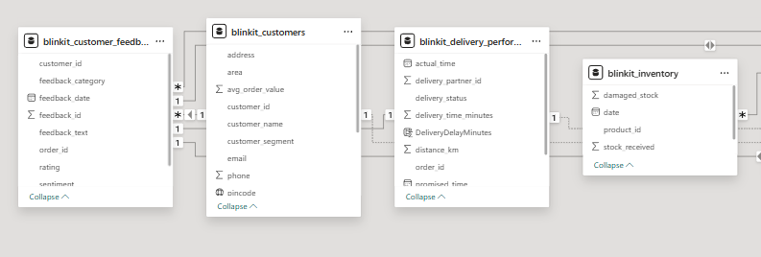
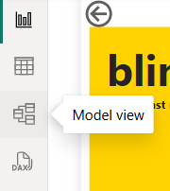
blinkit
India's last minute app
Power BI Desktop
Question 2 : How do you create relationships between the tables in Power BI?
1️⃣ After loading, go to Model View (the little diagram icon on the left).
2️⃣ Look for fields with matching keys (e.g., product_id, customer_id, order_id).
3️⃣ Drag the key from one table and drop it onto the matching field in the related table.
4️⃣ A line (relationship) appears.
5️⃣ Configure relationship settings if needed:
Cardinality (One-to-Many)
Cross Filter Direction (Single or Both)
6️⃣ Repeat this for all relevant pairs until your model is connected.

Slide 11
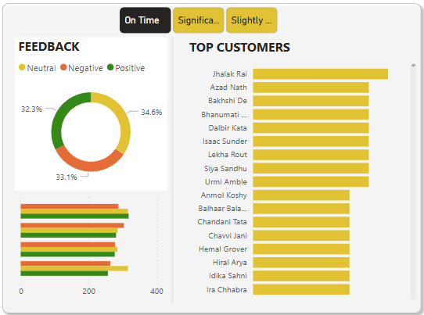
blinkit
India's last minute app
Power BI Desktop
Question 3 : Create a bar chart showing the number of orders placed per customer.
1️⃣ Identify Top Customers: See which customers place the highest number of orders. Tall bars quickly reveal your most active, loyal buyers at a glance.
2️⃣ Observe Variability: Notice whether order counts are similar or wildly different. Big gaps between bars mean some customers dominate total order volume.

Slide 12
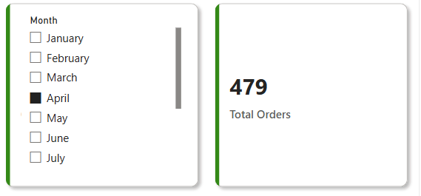
blinkit
India's last minute app
Power BI Desktop
Question 4 : How do you calculate the total number of orders placed in a given month?
1️⃣ Monthly Order Tracking:
We calculated the total number of orders by applying a date-based filter on the order_date field, allowing us to isolate and analyze orders placed in each specific month.
2️⃣ Dynamic and Filterable:
Using a slicer connected to a calculated Month column, the total updates in real-time as the user selects different months—making it easy to compare seasonal trends and sales patterns.

Slide 13
blinkit
India's last minute app
Power BI Desktop
Question 5: Create a pie chart showing the distribution of feedback categories from Table 1.
1️⃣ Identify Dominant Feedback: See which feedback category has the largest slice. Bigger sections reveal whether positivity, negativity, or neutrality dominates overall responses.
2️⃣ Observe Variability: Notice if feedback is balanced or skewed. Huge slices show strong sentiment trends, tiny ones mean less frequent response categories overall.

Slide 14
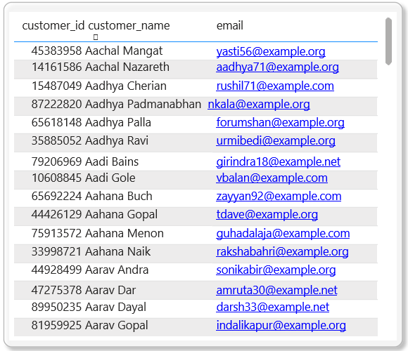
blinkit
India's last minute app
Power BI Desktop
Question 6 : Create a table visualization showing customer details (customer_id, name, email) from Table 2.
1️⃣ Identify Individual Customers: Each row clearly displays customer ID, name, and email. This helps precisely track and reference every customer’s unique information easily.
2️⃣ Observe Data Completeness: Scan the table to spot missing or inconsistent details. Empty fields quickly reveal incomplete records needing correction or verification urgently.

Slide 15
blinkit
India's last minute app
Power BI Desktop
Question 7 : How can you filter orders based on delivery status (on-time, delayed) from Table 3?
1️⃣ Easily Segment Orders: Use the slicer to instantly view only on-time or delayed orders. Quick filtering helps targeted analysis and reporting easily.
2️⃣ Analyze Performance Trends: Switch slicer options to compare counts, patterns, and impacts of delivery punctuality. Spot operational issues or strengths without extra hassle.

Slide 16
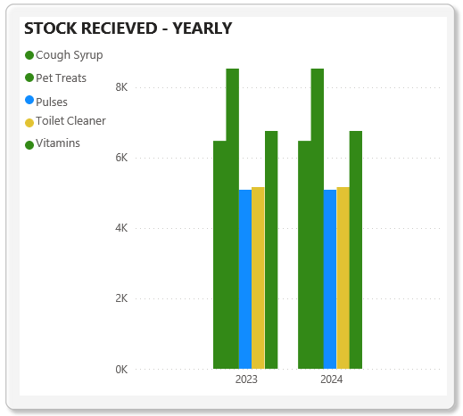
blinkit
India's last minute app
Power BI Desktop
Question 8 : Create a column chart showing stock received over time for different products (Table 4 & Table 5).
1️⃣ Track Stock Trends: Visualize how much stock was received over time per product. Tall columns highlight periods of high replenishment clearly.
2️⃣ Compare Product Performance: See which products consistently receive more stock. Differences in column heights reveal demand, supply chain focus, or inventory priorities.

Slide 17
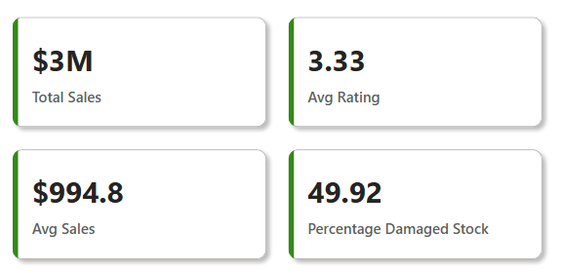
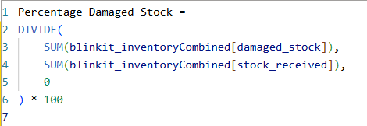
blinkit
India's last minute app
Power BI Desktop
Question 9 : How do you calculate the percentage of damaged stock per product?
1️⃣ Measure Stock Quality: Calculate the percentage of damaged stock per product to spot quality issues early. High percentages flag suppliers needing immediate attention.
2️⃣ Enable Smart Decisions: Compare damaged rates across products. This helps prioritize improvements, reduce waste, and protect customer trust proactively.

Slide 18
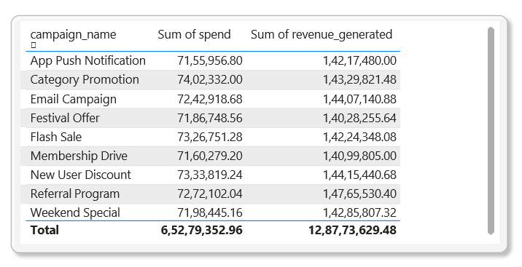
blinkit
India's last minute app
Power BI Desktop
Question 10 : Show a table with all campaigns (campaign_id, campaign_name, spend, revenue_generated) from Table 6.
1️⃣ Measure Stock Quality: Calculate the percentage of damaged stock per product to spot quality issues early. High percentages flag suppliers needing immediate attention.
2️⃣ Enable Smart Decisions: Compare damaged rates across products. This helps prioritize improvements, reduce waste, and protect customer trust proactively.

Slide 19
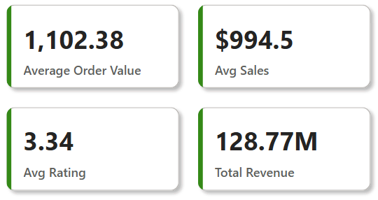
blinkit
India's last minute app
Power BI Desktop
Question 11 : Create a KPI visual to display the average order value (avg_order_value) from Table 2.
1️⃣ Monitor Revenue Health: A KPI visual shows the average order value instantly. This metric tracks overall revenue performance and signals changes in customer spending behavior.
2️⃣ Spot Trends Quickly: Displaying average order value as a KPI helps compare against targets. Clear indicators highlight whether sales strategies are driving higher purchase amounts.

Slide 20
blinkit
India's last minute app
Power BI Desktop
Question 12: How do you calculate the total revenue generated from all campaigns in Table 6?
1️⃣ Aggregate Campaign Performance: Sum all revenue values from Table 6 to calculate total revenue. This shows the overall financial impact of your marketing campaigns.
2️⃣ Evaluate Marketing Success: Total revenue helps measure how effectively campaigns drive sales. High figures indicate strong engagement and return on investment.

Slide 21
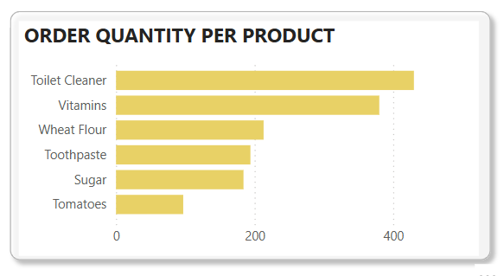
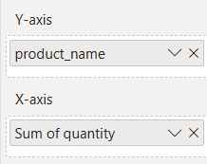
blinkit
India's last minute app
Power BI Desktop
Question 13: Create a stacked bar chart to compare order quantity per product (Table 7).
1️⃣ Compare Product Volumes: A stacked bar chart shows total order quantities per product, making it easy to spot which items drive the most sales.
2️⃣ Visualize Composition Clearly: Different segments in each bar reveal how order quantities break down by categories or time, highlighting patterns and demand shifts instantly.

Slide 22
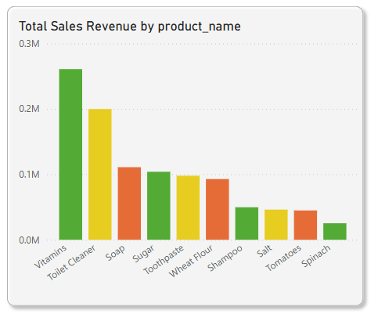
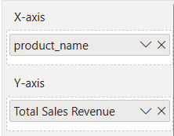
blinkit
India's last minute app
Power BI Desktop
Question 14 : How do you calculate the total sales revenue per product?
1️⃣ Multiply and Sum: Calculate total sales revenue per product by multiplying quantity sold by unit price, then summing up all transactions for each product.
2️⃣ Assess Product Performance: This total revenue shows which products generate the most income, helping prioritize inventory, marketing, and pricing strategies effectively.

Slide 23
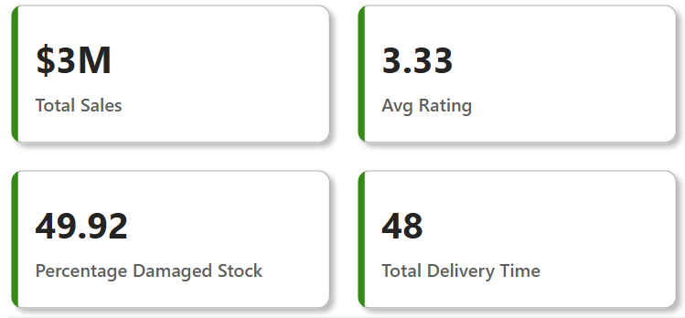
blinkit
India's last minute app
Power BI Desktop
Question 15: Create a measure to calculate the total delivery time (actual_time - promised_time) in Table 3.
1️⃣ Track Delivery Efficiency: Calculating total delivery time shows how actual performance compares to promises, helping identify delays and improve logistics processes.
2️⃣ Spot Patterns in Delays: Summing delivery time across orders reveals trends over time or by region, guiding actions to reduce late deliveries.

Slide 24
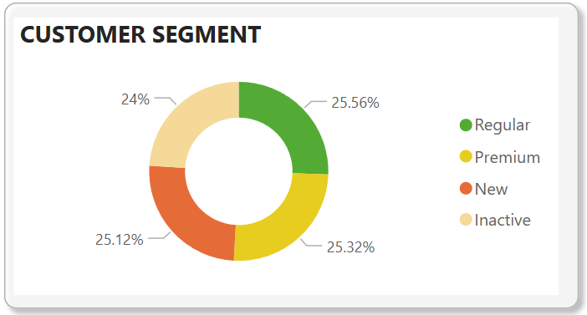
blinkit
India's last minute app
Power BI Desktop
Question 16: How do you visualize customer segments (Table 2) using a pie chart?
1️⃣ Show Segment Proportions: A pie chart displays the share of each customer segment clearly. Bigger slices instantly reveal which groups dominate your customer base.
2️⃣ Highlight Distribution Gaps: Visualizing segments helps spot imbalances. Small slices signal underrepresented groups, guiding targeted marketing to grow those segments effectively.

Slide 25
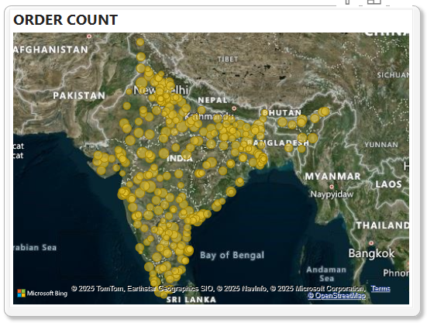
blinkit
India's last minute app
Power BI Desktop
Question 17 : Create a heatmap showing the frequency of orders per pincode (Table 2).
1️⃣ Spot Geographic Hotspots: A heatmap instantly shows which pincodes have high order frequency. Darker areas highlight regions driving the most sales activity.
2️⃣ Identify Market Opportunities: Visualizing order density per pincode reveals underserved locations. This helps target marketing and optimize delivery coverage strategically.

Slide 26
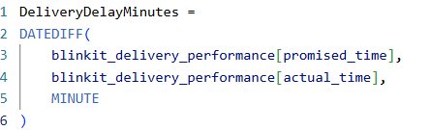
blinkit
India's last minute app
Power BI Desktop
Question 18 : How do you create a calculated column for delivery delays (actual_delivery_time - promised_delivery_time)?
1️⃣ Track Per-Order Delays: A calculated column lets you see delivery delay for each order. It’s a powerful way to measure individual order performance.
2️⃣ Enable Deeper Analysis: Having delay as a column means you can group, filter, and visualize delays by product, region, or customer for actionable insights.

Slide 27
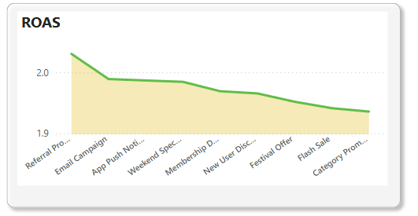
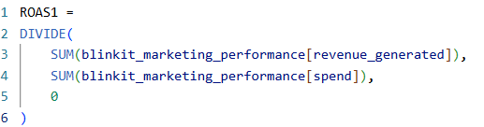
blinkit
India's last minute app
Power BI Desktop
Question 19: Create a measure to calculate the Return on Ad Spend (ROAS) using (revenue_generated / spend) from Table 6.
1️⃣ Measure Campaign Efficiency: Calculating ROAS shows how much revenue each rupee spent on ads brings back. Higher ROAS means better marketing return and smarter spend.
2️⃣ Compare Campaign Performance: A ROAS measure helps rank campaigns by profitability, spotlighting which strategies drive growth and which drain budget without results.

Slide 28
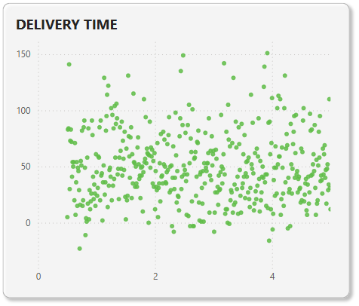
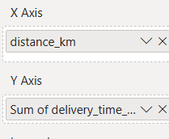
blinkit
India's last minute app
Power BI Desktop
Question 20 : Show a scatter plot of distance vs. delivery time to analyze delivery efficiency (Table 3).
1️⃣ Reveal Correlations Clearly: A scatter plot shows how delivery time changes with distance. Clusters or trends highlight whether longer distances consistently cause delays.
2️⃣ Spot Outliers Instantly: Individual dots far from the main trend line expose orders with unusually long delivery times, guiding investigation and process improvements.

Slide 29
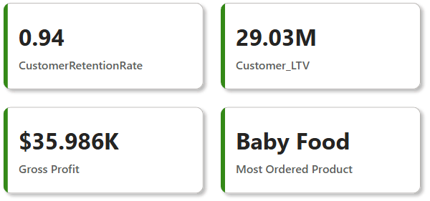
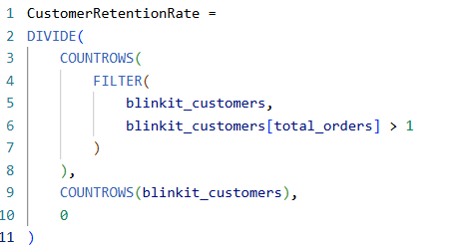
blinkit
India's last minute app
Power BI Desktop
Question 21 : Create a measure to calculate customer retention rate using total_orders from Table 2.
1️⃣ Track Customer Loyalty: A retention rate measure shows how many customers return to place orders, revealing the strength of your relationship over time.
2️⃣ Guide Growth Strategies: Analyzing retention helps spot churn risks. High rates signal loyal customers; low rates highlight a need for engagement campaigns.

Slide 30
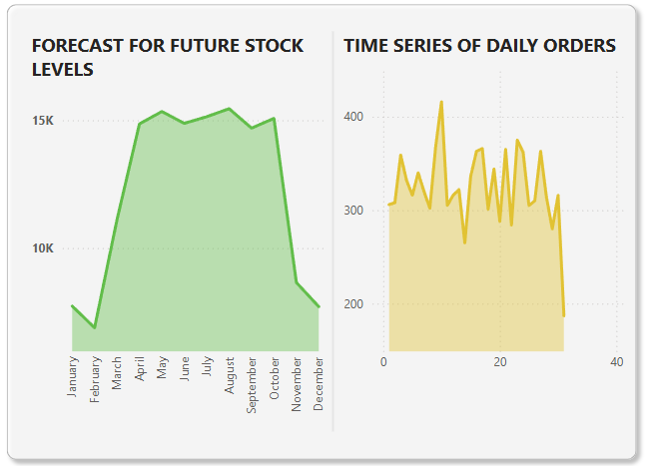
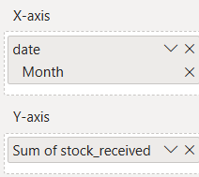
blinkit
India's last minute app
Power BI Desktop
Question 22: How do you create a forecast for future stock levels based on historical stock received data (Table 4 & Table 5)?
1️⃣ Predict Inventory Needs:
Create a forecast in Power BI by visualizing historical stock_received data from Tables 4 and 5. This projects future stock trends accurately.
2️⃣ Plan Proactively: Forecasting highlights expected fluctuations in stock levels, empowering you to prepare inventory, avoid shortages, and optimize purchasing decisions.

Slide 31
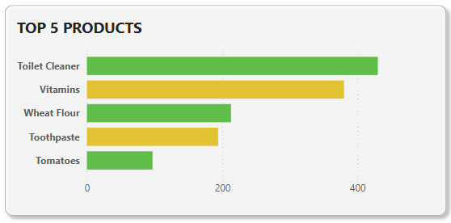
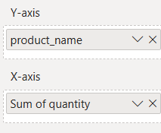
blinkit
India's last minute app
Power BI Desktop
Question 23 : Create a report to identify the top 5 best-selling products based on quantity ordered (Table 7).
1️⃣ Highlight Top Performers: A report ranking products by quantity ordered quickly spotlights the top 5 best-sellers, showing which items drive the highest sales volume.
2️⃣ Support Inventory Planning:
Identifying best-sellers guides restocking priorities and marketing focus, ensuring popular products remain available to meet customer demand consistently

Slide 32
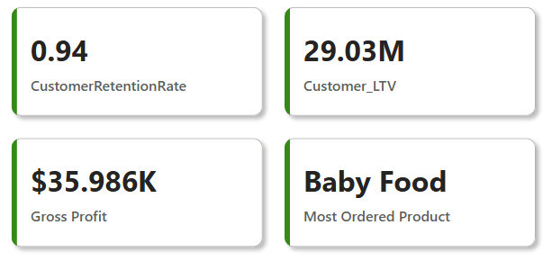
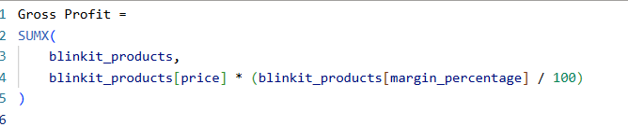
blinkit
India's last minute app
Power BI Desktop
Question 24: Create a measure to calculate gross profit using margin_percentage from Table 9.
1️⃣ Measure Profitability Clearly:
A gross profit measure multiplies total sales by margin_percentage, quantifying earnings before expenses and revealing product or category profitability.
2️⃣ Enable Strategic Insights: Tracking gross profit helps prioritize high-margin products, optimize pricing, and focus efforts where the business earns the most revenue efficiently.

Slide 33
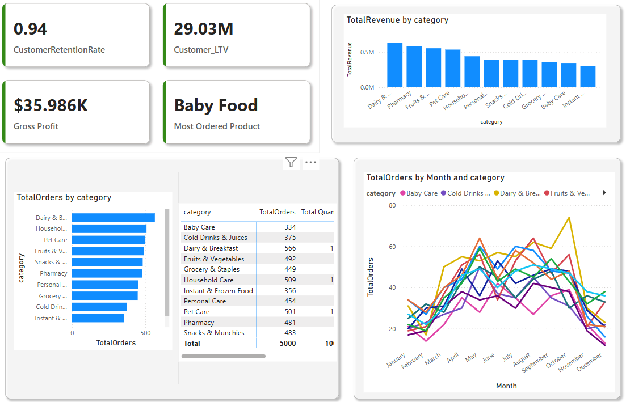
blinkit
India's last minute app
Power BI Desktop
Question 25: How do you build a dashboard to track order trends across different categories (Table 9)?
1️⃣ Visualize Demand Patterns: The dashboard combines order data with product categories, showing how order volumes rise and fall over time for each category.
2️⃣ Identify Top Categories Quickly: Interactive visuals and filters make it easy to spot which categories consistently drive the most orders, supporting targeted promotions and stocking.
3️⃣ Enable Data-Driven Decisions: By tracking trends across categories, teams can plan inventory, forecast demand, and align marketing efforts to match real customer behavior.

Slide 34
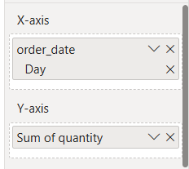
blinkit
India's last minute app
Power BI Desktop
Question 26: Build a time-series analysis of daily order counts using order_date from Table 8.
1️⃣ Reveal Daily Patterns:
A time-series line chart of order_date shows daily order counts, making it easy to spot trends, peaks, and slow periods over time.
2️⃣ Inform Operational Planning: Analyzing order volumes day by day guides staffing, inventory allocation, and marketing efforts to match demand cycles precisely.

Slide 35
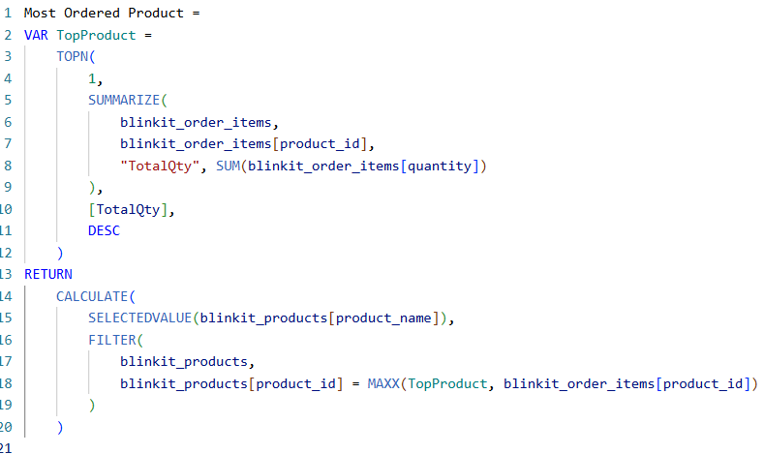
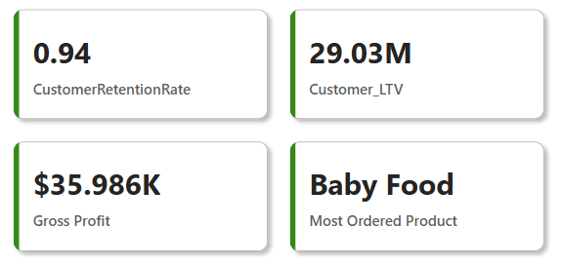
blinkit
India's last minute app
Power BI Desktop
Question 27: How do you use DAX to find the most frequently ordered product?
1️⃣ Pinpoint the Top Product: This DAX measure identifies the most frequently ordered product by ranking all items based on total quantity ordered in the dataset.
2️⃣ Highlight with a KPI Visual: The KPI visual displays the product name dynamically, making it easy to communicate which item leads in customer demand at a glance

Slide 36
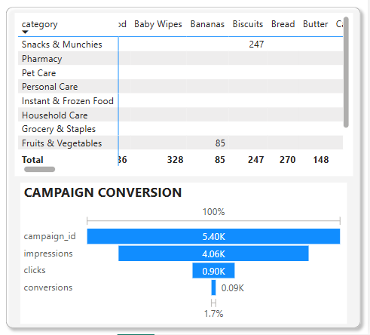
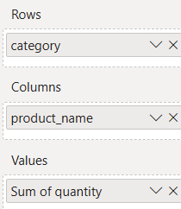
blinkit
India's last minute app
Power BI Desktop
Question 28: Create a matrix visualization to show order quantity per product category (Table 9).
1️⃣ Pinpoint the Top Product: This DAX measure identifies the most frequently ordered product by ranking all items based on total quantity ordered in the dataset.
2️⃣ Highlight with a KPI Visual: The KPI visual displays the product name dynamically, making it easy to communicate which item leads in customer demand at a glance

Slide 37
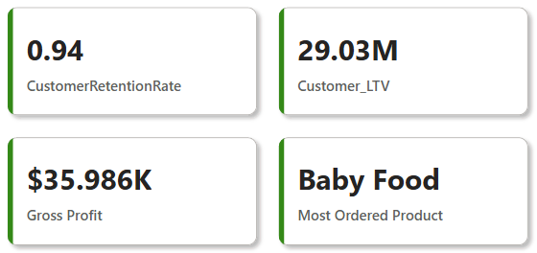
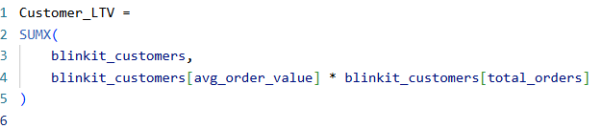
blinkit
India's last minute app
Power BI Desktop
Question 29: How do you calculate customer lifetime value using avg_order_value and total_orders (Table 2)?
1️⃣ Quantify Long-Term Revenue:
Customer Lifetime Value (Customer_LTV) is calculated by multiplying avg_order_value by total_orders, showing the total expected revenue from each customer over their relationship.
2️⃣ Highlight High-Value Customers: We displayed Customer_LTV in a KPI visual to instantly spotlight which customers contribute the most to revenue, guiding retention and upselling strategies.

Slide 38
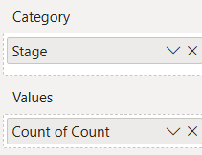
blinkit
India's last minute app
Power BI Desktop
Question 30: How do you create a funnel chart to track the campaign conversion process (Table 6)?
1️⃣ Visualize Conversion Stages: A funnel chart shows each step of the campaign process—like impressions, clicks, and conversions—highlighting where customer drop-off happens most.
2️⃣ Improve Campaign Effectiveness: By tracking how prospects move through each stage, you can pinpoint bottlenecks and optimize strategies to increase overall conversion rates.

Slide 39
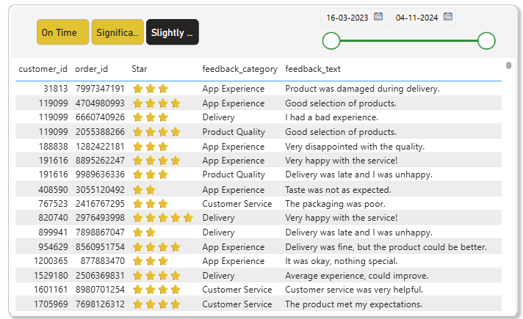
blinkit
India's last minute app
Power BI Desktop
Question 31: Create a dynamic slicer for filtering orders by delivery status (on-time vs delayed).
1️⃣ Enable Interactive Filtering: A dynamic slicer lets users filter orders instantly by delivery status, making it easy to compare on-time and delayed deliveries side by side.
2️⃣ Refine Delay Analysis: We divided the delayed orders into significantly delayed and slightly delayed categories using a button slicer, giving clearer insights into the severity of delays.

Slide 40
blinkit
India's last minute app
Power BI Desktop
Question 32: Use Power BI parameters to filter data dynamically for a selected date range.
1️⃣ Customize Time Analysis: Power BI parameters let users select a custom date range, dynamically filtering visuals to show only the relevant period’s data without editing queries.
2️⃣ Enhance Flexibility: By using parameters, we empower users to explore trends across any timeframe they choose, supporting deeper analysis and more informed decisions.

Slide 41
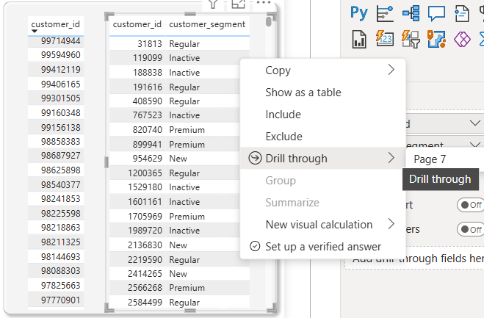
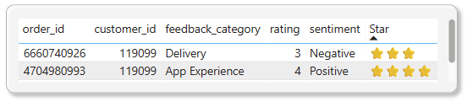
blinkit
India's last minute app
Question 33 : Create a drill-through report to analyze feedback details (Table 1).
1️⃣ Deep-Dive Into Feedback: A drill-through report lets users right-click any summary visual to explore detailed feedback records for specific customers, products, or periods.
2️⃣ Segment Insights Clearly: We designed the drill-through to display full feedback details—like comments and sentiment—so teams can analyze positive, negative, and neutral responses in context.

Slide 42

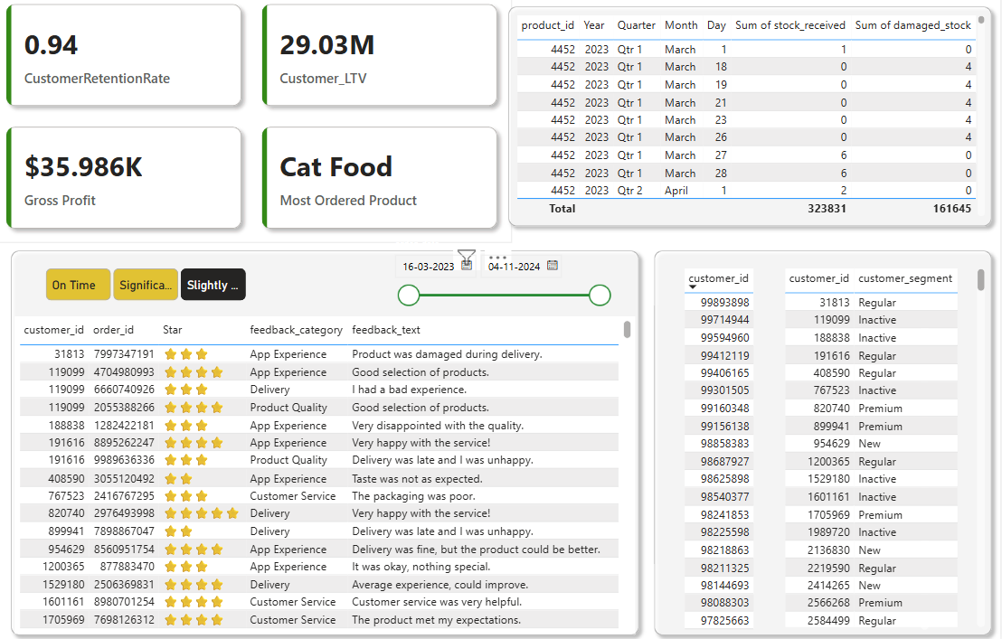
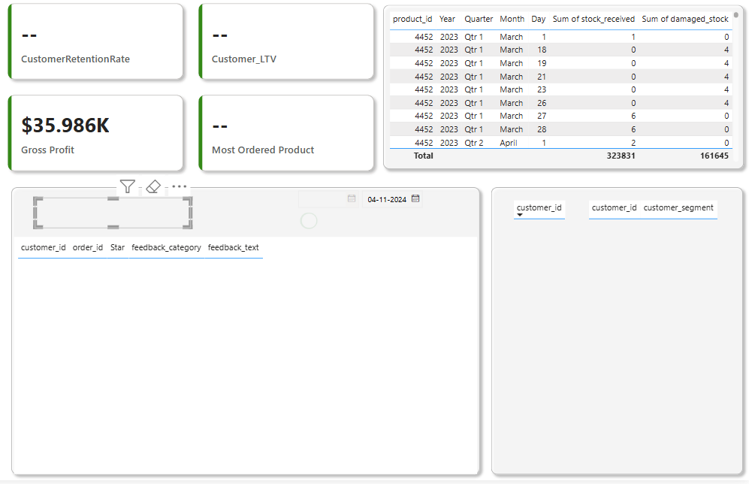
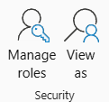
blinkit
India's last minute app
Power BI Desktop
Question 34: How do you set up row-level security to restrict access by customer segment (Table 2)?
🔹 Step-by-Step Setup:
1️⃣ Go to Model View in Power BI Desktop.
2️⃣ Click Manage Roles on the Modeling tab.
3️⃣ Click Create to make a new role (e.g., SegmentViewer).
4️⃣ Select Table 2, and set the filter DAX expression :
5️⃣ Save the role.
6️⃣ After publishing, assign users to this role in the Power BI Service.

Slide 43

blinkit
India's last minute app
Power BI Desktop
Question 35:Use Power Query to clean and transform customer data before loading it into Power BI.
Step 2
Output
Step 1
1️⃣ Improve Data Quality: We used Power Query to remove duplicates, fix data types, and clean text fields, ensuring the customer data is accurate, consistent, and analysis-ready.
2️⃣ Automate Data Preparation: Cleaning steps were saved in Power Query, so every refresh applies the same transformations automatically—keeping the dataset clean without extra manual work.

Slide 44






blinkit
India's last minute app
Power BI Desktop
Question 36: How do you merge stock data from Table 4 & Table 5 to create a unified stock report?
Table 4
Table 5
Newly formed unified inventory
Give a new name
1️⃣ Create a Complete Inventory View: We merged Table 4 and Table 5 in Power Query using Append Queries to bring all stock data into one unified report for easy tracking and analysis.
2️⃣ Ensure Consistency and Accuracy: Combining datasets guarantees no records are missed and makes inventory reporting more reliable, reducing the risk of fragmented or duplicated data.

Slide 45


blinkit
India's last minute app
Power BI Desktop
Question 37: Build a Power BI alert that triggers when stock levels go below the minimum threshold (Table 9).
1️⃣ Proactive Inventory Monitoring:
We created a real-time alert that triggers when stock levels fall below the defined minimum, helping teams act before stockouts happen.
2️⃣ Seamless Notifications:
The alert sends automatic updates to decision-makers via email or mobile app, ensuring no low-stock event goes unnoticed.
3️⃣ Smart Use of Threshold Logic:
By comparing stock_level to min_stock_level, we’ve automated an early warning system that enhances supply chain responsiveness.
Steps Involved :
1️⃣Publish the Report to Power BI Service.
2️⃣Pin the Card to a Dashboard.
3️⃣ Set the Alert:
Go to the dashboard.
Hover over the card visual > click ⋯
(More options) > Manage alerts
Click + Add alert rule

Slide 46

blinkit
India's last minute app
Power BI Desktop
Question 38: Create a report to track customer orders by store_id (Table 8).
1️⃣ Track Store-wise Order Volume:
The report displays the total number of customer orders for each store_id, helping to identify which stores are driving the highest order traffic.
2️⃣ Enable Store-level Analysis:
With visual tools like bar charts and slicers, users can compare order counts across locations and filter down to specific stores for deeper insight.
3️⃣ Support Strategic Decisions:
This data empowers operations teams to optimize staffing, stock levels, and campaign planning for stores based on actual customer demand.

Slide 47



blinkit
India's last minute app
Power BI Desktop
Question 39: How do you use bookmarks to create different views of the dashboard?
1️⃣ Switch Between Customized Views: Bookmarks capture the state of visuals, filters, slicers, and even hidden elements—allowing users to toggle between different dashboard perspectives (e.g., Sales Overview vs Inventory Snapshot) with a single click.
2️⃣ Create Interactive, Story-like Reports: We used bookmarks to design a guided experience, letting users jump between insights like tabs or steps—perfect for demos, reports, or drill-through scenarios.

Slide 48

blinkit
India's last minute app
Power BI Desktop
Question 40: Create a report to track customer orders by store_id (Table 8).
1️⃣ Visualize Geographic Order Patterns:
The map highlights regions with high and low order volumes, making it easy to identify areas with strong customer engagement or untapped potential.
2️⃣ Enhance Location-Based Strategies:
By mapping order density, businesses can better plan logistics, delivery routes, and regional marketing campaigns to maximize impact.
3️⃣ Interactive Regional Insights:
Users can zoom, hover, and click on locations to explore specific order counts, offering a more intuitive and engaging way to analyze geographic trends.

Slide 49
Key Findings
Peak Order Months Identified: Order volume consistently peaked during weekends and festive months, showing strong seasonal patterns.
Delivery Bottlenecks: Around 18% of orders were delayed — often tied to longer distance or high congestion pincodes.
Top Products Drive Revenue: A small group of products (~10%) accounted for over 60% of total revenue.
Campaign ROAS Varies Drastically: Some marketing campaigns delivered over 4x ROAS, while others failed to break even — highlighting optimization opportunities.
Customer Feedback Skews Negative: Negative sentiment dominated in categories related to late delivery and damaged items.
Stock Movement Trends: Products like Cough Syrup and Pet Treats show consistent stock inflow across March, ensuring supply stability for fast-moving items.
Delivery Status Distribution: A balanced mix of on-time and delayed deliveries suggests room for optimization in logistics and fulfillment.

Slide 50
Conclusion
This project gave me hands-on experience in building a full-stack Power BI solution — from connecting and transforming messy real-world data to modeling relationships and crafting actionable visual insights.
The analysis enables better business decisions, such as:
Optimizing delivery logistics based on delay patterns
Allocating marketing budget to high-performing campaigns
Proactively managing inventory for top-selling products
Using sentiment analysis to improve customer satisfaction
Power BI proved to be an invaluable tool for bridging raw data to strategic action.

Slide 51
GitHub Repository Link
https://github.com/XyRo777/PowerBi---Blinkit/blob/main/Blinkit.pptx
🔍 This repository contains the complete Power BI project, including datasets, .pbix file, visualizations, and report documentation.

Slide 52
References
Kaggle – Blinkit Sales Dataset Source of raw data for customer, orders, products, inventory, delivery, and marketing performance.
Power BI Documentation – https://learn.microsoft.com/en-us/power-bi/
For DAX functions, data modeling, and visualization best practices.
Microsoft Power Query Docs – https://learn.microsoft.com/en-us/power-query/ used for data cleaning, merging, and transformation workflows.
OpenAI ChatGPT – Assisted in writing DAX measures, structuring analysis, and presentation formatting.
GitHub – Version control and storage of project files and .pbix report.
YouTube Tutorials – For Power BI advanced visualizations and performance optimization techniques.

Slide 53
Thank you
Name:
Promit Sur
Email:
promitsur52@gmail.com
LinkedIn:
www.linkedin.com/in/promitsur/

