Slide 1
Boolean Map based Saliency

Slide 2
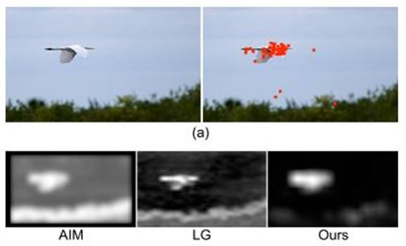

Slide 3

Eye fixation
Salient object detection

Slide 4

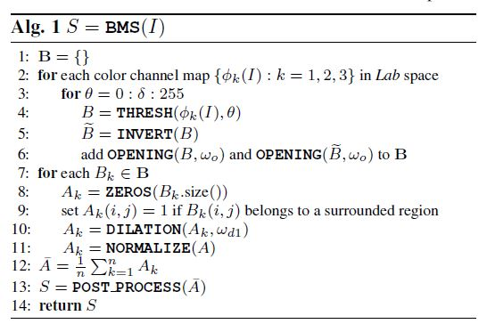



I (Resize w = 600)
B
A(B)
$$\overline{A}$$

Slide 5


Slide 6


Slide 7
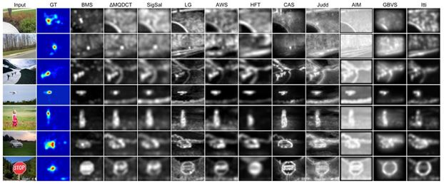


Slide 8
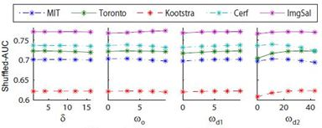

Slide 9
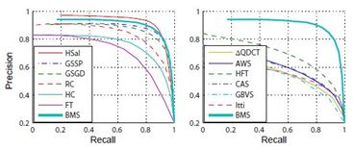

Slide 10
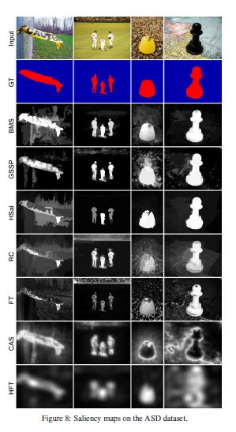
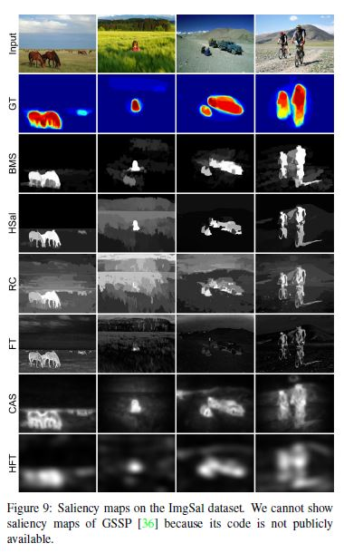

Slide 11
Saliency-based Visual Attention

Slide 12
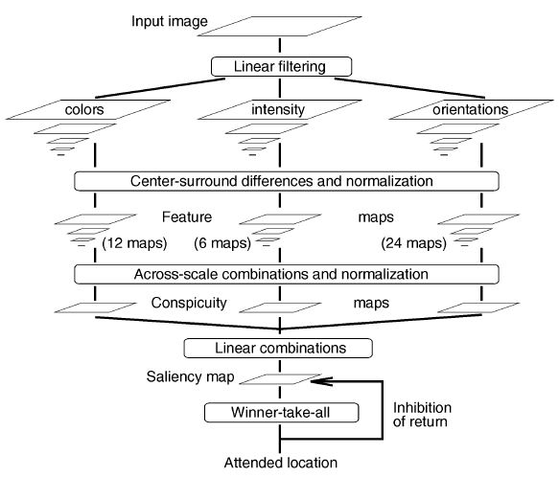

Slide 15


Slide 16


Slide 17


Slide 19
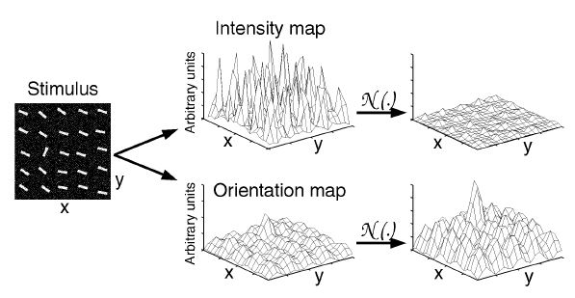

Slide 20




Slide 21


Slide 22
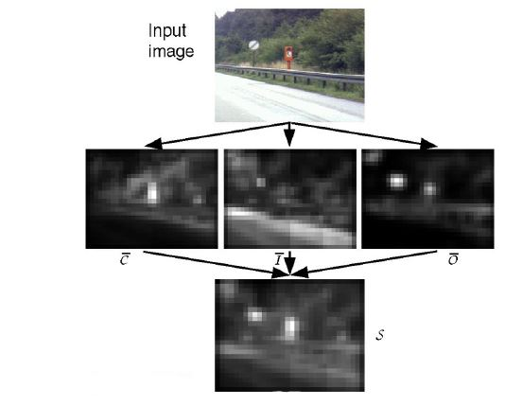

Slide 24
