Slide 1
Data Mining: Concepts and Techniques — Chapter 2 —
Jiawei Han
Department of Computer Science
University of Illinois at Urbana-Champaign
www.cs.uiuc.edu/~hanj
©2006 Jiawei Han and Micheline Kamber, All rights reserved

Slide 2
Chapter 2: Data Preprocessing
Why preprocess the data?
Descriptive data summarization
Data cleaning
Data integration and transformation
Data reduction
Discretization and concept hierarchy generation
Summary

Slide 3
Why Data Preprocessing?
Data in the real world is dirty
incomplete: lacking attribute values, lacking certain attributes of interest, or containing only aggregate data
e.g., occupation=“ ”
noisy: containing errors or outliers
e.g., Salary=“-10”
inconsistent: containing discrepancies in codes or names
e.g., Age=“42” Birthday=“03/07/1997”
e.g., Was rating “1,2,3”, now rating “A, B, C”
e.g., discrepancy between duplicate records

Slide 4
Why Is Data Dirty?
Incomplete data may come from
“Not applicable” data value when collected
Different considerations between the time when the data was collected and when it is analyzed.
Human/hardware/software problems
Noisy data (incorrect values) may come from
Faulty data collection instruments
Human or computer error at data entry
Errors in data transmission
Inconsistent data may come from
Different data sources
Functional dependency violation (e.g., modify some linked data)
Duplicate records also need data cleaning

Slide 5
Why Is Data Preprocessing Important?
No quality data, no quality mining results!
Quality decisions must be based on quality data
e.g., duplicate or missing data may cause incorrect or even misleading statistics.
Data warehouse needs consistent integration of quality data
Data extraction, cleaning, and transformation comprises the majority of the work of building a data warehouse

Slide 6
Multi-Dimensional Measure of Data Quality
A well-accepted multidimensional view:
Accuracy
Completeness
Consistency
Timeliness
Believability
Value added
Interpretability
Accessibility
Broad categories:
Intrinsic, contextual, representational, and accessibility

Slide 7
Major Tasks in Data Preprocessing
Data cleaning
Fill in missing values, smooth noisy data, identify or remove outliers, and resolve inconsistencies
Data integration
Integration of multiple databases, data cubes, or files
Data transformation
Normalization and aggregation
Data reduction
Obtains reduced representation in volume but produces the same or similar analytical results
Data discretization
Part of data reduction but with particular importance, especially for numerical data

Slide 8
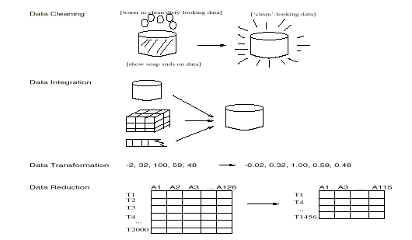
Forms of Data Preprocessing

Slide 9
Chapter 2: Data Preprocessing
Why preprocess the data?
Descriptive data summarization
Data cleaning
Data integration and transformation
Data reduction
Discretization and concept hierarchy generation
Summary

Slide 10
Mining Data Descriptive Characteristics
Motivation
To better understand the data: central tendency, variation and spread
Data dispersion characteristics
median, max, min, quantiles, outliers, variance, etc.
Numerical dimensions correspond to sorted intervals
Data dispersion: analyzed with multiple granularities of precision
Boxplot or quantile analysis on sorted intervals
Dispersion analysis on computed measures
Folding measures into numerical dimensions
Boxplot or quantile analysis on the transformed cube

Slide 11
Measuring the Central Tendency
Mean (algebraic measure) (sample vs. population):
Weighted arithmetic mean:
Trimmed mean: chopping extreme values
Median: A holistic measure
Middle value if odd number of values, or average of the middle two values otherwise
Estimated by interpolation (for grouped data):
Mode
Value that occurs most frequently in the data
Unimodal, bimodal, trimodal
Empirical formula:

Slide 12
ค่าเฉลี่ยกรณีแจกแจงความถี่
ค่าเฉลี่ยเลขคณิต
เมื่อ f คือ ความถี่ (จำนวน)
ชั่วโมง |  | จำนวน
110 | 115 | 3
116 | 121 | 2
122 | 127 | 7
ชั่วโมง |  | จำนวน | จุดกึ่งกลาง | fx
110 | 115 | 3 | 112.5 | 337.5
116 | 121 | 2 | 118.5 | 237
122 | 127 | 7 | 124.5 | 871.5

Slide 13
Finding the median of raw data is easy.
e.g.1 Find the median of
13
34
23
9
7
28
17
31
32
The data must be put in numerical order:
7
9
13
17
23
28
31
32
34
The median is the middle value, which we can see is the 5th value, so,
median = 23
The formula telling us which value we want is , where n is the number of data items.
If n is an even number, we average the 2 middle values.

Slide 14
e.g.2 Find the median of
x | 1 | 2 | 3 | 4 | 5
f | 4 | 7 | 9 | 6 | 2
There are 28 observations so using we need:
We need to average the 14th and 15th numbers.
Accumulating the frequencies:
x
1
2
3
4
5
Cu. f
4
11
20
so, the 14th and 15th observations are both 3.
The median is 3.

Slide 15
With a grouped distribution, we can only estimate the median.
e.g. 3
Length (cm)
1 - 10
11 - 20
21 - 30
31 - 40
41 - 50
Frequency, f
3
4
5
6
3
There are 21 observations so we want to estimate the size of the 11th one. It lies in the 3rd class.

Slide 16
With a grouped distribution, we can only estimate the median.
e.g. 3
Length (cm)
1 - 10
11 - 20
21 - 30
31 - 40
41 - 50
Frequency, f
3
4
5
6
3
There are 21 observations so we want to estimate the size of the 11th one. It lies in the 3rd class.
The first 2 classes have a cumulative frequency of 7,

Slide 17
With a grouped distribution, we can only estimate the median.
e.g. 3
Length (cm)
1 - 10
11 - 20
21 - 30
31 - 40
41 - 50
Frequency, f
3
4
5
6
3
There are 21 observations so we want to estimate the size of the 11th one. It lies in the 3rd class.
The first 2 classes have a cumulative frequency of 7,
so to reach 11, we need 4 more.

Slide 18
With a grouped distribution, we can only estimate the median.
e.g. 3
Length (cm)
1 - 10
11 - 20
21 - 30
31 - 40
41 - 50
Frequency, f
3
4
5
6
3
There are 21 observations so we want to estimate the size of the 11th one. It lies in the 3rd class.
The first 2 classes have a cumulative frequency of 7,
so to reach 11, we need 4 more.
The 3rd class has a frequency of 5 so we need to go part-way along this class.

Slide 19
With a grouped distribution, we can only estimate the median.
e.g. 3
Length (cm)
1 - 10
11 - 20
21 - 30
31 - 40
41 - 50
Frequency, f
3
4
5
6
3
There are 21 observations so we want to estimate the size of the 11th one. It lies in the 3rd class.
The first 2 classes have a cumulative frequency of 7,
so to reach 11, we need 4 more.
The 3rd class has a frequency of 5 so we need to go part-way along this class.

Slide 20
e.g. 3
Length (cm)
1 - 10
11 - 20
21 - 30
31 - 40
41 - 50
Frequency, f
3
4
5
6
3
There are 21 observations so we want to estimate the size of the 11th one. It lies in the 3rd class.
The first 2 classes have a cumulative frequency of 7,
The 3rd class has a frequency of 5 so we need to go part-way along this class.
so to reach 11, we need 4 more.
Coming up with our own method, needing 4 out of the frequency of 5, we would go 4/5th along the class.
The class is 10 wide

Slide 21
e.g. 3
Length (cm)
1 - 10
11 - 20
21 - 30
31 - 40
41 - 50
Frequency, f
3
4
5
6
3
There are 21 observations so we want to estimate the size of the 11th one. It lies in the 3rd class.
The first 2 classes have a cumulative frequency of 7,
so to reach 11, we need 4 more.
The 3rd class has a frequency of 5 so we need to go part-way along this class.
Coming up with our own method, needing 4 out of the frequency of 5, we would go 4/5th along the class.
The class is 10 wide
and 4/5th of 10 is 8.

Slide 22
e.g. 3
Length (cm)
1 - 10
11 - 20
21 - 30
31 - 40
41 - 50
Frequency, f
3
4
5
6
3
There are 21 observations so we want to estimate the size of the 11th one. It lies in the 3rd class.
The first 2 classes have a cumulative frequency of 7,
so to reach 11, we need 4 more.
The 3rd class has a frequency of 5 so we need to go part-way along this class.
Coming up with our own method, needing 4 out of the frequency of 5, we would go 4/5th along the class.
The class is 10 wide
and 4/5th of 10 is 8.
We would go 8 along the class, which starts at 20·5,

Slide 23
20·5
e.g. 3
Length (cm)
1 - 10
11 - 20
21 - 30
31 - 40
41 - 50
Frequency, f
3
4
5
6
3
There are 21 observations so we want to estimate the size of the 11th one. It lies in the 3rd class.
The first 2 classes have a cumulative frequency of 7,
so to reach 11, we need 4 more.
The 3rd class has a frequency of 5 so we need to go part-way along this class.
Coming up with our own method, needing 4 out of the frequency of 5, we would go 4/5th along the class.
The class is 10 wide
and 4/5th of 10 is 8.
We would go 8 along the class, which starts at 20·5,

Slide 24
e.g. 3
Length (cm)
1 - 10
11 - 20
21 - 30
31 - 40
41 - 50
Frequency, f
3
4
5
6
3
There are 21 observations so we want to estimate the size of the 11th one. It lies in the 3rd class.
The first 2 classes have a cumulative frequency of 7,
so to reach 11, we need 4 more.
The 3rd class has a frequency of 5 so we need to go part-way along this class.
Coming up with our own method, needing 4 out of the frequency of 5, we would go 4/5th along the class.
The class is 10 wide
and 4/5th of 10 is 8.
giving 28 ·5.
We would go 8 along the class, which starts at 20·5,
This is a reasonable estimate but not quite the accepted method which is called Linear Interpolation.

Slide 25
e.g. 3
Length (cm)
1 - 10
11 - 20
21 - 30
31 - 40
41 - 50
Frequency, f
3
4
5
6
3
Our reasoning was:
The median is the 11th observation.
There are 7 in class 1 and class 2.
We need to add 4 to reach the median.
We need to assume the data are evenly distributed in the 3rd class and it can be shown that this means the median is found at 3·5 along the class not 4.
You don’t need to know the reason for this but I’ve put an explanation at the end of the presentation.
If you liked our reasoning to get to the estimate, stick to it, but in locating the median use instead of and
you will get the correct answer.

Slide 26
e.g. 3
Length (cm)
1 - 10
11 - 20
21 - 30
31 - 40
41 - 50
Frequency, f
3
4
5
6
3
If you prefer to use a formula to find the estimate of the median, the formula is given by
where,

Slide 27

SUMMARY
To use linear interpolation to find an estimate of the median for a grouped frequency distribution, we
locate the class containing the median using total frequency divided by 2,
use
where,
F is the cumulative frequencies up to the class containing the median,
( think of n/2 – F as the distance along the class to the median ),
f is the frequency of the class containing the median,
w is the width of the class containing the median.
or, use reasoning to save the need to remember the formula.

Slide 28
e.g.1 Estimate the median for the following:.
Height (cm)
1 - 5
6 - 10
11 - 15
16 - 20
Frequency, f
7
10
8
5
n
=
30
Solution:
The median is in the 2nd class.
Method 1: Without the formula,
The 1st class has 7 . . .

Slide 29
e.g.1 Estimate the median for the following:.
Height (cm)
1 - 5
6 - 10
11 - 15
16 - 20
Frequency, f
7
10
8
5
n
=
30
Solution:
The median is in the 2nd class.
Method 1: Without the formula,
The 1st class has 7 . . .
so we need to go 15 – 7 = 8 along the 2nd class.
There are 10 in the 2nd class . . .

Slide 30
e.g.1 Estimate the median for the following:.
Height (cm)
1 - 5
6 - 10
11 - 15
16 - 20
Frequency, f
7
10
8
5
n
=
30
Solution:
The median is in the 2nd class.
Method 1: Without the formula,
The 1st class has 7 . . .
so we need to go 15 – 7 = 8 along the 2nd class.
There are 10 in the 2nd class . . .
so we want 8/10th of the class width:

Slide 31
e.g.1 Estimate the median for the following:.
Height (cm)
1 - 5
6 - 10
11 - 15
16 - 20
Frequency, f
7
10
8
5
n
=
30
Solution:
The median is in the 2nd class.
Method 1: Without the formula,
The 1st class has 7 . . .
so we need to go 15 – 7 = 8 along the 2nd class.
There are 10 in the 2nd class . . .
so we want 8/10th of the class width:
The l.c.b. is 5·5, so the estimate of the median is 9·5.

Slide 32
e.g.1 Estimate the median for the following:.
Height (cm)
1 - 5
6 - 10
11 - 15
16 - 20
Frequency, f
7
10
8
5
n
=
30
Solution:
Method 2: Using the formula,
where,
distance along class:

Slide 33
e.g.1 Estimate the median for the following:.
Height (cm)
1 - 5
6 - 10
11 - 15
16 - 20
Frequency, f
7
10
8
5
n
=
30
Solution:
Method 2: Using the formula,
where,
distance along class:

Slide 34
e.g.1 Estimate the median for the following:.
Height (cm)
1 - 5
6 - 10
11 - 15
16 - 20
Frequency, f
7
10
8
5
n
=
30
Solution:
Method 2: Using the formula,
where,
distance along class:

Slide 35
e.g.1 Estimate the median for the following:.
Height (cm)
1 - 5
6 - 10
11 - 15
16 - 20
Frequency, f
7
10
8
5
n
=
30
Solution:
Method 2: Using the formula,
where,
distance along class:
frequency of class,

Slide 36
e.g.1 Estimate the median for the following:.
Height (cm)
1 - 5
6 - 10
11 - 15
16 - 20
Frequency, f
7
10
8
5
n
=
30
Solution:
Method 2: Using the formula,
where,
distance along class:
frequency of class,

Slide 37
e.g.1 Estimate the median for the following:.
Height (cm)
1 - 5
6 - 10
11 - 15
16 - 20
Frequency, f
7
10
8
5
n
=
30
Solution:
Method 2: Using the formula,
where,
distance along class:
frequency of class,
width of class,

Slide 38
e.g.1 Estimate the median for the following:.
Height (cm)
1 - 5
6 - 10
11 - 15
16 - 20
Frequency, f
7
10
8
5
n
=
30
Solution:
Method 2: Using the formula,
where,
distance along class:
frequency of class,
width of class,

Slide 39

Exercise
Use linear interpolation to estimate the median of the following:
1.
Length(cm)
21 - 30
31 - 35
36 - 40
41 - 50
Frequency, f
5
7
10
6
2.
Age (yrs)
10 - 12
13 - 15
16 - 18
Frequency, f
20
24
16

Slide 40
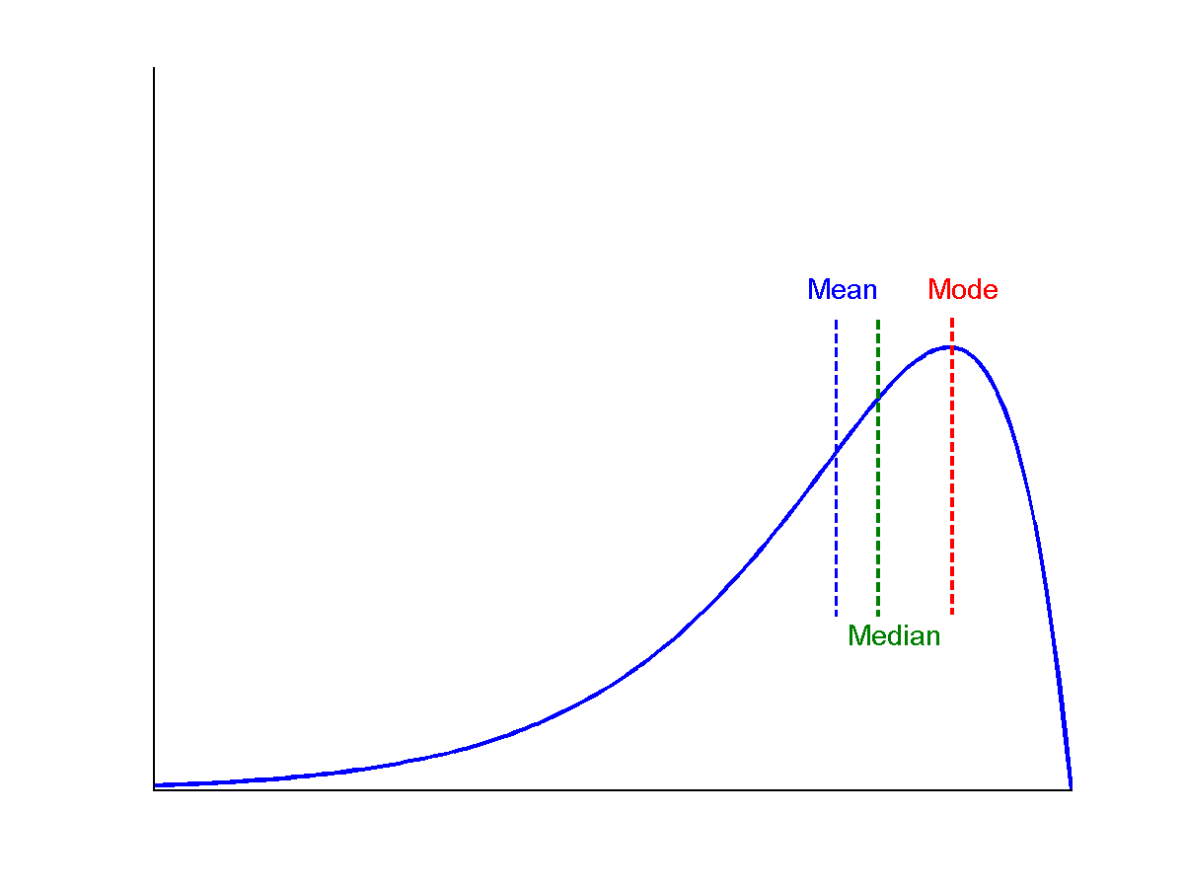
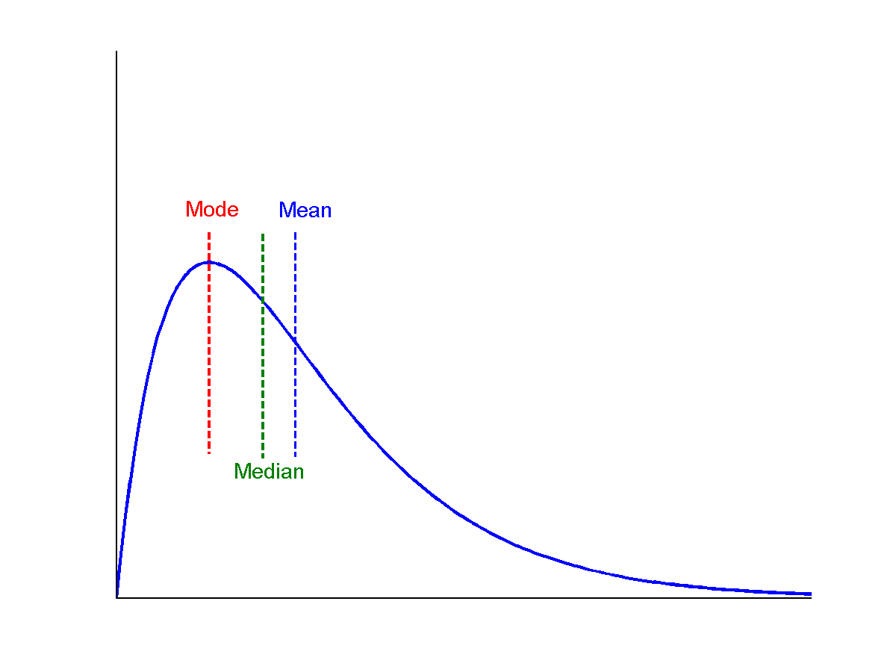
Symmetric vs. Skewed Data
Median, mean and mode of symmetric, positively and negatively skewed data

Slide 41
Measuring the Dispersion of Data
Quartiles, outliers and boxplots
Quartiles: Q₁ (25th percentile), Q₃ (75th percentile)
Inter-quartile range: IQR = Q₃ – Q₁
Five number summary: min, Q₁, M, Q₃, max
Boxplot: ends of the box are the quartiles, median is marked, whiskers, and plot outlier individually
Outlier: usually, a value higher/lower than 1.5 x IQR
Variance and standard deviation (sample: s, population: σ)
Variance: (algebraic, scalable computation)
Standard deviation s (or σ) is the square root of variance s² ⁽or σ²⁾

Slide 42
Properties of Normal Distribution Curve
The normal (distribution) curve
From μ–σ to μ+σ: contains about 68% of the measurements (μ: mean, σ: standard deviation)
From μ–2σ to μ+2σ: contains about 95% of it
From μ–3σ to μ+3σ: contains about 99.7% of it

Slide 43
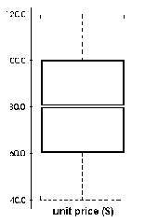
Boxplot Analysis
Five-number summary of a distribution:
Minimum, Q1, M, Q3, Maximum
Boxplot
Data is represented with a box
The ends of the box are at the first and third quartiles, i.e., the height of the box is IRQ
The median is marked by a line within the box
Whiskers: two lines outside the box extend to Minimum and Maximum

Slide 44
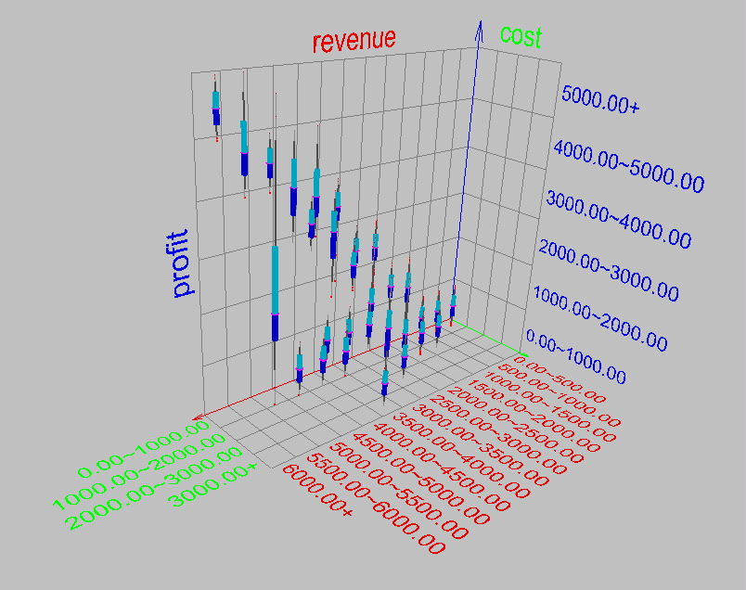
Visualization of Data Dispersion: Boxplot Analysis

Slide 45
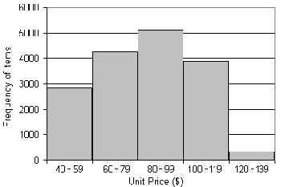
Histogram Analysis
Graph displays of basic statistical class descriptions
Frequency histograms
A univariate graphical method
Consists of a set of rectangles that reflect the counts or frequencies of the classes present in the given data

Slide 46
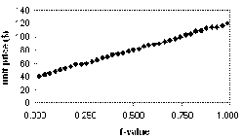
Quantile Plot
Displays all of the data (allowing the user to assess both the overall behavior and unusual occurrences)
Plots quantile information
For a data x_{i} data sorted in increasing order, f_{i} indicates that approximately 100 f_{i}% of the data are below or equal to the value x_{i}

Slide 47
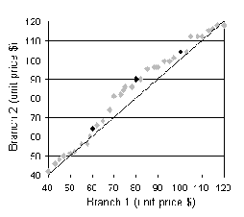
Quantile-Quantile (Q-Q) Plot
Graphs the quantiles of one univariate distribution against the corresponding quantiles of another
Allows the user to view whether there is a shift in going from one distribution to another

Slide 48
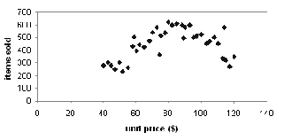
Scatter plot
Provides a first look at bivariate data to see clusters of points, outliers, etc
Each pair of values is treated as a pair of coordinates and plotted as points in the plane

Slide 49
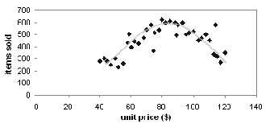
Loess Curve
Adds a smooth curve to a scatter plot in order to provide better perception of the pattern of dependence
Loess curve is fitted by setting two parameters: a smoothing parameter, and the degree of the polynomials that are fitted by the regression

Slide 50
Positively and Negatively Correlated Data

Slide 51
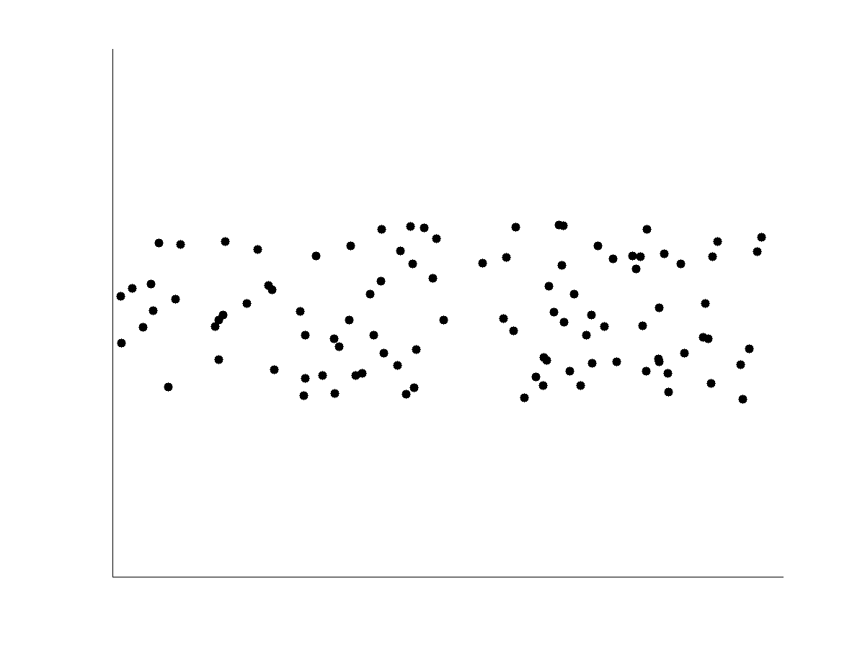
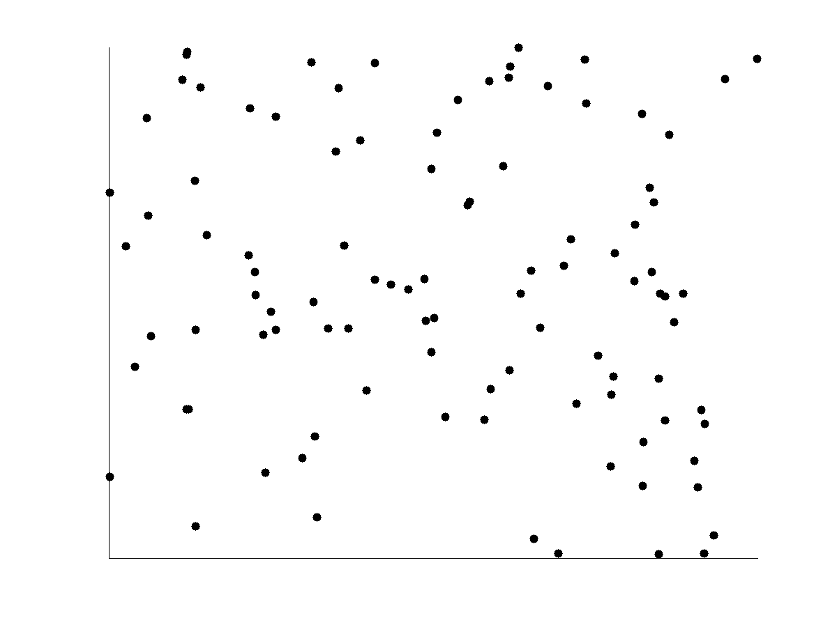
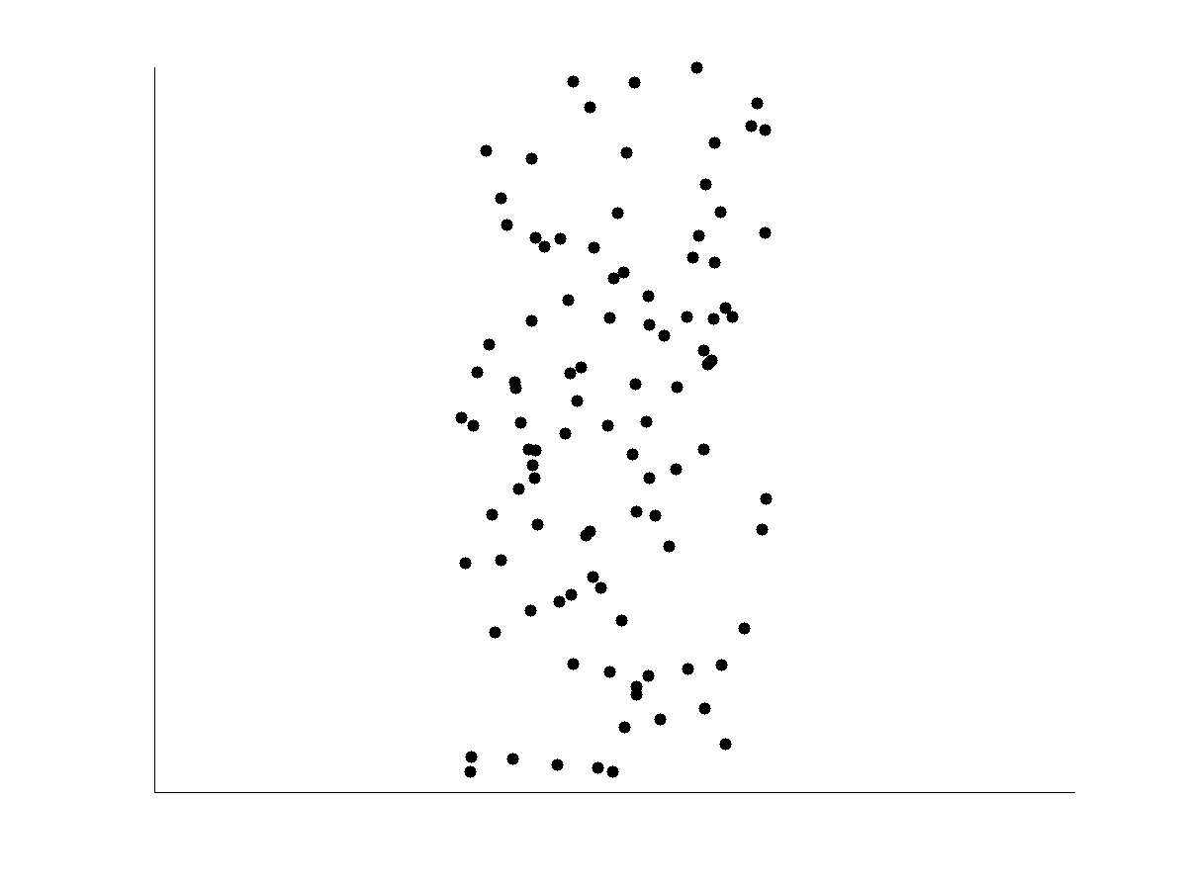
Not Correlated Data

Slide 52
Graphic Displays of Basic Statistical Descriptions
Histogram: (shown before)
Boxplot: (covered before)
Quantile plot: each value x_{i} is paired with f_{i} indicating that approximately 100 f_{i} % of data are ≤ x_{i}
Quantile-quantile (q-q) plot: graphs the quantiles of one univariant distribution against the corresponding quantiles of another
Scatter plot: each pair of values is a pair of coordinates and plotted as points in the plane
Loess (local regression) curve: add a smooth curve to a scatter plot to provide better perception of the pattern of dependence

Slide 53
Chapter 2: Data Preprocessing
Why preprocess the data?
Descriptive data summarization
Data cleaning
Data integration and transformation
Data reduction
Discretization and concept hierarchy generation
Summary

Slide 54
Data Cleaning
Importance
“Data cleaning is one of the three biggest problems in data warehousing”—Ralph Kimball
“Data cleaning is the number one problem in data warehousing”—DCI survey
Data cleaning tasks
Fill in missing values
Identify outliers and smooth out noisy data
Correct inconsistent data
Resolve redundancy caused by data integration

Slide 55
Missing Data
Data is not always available
E.g., many tuples have no recorded value for several attributes, such as customer income in sales data
Missing data may be due to
equipment malfunction
inconsistent with other recorded data and thus deleted
data not entered due to misunderstanding
certain data may not be considered important at the time of entry
not register history or changes of the data
Missing data may need to be inferred.

Slide 56
How to Handle Missing Data?
Ignore the tuple: usually done when class label is missing (assuming the tasks in classification—not effective when the percentage of missing values per attribute varies considerably.
Fill in the missing value manually: tedious + infeasible?
Fill in it automatically with
a global constant : e.g., “unknown”, a new class?!
the attribute mean
the attribute mean for all samples belonging to the same class: smarter
the most probable value: inference-based such as Bayesian formula or decision tree

Slide 57
Noisy Data
Noise: random error or variance in a measured variable
Incorrect attribute values may due to
faulty data collection instruments
data entry problems
data transmission problems
technology limitation
inconsistency in naming convention
Other data problems which requires data cleaning
duplicate records
incomplete data
inconsistent data

Slide 58
How to Handle Noisy Data?
Binning
first sort data and partition into (equal-frequency) bins
then one can smooth by bin means, smooth by bin median, smooth by bin boundaries, etc.
Regression
smooth by fitting the data into regression functions
Clustering
detect and remove outliers
Combined computer and human inspection
detect suspicious values and check by human (e.g., deal with possible outliers)

Slide 59
Simple Discretization Methods: Binning
Equal-width (distance) partitioning
Divides the range into N intervals of equal size: uniform grid
if A and B are the lowest and highest values of the attribute, the width of intervals will be: W = (B –A)/N.
The most straightforward, but outliers may dominate presentation
Skewed data is not handled well
Equal-depth (frequency) partitioning
Divides the range into N intervals, each containing approximately same number of samples
Good data scaling
Managing categorical attributes can be tricky

Slide 60
Binning Methods for Data Smoothing
Sorted data for price (in dollars): 4, 8, 9, 15, 21, 21, 24, 25, 26, 28, 29, 34
* Partition into equal-frequency (equi-depth) bins:
- Bin 1: 4, 8, 9, 15
- Bin 2: 21, 21, 24, 25
- Bin 3: 26, 28, 29, 34
* Smoothing by bin means:
- Bin 1: 9, 9, 9, 9
- Bin 2: 23, 23, 23, 23
- Bin 3: 29, 29, 29, 29
* Smoothing by bin boundaries:
- Bin 1: 4, 4, 4, 15
- Bin 2: 21, 21, 25, 25
- Bin 3: 26, 26, 26, 34

Slide 61
Regression
y
Y1
Y1’
y = x + 1
X1
x

Slide 62
Least Square Method ด้วย Linear Equation
เราต้องการหาสมการเส้น graph ที่ใช้ประมาณข้อมูล (Data Point) ที่ดีที่สุด (Best Fit)
ที่ต่ำที่สุด
เส้น graph ที่มีความสอดคล้องกับข้อมูลมากที่สุดในเชิง Least Square หมายถึงเส้นตรงที่ให้ค่า J ซึ่งเป็นผลรวมของระยะห่างระหว่าง Data Point และ เส้น graph ยกกำลังสองน้อยที่สุด
โดย k เป็นจำนวนข้อมูล

Slide 63
วิธีทำ
สร้างข้อมูลของ Data Points
x | y
0 | 2
5 | 6
10 | 11
แทนค่า(x_{i} ,y_{i}) ลงในสมการ J
k คือ จำนวนข้อมูลที่มี ในที่นี้ k = 3

Slide 64
วิธีทำ
หาค่า m และ b ที่ทำให้ J มีค่าต่ำสุด

Slide 65
วิธีทำ
แก้สมการหาค่า m และ b ที่ทำให้ J มีค่าต่ำสุด
>> A = [250 30; 30 6];
>> B = [280; 38];
>> X = inv(A)*B
X =
0.9000
1.8333
เส้นตรงที่มีความสอดคล้องกับข้อมูลมากที่สุดในเชิง Least Square คือเส้นตรง

Slide 66
Least Square Method ด้วย Quadratic Equation
เราต้องการจะทำให้เส้นที่อธิบายด้วยสมการ Quadratic สอดคล้องมากที่สุดกับชุดข้อมูลที่มีจำนวน n ตัว จะต้องใช้ J ที่มีค่าเป็น
หาค่า a₁, a₂ และ a₃ ที่ทำให้ J มีค่าต่ำสุด
3 unknown equations

Slide 67
วิธีทำ
แก้สมการหาคำตอบจะได้ค่า a₁, a₂, a₃
มีวิธีที่ง่ายกว่านี้ ?

Slide 68
ฟังก์ชัน Polyfit
สมการทั่วไปของ J
รูปแบบการใช้งานฟังก์ชัน Polyfit
p=polyfit(x,y,n)
x คือ ข้อมูลเวกเตอร์
y คือ ผลลัพธ์
p คือค่าเวกเตอร์แถวความยาว n+1 ของค่าสัมประสิทธิ์ของโพลิโนเมียล

Slide 69
polyfit(x,y,n)
สร้างสมการโพลิโนเมียลจากค่าเวกเตอร์ x และ y ที่กำหนดให้ โดยมีเส้นโค้งเท่ากับจำนวน n-1 ผลลัพธ์ที่ได้ออกมาจะมีค่าเท่ากับสัมประสิทธิ์ของสมการโพลิโนเมียลที่สร้างขึ้นมา
polyval(p,x)
หาพิกัด y จากค่าสมการคณิตศาสตร์เมื่อมีการป้อนค่า x

Slide 70
ตัวอย่าง
x = [1:9];
y = [5,6,10,20,28,33,34,36,42];
xp = [1:.01:9];
for k = 1:4
yp(k,:) = polyval(polyfit(x,y,k),xp);
J(k) = sum((polyval(polyfit(x,y,k),x)-y).^2);
end
subplot(2,2,1); plot(xp,yp(1,:),x,y,'o'),axis([0 10 0 50])
subplot(2,2,2); plot(xp,yp(2,:),x,y,'o'),axis([0 10 0 50])
subplot(2,2,3); plot(xp,yp(3,:),x,y,'o'),axis([0 10 0 50])
subplot(2,2,4); plot(xp,yp(4,:),x,y,'o'),axis([0 10 0 50])
disp(J)

Slide 71
Error
K=1, j=4.578
K=2, j=0.962
K=3, j=0.410
K=4, j=0.264
K=5, j=0.168
K=6, j=0.149

Slide 72
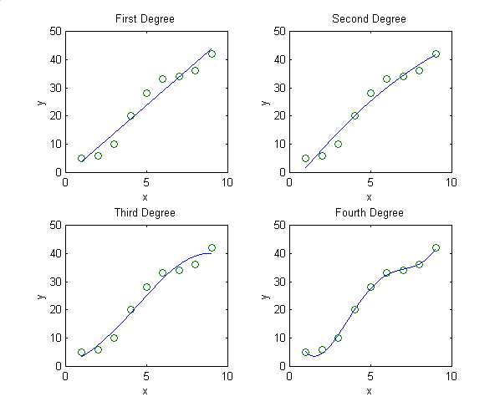
ผลลัพธ์
ผลลัพธ์ J มีค่าดังนี้คือ: 71.5389 56.6727 41.8838 4.6566
ค่า J มีค่าลดลงเมื่อค่าดีกรีของโพลิโนเมียลเพิ่มขึ้น
เส้นของโพลิโนเมียลดีกรีสูงจะมีความ สามารถโค้งงอได้มากกว่าโพลิโนเมียลดีกรีต่ำ

Slide 73
Cluster Analysis

Slide 74
Data Cleaning as a Process
Data discrepancy detection
Use metadata (e.g., domain, range, dependency, distribution)
Check field overloading
Check uniqueness rule, consecutive rule and null rule
Use commercial tools
Data scrubbing: use simple domain knowledge (e.g., postal code, spell-check) to detect errors and make corrections
Data auditing: by analyzing data to discover rules and relationship to detect violators (e.g., correlation and clustering to find outliers)
Data migration(Change Platform) and integration(Mix data to transform)
Data migration tools: allow transformations to be specified
ETL (Extraction/Transformation/Loading) tools: allow users to specify transformations through a graphical user interface
Integration of the two processes
Iterative and interactive (e.g., Potter’s Wheels)

Slide 75
Chapter 2: Data Preprocessing
Why preprocess the data?
Data cleaning
Data integration and transformation
Data reduction
Discretization and concept hierarchy generation
Summary

Slide 76
Data Integration
Data integration:
Combines data from multiple sources into a coherent store
Schema integration: e.g., A.cust-id ≡ B.cust-#
Integrate metadata from different sources
Entity identification problem:
Identify real world entities from multiple data sources, e.g., Bill Clinton = William Clinton
Detecting and resolving data value conflicts
For the same real world entity, attribute values from different sources are different
Possible reasons: different representations, different scales, e.g., metric vs. British units

Slide 77
Handling Redundancy in Data Integration
Redundant data occur often when integration of multiple databases
Object identification: The same attribute or object may have different names in different databases
Derivable data: One attribute may be a “derived” attribute in another table, e.g., annual revenue
Redundant attributes may be able to be detected by correlation analysis
Careful integration of the data from multiple sources may help reduce/avoid redundancies and inconsistencies and improve mining speed and quality

Slide 78
Correlation Analysis (Numerical Data)
Correlation coefficient (also called Pearson’s product moment coefficient)
where n is the number of tuples, and are the respective means of A and B, σ_{A} and σ_{B} are the respective standard deviation of A and B, and Σ(AB) is the sum of the AB cross-product.
If r_{A,B} > 0, A and B are positively correlated (A’s values increase as B’s). The higher, the stronger correlation.
r_{A,B} = 0: independent; r_{A,B} < 0: negatively correlated

Slide 79
Correlation Analysis (Categorical Data)
Χ² (chi-square) test
The larger the Χ² value, the more likely the variables are related
The cells that contribute the most to the Χ² value are those whose actual count is very different from the expected count
Correlation does not imply causality
# of hospitals and # of car-theft in a city are correlated
Both are causally linked to the third variable: population

Slide 80
Chi-Square Calculation: An Example
Χ² (chi-square) calculation (numbers in parenthesis are expected counts calculated based on the data distribution in the two categories)
It shows that like_science_fiction and play_chess are correlated in the group
 | Play chess | Not play chess | Sum (row)
Like science fiction | 250(90) | 200(360) | 450
Not like science fiction | 50(210) | 1000(840) | 1050
Sum(col.) | 300 | 1200 | 1500

Slide 81
Data Transformation
Smoothing: remove noise from data
Aggregation: summarization, data cube construction
Generalization: concept hierarchy climbing
Normalization: scaled to fall within a small, specified range
min-max normalization
z-score normalization
normalization by decimal scaling
Attribute/feature construction
New attributes constructed from the given ones

Slide 82
Data Transformation: Normalization
Min-max normalization: to [new_min_{A}, new_max_{A}]
Ex. Let income range $12,000 to $98,000 normalized to [0.0, 1.0]. Then $73,000 is mapped to
Z-score normalization (μ: mean, σ: standard deviation):
Ex. Let μ = 54,000, σ = 16,000. Then
Normalization by decimal scaling
Where j is the smallest integer such that Max(|ν’|) < 1

Slide 83
Chapter 2: Data Preprocessing
Why preprocess the data?
Data cleaning
Data integration and transformation
Data reduction
Discretization and concept hierarchy generation
Summary

Slide 84
Data Reduction Strategies
Why data reduction?
A database/data warehouse may store terabytes of data
Complex data analysis/mining may take a very long time to run on the complete data set
Data reduction
Obtain a reduced representation of the data set that is much smaller in volume but yet produce the same (or almost the same) analytical results
Data reduction strategies
Data cube aggregation:
Dimensionality reduction — e.g., remove unimportant attributes
Data Compression
Numerosity reduction — e.g., fit data into models
Discretization and concept hierarchy generation

Slide 85
Data Cube Aggregation
The lowest level of a data cube (base cuboid)
The aggregated data for an individual entity of interest
E.g., a customer in a phone calling data warehouse
Multiple levels of aggregation in data cubes
Further reduce the size of data to deal with
Reference appropriate levels
Use the smallest representation which is enough to solve the task
Queries regarding aggregated information should be answered using data cube, when possible

Slide 86
Attribute Subset Selection
Feature selection (i.e., attribute subset selection):
Select a minimum set of features such that the probability distribution of different classes given the values for those features is as close as possible to the original distribution given the values of all features
reduce # of patterns in the patterns, easier to understand
Heuristic methods (due to exponential # of choices):
Step-wise forward selection
Step-wise backward elimination
Combining forward selection and backward elimination
Decision-tree induction

Slide 87
Example of Decision Tree Induction
Initial attribute set:
{A1, A2, A3, A4, A5, A6}
A4 ?
A1?
A6?
Class 1
Class 2
Class 1
Class 2
>
Reduced attribute set: {A1, A4, A6}

Slide 88
Heuristic Feature Selection Methods
There are 2^{d} possible sub-features of d features
Several heuristic feature selection methods:
Best single features under the feature independence assumption: choose by significance tests
Best step-wise feature selection:
The best single-feature is picked first
Then next best feature condition to the first, ...
Step-wise feature elimination:
Repeatedly eliminate the worst feature
Best combined feature selection and elimination
Optimal branch and bound:
Use feature elimination and backtracking

Slide 89
Data Compression
String compression
There are extensive theories and well-tuned algorithms
Typically lossless
But only limited manipulation is possible without expansion
Audio/video compression
Typically lossy compression, with progressive refinement
Sometimes small fragments of signal can be reconstructed without reconstructing the whole
Time sequence is not audio
Typically short and vary slowly with time

Slide 90
Data Compression
Original Data
Compressed
Data
lossless
Original Data
Approximated
lossy

Slide 91
Dimensionality Reduction: Wavelet Transformation
Haar2
Daubechie4
Discrete wavelet transform (DWT): linear signal processing, multi-resolutional analysis
Compressed approximation: store only a small fraction of the strongest of the wavelet coefficients
Similar to discrete Fourier transform (DFT), but better lossy compression, localized in space
Method:
Length, L, must be an integer power of 2 (padding with 0’s, when necessary)
Each transform has 2 functions: smoothing, difference
Applies to pairs of data, resulting in two set of data of length L/2
Applies two functions recursively, until reaches the desired length

Slide 92
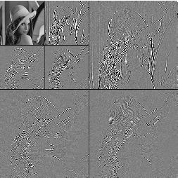
DWT for Image Compression
Image
Low Pass High Pass
Low Pass High Pass
Low Pass High Pass

Slide 93
Dimensionality Reduction: Principal Component Analysis (PCA)
Given N data vectors from n-dimensions, find k ≤ n orthogonal vectors (principal components) that can be best used to represent data
Steps
Normalize input data: Each attribute falls within the same range
Compute k orthonormal (unit) vectors, i.e., principal components
Each input data (vector) is a linear combination of the k principal component vectors
The principal components are sorted in order of decreasing “significance” or strength
Since the components are sorted, the size of the data can be reduced by eliminating the weak components, i.e., those with low variance. (i.e., using the strongest principal components, it is possible to reconstruct a good approximation of the original data
Works for numeric data only
Used when the number of dimensions is large

Slide 94
Principal Component Analysis
X2
Y1
Y2
X1

Slide 95
Numerosity Reduction
Reduce data volume by choosing alternative, smaller forms of data representation
Parametric methods
Assume the data fits some model, estimate model parameters, store only the parameters, and discard the data (except possible outliers)
Example: Log-linear models—obtain value at a point in m-D space as the product on appropriate marginal subspaces
Non-parametric methods
Do not assume models
Major families: histograms, clustering, sampling

Slide 96
Data Reduction Method (1): Regression and Log-Linear Models
Linear regression: Data are modeled to fit a straight line
Often uses the least-square method to fit the line
Multiple regression: allows a response variable Y to be modeled as a linear function of multidimensional feature vector
Log-linear model: approximates discrete multidimensional probability distributions

Slide 97
Regress Analysis and Log-Linear Models
Linear regression: Y = w X + b
Two regression coefficients, w and b, specify the line and are to be estimated by using the data at hand
Using the least squares criterion to the known values of Y1, Y2, …, X1, X2, ….
Multiple regression: Y = b0 + b1 X1 + b2 X2.
Many nonlinear functions can be transformed into the above
Log-linear models:
The multi-way table of joint probabilities is approximated by a product of lower-order tables
Probability: p(a, b, c, d) = αab βacχad δbcd

Slide 98
Data Reduction Method (2): Histograms
Divide data into buckets and store average (sum) for each bucket
Partitioning rules:
Equal-width: equal bucket range
Equal-frequency (or equal-depth)
V-optimal: with the least histogram variance (weighted sum of the original values that each bucket represents)
MaxDiff: set bucket boundary between each pair for pairs have the β–1 largest differences

Slide 99
Data Reduction Method (3): Clustering
Partition data set into clusters based on similarity, and store cluster representation (e.g., centroid and diameter) only
Can be very effective if data is clustered but not if data is “smeared”
Can have hierarchical clustering and be stored in multi-dimensional index tree structures
There are many choices of clustering definitions and clustering algorithms
Cluster analysis will be studied in depth in Chapter 7

Slide 100
Data Reduction Method (4): Sampling
Sampling: obtaining a small sample s to represent the whole data set N
Allow a mining algorithm to run in complexity that is potentially sub-linear to the size of the data
Choose a representative subset of the data
Simple random sampling may have very poor performance in the presence of skew
Develop adaptive sampling methods
Stratified sampling:
Approximate the percentage of each class (or subpopulation of interest) in the overall database
Used in conjunction with skewed data
Note: Sampling may not reduce database I/Os (page at a time)

Slide 101
Sampling: with or without Replacement
SRSWOR
(simple random
sample without
replacement)
SRSWR
Raw Data

Slide 102
Sampling: Cluster or Stratified Sampling
Raw Data
Cluster/Stratified Sample

Slide 103
Chapter 2: Data Preprocessing
Why preprocess the data?
Data cleaning
Data integration and transformation
Data reduction
Discretization and concept hierarchy generation
Summary

Slide 104
Discretization
Three types of attributes:
Nominal — values from an unordered set, e.g., color, profession
Ordinal — values from an ordered set, e.g., military or academic rank
Continuous — real numbers, e.g., integer or real numbers
Discretization:
Divide the range of a continuous attribute into intervals
Some classification algorithms only accept categorical attributes.
Reduce data size by discretization
Prepare for further analysis

Slide 105
Discretization and Concept Hierarchy
Discretization
Reduce the number of values for a given continuous attribute by dividing the range of the attribute into intervals
Interval labels can then be used to replace actual data values
Supervised vs. unsupervised
Split (top-down) vs. merge (bottom-up)
Discretization can be performed recursively on an attribute
Concept hierarchy formation
Recursively reduce the data by collecting and replacing low level concepts (such as numeric values for age) by higher level concepts (such as young, middle-aged, or senior)

Slide 106
Discretization and Concept Hierarchy Generation for Numeric Data
Typical methods: All the methods can be applied recursively
Binning (covered above)
Top-down split, unsupervised,
Histogram analysis (covered above)
Top-down split, unsupervised
Clustering analysis (covered above)
Either top-down split or bottom-up merge, unsupervised
Entropy-based discretization: supervised, top-down split
Interval merging by χ² Analysis: unsupervised, bottom-up merge
Segmentation by natural partitioning: top-down split, unsupervised

Slide 107
Entropy-Based Discretization
Given a set of samples S, if S is partitioned into two intervals S₁ and S₂ using boundary T, the information gain after partitioning is
Entropy is calculated based on class distribution of the samples in the set. Given m classes, the entropy of S₁ is
where p_{i} is the probability of class i in S₁
The boundary that minimizes the entropy function over all possible boundaries is selected as a binary discretization
The process is recursively applied to partitions obtained until some stopping criterion is met
Such a boundary may reduce data size and improve classification accuracy

Slide 108
Interval Merge by χ² Analysis
Merging-based (bottom-up) vs. splitting-based methods
Merge: Find the best neighboring intervals and merge them to form larger intervals recursively
ChiMerge [Kerber AAAI 1992, See also Liu et al. DMKD 2002]
Initially, each distinct value of a numerical attr. A is considered to be one interval
χ² tests are performed for every pair of adjacent intervals
Adjacent intervals with the least χ² values are merged together, since low χ² values for a pair indicate similar class distributions
This merge process proceeds recursively until a predefined stopping criterion is met (such as significance level, max-interval, max inconsistency, etc.)

Slide 109
Segmentation by Natural Partitioning
A simply 3-4-5 rule can be used to segment numeric data into relatively uniform, “natural” intervals.
If an interval covers 3, 6, 7 or 9 distinct values at the most significant digit, partition the range into 3 equi-width intervals
If it covers 2, 4, or 8 distinct values at the most significant digit, partition the range into 4 intervals
If it covers 1, 5, or 10 distinct values at the most significant digit, partition the range into 5 intervals

Slide 110
Example of 3-4-5 Rule
count
Step 1:
-$351 -$159 profit $1,838 $4,700
Min Low (i.e, 5%-tile) High(i.e, 95%-0 tile) Max
Step 2:
msd=1,000 Low=-$1,000 High=$2,000
Step 3:
(-$1,000 - $2,000)
(-$1,000 - 0)
(0 -$ 1,000)
($1,000 - $2,000)
Step 4:
(-$400 -$5,000)
(-$400 - 0)
(0 - $1,000)
($1,000 - $2, 000)
($2,000 - $5, 000)
(-$400 -
-$300)
(0 -
$200)
($1,000 -
$1,200)
($2,000 -
$3,000)
($200 -
$400)
($1,200 -
$1,400)
(-$300 -
-$200)
($3,000 -
$4,000)
($400 -
$600)
($1,400 -
$1,600)
(-$200 -
-$100)
($4,000 -
$5,000)
($600 -
$800)
($1,600 -
$1,800)
($1,800 -
$2,000)
(-$100 -
0)
($800 -
$1,000)

Slide 111
Concept Hierarchy Generation for Categorical Data
Specification of a partial/total ordering of attributes explicitly at the schema level by users or experts
street < city < state < country
Specification of a hierarchy for a set of values by explicit data grouping
{Urbana, Champaign, Chicago} < Illinois
Specification of only a partial set of attributes
E.g., only street < city, not others
Automatic generation of hierarchies (or attribute levels) by the analysis of the number of distinct values
E.g., for a set of attributes: {street, city, state, country}

Slide 112
Automatic Concept Hierarchy Generation
Some hierarchies can be automatically generated based on the analysis of the number of distinct values per attribute in the data set
The attribute with the most distinct values is placed at the lowest level of the hierarchy
Exceptions, e.g., weekday, month, quarter, year
country
15 distinct values
province_or_ state
365 distinct values
city
3567 distinct values
street
674,339 distinct values

Slide 113
Chapter 2: Data Preprocessing
Why preprocess the data?
Data cleaning
Data integration and transformation
Data reduction
Discretization and concept hierarchy generation
Summary

Slide 114
Summary
Data preparation or preprocessing is a big issue for both data warehousing and data mining
Discriptive data summarization is need for quality data preprocessing
Data preparation includes
Data cleaning and data integration
Data reduction and feature selection
Discretization
A lot a methods have been developed but data preprocessing still an active area of research

Slide 115
References
D. P. Ballou and G. K. Tayi. Enhancing data quality in data warehouse environments. Communications of ACM, 42:73-78, 1999
T. Dasu and T. Johnson. Exploratory Data Mining and Data Cleaning. John Wiley & Sons, 2003
T. Dasu, T. Johnson, S. Muthukrishnan, V. Shkapenyuk. Mining Database Structure; Or, How to Build a Data Quality Browser. SIGMOD’02.
H.V. Jagadish et al., Special Issue on Data Reduction Techniques. Bulletin of the Technical Committee on Data Engineering, 20(4), December 1997
D. Pyle. Data Preparation for Data Mining. Morgan Kaufmann, 1999
E. Rahm and H. H. Do. Data Cleaning: Problems and Current Approaches. IEEE Bulletin of the Technical Committee on Data Engineering. Vol.23, No.4
V. Raman and J. Hellerstein. Potters Wheel: An Interactive Framework for Data Cleaning and Transformation, VLDB’2001
T. Redman. Data Quality: Management and Technology. Bantam Books, 1992
Y. Wand and R. Wang. Anchoring data quality dimensions ontological foundations. Communications of ACM, 39:86-95, 1996
R. Wang, V. Storey, and C. Firth. A framework for analysis of data quality research. IEEE Trans. Knowledge and Data Engineering, 7:623-640, 1995

Slide 116
