Slide 1
Software Development Processes

Slide 2
Topics
Software process models
  Plan-driven
  Agile
Software development activities
Examples of software process
  The Rational Unified Process
  Extreme Programming

Slide 3
Plan-driven and Agile Processes
Plan-driven processes
  All of the process activities are planned in advance and progress is measured against this plan.
Agile processes
  Planning is incremental and it is easier to change the process to reflect changing customer requirements.
In practice, most practical processes include elements of both plan-driven and agile approaches.
There are no right or wrong software processes.

Slide 4
Plan-Driven Process Models
Waterfall model
Evolutionary model
Incremental model
Spiral model
Component-based development

Slide 5







Waterfall Model
Requirement
Definition
Requirement
Description
System and
Software Design
Specification and
Design Documents
Implementation and
Unit Testing
Software
Components
Integration and
System Testing
Product
Operation and
Maintenance

Slide 6
Waterfall Model Problems
Inflexible partitioning of the project into distinct stages makes it difficult to respond to changing customer requirements.
  Therefore, this model is only appropriate when the requirements are well-understood and changes will be fairly limited during the design process.
  Few business systems have stable requirements.
The waterfall model is mostly used for large systems engineering projects where a system is developed at several sites.
  In those circumstances, the plan-driven nature of the waterfall model helps coordinate the work.

Slide 7





Incremental Model
Increment 1
Analysis
Design
Code
Test
Delivery of
1st Increment
Increment 2
Analysis
Design
Code
Test
Delivery of
2nd Increment
Increment 3
Analysis
Design
Code
Test
Delivery of
3rd Increment
Increment 4
Analysis
Design
Code
Test
Delivery of
4th Increment
Calendar Time

Slide 8
Incremental Development Benefits
The cost of accommodating changing customer requirements is reduced.
  The amount of analysis and documentation that has to be redone is much less than is required with the waterfall model.
It is easier to get customer feedback on the development work that has been done.
  Customers can comment on demonstrations of the software and see how much has been implemented.
More rapid delivery and deployment of useful software to the customer is possible.
  Customers are able to use and gain value from the software earlier than is possible with a waterfall process.

Slide 9









Component-based Development
Component 3
Component 2
Component 4
Component 1
Component 5
Final
Product

Slide 10
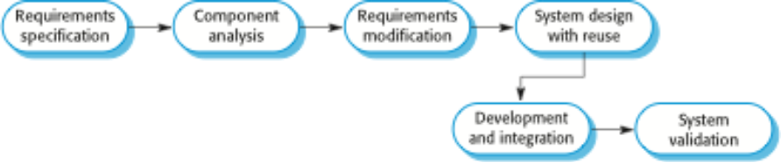
Component Based Development

Slide 11
Component-based Development
Based on systematic reuse where systems are integrated from existing components or COTS (Commercial-off-the-shelf) systems.
Process stages
  Component analysis;
  Requirements modification;
  System design with reuse;
  Development and integration.
Reuse is now the standard approach for building many types of business system

Slide 12
Types of Software Components
Web services that are developed according to service standards and which are available for remote invocation.
Collections of objects that are developed as a package to be integrated with a component framework such as .NET or J2EE.
Stand-alone software systems (COTS) that are configured for use in a particular environment.

Slide 13
Agile Methodologies
Rapid application development
Extreme programming
Scrum
Feature-Driven Development

Slide 14










Rapid Application Development (RAD)
Joint Application
Development (JAD)
Session
Focus Group Session
Developers’
Conception
Divergence
Scope
Concept
Req.
Change
Features
Function
Specs.
Change
Defects
Perfor-
mance
Total
Package
V.1
V.2
V.3
V.n
Final
Customers’
Conception
Re-design
2-6 Months
1-21
Days
(http://csweb.cs.bgsu.edu/maner/domains/RAD.gif)
Re-specify
Re-evaluate

Slide 15
RAD Issues
Enable users to see the end-design quicker to add valuable inputs and hence allow rapid software testing and speeding steps.
Allow a faster and updated version to reach the end users quicker by eliminating redundant steps or using the prototyping.
However, RAD depends on strong cohesive teams and individual commitment to the project.

Slide 16
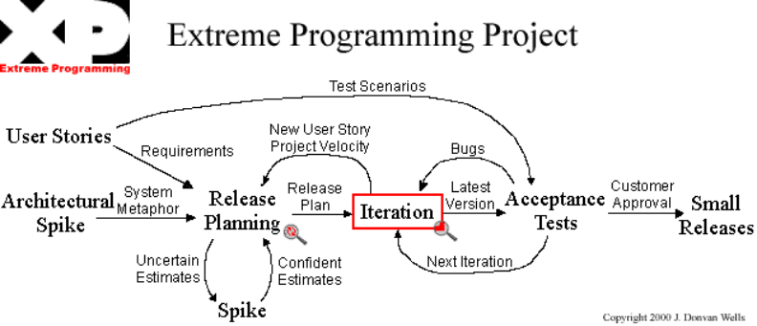
Extreme Programming

Slide 17
XP Issues
Lowers the cost of changes by embracing new requirements, and perform most of the design activity incrementally and on the fly.
Pair programming may be difficult for some practitioners.
There is no up-front “detailed design”, which could result in more redesign effort in the long run.

Slide 18
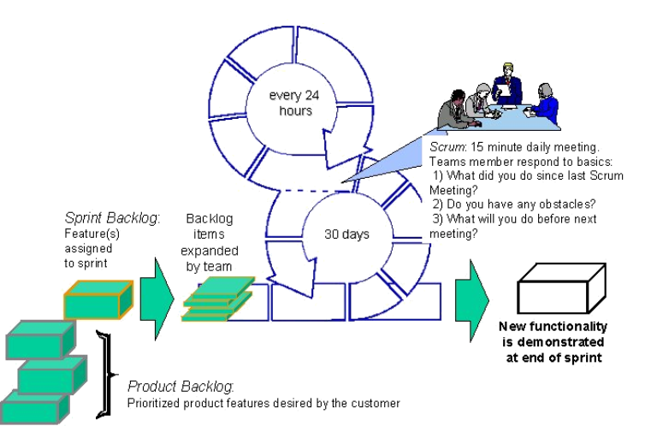
Scrum

Slide 19
Scrum issues
Improvement in team productivity, work prioritization, utilization of sprint, daily measured progress and communications.
However, Scrum relies on the master to facilitate the team. Internal power struggles may paralyze the team.

Slide 20
Software Development

Slide 21



Software Process Activities
Definition
Phase
Development
Phase
Support
Phase

Slide 22
Definition Phase

Slide 23


Software Process Activities
Definition
Phase
Development
Phase
Support
Phase
Requirements definition
Negotiation
Functional specification
System design

Slide 24



The Requirements Engineering Process
Requirements
Elicitation and
Analysis
Feasibility
Study
Requirements
Specification
Requirements
Validation
Feasibility
Report
System
Model
User and System
Requirements
Requirements
Document

Slide 25
Requirement Definition (IEEE)
Introduction
Overall description
External interface requirements
System features
Other nonfunctional requirements
Other requirements

Slide 26
Requirement Definition (Contd.)
Introduction
  Purpose
  Document conventions
  Intended audience
  Additional information
  Contact information
  References

Slide 27
Requirement Definition (Contd.)
Overall Description
  Product perspective
  Product functions
  User classes and characteristics
  Operating environment
  User environment
  Design/implementation constraints
  Assumptions and dependencies

Slide 28
Requirement Definition (Contd.)
External Interface Requirements
  User interfaces
  Hardware interfaces
  Software interfaces
  Communication protocols and interfaces

Slide 29
Requirement Definition (Contd.)
System Features
  System feature A
    Description and priority
    Action/result
    Functional requirements
  System feature B

Slide 30
Requirement Definition (Contd.)
Other Nonfunctional Requirements
  Performance requirements
  Safety requirements
  Security requirements
  Software quality attributes
  Project documentation
  User documentation

Slide 31
Requirement Definition (Contd.)
Other Requirements
  Terminology
  Glossary
  Definitions list

Slide 32
Negotiation
Prepare, prepare, prepare
Pay attention to timing
Leave behind your ego
Ramp up your listening skills
If you don't ask, you don't get
Anticipate compromise
Offer and expect commitment
Don't absorb their problems
Stick to your principles
Close with confirmation
  Source: http://smallbusiness.yahoo.com/r-article-a-57774-m-1-sc-11-10_techniques_for_better_negotiation-i

Slide 33
Design Process Activities (Sommerville)
Architectural design
Abstract specification
Interface design
Component design
Data structure design
Algorithm design

Slide 34



Requirement Specification
Requirements
Specification
Architectural
Design
Abstract
Specification
Interface
Design
Component
Design
Data Structure
Design
Algorithm
Design
System
Architecture
Software
Specification
Interface
Specification
Component
Specification
Data Structure
Specification
Algorithm
Specification

Slide 35
Functional Specification (Smith)
Functional specifications are the blueprint for how the application should look and work
Specifications
  Objectives
  Features
  Users
  Development process
  Software model
  Information flow
  Standards and environments
  Source: http://www.mojofat.com/tutorial/

Slide 36
How to Write the Functional Specifications?
Cover everything
Use lots of tentative screenshots
Write concisely, correctly and consistently
Use the most comfortable tools and format
Proofread and review
Example

Slide 37
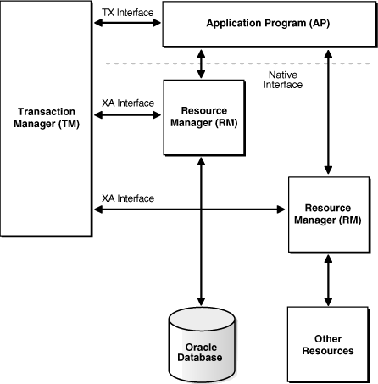
Software Model

Slide 38
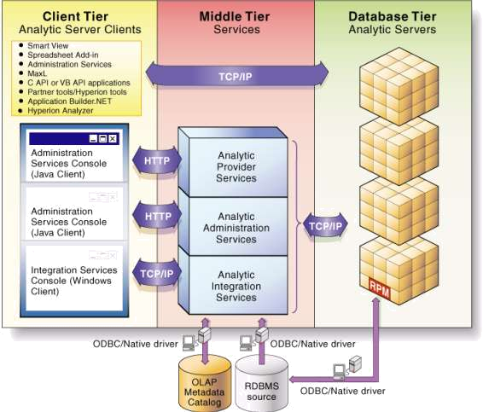
Information Flow Diagram

Slide 39
Software Process Modelling
An architectural model presents an abstract view of the sub-systems making up a system
May include major information flows between sub-systems
Usually presented as a block diagram
May identify different types of functional component in the model

Slide 40
Software Process Modelling
Traditional software process
Agile software process

Slide 41
Traditional Software Process
Waterfall model
Evolutionary model
Incremental model
Spiral model
Component based development

Slide 42

Waterfall Model
Requirement
Definition
Requirement
Description
System and
Software Design
Specification and
Design Documents
Implementation and
Unit Testing
Software
Components
Integration and
System Testing
Product
Operation and
Maintenance

Slide 43






Evolutionary Model
Concurrent Activities
Specification
Initial
Version
Intermediate
Version
Outline
Description
Development
Intermediate
Version
Intermediate
Version
Intermediate
Version
Validation
Final
Version

Slide 44

Incremental Model
Increment 1
Analysis
Design
Code
Test
Delivery of
1st Increment
Increment 2
Analysis
Design
Code
Test
Delivery of
2nd Increment
Increment 3
Analysis
Design
Code
Test
Delivery of
3rd Increment
Increment 4
Analysis
Design
Code
Test
Delivery of
4th Increment
Calendar Time

Slide 45
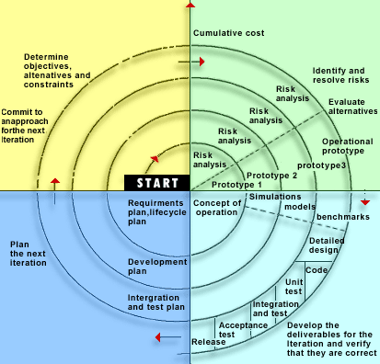
Spiral Model
http://www.fusioninfotech.com/methodology.html

Slide 46


Component Based Development
Component 3
Component 2
Component 4
Component 1
Component 5
Final
Product

Slide 47
Agile Software Process
Rapid application development
Extreme programming
Scrum
Feature-Driven Development

Slide 48


Rapid Application Development (RAD)
Joint Application
Development (JAD)
Session
Focus Group Session
Developers’
Conception
Change
Features
Function
Specs.
Change
Defects
Perfor-
mance
Scope
Concept
Req.
Total
Package
Divergence
V.1
V.2
V.3
V.n
Final
Customers’
Conception
Re-design
2-6 Months
1-21
Days
(http://csweb.cs.bgsu.edu/maner/domains/RAD.gif)
Re-specify
Re-evaluate

Slide 49
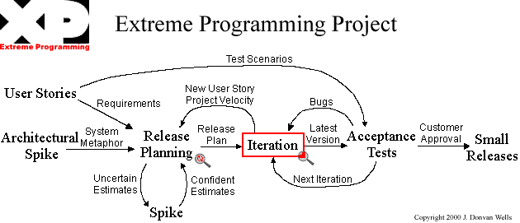
Extreme Programming

Slide 50
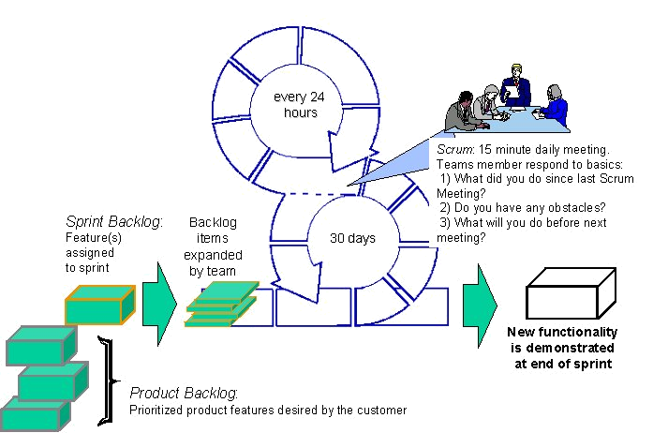
Scrum

Slide 51
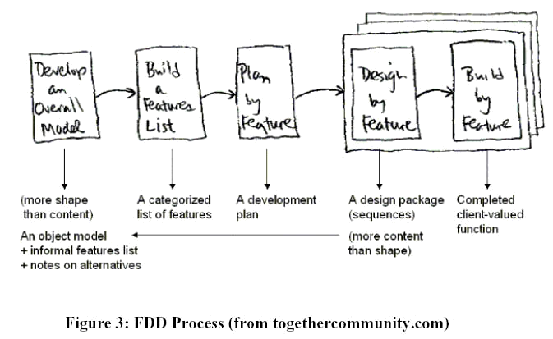
Feature-Driven Development

Slide 52
Crystal Methodologies
a family of methodologies developed by Alistair Cockburn.
All of the Crystal methods are highly people and communication centric and recognize the varying human cultures.
The methods are denoted by colors : Clear, Yellow, Orange, Orange Web, Red, Magenta, and Blue.
Only three of the methods – Crystal Clear, Orange and Orange Web - have been constructed and actually used on projects.

Slide 53
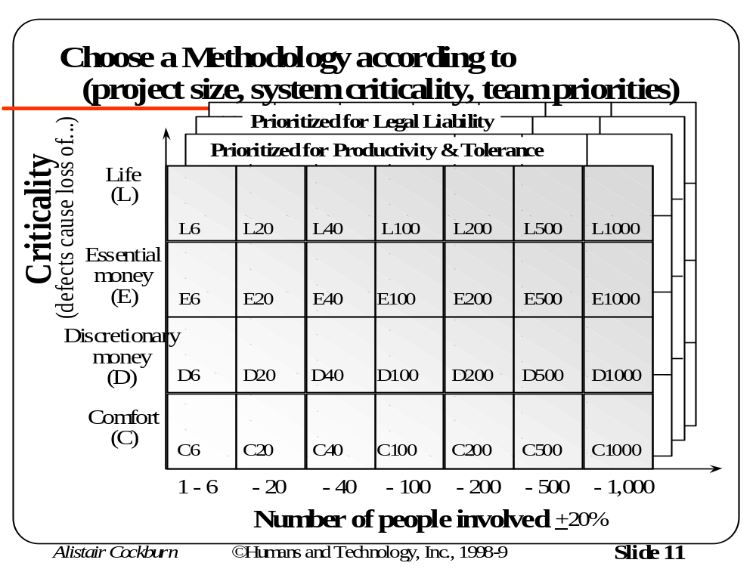
The Family of Methodologies

Slide 54
Crystal Methodologies: Two Rules
Use incremental development with increments of four months or less. Generally, one to three months.
Hold on both pre- and post- reflection with a strong preference for mid-project reflection workshops.

Slide 55
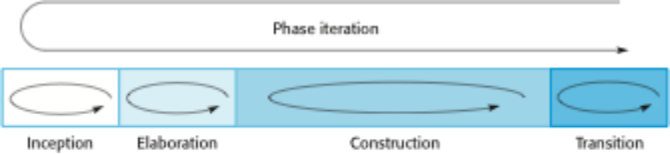
Rational Unified Process (RUP)
In-phase iteration
  Each phase is iterative with results developed incrementally.
Cross-phase iteration
  As shown by the loop in the RUP model, the whole set of phases may be enacted incrementally.

Slide 56
RUP Phases
Inception
  Establish the business case for the system.
Elaboration
  Develop an understanding of the problem domain and the system architecture.
Construction
  System design, programming and testing.
Transition
  Deploy the system in its operating environment.

Slide 57
RUP Practices
Develop software iteratively
  Plan increments based on customer priorities and deliver highest priority increments first.
Manage requirements
  Explicitly document customer requirements and keep track of changes to these requirements.
Use component-based architectures
  Organize the system architecture as a set of reusable components.

Slide 58
Development Phase

Slide 59

Software Process Activities
Definition
Phase
Development
Phase
Support
Phase
Sub-system development
System integration
System testing
System validation and verification
System installation

Slide 60
Programming and Debugging
Translating a design into a program and removing errors from that program
Programming is a personal activity - there is no generic programming process
Programmers carry out some program testing to discover faults in the program and remove these faults in the debugging process

Slide 61
The Debugging Process
Locate
Error
Design
Error Repair
Repair
Error
Re-Test
Program

Slide 62
Software Testing
Verification and validation (V & V) is intended to show that a system conforms to its specification and meets the requirements of the system customer
  Verification: ensures the product is designed to deliver all functionality to the customer
  Validation: ensures that functionality, as defined in requirements, is the intended behavior of the product
Involves checking and review processes and system testing
System testing involves executing the system with test cases that are derived from the specification of the real data to be processed by the system

Slide 63
Testing Stages
Component or unit testing
  Individual components are tested independently
  Components may be functions or objects or coherent groupings of these entities
System testing
  Testing of the system as a whole. Testing of emergent properties is particularly important.
Acceptance testing
  Testing with customer data to check that the system meets the customer’s needs

Slide 64
The Testing Process
Component
Testing
System
Testing
Acceptance
Testing

Slide 65



Testing Phases
Requirements
Specification
System
Specification
System
Design
Detailed
Design
Acceptance
Test Plan
System
Integration
Test Plan
Sub-System
Integration
Test Plan
Module and
Unit Code
and Test
Service
Acceptance
Test
System
Integration Test
Sub-System
Integration Test

Slide 66
Support Phase

Slide 67
Software Process Activities
Definition
Phase
Development
Phase
Support
Phase
System evolution
System decommissioning
Training
Documentation
Support

Slide 68
Supporting and Specification
Should supporting activities be included in specification documents?

Slide 69
Software Evolution
Software is inherently flexible and can change
As requirements change through changing business circumstances, the software that supports the business must also evolve and change
Although there has been a demarcation between development and evolution (maintenance) this is increasingly irrelevant as fewer and fewer systems are completely new

Slide 70

System Evolution
Define System
Requirements
Access Existing
Systems
Propose System
Changes
Modify
Systems
Existing
Systems
New
System

Slide 71
Computer-Aided Software Engineering (CASE)
CASE is software to support software development and evolution processes
Activity automation
  Graphical editors for system model development
  Data dictionary to manage design entities
  Graphical UI builder for user interface construction
  Debuggers to support program fault finding
  Automated translators to generate new versions of a program

Slide 72
CASE Classification
Classification helps us understand the different types of CASE tools and their support for process activities
Functional perspective
  Tools are classified according to their specific function
Process perspective
  Tools are classified according to process activities that are supported
Integration perspective
  Tools are classified according to their organisation into integrated units

Slide 73


Functional Tool Classification
Tool Types
Examples
Planning Tools PERT Tools, Estimation Tools, Spreadsheets
Editing Tools Text Editor, Diagram Editors, Word Processors
Change Management Tools Requirements Traceability Tools, Change Control System
Configuration Management Tools Version Management Systems, System Building Tools
Prototyping Tools Very High-Level Languages, User Interface Generators
Method-Support Tools Design Editors, Data Dictionaries, Code Generator
Language Processing Tools Compilers, Interpreters
Program Analysis Tools Cross Reference Generators, Static Analysers, Dynamic Analysers
Testing Tools Test Data Generators, File Comparators
Debugging Tools Interactive Debugging Systems
Documentation Tools Page Layout Programs, Image Editors
Re-Engineering Tools Cross-Reference Systems, Program Re-Structuring Systems

Slide 74



Activity-Based Tool Classification
Definition
Development
Support
Planning Tools √ √ √
Editing Tools √ √ √
Change Management Tools √ √ √
Configuration Management Tools √ √ √
Prototyping Tools √ √ √
Method-Support Tools √ √
Language Processing Tools √ √ √
Program Analysis Tools √
Testing Tools √
Debugging Tools √
Documentation Tools √ √ √
Re-Engineering Tools √ √

Slide 75
CASE Integration
Tools
  Support individual process tasks such as design consistency checking, text editing, etc
Workbenches
  Support a process phase such as specification or design, Normally include a number of integrated tools
Environments
  Support all or a substantial part of an entire software process. Normally include several integrated workbenches.

Slide 76








Tools, Workbenches, Environments
CASE
Technology
Tools
Workbenches
Environments
Editors
Compilers
File
Comparators
Integrated
Environments
Process-Centered
Environments
Analysis and
Design
Programming
Testing
Multi-Method
Workbenches
Single-Method
Workbenches
General-Purpose
Workbenches
Language-Specific
Workbenches

Slide 77
Summary

Slide 78
Summary
Software development
  Definition
    Requirements definition
    Negotiation
    Functional specification
    Software process modelling
  Development
    Programming and debugging
    Integration
    Testing
    Evolution
  Support

