Slide 1
Requirements Engineering

Slide 2
Review

Slide 3
Software Development Processes
Software development
  Definition
    Requirements definition
    Negotiation
    Functional specification
    Software process modelling
  Development
    Programming and debugging
    Integration
    Testing
    Evolution
  Support

Slide 4
Requirements

Slide 5
Requirements
A documented needนด f what a particular product or service should be or perform.
A statement that identifies a necessary attribute, capability, characteristic, or quality of a system.
May be:
  A high-level abstract statement of a service, a system, or of a system constraint.
  A detailed mathematical functional specification.

Slide 6
Systems / Software Requirements
A description of what a system must do or, referred as a Functional Requirement.
A description of something about the system itself, and how well it performs its functions is called Non-functional requirements.
  performance requirements
  quality of service requirements
    usability, availability, reliability, supportability, testability, maintainability, and ease-of-use.

Slide 7
Project Requirements
Projects are subjected to three sorts of requirements.
  Business requirements / User requirements
  Product requirements / System requirements
  Process requirements / Organization requirements

Slide 8
Emergent Properties
Emergent properties are properties of the system as a whole and only emerge once all of its individual sub-systems have been integrated
Examples of emergent properties
  Reliability
  Maintainability
  Performance
  Usability
  Security
  Safety

Slide 9
Sample Requirements
The system shall maintain records of all library materials including books, serials, newspapers and magazines, video and audio tapes, reports, collections of transparencies, computer disks and CD-ROMs.
The system shall allow users to search for an item by title, author, or by ISBN.
The system’s user interface shall be implemented using a World-Wide-Web browser.
The system shall support at least 20 transactions per second.
The system facilities which are available to public users shall be demonstrable in 10 minutes or less.

Slide 10
Users of Requirements
System customers
  specify the requirements and read them to check they meet their needs
Project managers
  Use the requirements document to plan a bid for system and to plan the system development process
System engineers
  Use the requirements to understand the system being developed
System test engineers
  Use the requirements to develop validation tests for the system
System maintenance engineers
  Use the requirements to help understand the system

Slide 11
Problems with Requirements
The requirements don’t reflect the real needs of the customer for the system.
Requirements are inconsistent and/or incomplete.
It is expensive to make changes to requirements after they have been agreed.
There are misunderstandings between customers, those developing the system requirements and software engineers developing or maintaining the system.

Slide 12
Writing Guidelines
Define standard templates for describing requirements
Use language simply consistently and concisely
Use diagrams appropriately
Supplement natural language with other description of requirements
Specify requirements quantitatively

Slide 13
Activity: Writing Requirements
What wrong with these requirements?
The system shall provide an easy-to-use graphical user interface based on MS Windows 95.
ระบบจะใช้ส่วนต่อประสานผู้ใช้แบบกราฟิกที่อ้างอิงจากไมโครซอฟท์วินโดวส์ 95

Slide 14
Solution
‘easy-to-use’
  What does it mean?
  Who should find it easy to use?
  Untestable

Slide 15
Activity: Writing Requirements
The software system shall be implemented using separate modules for cataloging, user access and archiving.
ระบบซอฟท์แวร์จะต้องถูกสร้างขึ้นโดยมีโมดูลแยกกันสำหรับ catalog, user access และ archive

Slide 16
Solution
Premature design
  Requirements should not include the detailed design.

Slide 17
Activity: Stakeholders identification
List the possible stakeholders for a library cataloging system.
Suggest how each might use a requirement document.
บอกรายชื่อของ stakeholder สำหรับระบบ catalog ของห้องสมุด
และแนะนำว่าแต่ละคนจะใช้เอกสารความต้องการอย่างไร

Slide 18
Solution
Library users
Library staff responsible for cataloging
Library management
Library staff responsible for providing user assistance
Book publishers (indirect)
System developers
Managers of other library automation systems

Slide 19
Solution
Library users: Not used directly but used to produce user documentation
Library staff responsible for cataloging: Used to assess if the facilities specified are those required to support the cataloging process.
Library management: Used to assess if the system supports the overall goals of the library
Library staff responsible for providing user assistance: Used to assess whether or not the retrieval facilities are those commonly used by end-users.
Book publishers (indirect): No direct use of document
System developers: Used to inform the system design and implementation
Managers of other library automation systems: used to check interactions with these systems

Slide 20
Activity: Writing Requirements
Suggest how the following requirements might be rewritten in a quantitative way. You may use any metrics you like to express the requirements.
แนะนำว่าความต้องการต่อไปนี้สามารถนำไปเขียนใหม่ในเชิงปริมาณได้อย่างไร นักศึกษาสามารถใช้ตัวชี้วัดประกอบได้
The library system shall be easy-to-use.
ระบบห้องสมุดจะต้องใช้ง่าย

Slide 21
Solution
It should be possible to train end-users of the system to use all retrieval facilities in a single 15 minute training session.

Slide 22
Activity: Writing Requirements
The library system shall provide reliable service to all classes of user.
ระบบห้องสมุดจะต้องมีความน่าเชื่อสำหรับผู้ใช้ทุกระดับ

Slide 23
Solution
The rate of occurrence of failures in the retrieval facilities of the system shall be less than 1 in 1000 queries.
The rate of occurrence of failure for the cataloging facilities of the system shall be less than 1 in 500 cataloging operations.

Slide 24
Activity: Writing Requirements
The library system shall provide a rapid response to all user requests for book information.
ระบบห้องสมุดจะต้องตอบสนองอย่างรวดเร็วต่อคำขอจากผู้ใช้เกี่ยวกับข้อมูลหนังสือ

Slide 25
Solution
The average system response time for user requests shall be less than 4 seconds.

Slide 26
Requirements Engineering

Slide 27
Requirements Engineering
The processes involved in developing system requirements
A subdiscipline of systems and software engineering that is concerned with determining the goals, functions, and constraints of hardware and software systems
The process usually begins with a feasibility study activity, then requirement analysis.
Usually costs about 15% of system development costs.

Slide 28
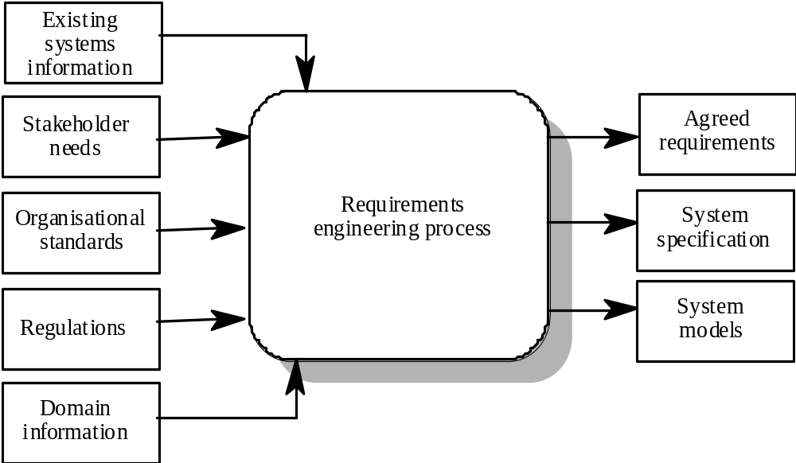
RE Process

Slide 29
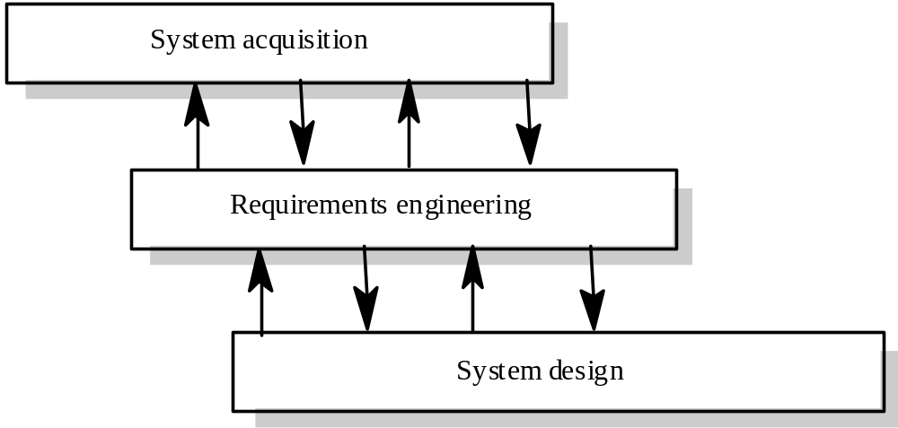
Context of RE Process

Slide 30
RE Process Activities
Requirements elicitation
  Requirements discovered through consultation with stakeholders
Requirements analysis and negotiation
  Requirements are analysed and conflicts resolved through negotiation
Requirements documentation
  A requirements document is produced
Requirements validation
  The requirements document is checked for consistency and completeness

Slide 31
RE Process Models
A process model is a simplified description of a process.
Types of process model include:
  Coarse-grain activity models
  Fine-grain activity models
  Role-action models
  Entity-relation models

Slide 32
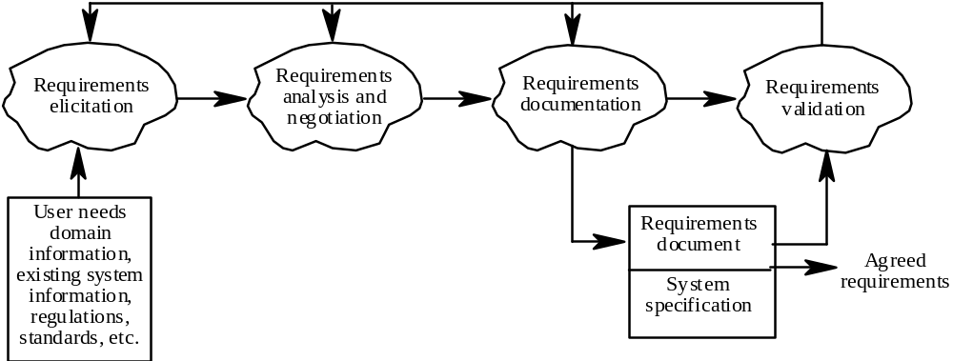
Coarse-grain activity model of RE

Slide 33
Acitivity: Activity Models
Define an activity model of the processes of checking a book out of a library, making an omelette and installing some new software on your computer. You should choose an appropriate level of granularity for the models
ให้นักศึกษากำหนดแบบจำลองกิจกรรมสำหรับกระบวนการต่อไปนี้ ใช้ระดับความละเอียดตามความเหมาะสม
  ยืมหนังสือออกจากห้องสมุด
  ทำไข่เจียว
  ติดตั้งซอฟท์แวร์ใหม่ในคอมพิวเตอร์ของตนเอง

Slide 34
Acitivity: Checking out a library book
Choose book
Find id card
Go to loans counter
Hand over book and id
Accept checked book

Slide 35
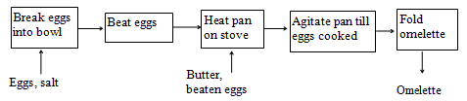
Acitivity: Making an Omelette

Slide 36
Human and Social Factors
Requirements engineering processes are dominated by human, social and organisational factors because they always involve a range of stakeholders from different backgrounds and with different individual and organisational goals.
System stakeholders may come from a range of technical and non-technical background and from different disciplines

Slide 37
Factors Influencing Requirements
Personality and status of stakeholders
The personal goals of individuals within an organisation
The degree of political influence of stakeholders within an organisation

Slide 38
RE Process Support
CASE tools for automated support are still limited because of the informality and the variability of the process.
CASE tools:
  Modelling and validation tools support the development of system models can be used to
    Specify the system
    Checking of these models for completeness and consistency.
  Management tools help manage:
    A database of requirements
    Support the management of changes to these requirements.

Slide 39
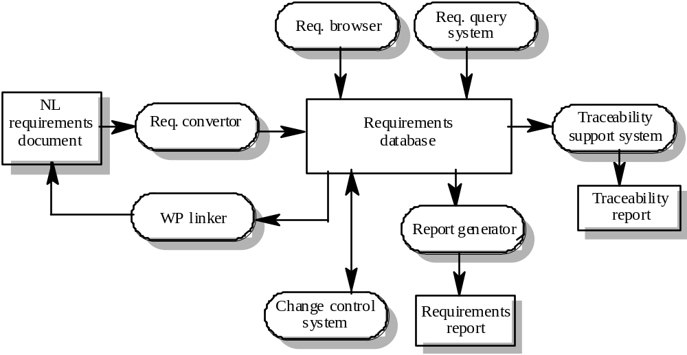
Requirements Management System

Slide 40
Requirements Management Tools
Requirements browser
Requirements query system
Traceability support system
Report generator
Requirements converter and word processor linker
Change control system

Slide 41
RE Process Problems
Lack of stakeholder involvement
Business needs not considered
Lack of requirements management
Lack of defined responsibilities
Stakeholder communication problems
Over-long schedules and poor quality requirements documents

Slide 42
Good Practice Guidelines for RE Process Improvement
Define a standard document structure
Uniquely identify each requirement
Define policies for requirements management
Use checklists for requirements analysis
Use scenarios to elicit requirements
Specify requirements quantitatively
Use prototyping to animate requirements
Reuse requirements

Slide 43
Requirements Elicitation

Slide 44
Analysis Checklists
Premature design
  Does the requirement include premature design or implementation information?
Combined requirements
  Does the description of a requirement describe a single requirement or could it be broken down into several different requirements?
Unnecessary requirements
  Is the requirement ‘gold plating’? That is, is the requirement a cosmetic addition to the system which is not really necessary.
Use of non-standard hardware
  Does the requirement mean that non-standard hardware or software must be used? To make this decision, you need to know the computer platform requirements.

Slide 45
Analysis Checklists
Conformance with business goals
  Is the requirement consistent with the business goals defined in the introduction to the requirements document? Requirements ambiguity
Requirements ambiguity
  Is the requirement ambiguous i.e. could it be read in different ways by different people? What are the possible interpretations of the requirement?
Requirements realism
  Is the requirement realistic given the technology which will be used to implement the system?
Requirements testability
  Is the requirement testable, that is, is it stated in such a way that test engineers can derive a test which can show if the system meets that requirement?

Slide 46
Requirements Negotiation
Disagreements about requirements are inevitable when a system has many stakeholders. Conflicts are not ‘failures’ but reflect different stakeholder needs and priorities
Requirements negotiation is the process of discussing requirements conflicts and reaching a compromise that all stakeholders can agree to
In planning a requirements engineering process, it is important to leave enough time for negotiation. Finding an acceptable compromise can be time-consuming

Slide 47
Requirements Elicitation and Analysis
There are a number of requirements elicitation and requirements analysis techniques.
Prototypes may be used in the RE process.

Slide 48
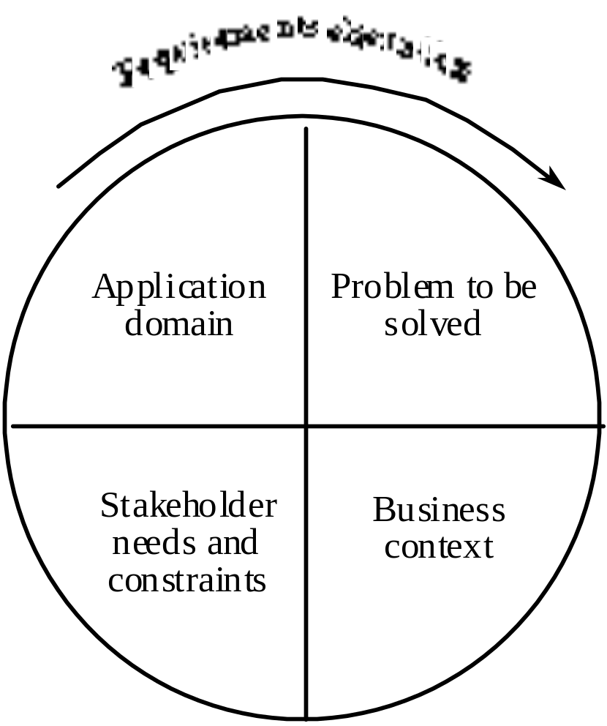
Components of requirements elicitation

Slide 49
Elicitation Activities
Application domain understanding
  Application domain knowledge is knowledge of the general area where the system is applied.
Problem understanding
  The details of the specific customer problem where the system will be applied must be understood.
Business understanding
  You must understand how systems interact and contribute to overall business goals.
Understanding the needs and constraints of system stakeholders
  You must understand, in detail, the specific needs of people who require system support in their work.

Slide 50
Elicitation activities
Application domain understanding
  Application domain knowledge is knowledge of the general area where the system is applied.
Problem understanding
  The details of the specific customer problem where the system will be applied must be understood.
Business understanding
  You must understand how systems interact and contribute to overall business goals.
Understanding the needs and constraints of system stakeholders
  You must understand, in detail, the specific needs of people who require system support in their work.

Slide 51
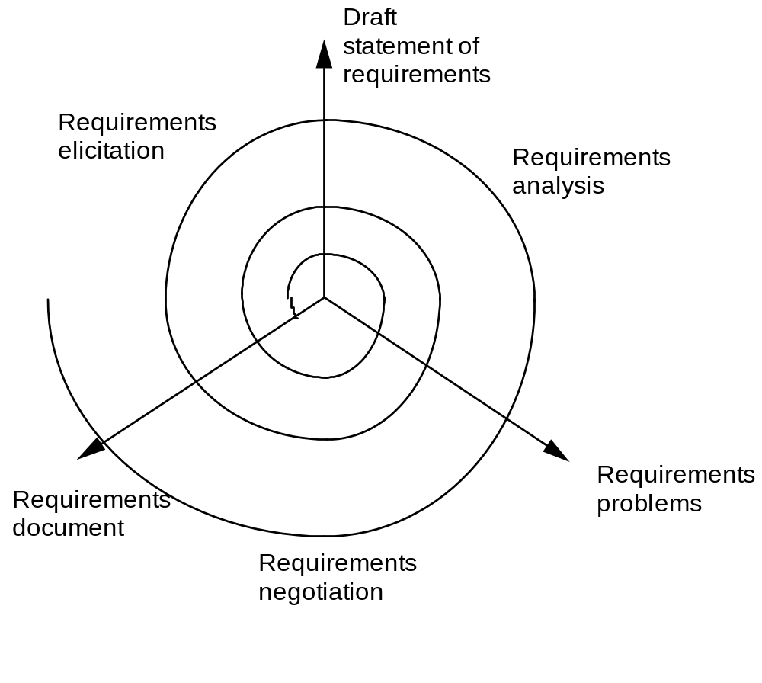
Elicitation, analysis and negotiation

Slide 52
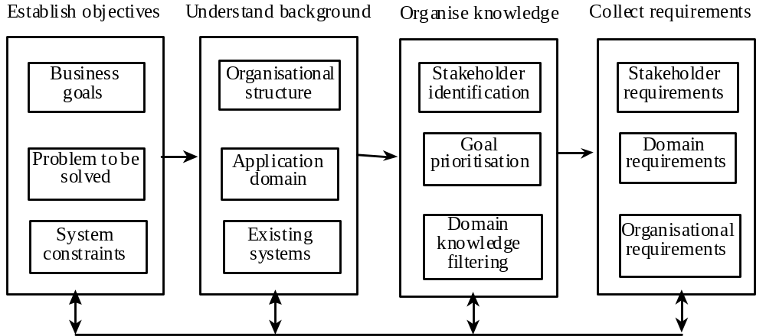
The requirements elicitation process

Slide 53
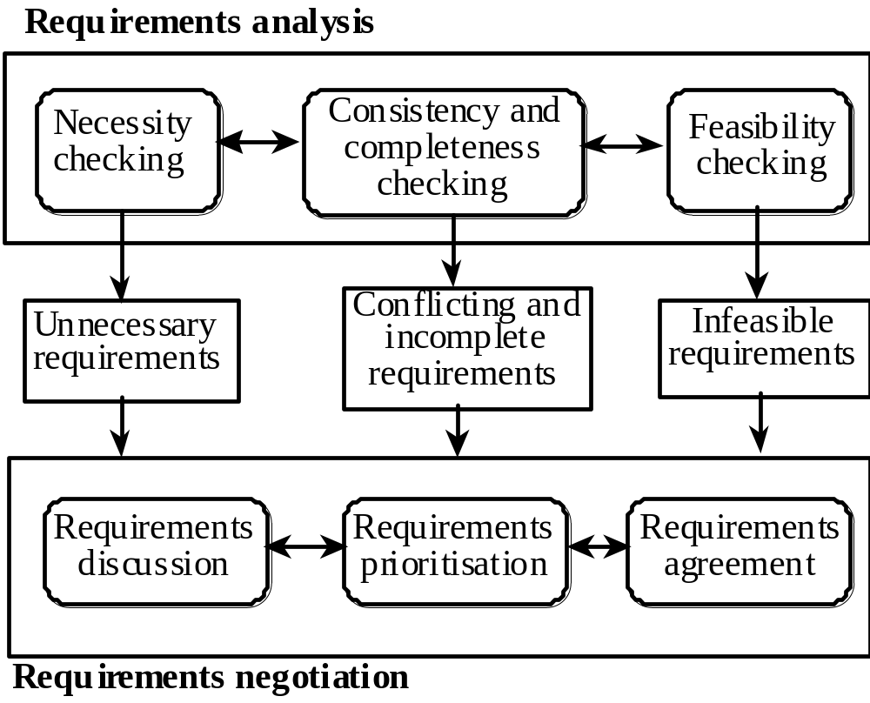
Requirements analysis and negotiation

Slide 54
Analysis Checks
Necessity checking
  The need for the requirement is analysed. In some cases, requirements may be proposed which don’t contribute to the business goals of the organisation or to the specific problem to be addressed by the system.
Consistency and completeness checking
  The requirements are cross-checked for consistency and completeness. Consistency means that no requirements should be contradictory; completeness means that no services or constraints which are needed have been missed out.
Feasibility checking
  The requirements are checked to ensure that they are feasible in the context of the budget and schedule available for the system development.

Slide 55
Requirements Negotiation
Requirements discussion
  Requirements which have been highlighted as problematical are discussed and the stakeholders involved present their views about the requirements.
Requirements prioritisation
  Disputed requirements are prioritised to identify critical requirements and to help the decision making process.
Requirements agreement
  Solutions to the requirements problems are identified and a compromise set of requirements are agreed. Generally, this will involve making changes to some of the requirements.

Slide 56
Elicitation Techniques
Specific techniques which may be used to collect knowledge about system requirements
This knowledge must be structured
  Partitioning - aggregating related knowledge
  Abstraction - recognising generalities
  Projection - organising according to perspective
Elicitation problems
  Not enough time for elicitation
  Inadequate preparation by engineers
  Stakeholders are unconvinced of the need for a new system

Slide 57
Specific elicitation techniques
Interviews
Scenarios
Observations and social analysis
Requirements reuse

Slide 58
Scenarios
Scenarios are stories which explain how a system might be used. They should include
  a description of the system state before entering the scenario
  the normal flow of events in the scenario
  exceptions to the normal flow of events
  information about concurrent activities
  a description of the system state at the end of the scenario
Scenarios are examples of interaction sessions which describe how a user interacts with a system
Discovering scenarios exposes possible system interactions and reveals system facilities which may be required

Slide 59
Library scenario - document ordering
Log on to EDDIS system
Issue order document command
Enter reference number of the required document
Select a delivery option
Log out from EDDIS
This sequence of events can be illustrated in a diagram

Slide 60
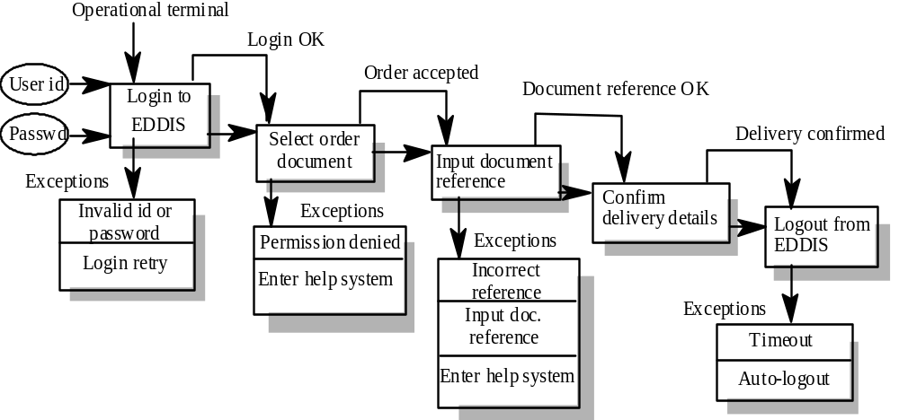
Library Scenario

Slide 61
Prototyping
A prototype is an initial version of a system which may be used for experimentation
Prototypes are valuable for requirements elicitation because users can experiment with the system and point out its strengths and weaknesses. They have something concrete to criticise
Rapid development of prototypes is essential so that they are available early in the elicitation process

Slide 62
Prototyping Benefits
The prototype allows users to experiment and discover what they really need to support their work
Establishes feasibility and usefulness before high development costs are incurred
Essential for developing the ‘look and feel’ of a user interface
Can be used for system testing and the development of documentation
Forces a detailed study of the requirements which reveals inconsistencies and omissions

Slide 63
Requirements Analysis
The goal of analysis is to discover problems, incompleteness and inconsistencies in the elicited requirements. These are then fed back to the stakeholders to resolve them through the negotiation process
Analysis is interleaved with elicitation as problems are discovered when the requirements are elicited
A problem checklist may be used to support analysis. Each requirement may be assessed against the checklist

Slide 64
Summary

Slide 65
Summary
Requirements engineering process include these activities:
Requirements elicitation
  Requirements discovered through consultation with stakeholders
Requirements analysis and negotiation
  Requirements are analysed and conflicts resolved through negotiation
Requirements documentation
  A requirements document is produced
Requirements validation
  The requirements document is checked for consistency and completeness

