Slide 1
Modeling and Design

Slide 2
Class Review
Software specification is the process of determining system services, its operation constraints and the development constraints. The process is called Requirement Engineering (RE).
RE consists of four activities: Feasibility study, Requirements elicitation and analysis, Requirements specification, and Requirements validation.
There are two main types of requirements: functional and non-functional requirements.

Slide 3
Class Review
There are four activities in Requirements Elicitation and analysis: Discovery, Classification and organization, Prioritization and negotiation, ending with Requirements specification.
Requirements management is the process of managing and controlling business, organizational and technical changes to requirements.

Slide 4
Modeling
In Requirements Engineering, modeling of the existing system are created to guide the requirements for the new system.
The models of the new system are also created. Stakeholders see the models as the proposal of the new system. Engineers use it to discuss design proposals.

Slide 5
Design
The design process begins with architectural design to identify the sub-systems and the framework for sub-system control and communication.
The output of this design process is a description of the software architecture.

Slide 6
Modeling and Design
In real life, Requirements Engineering may be overlapped with Designing.

Slide 7
Modeling

Slide 8
Modeling
Modeling is a mean of representing a system using some kind of graphical notation such as the Unified Modeling Language (UML).
Modelling helps clarify the functionality of the system and ,therefore, is used to communicate with customers.
Types of Models:
  Context models
  Interaction models
  Structural models
  Behavioral models

Slide 9
Models
Context models
  Illustrate system boundaries or the operational context of a system or scope.
Interaction models:
  User interaction model helps identifying user requirements.
  Systems interaction model highlights communication issues.
  Component interaction model helps in understanding a system architecture.

Slide 10
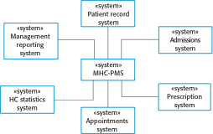
Context Model: MHC PMS
Mental Healthcare Patient Management System

Slide 11
Models
Structural models
  When designing the system architecture, use structureal models to display the organization of a system in terms of the components and their relationships.
Behavioral models
  Display the dynamic behavior of a system in execution by showing what happens and how a system responses to a stimulus.
Use case diagrams and Sequence diagrams may be used.

Slide 12

Unified Modelling Language (UML)

Slide 13
Unified Modelling Language (UML)
UML (Unified Modeling Language) is a standardized general-purpose modeling language in the field of software engineering
Developed by Object Management Group (OMG)

Slide 14
UML (Contd.)
UML 2.0 has 13 types of diagrams divided into three categories
Development of UML
  1996 - UML 1.0
  1997 - UML 1.1
  1998 - UML 1.2
  1999 - UML 1.3
  2000 - UML 1.4
  2001 - UML 2.0

Slide 15
UML (Contd.)
Current Versions of UML (as of 2010)
  UML 2.3 (May 2010)
  UML Superstructure version 2.3
    Definition of the notation and semantics for diagrams and their model elements
  UML Infrastructure version 2.3
    Definition of the core metamodel on which the Superstructure is based

Slide 16
14 UML Diagrams
Structure Diagrams
  Class Diagram
  Component Diagram
  Composite Structure Diagram
  Deployment Diagram
  Object Diagram
  Package Diagram
  Profile Diagram*
Behavior Diagrams
  Activity Diagram
  State Machine Diagram
  Use Case Diagram
Interaction Diagrams
  Communication Diagram
  Interaction Overview Diagram
  Sequence Diagram
  Timing Diagram
(Source: Wikipedia)

Slide 17
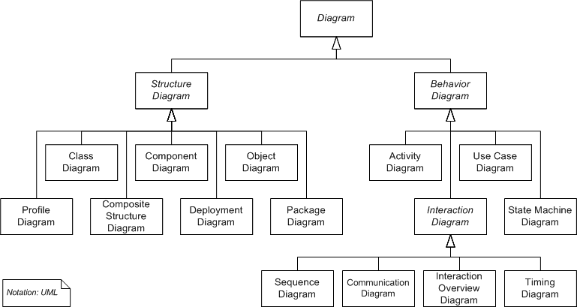
14 UML Diagrams (Contd.)

Slide 18
Structure Diagrams
Emphasizes the static structure of the system using objects, attributes, operations and relationships

Slide 19






Structure Diagrams: Class Diagram
Shows the system’s classes, their attributes, and the relationships among the classes
Application: General OO programming
NAME
NAME
<<interface>>
NAME
Attribute
Container
Operation
Operation
Class
Interface
Package
Generalize Relationship
Realize Relationship

Slide 20
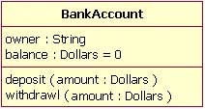
Structure Diagrams: Class Diagram

Slide 21
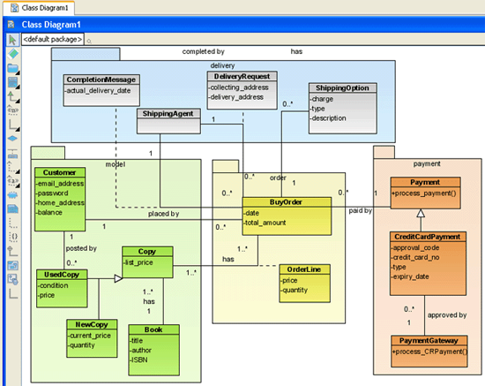
Structure Diagrams: Class Diagram

Slide 22
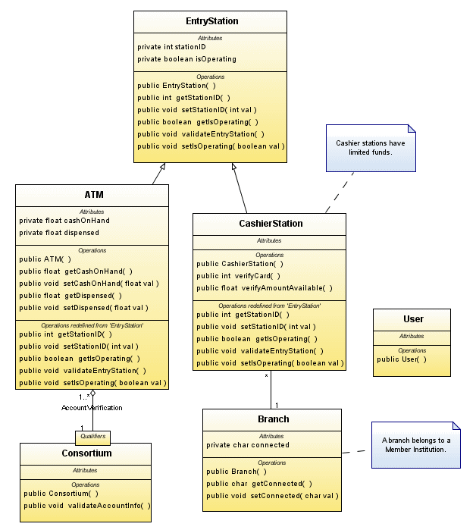
Structure Diagrams: Class Diagram

Slide 23
Structure Diagrams: Component Diagram
Depicts how a software system is split up into components
Shows the dependencies among these components
Application: Any systems which can be modularized
Component

Slide 24
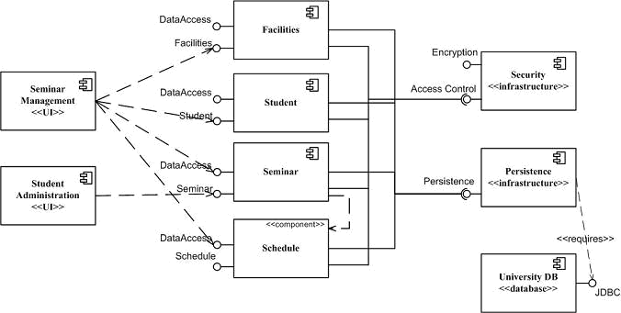
Structure Diagrams: Component Diagram

Slide 25
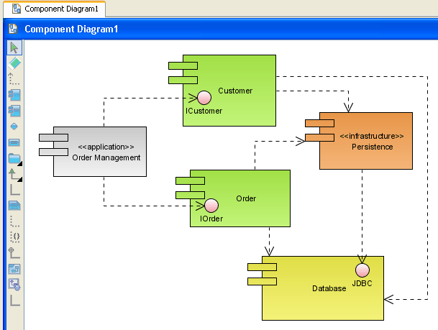
Structure Diagrams: Component Diagram

Slide 26
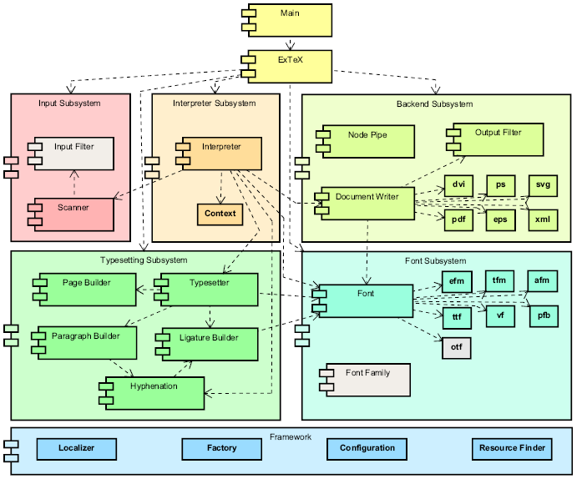
Structure Diagrams: Component Diagram

Slide 27
Structure Diagrams: Composite Structure Diagram
Describes the internal structure of a class
Describes the collaborations that this structure makes possible
Application: Any systems which involves modules with internal structure

Slide 28
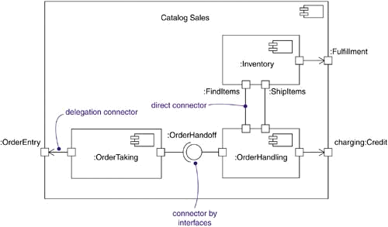
Structure Diagrams: Composite Structure Diagram

Slide 29
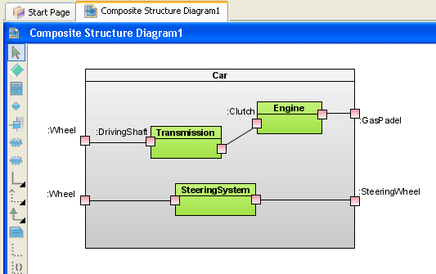
Structure Diagrams: Composite Structure Diagram

Slide 30
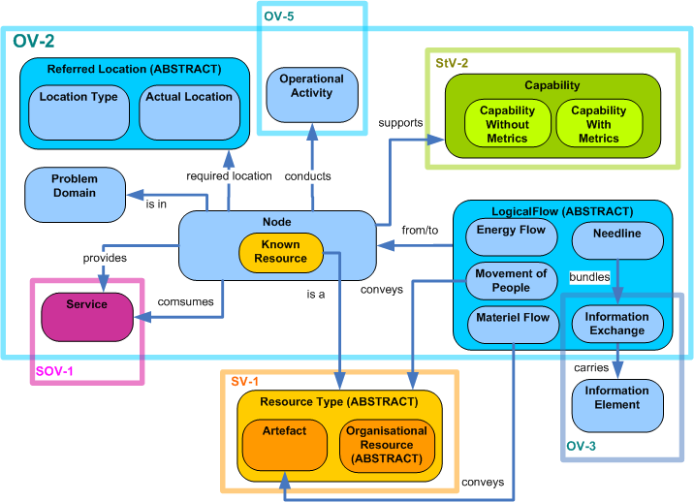
Structure Diagrams: Composite Structure Diagram

Slide 31
Structure Diagrams: Deployment Diagram
Serves to model the hardware used in system implementations
Describes the execution environments and artifacts deployed on the hardware
Application: Hardware dependent systems

Slide 32
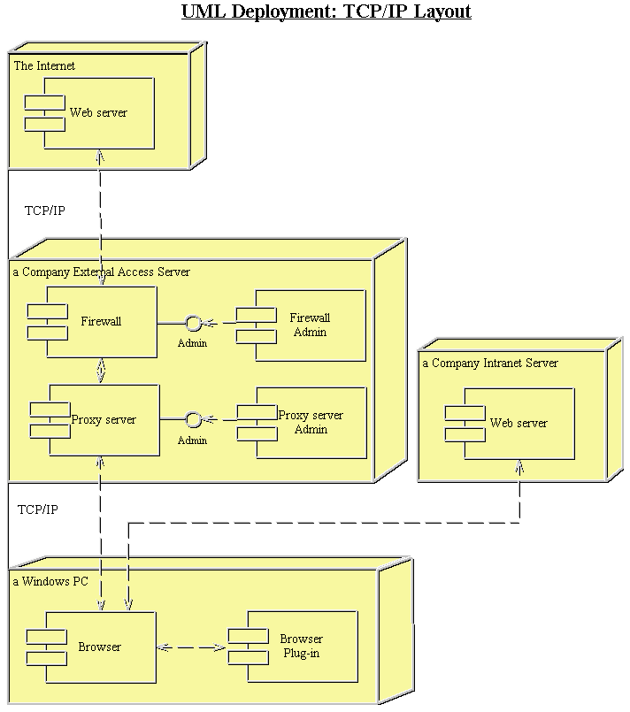
Structure Diagrams: Deployment Diagram

Slide 33
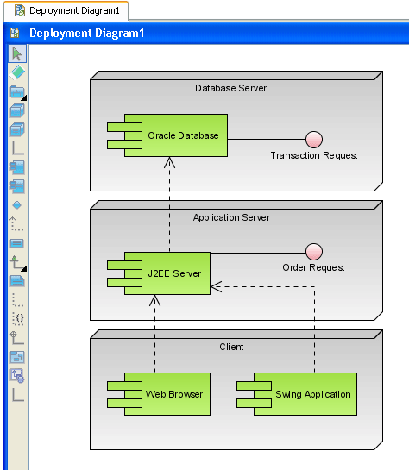
Structure Diagrams: Deployment Diagram

Slide 34
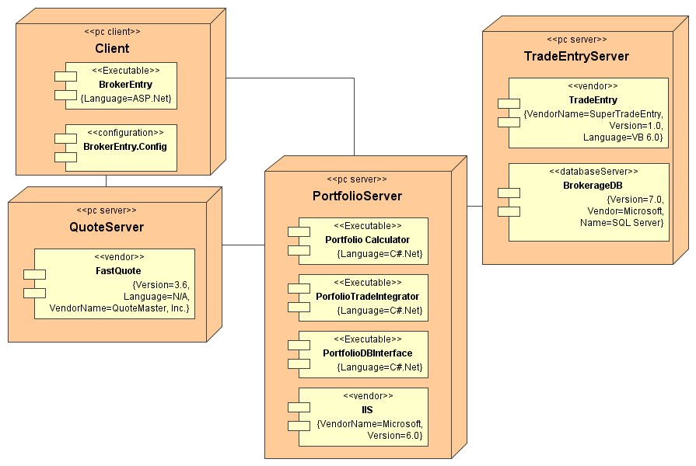
Structure Diagrams: Deployment Diagram

Slide 35
Structure Diagrams: Object Diagram
Shows a complete or partial view of the structure of a modeled system at a specific time
Application: A system which needs to show internal data structure

Slide 36
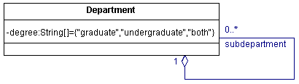
Structure Diagrams: Object Diagram

Slide 37
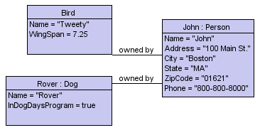
Structure Diagrams: Object Diagram

Slide 38
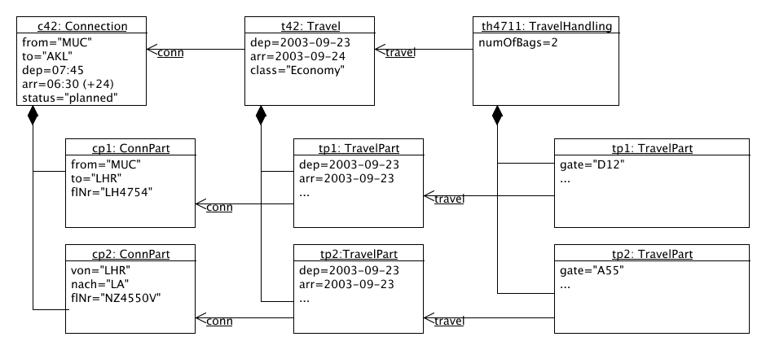
Structure Diagrams: Object Diagram

Slide 39
Structure Diagrams: Package Diagram
Groups objects into packages in order to simplify the system
Shows the dependencies among these groupings
Application: A system which emphasizes on functionality
Package
Dependencies

Slide 40
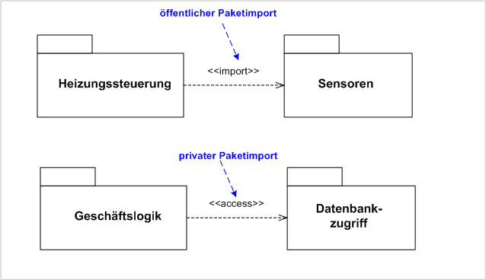
Structure Diagrams: Package Diagram

Slide 41
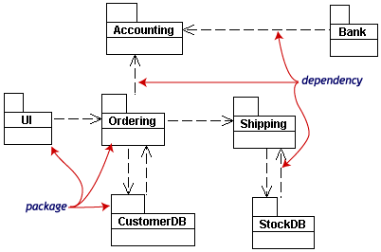
Structure Diagrams: Package Diagram

Slide 42
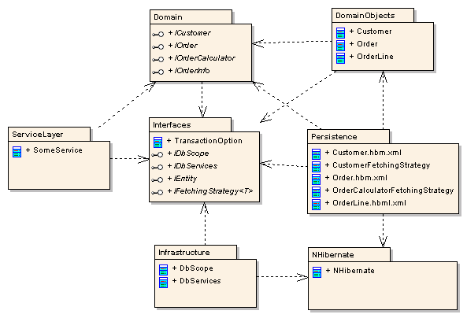
Structure Diagrams: Package Diagram

Slide 43
Structure Diagrams: Profile Diagram
A kind of package that extends a reference metamodel by defining limited extensions to the reference metamodel with the purpose of adapting it to a specific platform or domain.
Show custom stereotypes.
Application: A system working on different platforms.

Slide 44
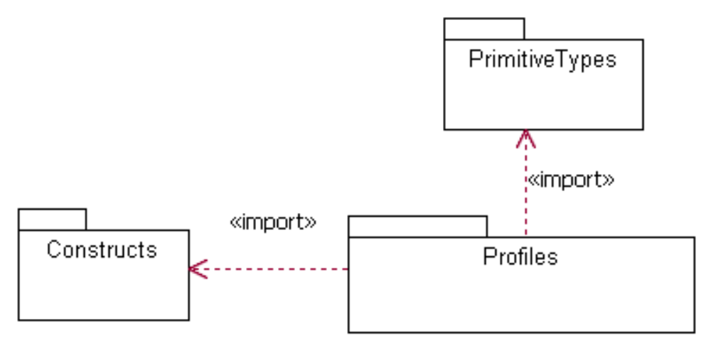
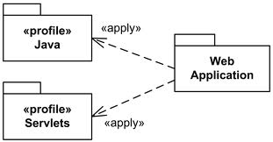
Structure Diagrams: Profile Diagram

Slide 45
Behavior Diagrams
Emphasizes what must happen in the system being modeled

Slide 46
Behavior Diagrams: Activity Diagram
Represents the business and operational step-by-step workflows of components in a system
An activity diagram shows the overall flow of control
Application: Flowing processes
Initial State
Final State
Activity State
Synchronization Bar

Slide 47
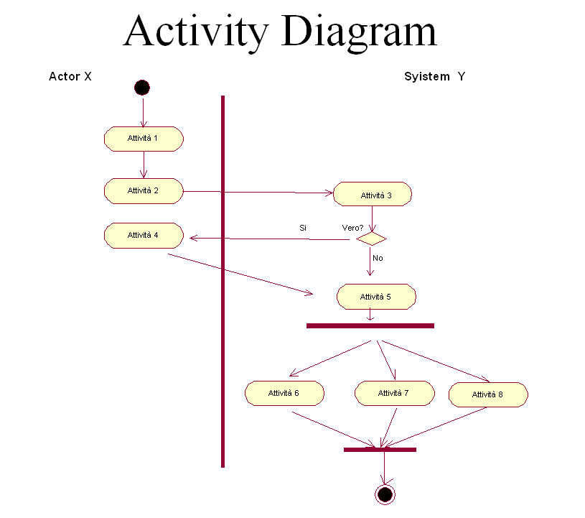
Behavior Diagrams: Activity Diagram

Slide 48
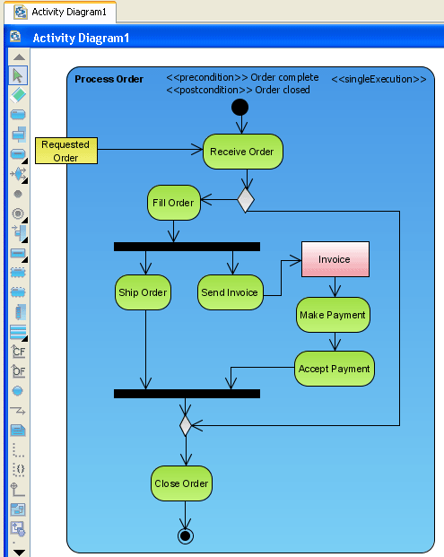
Behavior Diagrams: Activity Diagram

Slide 49
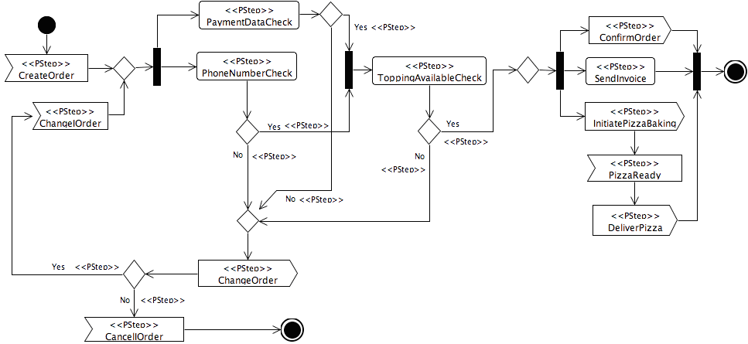
Behavior Diagrams: Activity Diagram

Slide 50
Behavior Diagrams: State Machine Diagram
Describe various states which certain classes response to certain events
It is normally used for explaining classes with high complexity
Application: Flowing processes with different choices of interactions

Slide 51
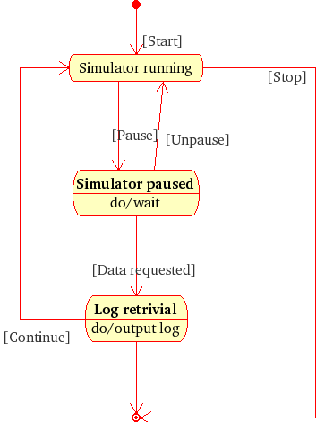
Behavior Diagrams: State Machine Diagram

Slide 52
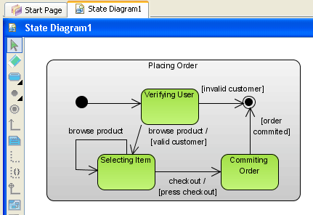
Behavior Diagrams: State Machine Diagram

Slide 53
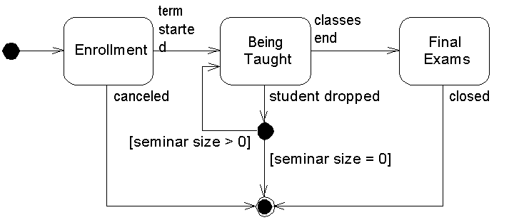
Behavior Diagrams: State Machine Diagram

Slide 54
Behavior Diagrams: Use Case Diagram
Describe what a system does from the standpoint of an external observer
The emphasis is on what a system does rather than how
Application: Determining features, communicating with clients, generating test cases

Slide 55
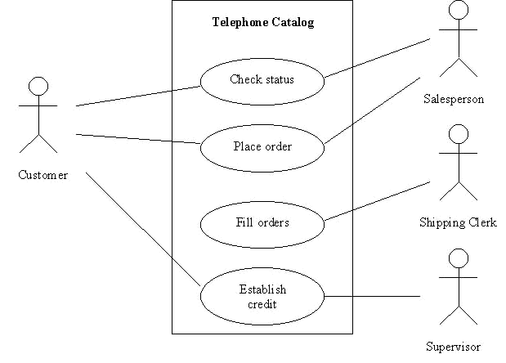
Behavior Diagrams: Use Case Diagram

Slide 56
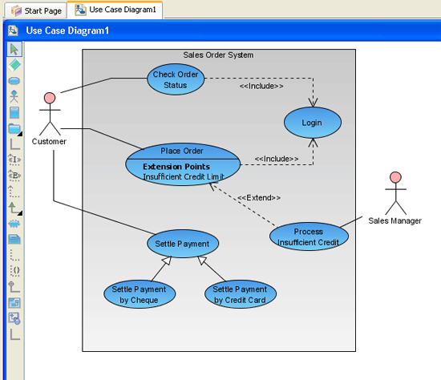
Behavior Diagrams: Use Case Diagram

Slide 57
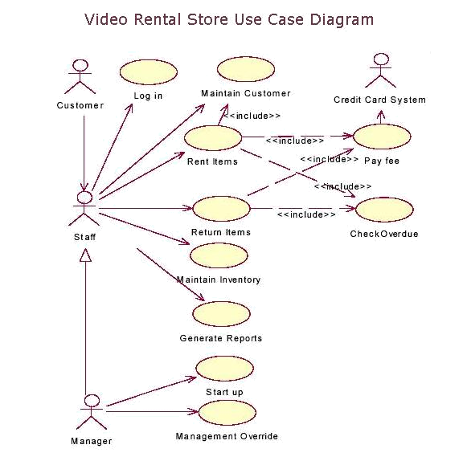
Behavior Diagrams: Use Case Diagram

Slide 58
Interaction Diagrams
A subset of behavior diagrams
Emphasize the flow of control and data among the things in the system being modeled

Slide 59
Interaction Diagrams: Communication Diagram
Shows the message flow between objects in an OO application
Shows the basic associations (relationships) between classes
Application: General systems with interactive processes

Slide 60
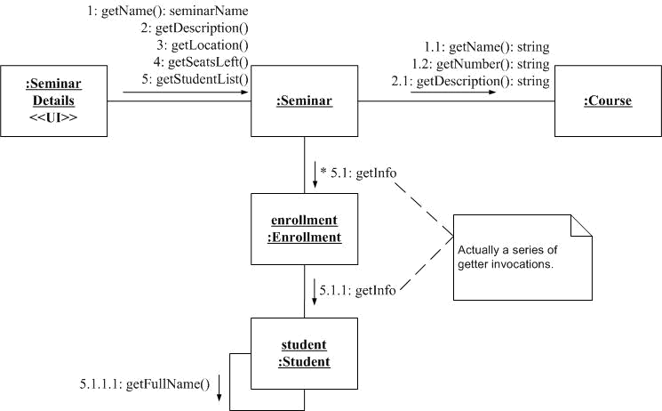
Interaction Diagrams: Communication Diagram

Slide 61
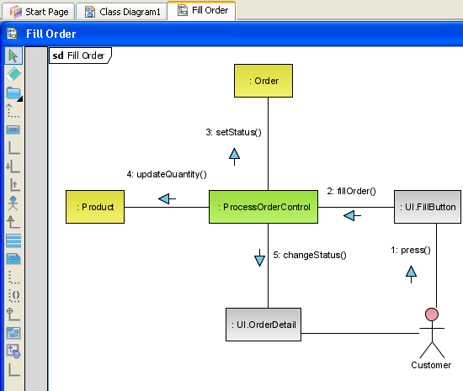
Interaction Diagrams: Communication Diagram

Slide 62
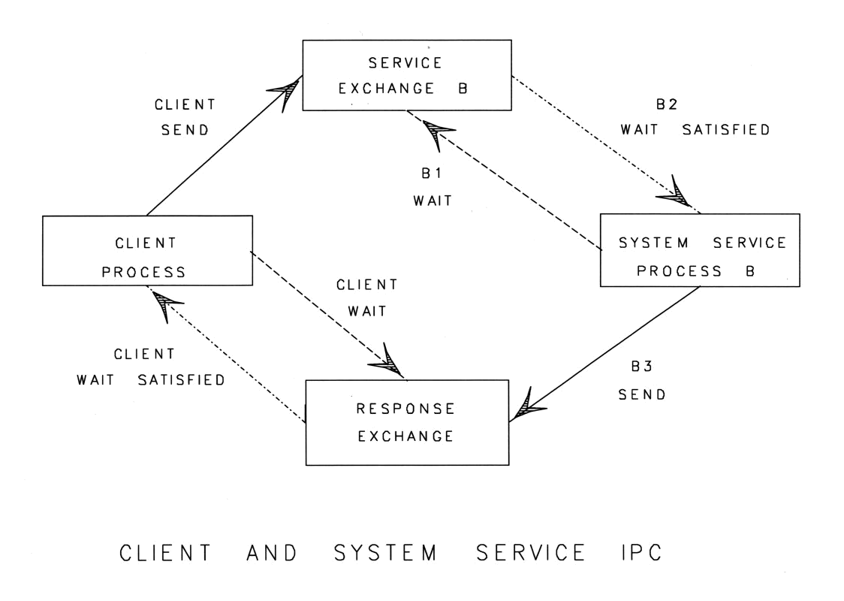
Interaction Diagrams: Communication Diagram

Slide 63
Interaction Diagrams: Interaction Overview Diagram
Is an activity diagram in which overviews control flows
The nodes within the diagram are framed
Application: System components with flowing interactions

Slide 64
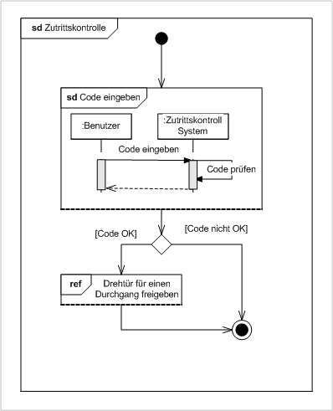
Interaction Diagrams: Interaction Overview Diagram

Slide 65
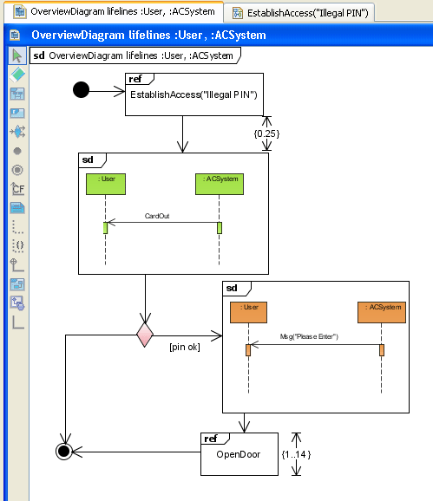
Interaction Diagrams: Interaction Overview Diagram

Slide 66
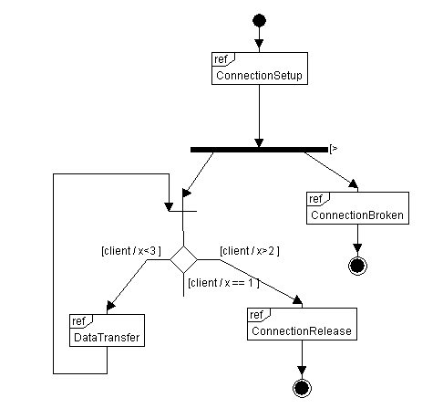
Interaction Diagrams: Interaction Overview Diagram

Slide 67
Interaction Diagrams: Sequence Diagram
Shows the sequence of the system, ordered by objects and time
Indicates the lifespan of objects relative to those messages
Application: Systems with tentative sequences

Slide 68
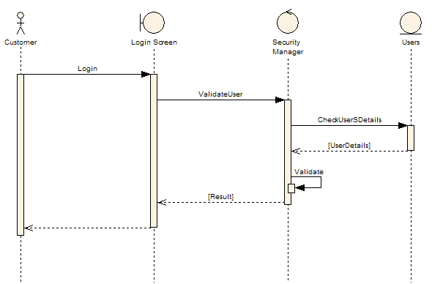
Interaction Diagrams: Sequence Diagram

Slide 69
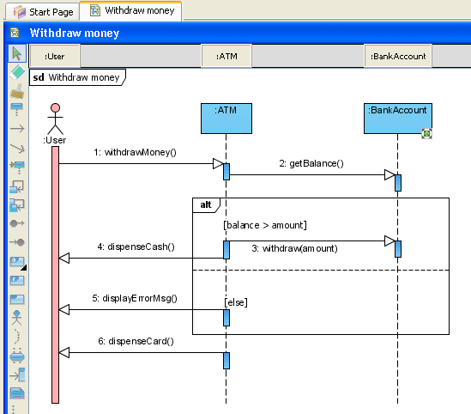
Interaction Diagrams: Sequence Diagram

Slide 70
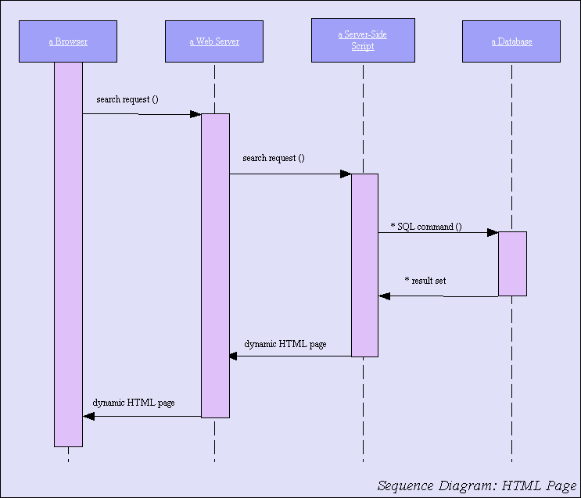
Interaction Diagrams: Sequence Diagram

Slide 71
Interaction Diagrams: Timing Diagram
Focuses on timing constraints
Application: Processes which are time-oriented

Slide 72
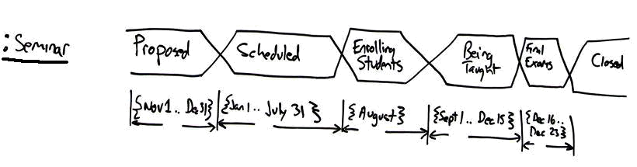
Interaction Diagrams: Timing Diagram

Slide 73
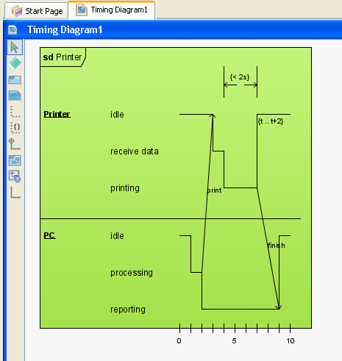
Interaction Diagrams: Timing Diagram

Slide 74
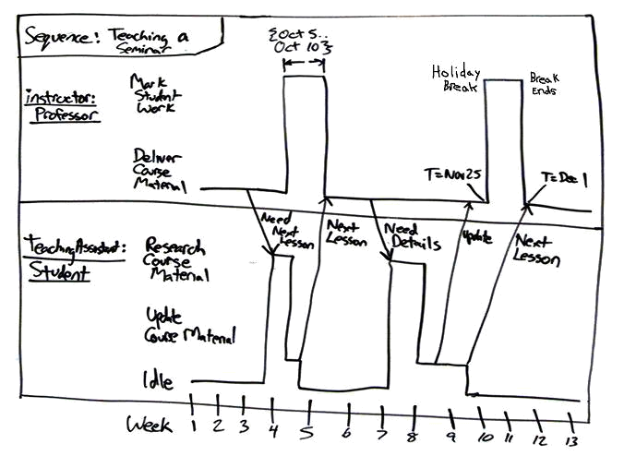
Interaction Diagrams: Timing Diagram

Slide 75
Exercise
Draw a UML model of the process of SE project using one of the following diagrams:
  Use case
  State machine
  Sequence
  Timing

Slide 76
Summary
Modeling is the process of representing the system, mostly in graphical notations, for understanding, designing and communication.
Architectural design is the process of identifying sub-systems and its framework for controlling and communication.
Software architecture is the output of the Architectural design process.

