Slide 1
Architectural Design

Slide 2
Class Review
System modeling aids in representing and understanding of the system.
Requirements specification may be overlapped with Designing activities.
Designing starts from Architectural design which involves identifying sub-systems and its framework for controlling and communication.
Software architecture is the output of the Architectural design process.

Slide 3
Software Engineering Project Milestones (SEPM)
Requirements Specification Document (Mon 21 Sep)
  Requirements, Design
Prototype Demo #1 (Sprint #1-Mon 19 Oct)
  Reuse, Construction, Testing
Prototype Demo #2 (Sprint #2-Mon 9 Nov)
  Reuse, Construction, Testing
Final Prototype (Sprint #3-Mon 23 Nov)
  Acceptance test

Slide 4
Prototype Demo #1
Sprint #1 (3 weeks iteration)
Due on Mon 19 Oct
  Reuse, Construction, Testing
Presentation: 5-7 minutes
Outline
  Present the overview of application using Wireframes or an Interactive prototype
  Demo the selected function for Release #1
  Present the plans (test & integration & construction plans) for Sprint #2 (Release #2)

Slide 5
Prototype Demo #2
Sprint #2 (3 weeks iteration)
Due on 9 Nov
  Reuse, Construction, Testing
Presentation: 5-7 minutes
Outline
  Present the overview of application using Wireframes or an Interactive prototype
  Present any update on Release #1, if any.
  Demo the selected function for Release #2
  Present the plans (test & integration & construction plans) for the final sprint (Sprint #3, Release #3)

Slide 6
Final Prototype
Sprint #3 (2 weeks iteration)
Due on Mon 23 Nov
  Acceptance test
Presentation: 10 minutes
Outline
  Present the overview of application using an Interactive prototype
  Present any update on Release #1 or #2, if any.
  Demo the selected function for Release #3
  Demo the whole application

Slide 7
Software Architecture
As many definitions do, architecture is a set of components and their connections.
Software architecture definition is much more precise.
“The software architecture of a program or computing system is the structure or structures of the system, which comprise software elements, the externally visible properties of those elements, and the relationships among them.”¹
1. Software Architecture in Practice, 2nd Edition.

Slide 8
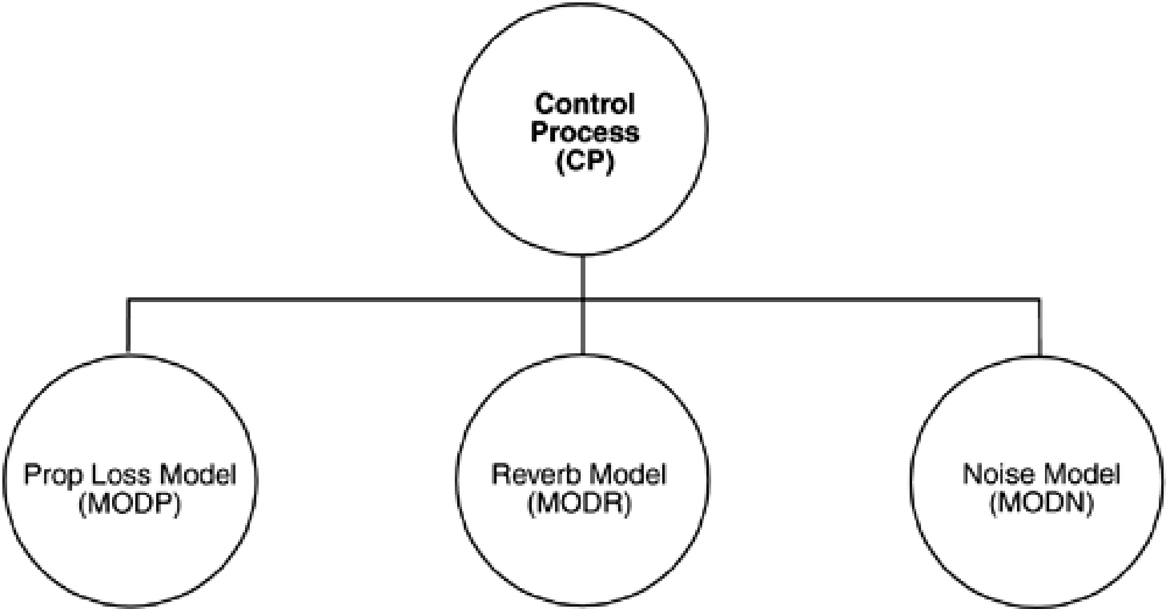
An Example
Underwater acoustic simulation
Informative or uninformative?
What can we tell from it?
What can we not tell from the diagram?
Notes:
We can tell that the system has:
The system consists of four elements.
Three of the elements— Prop Loss Model (MODP), Reverb Model (MODR), and Noise Model (MODN)—might have more in
common with each other than with the fourth—Control Process (CP)—because they are positioned next to each other.
All of the elements apparently have some sort of relationship with each other, since the diagram is fully connected.
Is this an architecture? Assuming (as many definitions do) that architecture is a set of components (of which we have four) and
connections among them (also present), this diagram seems to fill the bill. However, even if we accept the most primitive definition, what
can we not tell from the diagram?
What is the nature of the elements? What is the significance of their separation? Do they run on separate processors? Do they
run at separate times? Do the elements consist of processes, programs, or both? Do they represent ways in which the project
labor will be divided, or do they convey a sense of runtime separation? Are they objects, tasks, functions, processes,
distributed programs, or something else?
What are the responsibilities of the elements? What is it they do? What is their function in the system?
What is the significance of the connections? Do the connections mean that the elements communicate with each other, control
each other, send data to each other, use each other, invoke each other, synchronize with each other, share some
information-hiding secret with each other, or some combination of these or other relations? What are the mechanisms for the
communication? What information flows across the mechanisms, whatever they may be?
What is the significance of the layout? Why is CP on a separate level? Does it call the other three elements, and are the others
not allowed to call it? Does it contain the other three in an implementation unit sense? Or is there simply no room to put all four
elements on the same row in the diagram?

Slide 9
Software Architecture Implication
Architecture is high-level design of the system’s overall structure that defines software elements and its behavior.
Architecture is the principles and guidelines governing their design and evolution over time.
The systems can comprise more than one structure.

Slide 10
Architectural design decisions
Is there a generic application architecture that can be used?
How will the system be distributed?
What architectural styles are appropriate?
What approach will be used to structure the system?
How will the system be decomposed into modules?
What control strategy should be used?
How will the architectural design be evaluated?
How should the architecture be documented?
Chapter 6 Architectural design

Slide 11
Architecture reuse
Systems in the same domain often have similar architectures that reflect domain concepts.
Application product lines are built around a core architecture with variants that satisfy particular customer requirements.
The architecture of a system may be designed around one of more architectural patterns or ‘styles’.
  These capture the essence of an architecture and can be instantiated in different ways.
  Discussed later in this lecture.
Chapter 6 Architectural design

Slide 12
Software Architecture Views
Software architecture is commonly organized in views.
4+1 view model designed by Philippe Kruchten
  Logical view (Function)
  Process view (Concurrency/Thread view)
  Development (Structure/Decomposition)
  Physical (Deployment)
  User action (Use case)
Other views
  Code/Module view
  Data view

Slide 13
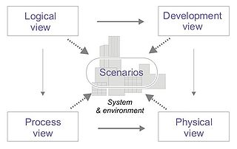
4+1

Slide 14
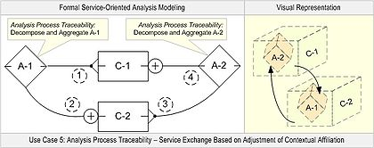
Languages/Notations
UML
Service-Oriented Modeling (SOM)
  Design and specify service-oriented business systems within a service-oriented architecture (SOA).
  Service-oriented analysis and design (SOMA)
  Service-oriented modeling framework (SOMF)

Slide 15
Advantages of Explicit Architecture
Stakeholder communication
  Architecture may be used as a focus of discussion by system stakeholders
System analysis
  Means that analysis of whether the system can meet its non-functional requirements is possible
Large-scale reuse
  The architecture may be reusable across a range of systems

Slide 16
Architectural Patterns (Styles)
An architectural style/pattern is a stylized description of good design practice, which has been tried and tested in different environments.
Patterns may be represented in tabular and/or graphical forms.
Patterns should provide information about when they are and when the are not useful.

Slide 17
Architectural Patterns
Model-view-controller (MVC)
Layered architecture
The Repository pattern
Client-server architecture
Database-centric architecture
Pipe and filter architecture
Application architectures
Information systems architecture
Service-oriented architecture (SOA)

Slide 18
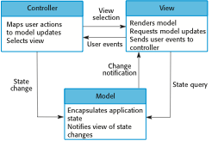
MVC
Separate Logic from Input and presentation (GUI) to permit independent development and testing of each.

Slide 19
MVC
Name | MVC (Model-View-Controller)
Description | Separates presentation and interaction from the system data. The system is structured into three logical components that interact with each other. The Model component manages the system data and associated operations on that data. The View component defines and manages how the data is presented to the user. The Controller component manages user interaction (e.g., key presses, mouse clicks, etc.) and passes these interactions to the View and the Model. See Figure 6.3.
Example | Figure 6.4 shows the architecture of a web-based application system organized using the MVC pattern.
When used | Used when there are multiple ways to view and interact with data. Also used when the future requirements for interaction and presentation of data are unknown.
Advantages | Allows the data to change independently of its representation and vice versa. Supports presentation of the same data in different ways with changes made in one representation shown in all of them.
Disadvantages | Can involve additional code and code complexity when the data model and interactions are simple.

Slide 20
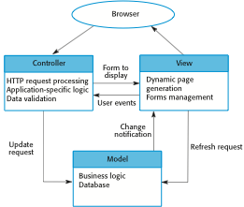
Web Application Architecture using MVC

Slide 21
Some MVC Frameworks
GUI
  Cocoa
  Microsoft Foundation Class Library (MFC)
Web-based
  Monorail (.NET)
  CakePHP

Slide 22
Layered architecture
Used to model the interfacing of sub-systems.
Organises the system into a set of layers. Each provides a set of services.
Supports the incremental development of sub-systems in different layers. When a layer interface changes, only the adjacent layer is affected.

Slide 23
The Layered architecture pattern
Name | Layered architecture
Description | Organizes the system into layers with related functionality associated with each layer. A layer provides services to the layer above it so the lowest-level layers represent core services that are likely to be used throughout the system. See Figure 6.6.
Example | A layered model of a system for sharing copyright documents held in different libraries, as shown in Figure 6.7.
When used | Used when building new facilities on top of existing systems; when the development is spread across several teams with each team responsibility for a layer of functionality; when there is a requirement for multi-level security.
Advantages | Allows replacement of entire layers so long as the interface is maintained. Redundant facilities (e.g., authentication) can be provided in each layer to increase the dependability of the system.
Disadvantages | In practice, providing a clean separation between layers is often difficult and a high-level layer may have to interact directly with lower-level layers rather than through the layer immediately below it. Performance can be a problem because of multiple levels of interpretation of a service request as it is processed at each layer.

Slide 24
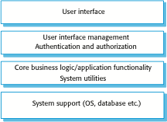
A generic layered architecture

Slide 25
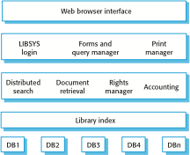
The architecture of the LIBSYS system

Slide 26
Repository architecture
Sub-systems must exchange data. This may be done in two ways:
  Shared data is held in a central database or repository and may be accessed by all sub-systems;
  Each sub-system maintains its own database and passes data explicitly to other sub-systems.
When large amounts of data are to be shared, the repository model of sharing is most commonly used a this is an efficient data sharing mechanism.

Slide 27
The Repository pattern
Name | Repository
Description | All data in a system is managed in a central repository that is accessible to all system components. Components do not interact directly, only through the repository.
Example | Figure 6.9 is an example of an IDE where the components use a repository of system design information. Each software tool generates information which is then available for use by other tools.
When used | You should use this pattern when you have a system in which large volumes of information are generated that has to be stored for a long time. You may also use it in data-driven systems where the inclusion of data in the repository triggers an action or tool.
Advantages | Components can be independent—they do not need to know of the existence of other components. Changes made by one component can be propagated to all components. All data can be managed consistently (e.g., backups done at the same time) as it is all in one place.
Disadvantages | The repository is a single point of failure so problems in the repository affect the whole system. May be inefficiencies in organizing all communication through the repository. Distributing the repository across several computers may be difficult.

Slide 28
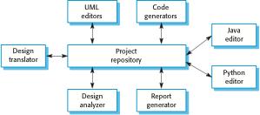
A repository architecture for an IDE

Slide 29
Client-server architecture
Distributed system model which shows how data and processing is distributed across a range of components.
  Can be implemented on a single computer.
Set of stand-alone servers which provide specific services such as printing, data management, etc.
Set of clients which call on these services.
Network which allows clients to access servers.

Slide 30
The Client–server pattern
Name | Client-server
Description | In a client–server architecture, the functionality of the system is organized into services, with each service delivered from a separate server. Clients are users of these services and access servers to make use of them.
Example | Figure 6.11 is an example of a film and video/DVD library organized as a client–server system.
When used | Used when data in a shared database has to be accessed from a range of locations. Because servers can be replicated, may also be used when the load on a system is variable.
Advantages | The principal advantage of this model is that servers can be distributed across a network. General functionality (e.g., a printing service) can be available to all clients and does not need to be implemented by all services.
Disadvantages | Each service is a single point of failure so susceptible to denial of service attacks or server failure. Performance may be unpredictable because it depends on the network as well as the system. May be management problems if servers are owned by different organizations.

Slide 31
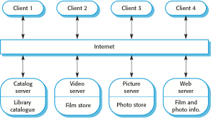
A client–server architecture for a film library

Slide 32
Pipe and filter architecture
Functional transformations process their inputs to produce outputs.
May be referred to as a pipe and filter model (as in UNIX shell).
Variants of this approach are very common. When transformations are sequential, this is a batch sequential model which is extensively used in data processing systems.
Not really suitable for interactive systems.

Slide 33
The pipe and filter pattern
Name | Pipe and filter
Description | The processing of the data in a system is organized so that each processing component (filter) is discrete and carries out one type of data transformation. The data flows (as in a pipe) from one component to another for processing.
Example | Figure 6.13 is an example of a pipe and filter system used for processing invoices.
When used | Commonly used in data processing applications (both batch- and transaction-based) where inputs are processed in separate stages to generate related outputs.
Advantages | Easy to understand and supports transformation reuse. Workflow style matches the structure of many business processes. Evolution by adding transformations is straightforward. Can be implemented as either a sequential or concurrent system.
Disadvantages | The format for data transfer has to be agreAed upon between communicating transformations. Each transformation must parse its input and unparse its output to the agreed form. This increases system overhead and may mean that it is impossible to reuse functional transformations that use incompatible data structures.

Slide 34
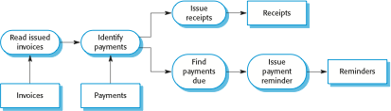
Example: pipe and filter architecture

Slide 35
Application architectures
Application systems are designed to meet an organisational need.
As businesses have much in common, their application systems also tend to have a common architecture that reflects the application requirements.
A generic application architecture is an architecture for a type of software system that may be configured and adapted to create a system that meets specific requirements.

Slide 36
Use of application architectures
As a starting point for architectural design.
As a design checklist.
As a way of organising the work of the development team.
As a means of assessing components for reuse.
As a vocabulary for talking about application types.

Slide 37
Examples of application types
Data processing applications
  Data driven applications that process data in batches without explicit user intervention during the processing.
Transaction processing applications
  Data-centred applications that process user requests and update information in a system database.
Event processing systems
  Applications where system actions depend on interpreting events from the system’s environment.
Language processing systems
  Applications where the users’ intentions are specified in a formal language that is processed and interpreted by the system.

Slide 38
Application type examples
Focus here is on transaction processing and language processing systems.
Transaction processing systems
  E-commerce systems;
  Reservation systems.
Language processing systems
  Compilers;
  Command interpreters.

Slide 39
Transaction processing systems
Process user requests for information from a database or requests to update the database.
From a user perspective a transaction is:
  Any coherent sequence of operations that satisfies a goal;
  For example - find the times of flights from London to Paris.
Users make asynchronous requests for service which are then processed by a transaction manager.

Slide 40
The structure of transaction processing applications

Slide 41
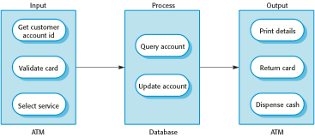
The software architecture of an ATM system

Slide 42
Information systems architecture
Information systems have a generic architecture that can be organised as a layered architecture.
These are transaction-based systems as interaction with these systems generally involves database transactions.
Layers include:
  The user interface
  User communications
  Information retrieval
  System database

Slide 43
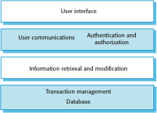
Layered information system architecture

Slide 44
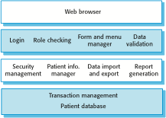
The architecture of the MHC-PMS

Slide 45
Web-based information systems
Information and resource management systems are now usually web-based systems where the user interfaces are implemented using a web browser.
For example, e-commerce systems are Internet-based resource management systems that accept electronic orders for goods or services and then arrange delivery of these goods or services to the customer.
In an e-commerce system, the application-specific layer includes additional functionality supporting a ‘shopping cart’ in which users can place a number of items in separate transactions, then pay for them all together in a single transaction.

Slide 46
Server implementation
These systems are often implemented as multi-tier client server/architectures (discussed in Chapter 18)
  The web server is responsible for all user communications, with the user interface implemented using a web browser;
  The application server is responsible for implementing application-specific logic as well as information storage and retrieval requests;
  The database server moves information to and from the database and handles transaction management.

Slide 47
Language processing systems
Accept a natural or artificial language as input and generate some other representation of that language.
May include an interpreter to act on the instructions in the language that is being processed.
Used in situations where the easiest way to solve a problem is to describe an algorithm or describe the system data
  Meta-case tools process tool descriptions, method rules, etc and generate tools.

Slide 48
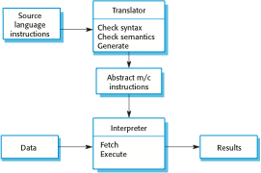
The architecture of a language processing system

Slide 49
Compiler components
A lexical analyzer, which takes input language tokens and converts them to an internal form.
A symbol table, which holds information about the names of entities (variables, class names, object names, etc.) used in the text that is being translated.
A syntax analyzer, which checks the syntax of the language being translated.
A syntax tree, which is an internal structure representing the program being compiled.

Slide 50
Compiler components
A semantic analyzer that uses information from the syntax tree and the symbol table to check the semantic correctness of the input language text.
A code generator that ‘walks’ the syntax tree and generates abstract machine code.

Slide 51

A pipe and filter compiler architecture

Slide 52
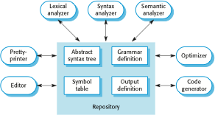
A repository architecture for a language processing system

Slide 53
Exercises
Choose an architectural pattern for your research project and state reasons why you choose it.
Decide whether to use an architectural design framework for your project. Also state your reason.

