Slide 1
Design and Implementation

Slide 2
Class Review
Architectural Design is high-level design of the system’s overall structure that defines software elements and its behavior.
Architectural patterns/styles can be in tabular(ตาราง) and/or graphical forms. It is a descriptions of good design practices.
Example patterns include MVC, Client-Server, Application architectures.

Slide 3
Design and Implementation
Design is identifying software components and their relationships, based on a customer’s requirements.
Implementation(การดำเนินงาน) is the process of realizing the design as a program.
COTS (Commercial Off-The-Shelf)(ผลิตภัณฑ์ที่มีจำหน่าย หาซื้อมาใช้ได้ทันที), simply called Off-The-Shelf (OTS), may be purchased and adapted to tailor(ตัดต่อ) user’s requirements.
The design process of a system developing using COTS is different.

Slide 4
Object-Oriented Design
Involves developing a number of different models.
Not appropriate(เหมาะสม) for small systems as the development and maintenance of these models are expensive.

Slide 5
Process Stages
Define system’s context and modes.
  Relationship between the system and its external environment.
Design the system architecture.
  Identify major system components and their interactions.
Identify the principle system objects.
  Rely(อาศัย) on skill, experience and domain knowledge of system designers.
Develop design models.
  Model objects, object classes and relationships.
Specify object interfaces.
  Objects may have several interfaces (methods, viewpoints)
  UML uses class diagrams for interface specification.

Slide 6
Design Patterns
A pattern is a description of the problem and the description of its solution.
A design pattern makes a way for reusing abstract(นามธรรม) knowledge about a problem and its solution.
Therefore, a design pattern should be sufficiently(เต็มที่) abstract for reuse in different settings.

Slide 7
A Design Pattern
Name
  A meaningful pattern identifier.
Problem description.
Solution description.
  Not a concrete(ชัดเจน,เป็นรูปธรรม) design but a template(แม่แบบ) for a design solution that can be instantiated in different ways.
Consequences(ผลที่เกิดขึ้น)
  The results and trade-offs of applying the pattern.

Slide 8
The Observer Pattern
Name
  Observer.
Description
  Separates the display of object state from the object itself.
Problem description
  Used when multiple displays of state are needed.
Solution description
  See slide with UML description.
Consequences
  Optimisations(การเพิ่มประสิทธิภาพ) to enhance(เสริม,ยกระดับ) display performance are impractical.

Slide 9
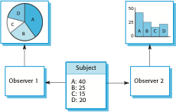
Multiple Display using The Observer Pattern

Slide 10
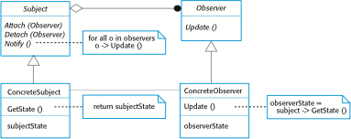
A UML model of the Observer pattern

Slide 11
Software Reuse

Slide 12
Reuse
The main purpose of reuse is cost reduction and schedule(กำหนดการณ์) compression(บีบอัด).
Costs and schedule are important for commercial(การค้า) and Internet-based systems.
The reuse of existing software is, therefore, emerged(ปรากฏออกมา) and is now generally(โดยทั่วไป) used for business and scientific software.

Slide 13
Reuse Levels
The abstraction level
  Use knowledge of successful abstractions in the design of your software.
The object level
  Directly reuse objects from a library rather(ค่อนข้างจะ) than writing the code yourself.
The component level
  Reuse components are collections of objects and object classes.
The system level
  Reuse entire(ทั้งหมด) application systems.

Slide 14
Benefits of Reuse
Increase dependability(เชื่อถือ,พึ่งพา,ไว้วางใจได้)
Reduce process risk
Effective(มีประสิทธิภาพ) use of specialists(ผู้ชำนาญเฉพาะด้าน)
Standard compliance(การยินยอม)
Accelerated(เร่งให้เกิด) development

Slide 15
Problems with Reuse
Increased maintenance costs
Lack of tools support
Creating, maintaining and using component library
Finding, understanding and adapting reusable components

Slide 16
Approaches(วิธีการ) that Support Reuse
Architectural patterns
Design patterns
Component-based development
Application frameworks
Software product lines
COT software reuse
ERP systems
Program libraries

Slide 17
Configuration Management

Slide 18
Configuration Management
Configuration(โครงร่าง) management is the general process of managing a changing software system.
Aim(มุ่งหมาย) in supporting the system integration(การรวมตัวกัน) process so that all developers can access the project code and documents in a controlled way, find out what changes have been made, and compile and link components to create a system.

Slide 19
Configuration Management Activities
Version management
System integration
Problem tracking

Slide 20
Software Configuration Management
Configuration identification - Identifying configurations, configuration items and baselines.
Configuration control - Implementing a controlled change process. This is usually achieved by setting up a change control board whose primary function is to approve(อนุมัติ) or reject(ปฏิเสธ) all change requests that are sent against(ต่อต้าน,ย้อนกลับไป) any baseline.

Slide 21
Software Configuration Management
Configuration status accounting(บัญชี) - Recording and reporting all the necessary(จำเป็น) information on the status of the development process.
Configuration auditing(การตรวจสอบบัญชี) – Ensuring(การสร้างความมั่นใจ) that configurations contain all their intended(มุ่งหมาย) parts and are sound with respect to their specifying documents, including requirements, architectural specifications(ข้อกำหนด) and user manuals.

Slide 22
Software Configuration Management
Build management - Managing the process and tools used for builds.
Process management - Ensuring adherence(การยึดมั่น,ความเลื่อมใส) to the organization's development process.
Environment management - Managing the software and hardware that host the system.
Teamwork - Facilitate(การส่งเสริม,สนับสนุน) team interactions related to the process.
Defect(ปมด้อย) tracking - Making sure every defect has traceability(ติดตามได้) back to the source.

Slide 23
Testing

Slide 24
Verification and Validation
Verification: (การพิสูจน์)
  "Are we building the product right”
  The software should conform to its specification
Validation: (ทำให้ใช้ได้จริง)
  "Are we building the right product”
  The software should do what the user really requires

Slide 25
The V&V Process
Is a whole life-cycle process
  V&V must be applied at each stage in the software process
Has two principal(หลัก) objectives
  The discovery of defects in a system
  The assessment(การประเมิน) whether(ไม่ว่าจะมีอะไรเกิดขึ้นก็ตาม) the system is useable in an operational situation

Slide 26
V&V Goals
Verification and validation should establish(สร้าง) confidence that the software is adequate(เพียงพอ,เหมาะสม)
  This does NOT mean completely free of defects
  Rather(ตรงกันข้าม), it must be good enough for its intended(มุ่งหมาย) use and the type of use will determine(ตัดสินใจ) the degree of confidence that is needed

Slide 27
V&V Confidence
Depends on:
  System’s Purpose
    The level of confidence depends on how critical the software is to an organisation
  User Expectations
    Users may have different expectations of certain kinds of software
  Marketing Environment
    Getting a product to market early may be more important than finding defects in the program

Slide 28
Static and Dynamic Verification
Static Verification
  Software inspections(การตรวจตราอย่างละเอียด)
    Concerned with analysis of the static system representation to discover problems
    May be supplement(ส่งเสริม,เพิ่มเติม) by tool-based document and code analysis
Dynamic Verification
  Software testing
    Concerned with exercising and observing product behaviour
    The system is executed with test data and its operational behaviour is observed

Slide 29
Static Verification: Software Inspections
These involve people examining(ตรวจสอบ) the source representation with the aim of discovering anomalies(ความผิดปกติ) and defects
Inspections do not require execution of a system so may be used before implementation

Slide 30
Software Inspection: Inspection Pre-Conditions
What are to be prepared:
  A precise(แม่นยำ) specification must be available
  Team members must be familiar with the
  organisation standards
  An error checklist should be prepared
Managerial perspectives(ทัศนวิสัย):
  Management must accept that inspection has costs
  Management should not use inspections for staff
  appraisal(การประเมิน) i.e. finding out who makes mistakes

Slide 31

Software Inspection: The Inspection Process
Planning
Overview
Follow Up
Individual
Preparation(การเตรียมตัว)
Rework
Inspection
And Meeting

Slide 32
Software Inspection: Error Checklists
Checklist of common errors should be used to
drive the inspection
Error checklists are programming language
dependent(อาศัย) and reflect(สะท้อน) the characteristic(ลักษณะเฉพาะ) errors that are likely(น่าจะ,มีแนวโน้ม) to arise(เกิดขึ้น) in the language
Examples:
  Initialisation
  Constant naming
  Loop termination
  Array bounds
  etc

Slide 33
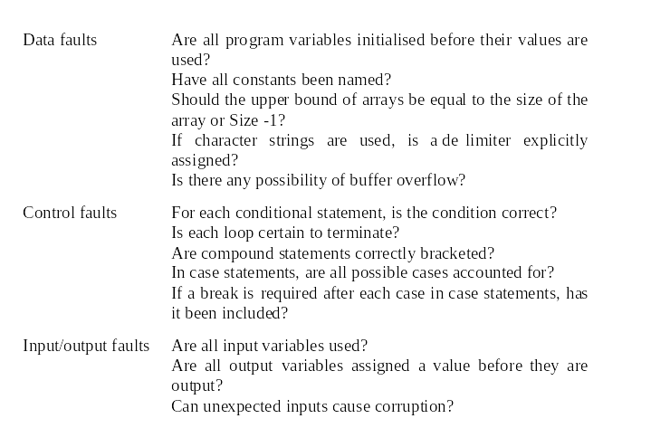
Software Inspection: Error Checks 1

Slide 34
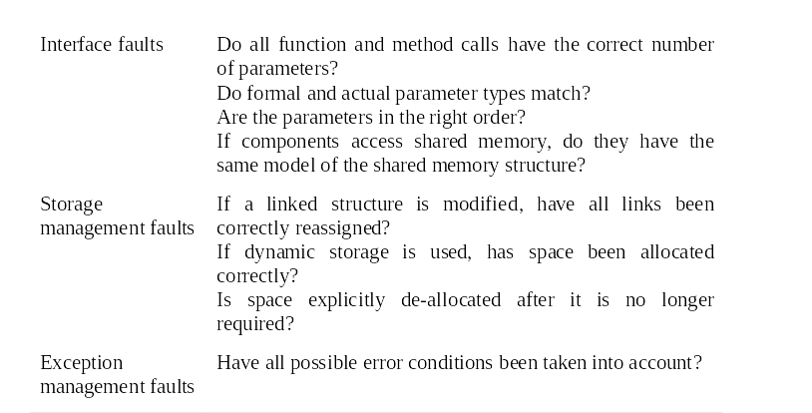
Software Inspection: Error Checks 2

Slide 35
Software Inspection: Inspection Rate
500 statements/hour during overview(ข้อคิดเห็นโดยทั่วไป,ลักษณะทั่วไป)
125 statement/hour during individual
preparation
90-125 statements/hour can be inspected during the inspection meeting
Inspection is therefore(เป็นเหตุ,ดังนั้น) an expensive process
Inspecting 500 lines costs about 40 man-hours effort(ความพยายาม)
  about £2,800 at UK rates (~196,000 Baht)

Slide 36
Software Inspection: Inspection Team
Made up with 4 people
  The author(ผู้ประพันธ์) of the code
  Inspector(ผู้ตรวจการณ์)
    Finds the errors, omissions and inconsistencies
  Reader
    Reads the code to the team
  Moderator(ประธานการประชุม,พิธีกร)
    Chairs the meeting and notes discovered errors

Slide 37
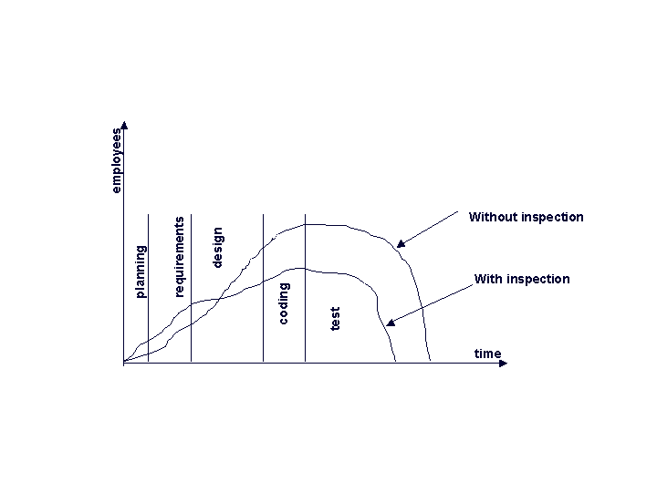
Software Inspection: Comparison
Source: http://www.the-software-experts.de/e_dta-sw-test-inspection.htm

Slide 38
Dynamic Verification: Software Testing
Can reveal(เปิดเผย) the presence(การมีอยู่) of errors NOT their absence(การไม่ปรากฎอยู่)
The only validation technique for non-functional requirements as the software has to be executed to see how it behaves(ประพฤติ)
Should be used in conjunction(ร่วมกัน) with static verification to provide full V&V coverage(ครอบคลุมถึง)

Slide 39


Software Testing: The Testing Process
Test
Cases
Test
Data
Test
Result
Test
Reports
Design
Test Cases
Prepare
Test Data
Run Program
With Test Data
Compare Results
to Test Cases

Slide 40
Software Testing: Types of Testing
Defect testing
  Tests designed to discover system defects
  A successful defect test is one which reveals the presence of defects in a system
Validation testing
  Intended to show that the software meets its requirements
  A successful test is one that shows that a requirements has been properly(อย่างเหมาะสม) implemented(ทำให้สำเร็จ)

Slide 41
Software Testing: Testing and Debugging
Defect testing and debugging are distinct(จำเพาะ) processes
Verification and validation is concerned with establishing the existence(การมีอยู่) of defects in a program
Debugging is concerned with locating and
repairing these errors

Slide 42

Software Testing: The Debugging Process
Test
Results
Specification
Test
Cases
Locate
Error
Design
Error Repair
Repair
Error
Retest
Program

Slide 43
Software Testing: Testing Policies
Testing policies(นโยบาย) define the approach to be used in selecting system tests
Examples:
  All functions accessed through menus should be tested
  Combinations of functions accessed through the same menu should be tested
  Where user input is required, all functions must be tested with correct and incorrect input

Slide 44
V&V Planning
Careful planning is required to get the most out of testing and inspection processes
V&V planning should start as early as of the ending of the requirement processes
The plan should identify the balance between inspection and testing

Slide 45



The V-model of Development
Requirements
Specification
System
Specification
System
Design
Detailed
Design
Acceptance
Test Plan
System
Integration
Test Plan
Sub-System
Integration
Test Plan
Module and
Unit Code
and Test
Service
Acceptance
Test
System
Integration Test
Sub-System
Integration Test

Slide 46
The Structure of a Software Test Plan
The testing process
Requirements traceability
Tested items
Testing schedule
Test recording procedures
Hardware and software requirements
Constraints

Slide 47

The Software Test Plan
The testing process
A description of the major phases of the testing process.
Requirements traceability(ตามรอยได้)
Users are most interested in the system meeting its requirements and testing should be planned so that all requirements are individually tested.
Tested items
The products of the software process that are to be tested.
Testing schedule
An overall testing schedule and resource allocation.(การจัดสรรค์)
Test recording procedures(กระบวนการ)
The recorded results of the tests. It must be possible to audit(ตรวจสอบ) the testing process to check that it been carried out correctly.
Hardware and software requirements
Software tools required and estimated(ประมาณ) hardware utilisation.(ความสามารถ,ประสิทธิภาพ)
Constraints(ข้อบังคับ)
Constraints affecting(ผลกระทบ) the testing process such as staff shortages.(ขาดแคลน)

Slide 48
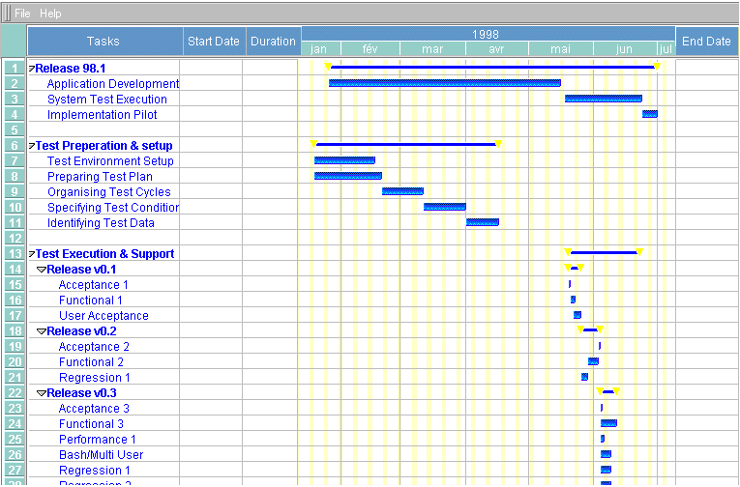
Sample Test Schedule
Source: http://bazman.tripod.com/testplan/chapter4.html

Slide 49
Software Testing: Mode of Testing
Component testing
System (or integration) testing
Release testing

Slide 50
Software Testing: Component Testing
Component or unit testing is the process of testing individual components in isolation(การแยกตัวออก)
Usually the responsibility(ความรับผิดชอบ) of the component developer (except sometimes for critical systems)
Tests are derived(กำเนิดจาก) from the developer’s experience
It is a defect testing process
Components may include:
  Individual functions or methods within an object
  Object classes with several attributes and methods

Slide 51
Software Testing: System Testing
Involves integrating components to create a system or sub-system
The responsibility of an independent testing team
Tests are based on a system specification
System testing styles:
  Top-down testing
    Requires the highest-level modules be test and integrated first
  Bottom-up testing
    Requires the lowest-level modules be test and integrated first

Slide 52
Software Testing: Release Testing
The process of testing a release(ปล่อย,ปลดปล่อย) of a system that will be distributed to customers
Primary goal is to increase the customer’s confidence that the system meets its requirements
Release testing is usually black-box(ไม่สนข้างในกล่อง) or functional testing
  Based on the system specification only
  Testers do not have knowledge of the system implementation

Slide 53

Software Testing: Testing Phases
Component
Testing
System
Testing
Release
Testing
Software developer
Based on experience
Independent testing team
Based on specification
Customer-oriented
Black-box testing

Slide 54
Software Testing: Testing Techniques
Black-box testing
Structural (white-box/glass-box) testing
Incremental testing
Interface testing
Path testing
Performance testing
Stress testing

Slide 55



Testing Techniques: Black-box Testing
Inputs causing
Anomalous(ผิดปกติ)
bahaviour
Input Test Data
I_{e}
System
Outputs which reveal
The presence of
defects
Output Test Result
O_{e}

Slide 56
Testing Techniques: Structural Testing
Sometime called ‘white-box’ or ‘glass-box’ testing
Derivation(แหล่งที่มา) of test cases according to program structure
Objective is to exercise all program statements (not all path combinations)

Slide 57


Testing Techniques: Incremental Testing
T1
A
T1
A
T2
T1
A
T2
B
T2
B
T3
B
T3
C
T3
C
T4
T4
D
T5
Test Sequence 1
Test Sequence 2
Test Sequence 3

Slide 58
Testing Techniques: Interface Testing
Objectives are to detect faults due to interface errors or invalid assumptions(การสันนิษฐาน) about interfaces
Particularly important for object-oriented development as objects are defined by their interfaces
Examples of errors:
  Interface misuse
  Interface misunderstanding
  Timing errors

Slide 59
Testing Techniques: Path Testing
The objective of path testing is to ensure(รับประกัน) that the set of test cases is such that each path through the program is executed at least once
The starting point for path testing is a program flow graph that shows nodes representing program decisions and arcs representing the flow of control
Statements with conditions are therefore(เพราะฉะนั้น,สื่อถึง) nodes in the flow graph

Slide 60
Testing Techniques: Performance Testing
Part of release testing may involve testing the emergent(ซึ่งปรากฎออกมา) properties of a system, such as performance and reliability
Performance tests usually involve planning a series of tests where the load is steadily(สม่ำเสมอ) increased until the system performance becomes unacceptable(ไม่สามารถจะยินยอม)

Slide 61
Testing Techniques: Stress Testing
Exercises the system beyond(ถัดไป,หลังจาก) its maximum design load
  Stressing the system often causes defects to
  come to light
Stressing the system test failure behaviour; Systems should not fail catastrophically(ย่อยยับ)
  Stress testing checks for unacceptable loss of service or data
Stress testing is particularly relevant(สัมพันธ์กัน) to distributed systems that can exhibit(นิทรรศการ,แสดง) severe(รุนแรง,เข้มงวด) degradation(การลดขั้น) as a network becomes overloaded

Slide 62
Summary
Object-oriented software design approaches consist of 5 activities:
  Define system’s context and modes.
  Design the system architecture.
  Identify the principle system objects.
  Develop design models.
  Specify object interfaces.

Slide 63
Summary
Reuse is becoming important systems get bigger and related costs are higher.
Approaches that support reuse include:
  Design patterns
  Configuration management
  COTS
  ERP
  Application frameworks
  Etc.

Slide 64
Summary
Validation and Verification are approaches for software quality.
  Verification is about doing the product right.
  Validation is about doing the right product.
Various testing principles are performed. So software can achieve the specific quality goals.

