Slide 1
Dependable Systems

Slide 2
Topics covered
Dependability(ความน่าไว้วางใจ) properties
Sociotechnical(สังคมเทคนิค) systems
Redundancy and diversity(ความแตกต่าง,หลากหลาย)
Dependable(เชื่อถือได้) processes
Formal(เป็นรูปแบบ) methods and dependability
30/10/2014
Chapter 10 Dependable Systems

Slide 3
System dependability
For many computer-based systems, the most important system property is the dependability of the system.
The dependability of a system reflects the user’s degree of trust in that system. It reflects the extent of the user’s confidence that it will operate as users expect and that it will not ‘fail’ in normal use.
Dependability covers the related systems attributes of reliability, availability and security. These are all inter-dependent.
30/10/2014

Slide 4
Importance of dependability
System failures may have widespread(แพร่หลาย) effects with large numbers of people affected by the failure.
Systems that are not dependable and are unreliable, unsafe or insecure may be rejected by their users.
The costs of system failure may be very high if the failure leads to economic losses or physical damage.
Undependable systems may cause information loss with a high consequent(ผลที่ตามมา) recovery cost.
30/10/2014

Slide 5
Causes of failure
Hardware failure
  Hardware fails because of design and manufacturing errors or because components have reached the end of their natural life.
Software failure
  Software fails due to errors in its specification, design or implementation.
Operational failure
  Human operators make mistakes. Now perhaps the largest single cause of system failures in socio-technical systems.
30/10/2014

Slide 6
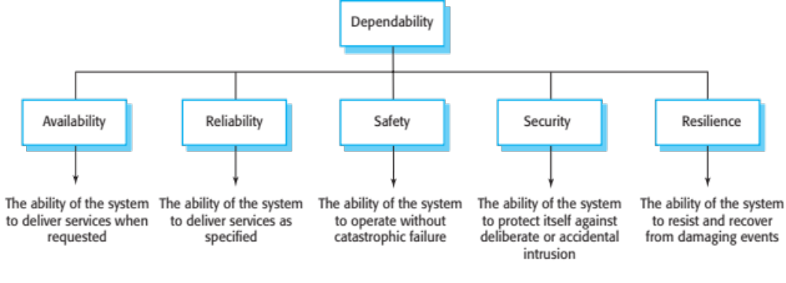
The principal dependability properties
30/10/2014

Slide 7
Principal properties
Availability
  The probability that the system will be up and running and able to deliver useful services to users.
Reliability
  The probability that the system will correctly deliver services as expected by users.
Safety
  A judgment of how likely it is that the system will cause damage to people or its environment.
30/10/2014

Slide 8
Principal properties
Security
  A judgment of how likely it is that the system can resist accidental or deliberate intrusions.
Resilience
  A judgment of how well a system can maintain the continuity of its critical services in the presence of disruptive events such as equipment failure and cyberattacks.
30/10/2014

Slide 9
Other dependability properties
Repairability
  Reflects the extent to which the system can be repaired in the event of a failure
Maintainability
  Reflects the extent to which the system can be adapted to new requirements;
Error tolerance(ความทนทาน)
  Reflects the extent to which user input errors can be avoided and tolerated.
30/10/2014

Slide 10
Dependability attribute dependencies
Safe system operation depends on the system being available and operating reliably.
A system may be unreliable because its data has been corrupted(ทุจริต,เสื่อม) by an external attack.
Denial(การบอกปัด) of service attacks on a system are intended to make it unavailable.
If a system is infected with a virus, you cannot be confident in its reliability or safety.
30/10/2014

Slide 11
Dependability achievement
Avoid the introduction of accidental errors when developing the system.
Design V & V processes that are effective in discovering residual(ส่วนที่เหลือ) errors in the system.
Design systems to be fault tolerant so that they can continue in operation when faults occur
Design protection mechanisms(ระบบกลไก) that guard against external attacks.
30/10/2014

Slide 12
Dependability achievement
Configure(กำหนดค่า) the system correctly for its operating environment.
Include system capabilities(ความสามารถ) to recognise(จำแนก) and resist cyberattacks.
Include recovery mechanisms to help restore normal system service after a failure.
30/10/2014

Slide 13
Dependability costs
Dependability costs tend(มีแนวโน้ม) to increase exponentially as increasing levels of dependability are required.
There are two reasons for this
  The use of more expensive development techniques and hardware that are required to achieve the higher levels of dependability.
  The increased testing and system validation that is required to convince(ทำให้เชื่อมั่น) the system client and regulators(คนควบคุม) that the required levels of dependability have been achieved.
30/10/2014

Slide 14
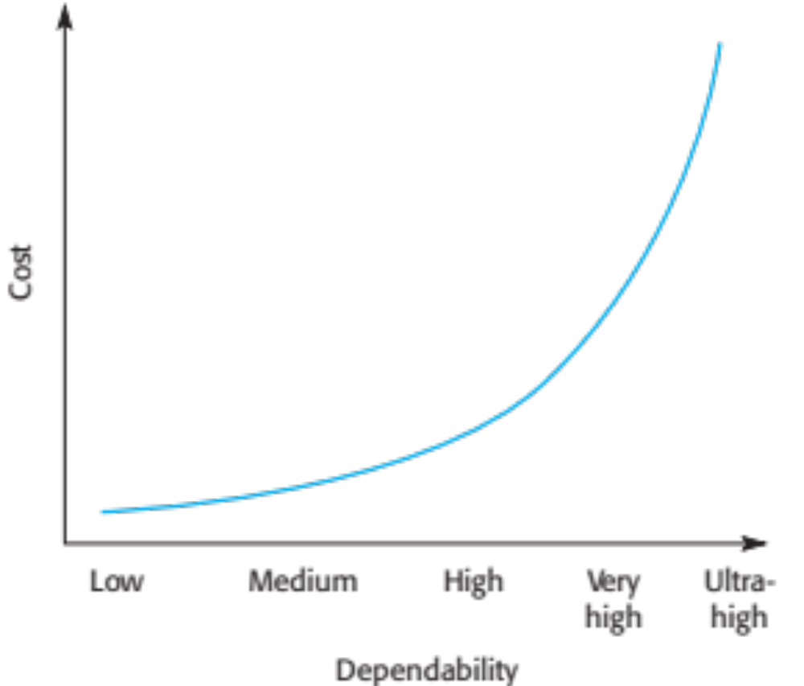
Cost/dependability curve
30/10/2014

Slide 15
Dependability economics
Because of very high costs of dependability achievement, it may be more cost effective to accept untrustworthy(ไม่น่าไว้วางใจ) systems and pay for failure costs
However, this depends on social and political(นโยบายทางการเมือง) factors. A reputation(ชื่อเสียง) for products that can’t be trusted may lose future business
Depends on system type - for business systems in particular, modest(ถ่อมตัว,ไม่รุนแรง) levels of dependability may be adequate(เพียงพอ,เหมาะสม)
30/10/2014

Slide 16
Systems and software
Software engineering is not an isolated(แยกตัวออกต่างหาก) activity but is part of a broader systems engineering process.
Software systems are therefore not isolated systems but are essential components of broader systems that have a human, social or organizational purpose.
Example
  The wilderness weather system is part of broader weather recording and forecasting systems
  These include hardware and software, forecasting processes, system users, the organizations that depend on weather forecasts, etc.
30/10/2014

Slide 17
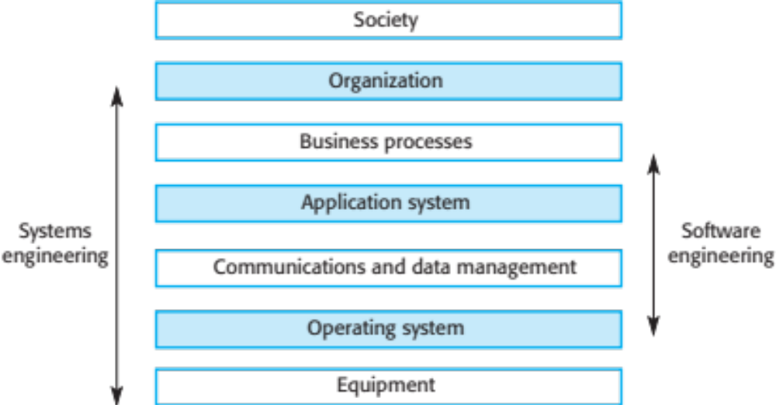
The sociotechnical systems stack
30/10/2014

Slide 18
Layers in the STS stack
Equipment
  Hardware devices, some of which may be computers. Most devices will include an embedded(ฝัง,ตรึง) system of some kind.
Operating system
  Provides a set of common facilities(สะดวก,คล่อง) for higher levels in the system.
Communications and data management
  Middleware that provides access to remote systems and databases.
Application systems
  Specific functionality to meet some organization requirements.
30/10/2014

Slide 19
Layers in the STS stack
Business processes
  A set of processes involving people and computer systems that support the activities of the business.
Organizations
  Higher level strategic(กลยุทธวิธี) business activities that affect the operation of the system.
Society
  Laws, regulation and culture that affect the operation of the system.

Slide 20
Regulation and compliance(ยินยอม)
The general model of economic organization that is now almost universal(ทุกหนทุกแห่ง) in the world is that privately owned companies offer(เสนอ) goods and services and make a profit on these.
To ensure the safety of their citizens, most governments regulate(ควบคุม) (limit the freedom of) privately owned companies so that they must follow certain(แน่นอน) standards to ensure that their products are safe and secure.
30/10/2014

Slide 21
Regulated systems
Many critical systems are regulated systems, which means that their use must be approved by an external regulator before the systems go into service.
  Nuclear systems
  Air traffic control systems
  Medical devices
A safety and dependability case has to be approved by the regulator. Therefore, critical systems development has to create the evidence(พยานหลักฐาน) to convince(ทำให้เชื่อมั่น) a regulator that the system is dependable, safe and secure.
30/10/2014

Slide 22
Safety regulation
Regulation(การควบคุม) and compliance(การยินยอม) (following the rules) applies to the sociotechnical system as a whole and not simply the software element of that system.
Safety-related systems may have to be certified(ได้รับการรับรอง) as safe by the regulator.
To achieve certification, companies that are developing safety-critical systems have to produce an extensive(กว้างขวาง,ถ้วนทั่ว) safety case that shows that rules and regulations have been followed.
It can be as expensive develop the documentation for certification as it is to develop the system itself.
30/10/2014

Slide 23
Redundancy and diversity
Redundancy
  Keep more than a single version of critical components so that if one fails then a backup is available.
Diversity(แตกต่าง,หลากหลาย)
  Provide the same functionality in different ways in different components so that they will not fail in the same way.
Redundant and diverse components should be independent so that they will not suffer(ประสบ,ได้รับ) from ‘common-mode’ failures
  For example, components implemented in different programming languages means that a compiler fault will not affect all of them.
30/10/2014

Slide 24
Diversity and redundancy examples
Redundancy. Where availability is critical (e.g. in e-commerce systems), companies normally keep backup servers and switch to these automatically if failure occurs.
Diversity. To provide resilience against external attacks, different servers may be implemented using different operating systems (e.g. Windows and Linux)
30/10/2014

Slide 25
Process diversity and redundancy
Process activities, such as validation, should not depend on a single approach, such as testing, to validate the system.
Redundant and diverse process activities are important especially(โดยเฉพาะอย่างยิ่ง) for verification and validation.
Multiple, different process activities the complement(ส่วนประกอบ) each other and allow for cross-checking help to avoid process errors, which may lead to errors in the software.
30/10/2014

Slide 26
Problems with redundancy and diversity
Adding diversity and redundancy to a system increases the system complexity.
This can increase the chances of error because of unanticipated(ที่ไม่คาดคิด) interactions(ปฏิสัมพันธ์) and dependencies(ส่วนต่อ) between the redundant system components.
Some engineers therefore advocate(ผู้สนับสนุน) simplicity(ความเข้าใจได้ง่าย ) and extensive(แพร่หลาย) V & V as a more effective route to software dependability.
Airbus FCS architecture is redundant/diverse; Boeing 777 FCS architecture has no software diversity
30/10/2014

Slide 27
Dependable processes
To ensure a minimal number of software faults, it is important to have a well-defined, repeatable software process.
A well-defined repeatable process is one that does not depend entirely on individual skills; rather can be enacted(ประกาศใช้) by different people.
Regulators use information about the process to check if good software engineering practice has been used.
For fault detection, it is clear that the process activities should include significant(สิ่งที่มีความหมาย) effort(ความพยายาม) devoted(มีใจจดจ่อ) to verification and validation.
30/10/2014

Slide 28
Dependable process characteristics
Explicitly(ชัดเจน,แจ่มแจ้ง) defined
  A process that has a defined process model that is used to drive the software production process. Data must be collected during the process that proves that the development team has followed the process as defined in the process model.
Repeatable
  A process that does not rely(ไว้วางใจ) on individual interpretation(การอธิบาย,การชี้แจง) and judgment(การตัดสิน). The process can be repeated across projects and with different team members, irrespective(ไม่คำนึงถึง) of who is involved in the development.
30/10/2014

Slide 29
Attributes of dependable processes
Process characteristic | Description
Auditable | The process should be understandable by people apart from process participants, who can check that process standards are being followed and make suggestions for process improvement.
Diverse | The process should include redundant and diverse verification and validation activities.
Documentable | The process should have a defined process model that sets out the activities in the process and the documentation that is to be produced during these activities.
Robust | The process should be able to recover from failures of individual process activities.
Standardized | A comprehensive set of software development standards covering software production and documentation should be available.
30/10/2014

Slide 30
Dependable process activities
Requirements reviews to check that the requirements are, as far as possible, complete and consistent(มั่นคง).
Requirements management to ensure that changes to the requirements are controlled and that the impact(แรงปะทะ) of proposed requirements changes is understood.
Formal specification, where a mathematical model of the software is created and analyzed.
System modeling, where the software design is explicitly(ชัดเจน,แจ่มแจ้ง) documented as a set of graphical models, and the links between the requirements and these models are documented.
30/10/2014

Slide 31
Dependable process activities
Design and program inspections, where the different descriptions of the system are inspected and checked by different people.
Static analysis, where automated checks are carried out on the source code of the program.
Test planning and management, where a comprehensive(กว้างขวาง,ครอบคลุม) set of system tests is designed.
  The testing process has to be carefully managed to demonstrate(ทดลองให้เห็นจริง) that these tests provide coverage(ครอบคลุมถึง) of the system requirements and have been correctly applied in the testing process.
30/10/2014

Slide 32
Dependable processes and agility
Dependable software often requires certification so both process and product documentation has to be produced.
Up-front requirements analysis is also essential to discover requirements and requirements conflicts(การขัดแย้ง) that may compromise(การประณีประนอม) the safety and security of the system.
These conflict with the general approach in agile development of co-development of the requirements and the system and minimizing documentation.
30/10/2014

Slide 33
Dependable processes and agility
An agile process may be defined that incorporates(รวมเข้าด้วยกัน) techniques such as iterative development, test-first development and user involvement in the development team.
So long as the team follows that process and documents their actions, agile methods can be used.
However, additional documentation and planning is essential so ‘pure agile’ is impractical(เพ้อฝัน,ทำไม่ได้) for dependable systems engineering.
30/10/2014

Slide 34
To be continued
30/10/2014

