Slide 1
Software Quality Management

Slide 2
Software Quality Management
Ensuring that(เพื่อให้มั่นใจ) the required level of quality is achieved
Defining(กำหนด) and following appropriate(เหมาะสม) quality standards and procedures
Developing a ‘quality culture’ where quality is seen as everyone’s responsibility

Slide 3
What is Quality?
‘Quality’ means that a product should meet its specification
This is problematical for software systems
  There is a tension between customer quality requirements (efficiency, reliability, etc.) and developer quality requirements (maintainability, reusability, etc.)
  Some quality requirements are difficult to specify in an unambiguous way(ทางที่ชัดเจน)
  Software specifications are usually incomplete and often inconsistent(ไม่ต่อเนื่อง สอดคลอง)

Slide 4
What is Quality?
‘Quality’ means standard, standardisation and documentation
V&V processes can be included in quality management

Slide 5
Quality Management Activities
Quality Planning
  Select applicable procedures and standards for a particular project and modify these as required
Quality Control
  Ensure(ตรวจสอบ) that procedures and standards are followed by the software development team
Quality Assurance(ประกัน)
  Establish(จัดตั้ง) organisational procedures and standards for quality

Slide 6
Quality Management
Quality management should be separated(แยกออก) from project management to ensure independence(อิสระต่อกัน)

Slide 7
Quality Management and Software Development
Software Development Process
D1
D2
D3
D4
D5
Quality Management Process
Standards and Procedures
Quality Plan
Quality Reports…….

Slide 8
Process and Product Quality
The quality of a developed product is influenced(เป็นผลมาจาก) by the quality of the production process
This is important in software development as some product quality attributes are hard to assess(ประเมิน)

Slide 9


Process-Based Quality
ประเมิน
Define Process
Develop
Product
Assess Product
Quality
กำหนด
Quality
OK?
No
Yes
Standardise
Process
Improve
Process
ปรับปรุง

Slide 10
Practical Process Quality
Define (Quality Planning)
  Define process standards such as how reviews should be conducted(ดำเนิน), configuration (กำหนด)
  management(จัดการ), etc.
Monitor (Quality Control)
  Monitor the development process to ensure
  that standards are being followed
Report (Quality Assurance)
  Report on the process to project management and customer

Slide 11
Quality Planning (QP)

Slide 12
Quality Planning
Define most significant quality attributes
Define the quality assessment(ประเมิน) process
Set out which organisational standards should be applied (either existing or new standards)

Slide 13
Quality Plans
Quality plan structure
  Scope and objectives of the quality aspects(หลักเกณฑ์,ลักษณะ)
  Quality deliverables that the project will produce
  Process by which those deliverables are produced
  Organisation and staffing
  Responsibilities of those involved(ผู้เกี่ยวข้อง)
Quality plans should be short, brief documents
  If they are too long, no-one will read them(555)

Slide 14
Software Quality Attributes
Safety
Security
Reliability
Flexibility
Robustness(แข็งแรง)
Understandability
Testability
Adaptability(ปรับตัว)
Modularity(แยกแยะ)
Complexity(ซับซ้อน)
Portability(พกพา)
Usability
Reusability(นำมาใช้)
Efficiency
Learnability

Slide 15
Quality Control (QC)

Slide 16
Quality Control
This involves(เกี่ยวข้อง) checking the software development process to ensure that procedures and standards are being followed
There are two approaches to quality control
  Quality reviews
  Automated software assessment(ประเมิน) and software measurement(การวัด)

Slide 17
Quality Reviews
Validating the quality of a process or product
V&V on process, system and documentation
There are different types of review with different objectives
  Inspections for defect(ข้อบกพร้อง) removal (product)
  Reviews for progress(ความคืบหน้า) assessment (product and process)
  Quality reviews (product and standards)

Slide 18
Review Results
Comments made during the review should be
classified
  No action - No change to the software or documentation is required
  Refer for repair - Designer or programmer should correct an identified fault(ความผิดที่ระบุไว้)
  Reconsider overall design - Some overall judgement must be made about the most cost-effective way of solving the problem
Requirements and specification errors may
have to be referred to the client

Slide 19
Quality Assurance (QA)

Slide 20
Standards
Standards are the key to effective quality management
They may be international, national, organizational or project standards
Product standards
  Define characteristics that all components should exhibit (แสดง )e.g. a common programming style
Process standards
  Define how the software process should be enactedทำขึ้น

Slide 21
Problems with Standards
They may not be seen as relevant(เกี่ยวข้อง) and up-to-date by software engineers
They often involve too much bureaucratic form filling(ระบบราชการ)
If they are unsupported by software tools, tedious manual work(คู่มือ) is often involved to maintain the documentation associated with the standards
= Too many additional works!!

Slide 22
International Standards

Slide 23
The CMMI Framework
The CMMI framework is the current stage of work on process assessment and improvement that started at the Software Engineering Institute, CMU in the 1980s(ออกนิเงิบ)
It has had a profound influence (มีผลอย่างมาก) on process improvement
  Capability Maturity Model introduced in the early 1990s
  Revised maturity framework (CMMI) introduced in 2001

Slide 24
CMMI Levels
Level 1: Initial
  Essentially uncontrolled
Level 2: Repeatable
  Product management procedures defined and used
Level 3: Defined
  Process management procedures and strategies(กลยุทธ์) defined and used
Level 4: Managed
  Quality management strategies defined and used
Level 5: Optimising(สังเคราะห์)
  Process improvement strategies defined and used

Slide 25
CMMI Levels (Contd.)
Optimising
Process Change Management
Technology Change Management
Defect Prevention
Managed
Software Quality Management
Quantitative Process Management
Defined
Peer Reviews
Intergroup Coordination
Software Product Engineering
Integrated Software Management
Training Program
Organisation Process Definition
Organisation Process Focus
Repeatable
Software Configuration Management
Software Quality Assurance
Software Subcontract Management
Software Project Tracking and Oversight
Software Project Planning
Requirements Management
Initial
Uncontrolled

Slide 26
CMMI Level 1: Initial
Activity
to produce
Results
Just do it!

Slide 27
CMMI Level 2: Repeatable
Planning
Activity
to produce
Results
input to
Evaluation
to improve
ประเมิน
Think before you act
Think after you act
Make sure you did right

Slide 28
CMMI Level 3: Defined
Planning
input to
Standards
Activity
to produce
Results
input to
input to
Evaluation
to improve
Use you lesson learned

Slide 29
CMMI Level 4: Managed
Planning
input to
to forecast(คาดการณ์)
Standards
Activity
to produce
Results
input to
input to
Evaluation
to improve
Predict(ทำนาย) the result you need and expect(หวัง)
Create opportunities to get those results

Slide 30
CMMI Level 5: Optimising
Planning
input to
to forecast
Standards
Activity
to produce
Results
input to
input to
to improve
Evaluation
to improve
Create lesson learned
Use lesson learned to create more lesson learned
Use more lesson learned to create even more lesson learned

Slide 31
CMMI Evaluation Process(ตย.)
Plan and contact the lead appraiser (LA)
Formally join and train on a CMMI workshop
Formally join and train on a CMM-Based Appraisal for Internal Process Improvement (CBA-IPI) workshop
Being initially reviewed by the LA and assessment team members (ATM)
Being assessed
The assessment results are sent to SEI

Slide 32
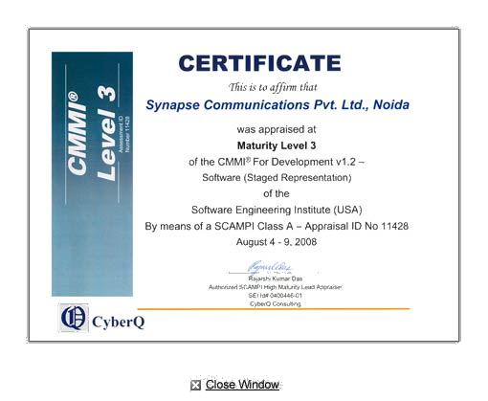
CMMI Certificate

Slide 33
International Organization for Standardization (ISO)
An international set of standards for quality management
Applicable to a range of organisations from manufacturing to service industries
Examples:
  ISO 9000 series
  ISO 12000 series
  ISO 14000 series

Slide 34
ISO 9000 Series
Deals with quality management and procedural standards
All procedures are documented in an organisational quality manual
Highlighted issues in ISO 9000 Series:
  Management responsibility
  Resource management
  Customer satisfaction(ความพึงพอใจ)
  Continuous improvement
  Etc.

Slide 35
ISO 12000 Series
ISO 12207
  Software Life Cycle Process
Consists of standard processes for the following activities:
  Procedure
  Plan
  Records
  Documents
  Audit & reviews

Slide 36
ISO 14000 Series
Environment Management
Life Cycle Assessment
Improvement of environmental performance of products
Etc.

Slide 37
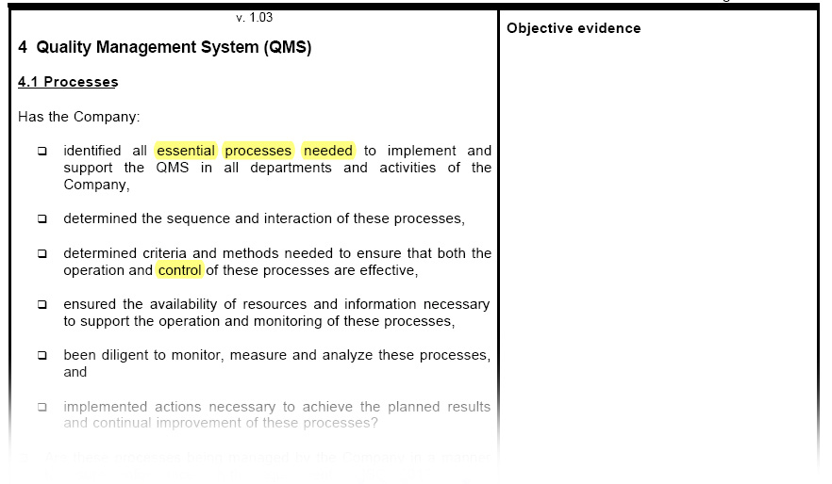
ISO Checklist

Slide 38
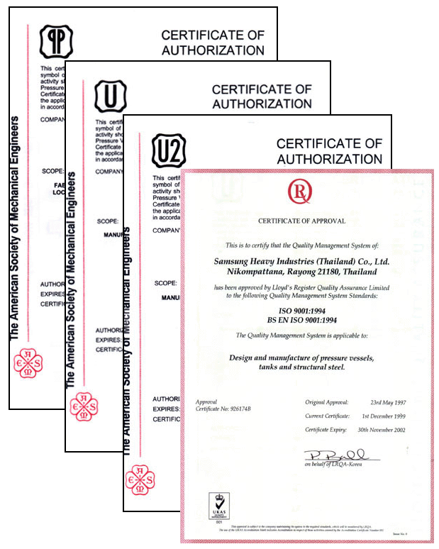
ISO Certificate

Slide 39
ISO in Thailand
สำนักงานมาตรฐานผลิตภัณฑ์อุตสาหกรรม (Thai Industrial Standard Institute: TISI)
  ISO series
  TIS
    TIS-620-2533 (1990) Thai character code for computers
~200,000-300,000 บาท/ปี/ISO 9000 series

Slide 40
SourceForge Status Model
Status 1: Planning
Status 2: Pre-Alpha
Status 3: Alpha
Status 4: Beta
Status 5: Production/Stable
Status 6: Mature
Status 7: Inactive

Slide 41
Thai Quality Software (TQS)
Developed by The Association of Thai Software Industry (ATSI) in 2001
Based on ISO 12207’s process implementation
Can be divided into 5 levels
  Level 1: Basic Software Engineering
  Level 2: Define
  Level 3: Perform
  Level 4: Measure
  Level 5: Continuous Improvement
  Each level equal ~20% of ISO 12207
Free of charge (as of 2009)

Slide 42
TQS Evaluation Process
Apply via ASTI
Join at least 2-day workshop
Being consulted by the experts for at least 5 times
Prepare the processes and documents
Being evaluated
Being certified

Slide 43
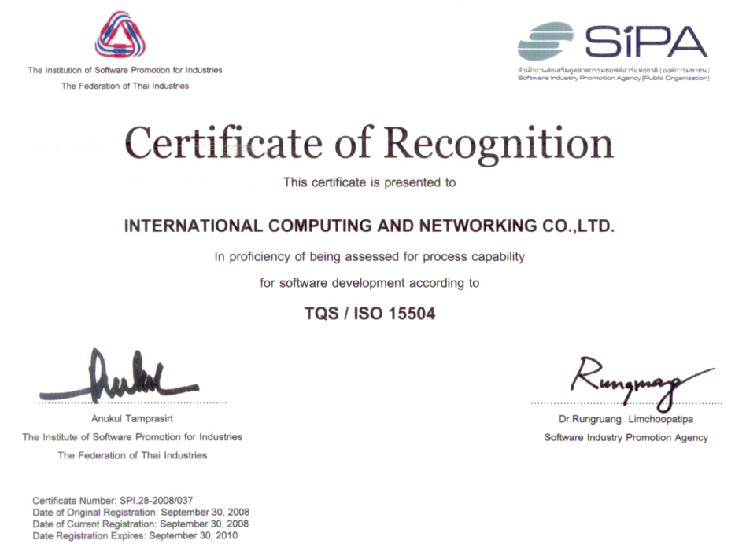
TQS Certificate

