Slide 1


SMART INDIA HACKATHON 2024
PS Code: SIH1668
Problem Statement Title: Creating an application to identify the presence of government issued personally identifiable information (PII) embedded in documents and data, inadvertently or otherwise.
Team Name: Vortex
Team Leader Name: Sakethavasudev
Institute Code (AISHE): U-0841
Institute Name: Indian Institute of Information Technology, Nagpur
Theme Name: Blockchain and Cybersecurity

Slide 2
Idea/Approach Details
Team Vortex
PII Detection and Management Solution: A system that detects, classifies, and manages Personally Identifiable Information (PII) in uploaded documents or data, ensuring compliance with privacy laws.
Document Preprocessing: Converts uploaded documents into a machine-readable format using Optical Character Recognition (OCR) or text extraction techniques.
Data Cleaning: Automatically cleans data for hidden characters and formatting inconsistencies to ensure accurate PII detection.
Advanced PII Detection: Uses regular expressions, AI models, and pattern recognition to detect sensitive data such as Aadhaar, PAN, driving license numbers, and other personal details.
PII Classification: Categorizes detected PII based on type (e.g., Aadhaar, PAN, driving license) for better handling, redaction, or masking.
User Notification and Customization: Notifies users when PII is detected and allows them to choose whether to proceed with the document or redact/mask sensitive information.
Redaction and Masking Features: Offers the ability to redact or mask sensitive PII (e.g., showing only the last four digits of Aadhaar), ensuring compliance with privacy laws.
Optional PII Verification: Provides an option to verify detected PII against public APIs or databases (where permitted), enhancing data accuracy while respecting privacy laws.
Compliance Tracking and Reporting: Generates logs and compliance reports for audit purposes, demonstrating adherence to privacy regulations like India’s PDP Bill.
Scalable and Extensible: Built to handle multiple document types and PII patterns, with the potential to integrate external APIs for enhanced security and functionality.

Slide 3
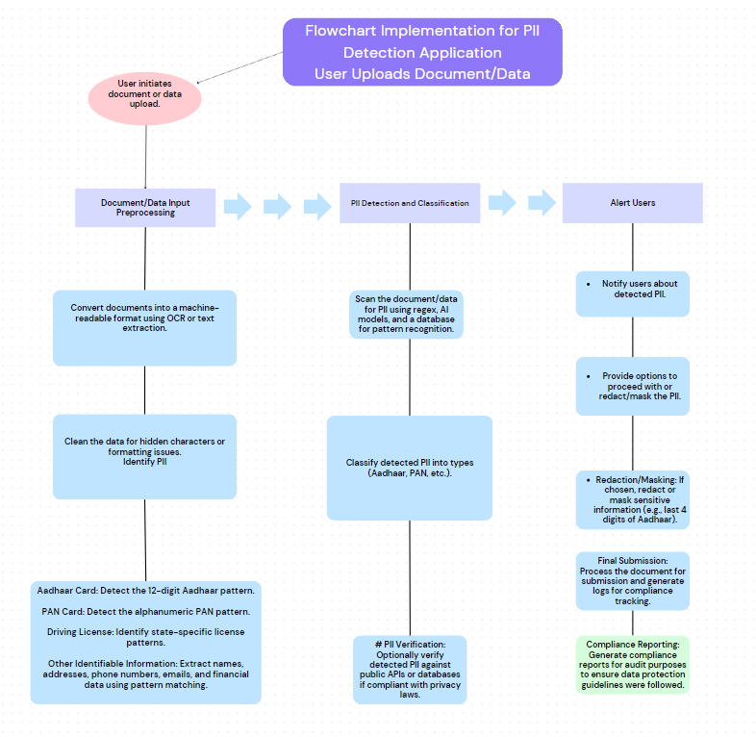





TECHNICAL APPROACH
Team Vortex

Slide 4
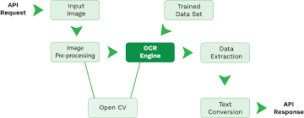
FEASIBILITY AND VIABILITY
Team Vortex
Banks and financial institutions detect and manage PII in customer data, including social security numbers, account details, and transaction histories, to prevent identity theft and fraud.
Law firms use PII detection to protect confidential client information in legal documents, such as social security numbers and case details, while preparing documents for court submissions.
Government departments utilize PII detection to manage personal data in forms, applications, and public records, complying with privacy laws and protecting citizens’ personal information.
Schools and universities apply PII detection to safeguard student records, including personal identification details and academic performance data.
4

Slide 5
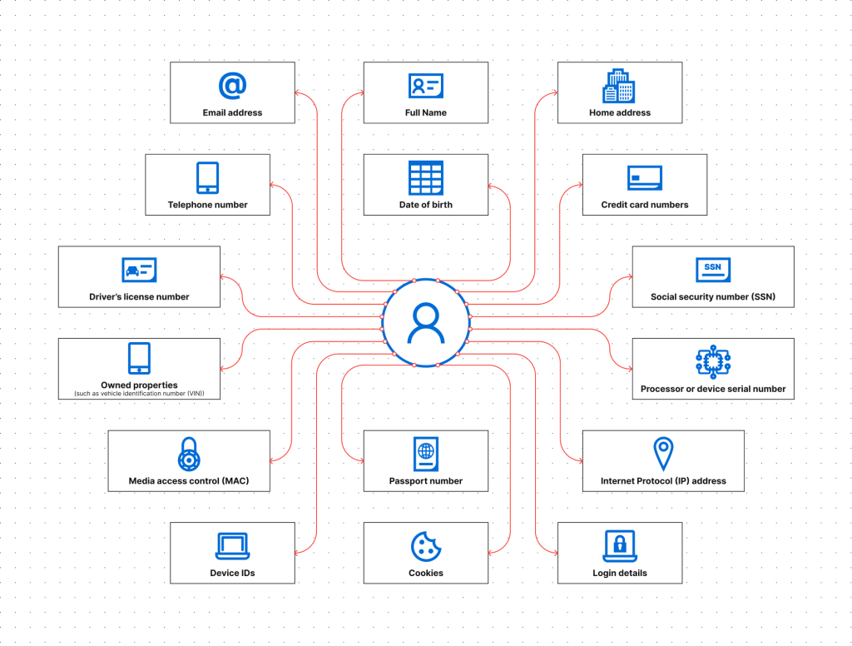
IMPACT AND BENEFITS
Team Vortex
Enhanced Privacy: Protects sensitive data (Aadhaar, PAN) from misuse and breaches.
Regulatory Compliance: Ensures adherence to laws like ,PDP Bill, avoiding fines.
Operational Efficiency: Automates PII detection and redaction, reducing manual errors.
Scalable System: Handles growing volumes of documents and data types effortlessly.
User Control: Allows users to choose redaction/masking options for better data handling.
5

Slide 6
Team Member Details
Team Vortex
Team Leader Name: Sakethvasudev
B.Tech CSE Year II
Team Member 1 Name: Dhruva Narayan K
B.Tech CSE Year II
Team Member 2 Name: Yuva Varshith
B.Tech CSE Year II
Team Member 3 Name: Kovidhraj
B.Tech CSE Year II
Team Member 4 Name: Akshith V
B.Tech CSE Year II
Team Member 5 Name: Sharanya
B.Tech CSE Year I

