Slide 1
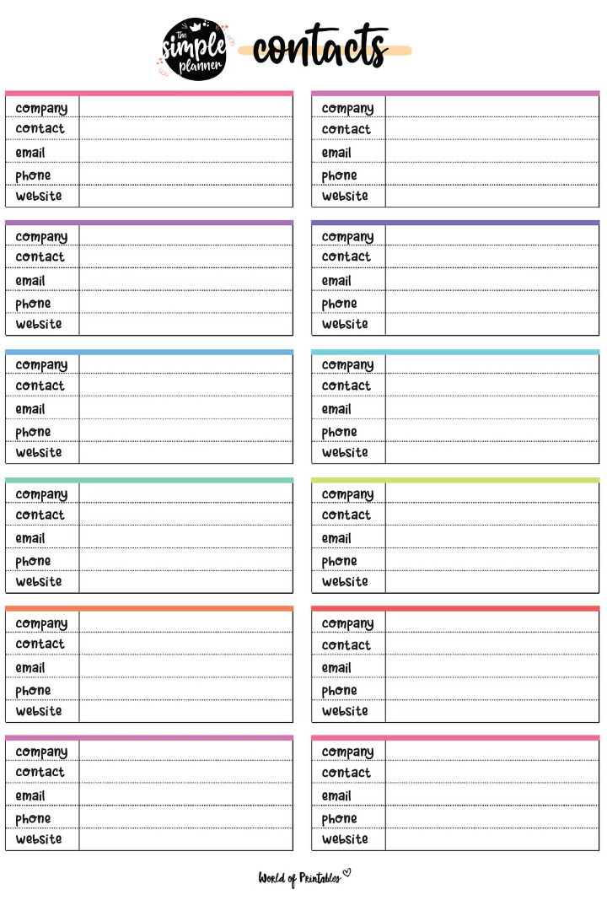
Contact Management System
Guided by-
Dr. Jagadish Chakole
Project by-
Anil (BT23CSE002) Praneeth (BT23CSE015)
Dhruva (BT23CSE016)

Slide 2
Key Features
Contact Management
Relationship Tracking
Undo functionality
Enables users to add, delete, edit, and search contacts by name or phone number.
Utilizes a linked list data structure to efficiently manage contacts.
Facilitates the establishment of relationships between contacts.
Uses a graph to keep track of the relationships.
undoing the last operation performed, such as adding, deleting, or editing contacts.
Maintains a stack of operations to enable efficient undo functionality.

Slide 3

d
Organizing Your Contacts for Maximum Efficiency
Categorize Contacts
1
Begin by categorizing your contacts into logical groups, such as personal, professional, or by industry. This will make it easier to find and manage specific contacts when needed.
2
Maintain Accurate Information
Regularly review and update your contact information to ensure that it remains accurate and up-to-date. This will prevent missed connections and ensure that your communication is effective.
Leverage Search and Filtering
3
Utilize the search and filtering capabilities of your contact management system to quickly locate specific contacts or groups of contacts based on various criteria, such as name, company, or relationship type.

Slide 4
Project Walkthrough

Slide 5
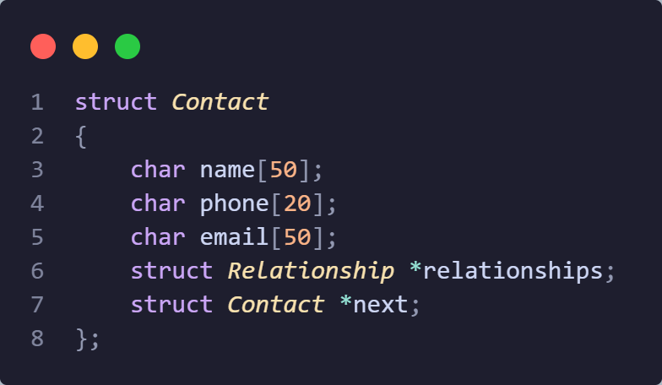
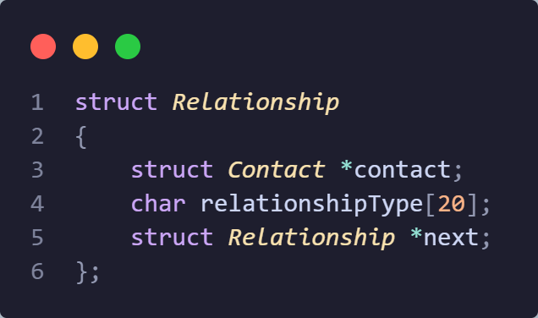
Structure of contact
Structure of Relationship

Slide 6
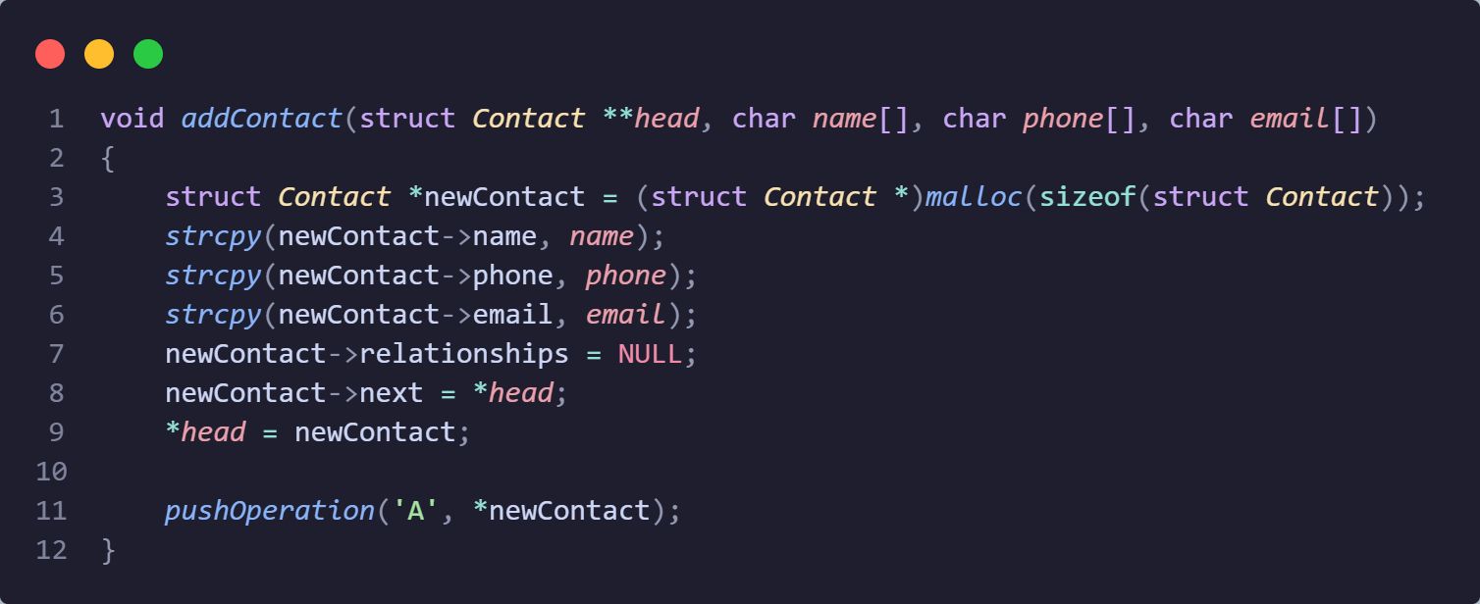
Function to add new contacts.
Memory Allocation:
Allocates memory for a new contact using malloc() to store the contact's information
Linked List Insertion
Inserts the new contact at the beginning of the linked list, updating pointers accordingly, allowing for efficient addition and management of contacts.

Slide 7
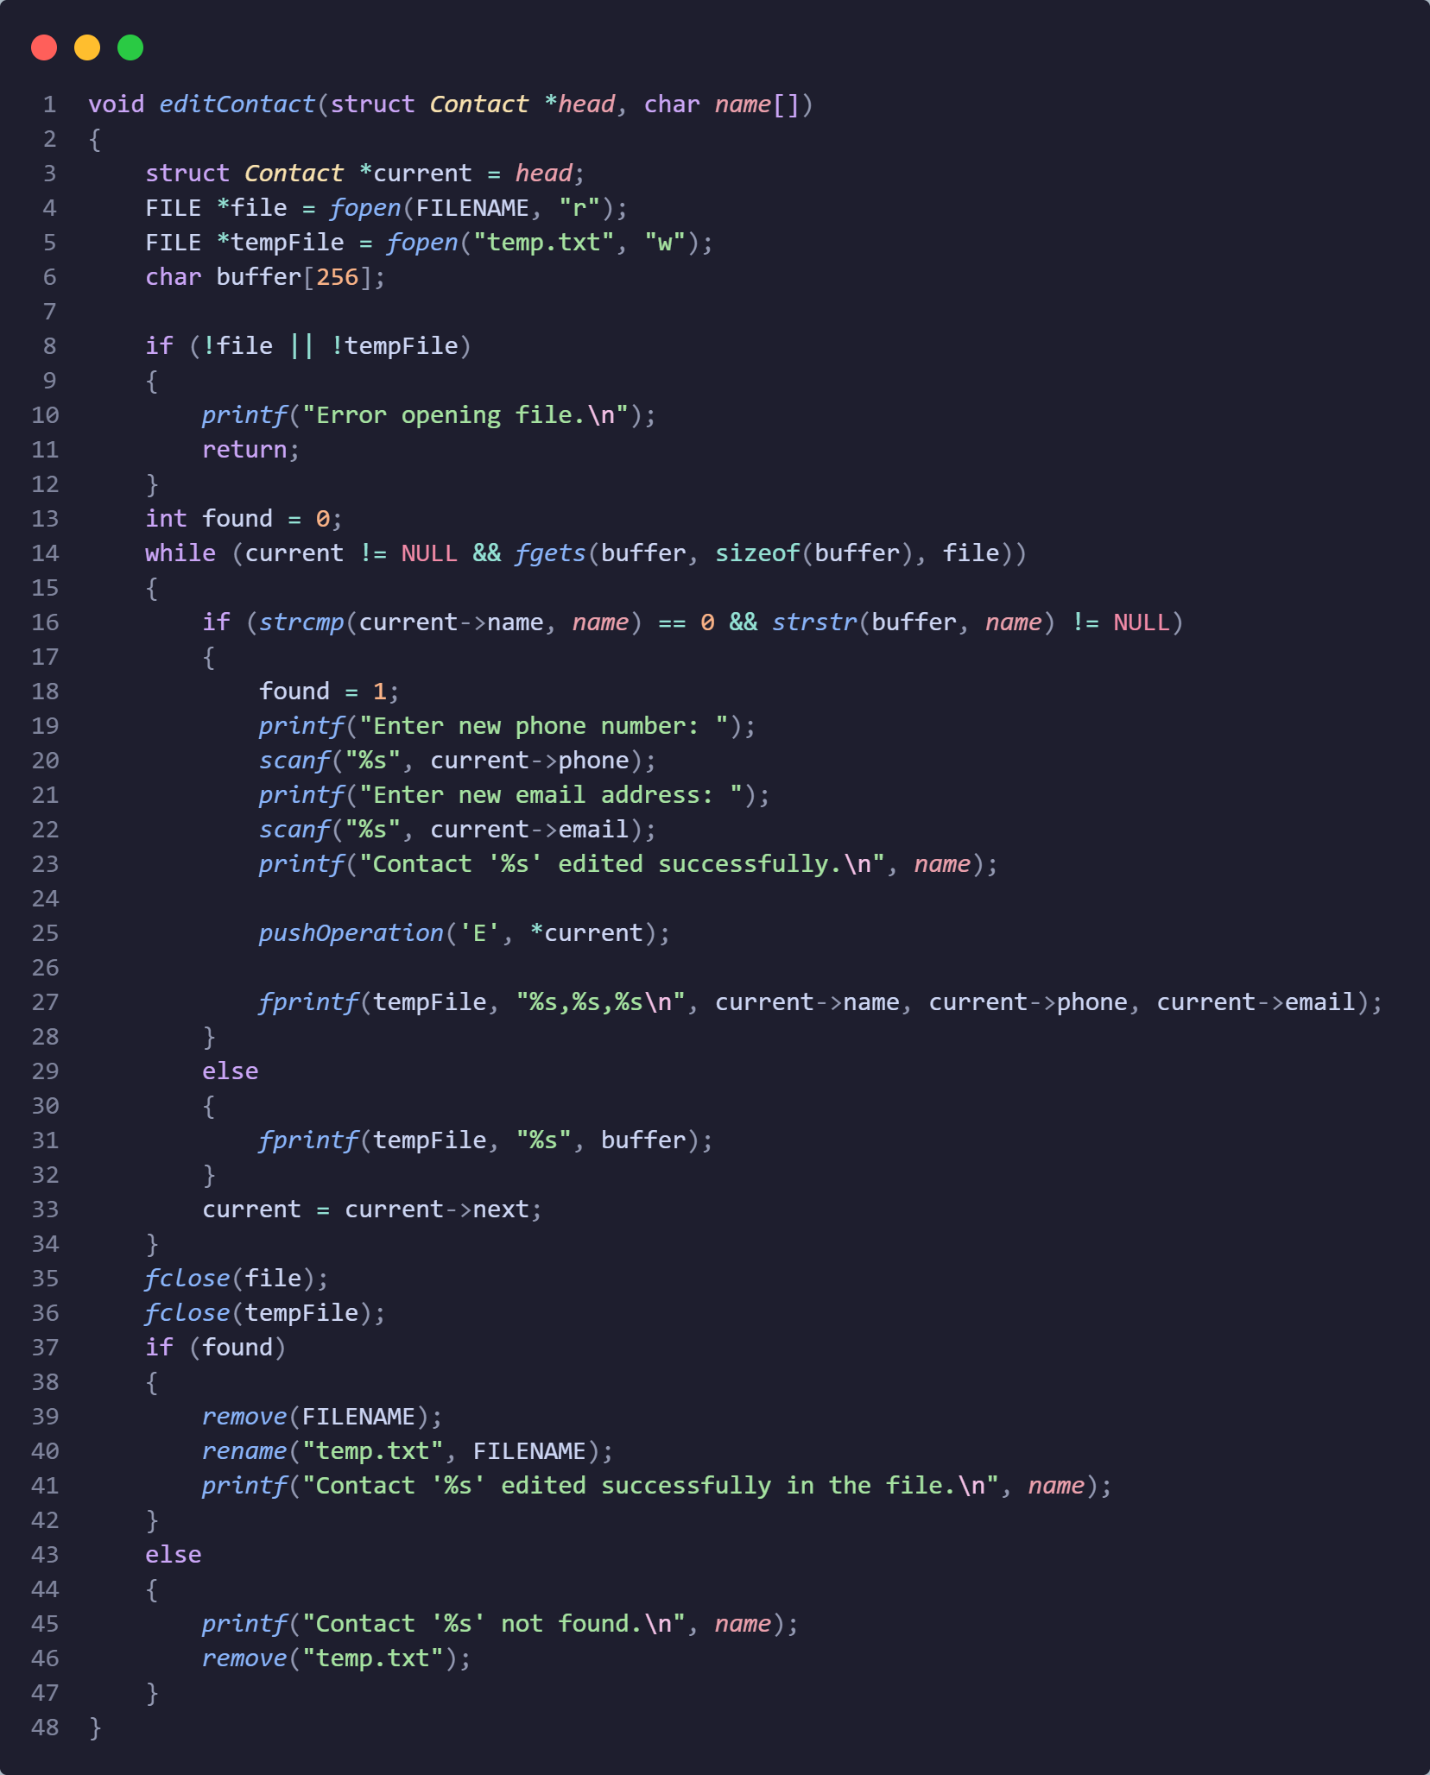
Functions to edit contacts
Search and Update:
Locates the contact by name in the linked list and prompts the user to enter the new phone number and email address
Updates the contact's information with the new data provided, ensuring accurate and up-to-date contact details.
File Modification:
Modifies the corresponding entry in the contacts file, ensuring consistency between the in-memory data and the stored file.
Utilizes file operations to read and write data, maintaining integrity across the application's data sources.

Slide 8
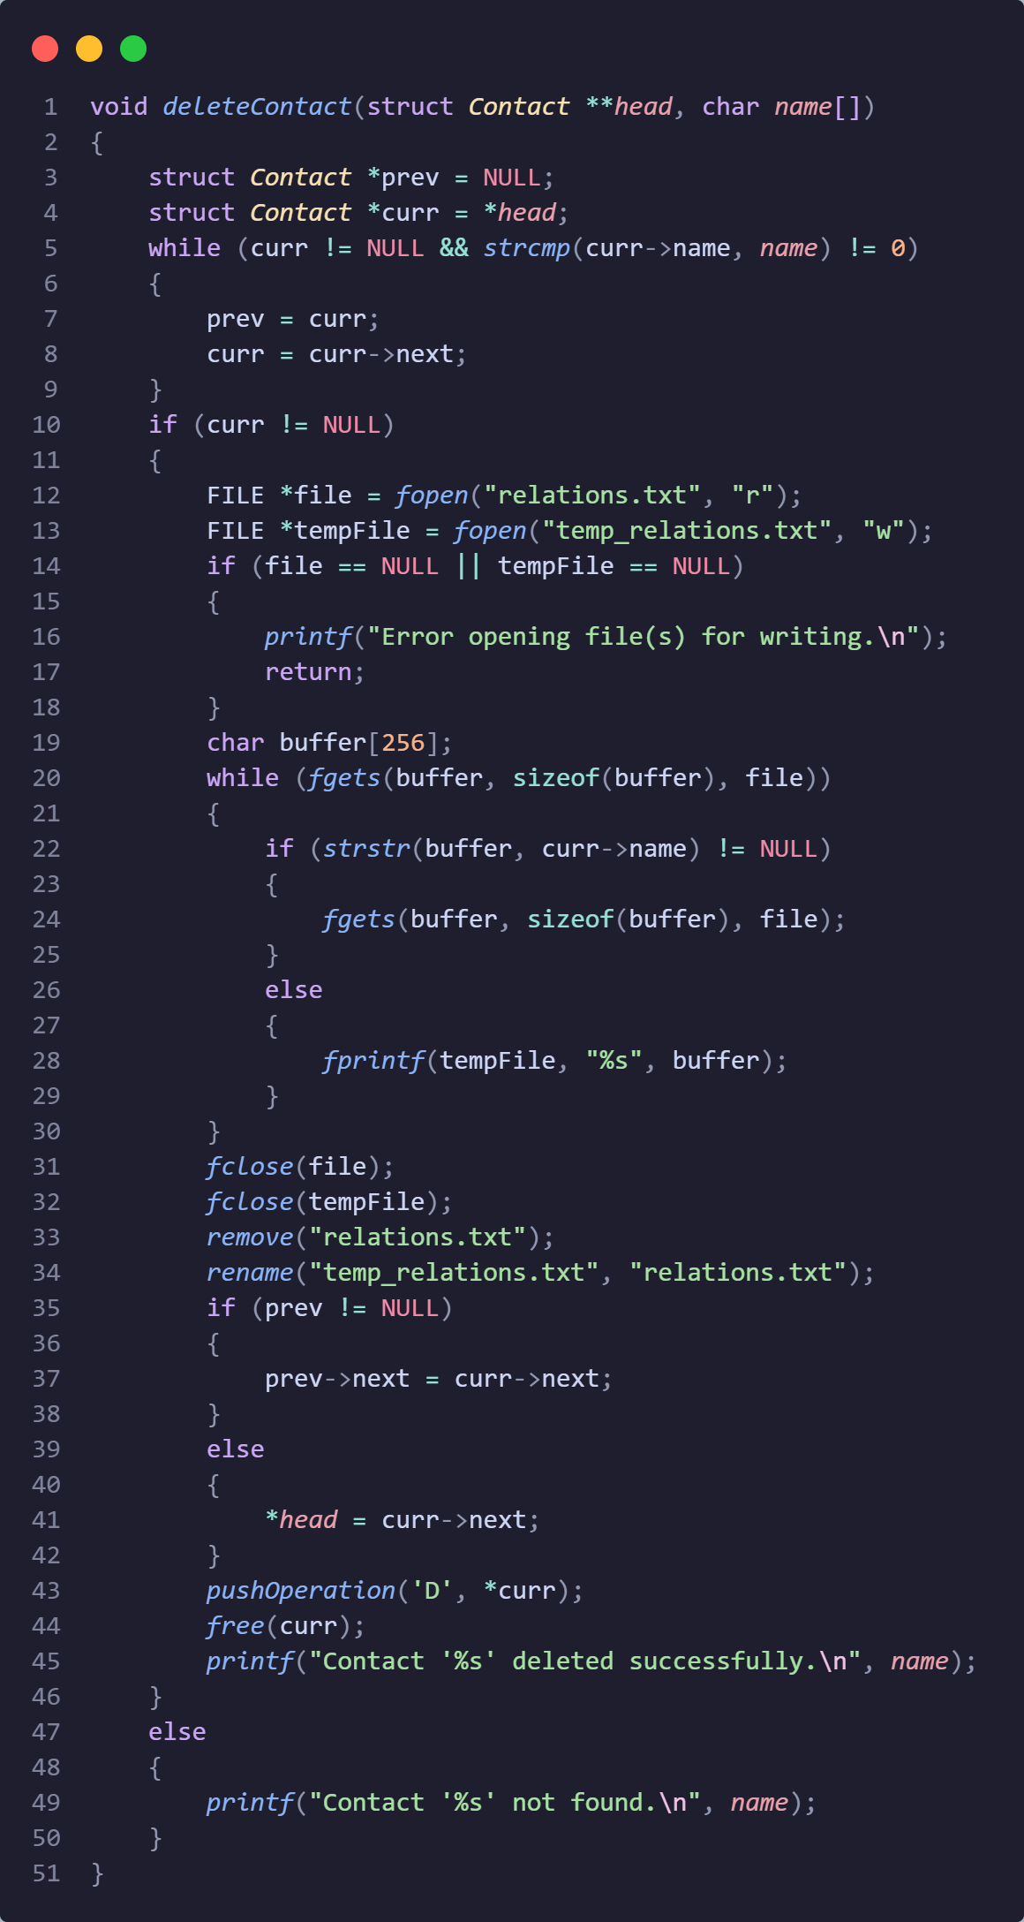
Functions to delete a contact
Search and Removal:
Searches for the contact by name in the linked list.
If found, removes the contact from the linked list, ensuring efficient deletion of the specified contact.
File Update:
Updates the contacts file by removing the corresponding entry, ensuring consistency between the in-memory data and the stored file.
Utilizes file operations to read and write data, maintaining data integrity across the application

Slide 9
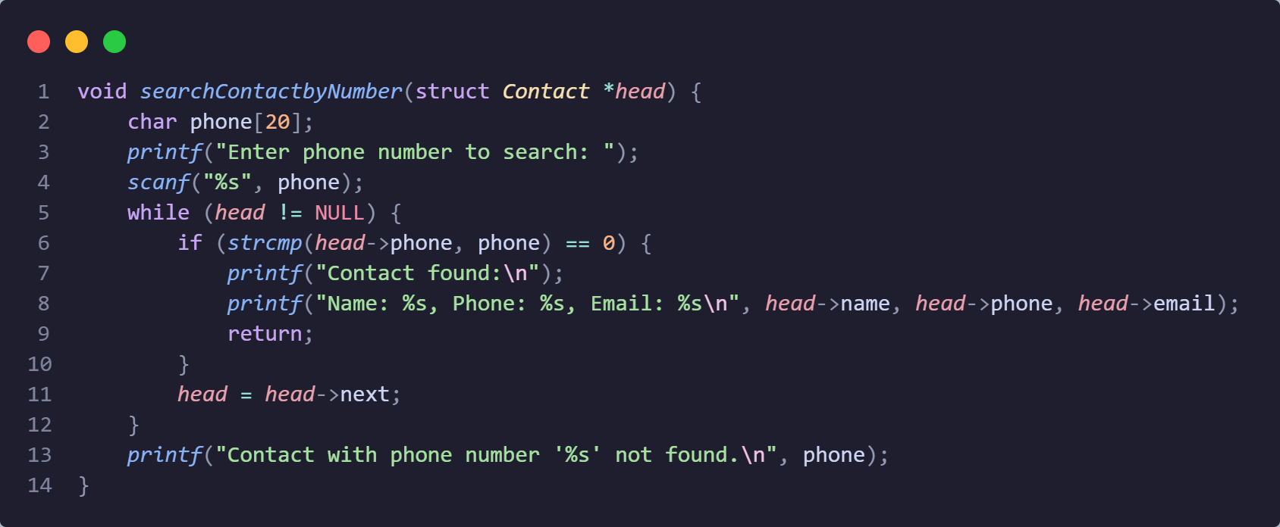
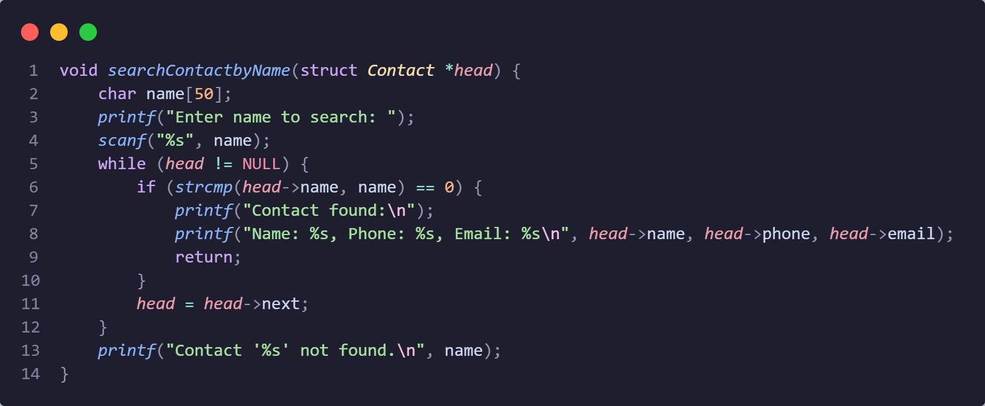
Search by number
Search by name

Slide 10
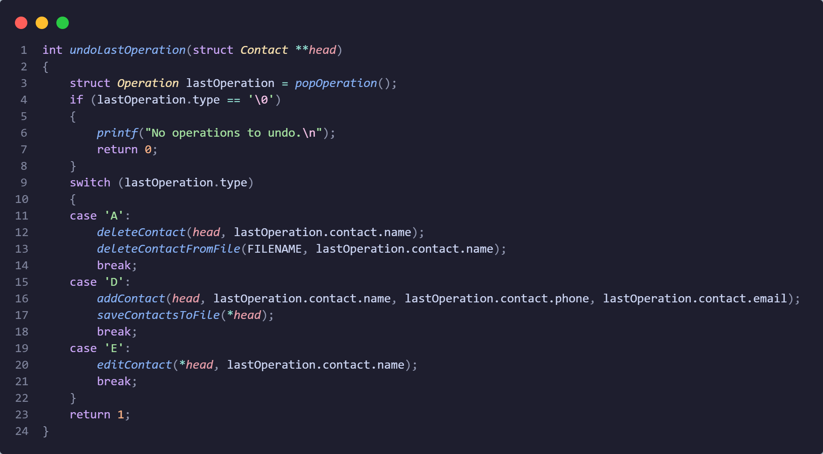
Function to Undo the last operation.
Reversal of Actions:
Allows users to reverse recent actions like adding, deleting, or editing contacts, providing a safety net for corrections.
Data Consistency:
Maintains consistency by reverting both in-memory data and external files, ensuring accuracy and integrity of contact data.

Slide 11
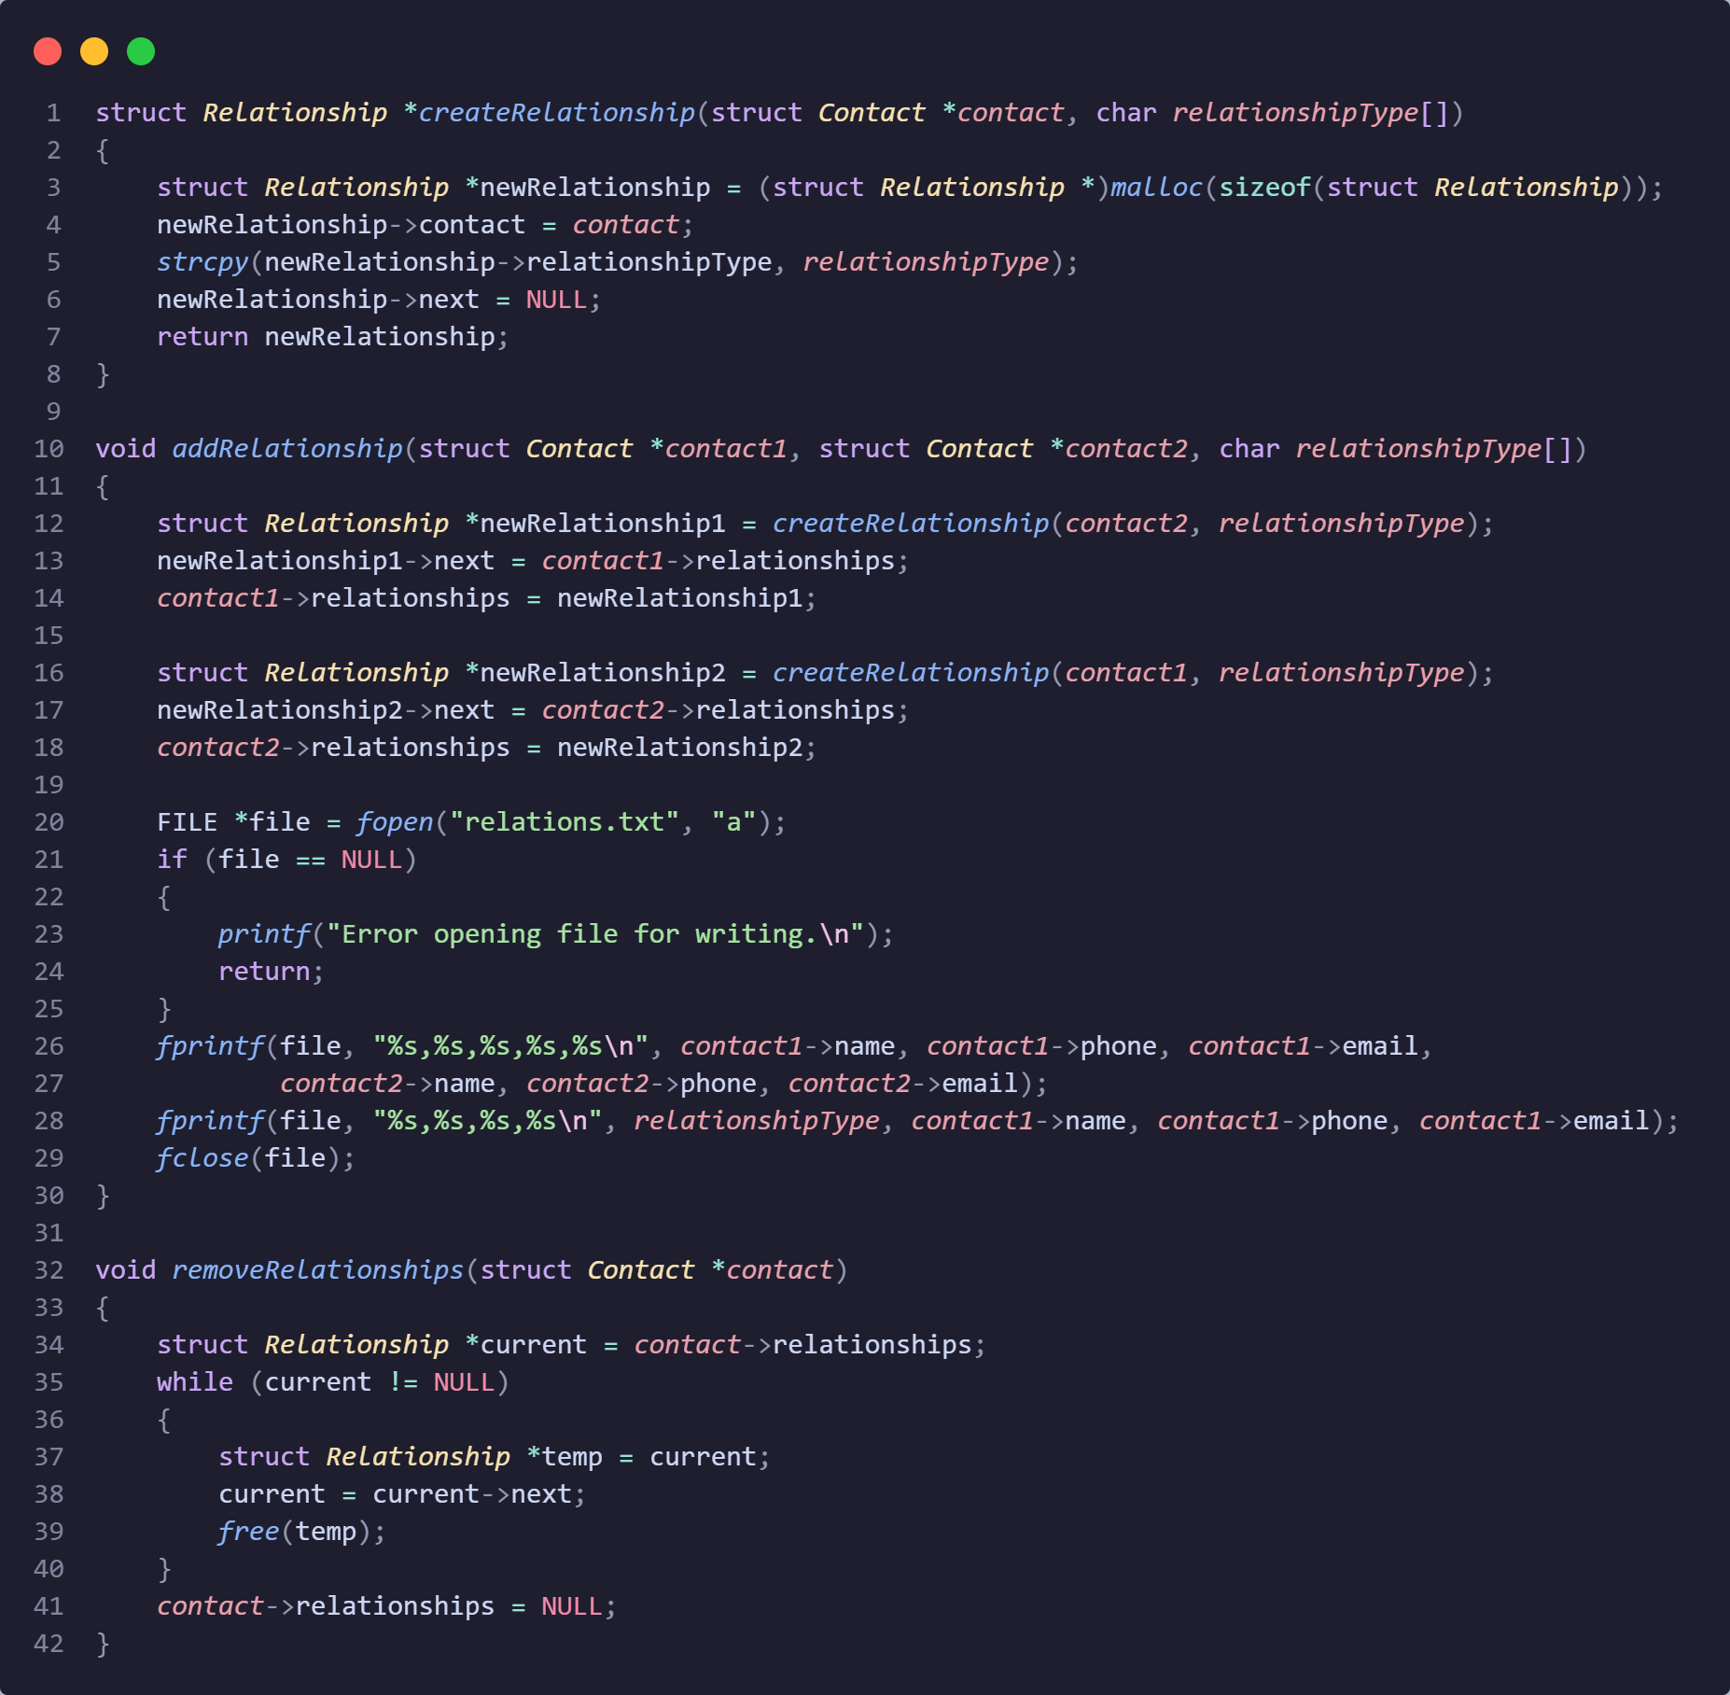
Relationship Tracking
Creating a relationship
Adding relationship
Remove relationships

Slide 12
Thank you

