Slide 1
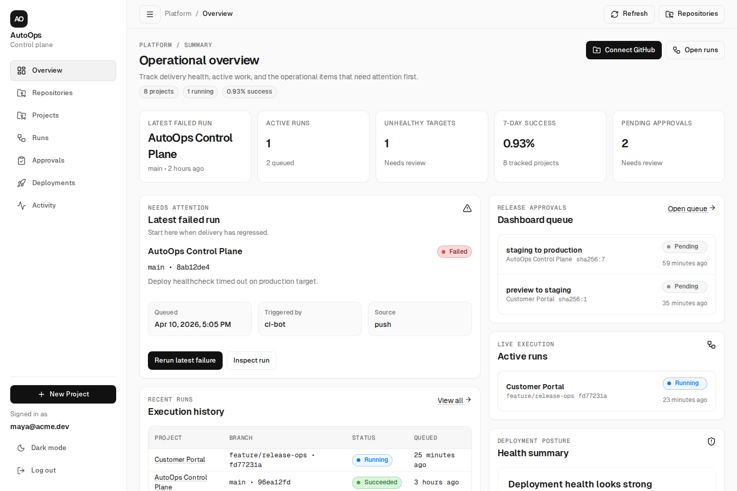
AutoOps
Dashboard
Self-Hosted CI/CD
Platform MVP
A control plane for GitHub-triggered pipelines, Docker-based execution, deployment health, approvals, and rollback-safe operations.
Express API
Worker
React Dashboard
Postgres
Docker
SSH + Managed Deploys
Anas Khan • Anshuman Tiwari • Bhumika Burhade • Chetali Aggrawal
Notes:
SPEAKER: Chetali Aggrawal
Good morning/afternoon. We're presenting AutoOps — a self-hosted CI/CD platform MVP.
The goal of this project is to give teams a single control plane for GitHub-triggered pipelines, deployment operations, approvals, and rollback handling.
As you can see on the right, the dashboard is already functional. It tracks active runs, deployment health, approval queues, and execution history — all from one screen.
Our team built this with Express, React 19, a background worker, Postgres, and Docker-based execution — the tech tags you see at the bottom.
Let's start with what problem we're solving.

Slide 2
Project Thesis
AutoOps
What AutoOps is designed to solve
The problem AutoOps addresses and who it serves.
• Turns a GitHub push into a controlled, self-hosted CI/CD workflow.
• Centralizes queueing, execution, deployment state, and recovery.
• Strongest where operations hurt: stage visibility, approval gates, and rollback.
• Supports both custom pipelines and managed imports for web applications.
Core promise
Push code. Track every stage. Deploy safely. Recover quickly.
Primary users
Platform teams, operators, and self-hosted product teams that need more control.
2
Notes:
SPEAKER: Chetali Aggrawal
At a high level, AutoOps solves a common problem: CI/CD workflows are often spread across scripts, servers, and dashboards. Teams lose visibility into what's running, what failed, and how to recover.
AutoOps brings those pieces together into one system. It turns a GitHub push into a controlled, self-hosted workflow. It centralizes queueing, execution, deployment state, and recovery — so operators don't rely on fragmented scripts.
The core promise is simple: push code, track every stage, deploy safely, recover quickly.
Our primary users are platform teams, operators, and self-hosted product teams that need more control over their delivery pipeline.

Slide 3
Capability Map
AutoOps
What Phase 1 already includes
Six capabilities that cover the full CI/CD loop from intake to recovery.
GitHub Intake
Pipeline Config
Execution Engine
App installations, webhook validation, deduplication, repository syncing, and onboarding metadata.
Per-repository .autoops/pipeline.yml with triggers, build settings, test commands, and deployment targets.
Queued runs, ordered stages, Docker build and test execution, image push, and per-target deployment.
Operations UI
Recovery Controls
Managed Mode
Overview, repositories, projects, runs, deployments, approvals, activity feeds, and rollback actions.
Deployment revisions, automatic rollback, manual rollback, and protected-target promotion approvals.
Supported imports for standalone Next.js, React, CRA, and static HTML applications.
3
Notes:
SPEAKER: Chetali Aggrawal
In Phase 1, the platform already covers the full delivery loop — this is not just a single slice of CI/CD.
We have six capabilities:
- GitHub Intake handles app installations, webhook validation, and repo syncing.
- Pipeline Config lets each repository define its own build and deploy settings.
- The Execution Engine queues runs, builds Docker images, runs tests, and deploys.
- The Operations UI gives operators a full dashboard with runs, deployments, approvals, and rollback actions.
- Recovery Controls handle deployment revisions, automatic rollback, and promotion approvals.
- And Managed Mode supports importing standalone web applications directly.
I'll now hand it over to Bhumika, who will explain the architecture and how the execution flow works.

Slide 4
Architecture
AutoOps
How the system is split up
Clean separation between control plane, execution, product UI, and shared platform logic.
apps/api
packages/core
apps/worker
GitHub
Express control plane
Authentication
Project and deployment APIs
Repository analysis
Shared types
Pipeline parsing
Security helpers
Rollback logic
Claims queued runs
Clones repos
Builds, tests, deploys
Handles rollback and promotion
Installations
Push webhooks
Repository access
apps/web
packages/db
Deployment targets
React 19 dashboard
Operator workflows
Run and deployment views
Approvals and activity
Postgres schema
Runs, targets, revisions
Secrets, approvals, audit logs
SSH Compose hosts
Managed VPS targets
Healthcheck endpoints
4
Notes:
SPEAKER: Bhumika Burhade
The architecture is divided into clear layers.
On the left, GitHub sends installations and push webhooks into our system. The apps/api package acts as the control plane — it handles authentication, project and deployment APIs, and repository analysis.
The packages/core module contains shared types, pipeline parsing, security helpers, and rollback logic. The apps/worker claims queued runs, clones repos, builds, tests, deploys, and handles rollback and promotion.
On the bottom row: apps/web is the React 19 operator dashboard, packages/db manages the Postgres schema with runs, targets, revisions, secrets, and audit logs, and deployment targets support SSH Compose hosts and managed VPS with healthcheck endpoints.
This clean separation makes the system easier to maintain and extend.

Slide 5
Execution Flow
AutoOps
From webhook to deployed revision
Every push follows this sequence from webhook to deployed revision.
Push event
Validation
Queueing
Prepare
Build + test
Deploy
GitHub emits a signed push webhook.
API verifies headers and deduplicates the delivery.
Matching projects create queued runs with branch and SHA.
Worker clones the repo and resolves the pipeline config.
Docker image build and test commands run in sequence.
Image push, target deploy, healthcheck, revision record.
Persistent state
Operator result
Runs, stages, logs, delivery outcomes, targets, revisions, and approvals all land in Postgres for traceability.
The dashboard can immediately show what failed, where it failed, and what the next safe recovery action should be.
5
Notes:
SPEAKER: Bhumika Burhade
This slide shows the full execution flow — every push follows this exact sequence.
It starts with a Push Event: GitHub emits a signed webhook. The API validates headers and deduplicates the delivery. Then matching projects create queued runs with the branch and commit SHA.
The worker picks up the run, clones the repository, and resolves the pipeline config. It then runs the Docker image build and test commands in sequence. Finally, it pushes the image, deploys to the target, runs a healthcheck, and records the deployment revision.
Everything is persisted — runs, stages, logs, delivery outcomes, targets, revisions, and approvals all land in Postgres for full traceability.
The result is that the dashboard can immediately show what failed, where it failed, and what the next safe recovery action should be.
Next, Anas will show how the product looks from the operator's point of view.

Slide 6
Product UI
AutoOps
Overview page for the operator
The dashboard starts with the things that need attention first.
Overview
What it shows
Project count, running work, success rate, unhealthy targets, and pending approvals.
Why it matters
The page is tuned for triage: latest failure, active work, and fast rerun access are all surfaced immediately.
6
Notes:
SPEAKER: Anas Khan
This is the overview screen — the first thing an operator sees when they log in.
It's designed for triage. The top row shows the most important metrics: active runs, unhealthy targets, 7-day success rate, and pending approvals. Below that, the "Needs Attention" section highlights the latest failed run with a one-click rerun button.
On the right, the release approval queue shows pending promotions, and the live execution panel shows currently running deployments. At the bottom, the execution history table gives a quick view of recent runs across all projects.
Instead of digging through multiple tools, the operator gets an immediate picture of delivery health from this single page.

Slide 7
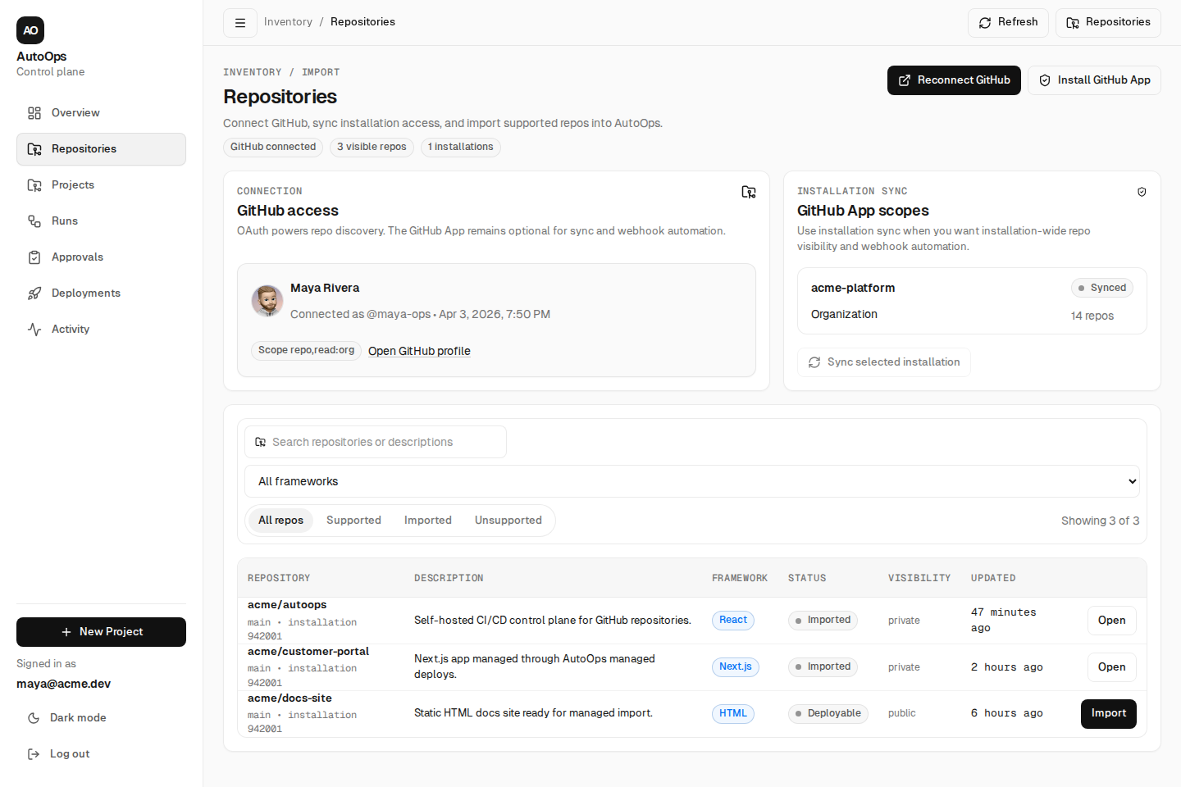
Onboarding
AutoOps
GitHub connection and repository discovery
This is where AutoOps links source repositories to managed or custom deployment paths.
Repositories
GitHub integration
The UI brings together OAuth connection, installation sync, repository inventory, and import actions in one workflow.
Managed import path
Supported repos can be analyzed and imported directly into managed deployments when they match v1 constraints.
Version 1 boundary
Managed mode targets standalone Next.js, React, CRA, and static HTML repositories. Monorepos stay on the custom-pipeline route.
7
Notes:
SPEAKER: Anas Khan
This repositories view supports onboarding — it's where AutoOps links source repositories to deployment paths.
The UI brings together OAuth connection, GitHub App installation sync, repository inventory, and import actions in one workflow. Teams can connect GitHub, inspect repositories, and decide whether a project should follow a managed deployment path or a custom pipeline path.
For Version 1, managed mode targets standalone Next.js, React, CRA, and static HTML repositories. Monorepos stay on the custom-pipeline route. This makes AutoOps flexible enough for different project types while keeping the workflow centralized.

Slide 8
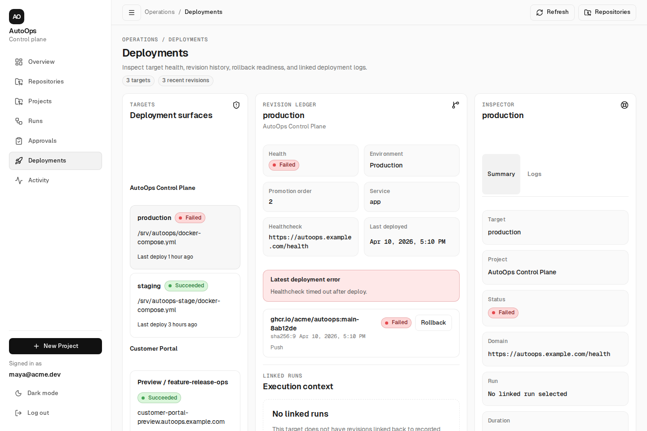
Deployment Ops
AutoOps
Deployment safety at a glance
The deployment view makes release safety concrete with revisions, approvals, and target-level status.
Deployments
• Targets carry environment, protection status, promotion order, healthcheck URL, and deployment metadata.
• Successful releases become deployment revisions with image references and digests, which makes rollback explicit.
• If deployment health fails after a known-good revision exists, the worker can attempt automatic rollback.
8
Notes:
SPEAKER: Anas Khan
This deployment view is one of the strongest parts of the platform — and it's where AutoOps shows operational maturity.
Each target carries its environment, protection status, promotion order, healthcheck URL, and deployment metadata. When a release succeeds, it becomes a deployment revision with image references and digests — which makes rollback explicit rather than guesswork.
The key point here is: if deployment health fails after a known-good revision exists, the worker can attempt automatic rollback. Deployment history is tied directly to recovery options.
You can also see the revision ledger and inspector panels, which let operators drill into exactly what was deployed, when, and what went wrong.

Slide 9
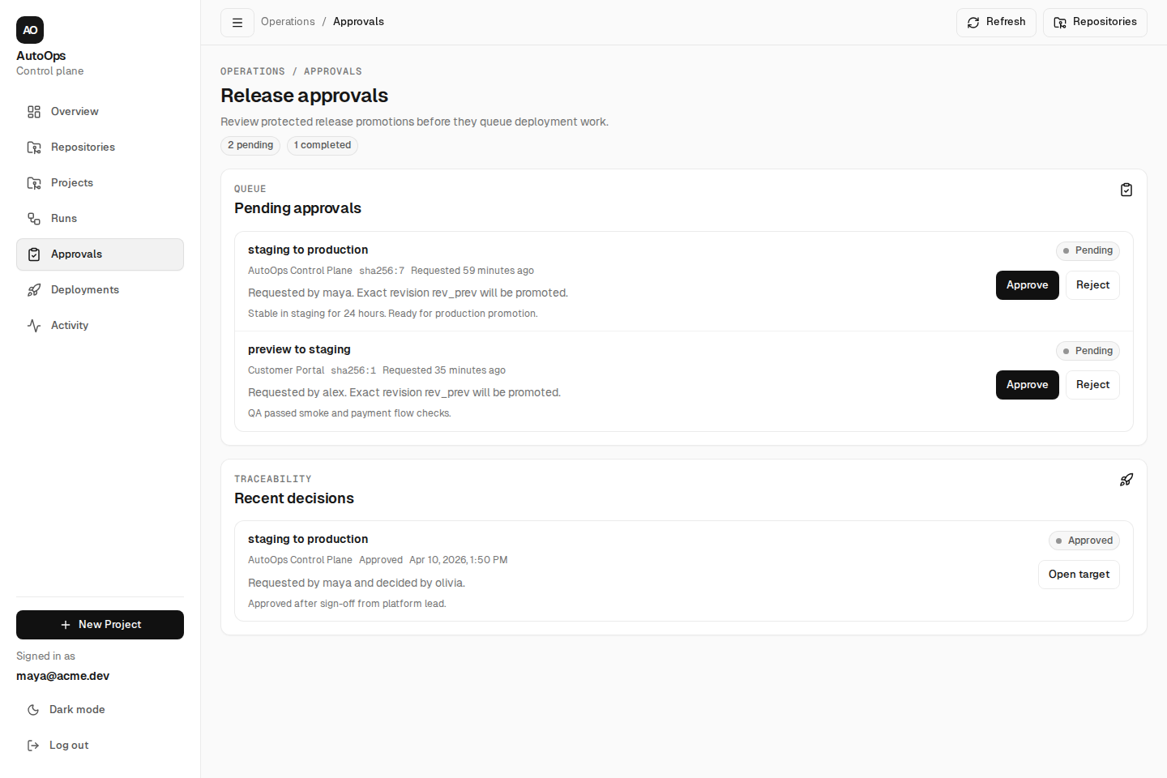
Governance
AutoOps
Protected release approvals and traceability
Approvals are first-class workflow objects, not comments pasted into chat.
Approvals
Approval model
Protected promotions can require explicit approval before deployment work is queued.
Stored context
Each record keeps requester, revision, source target, destination target, comments, and decision timestamps.
Why it matters
Operators get a durable change trail for protected releases instead of relying on memory or side-channel approvals.
9
Notes:
SPEAKER: Anas Khan
This slide focuses on governance and traceability.
AutoOps supports protected release approvals — so important promotions can require an explicit decision before deployment work is queued. For example, promoting from staging to production requires someone to approve it first.
Each approval record stores the requester, revision, source target, destination target, comments, and decision timestamps. This creates a proper audit trail.
The bottom section shows recent decisions, so there's always a traceable history of who approved what and when. Operators get a durable change trail instead of relying on memory or side-channel approvals.
I'll now pass it to Anshuman for code quality, our roadmap, and the closing.

Slide 10
Code Quality
AutoOps
Test coverage and engineering discipline
Every package has tests, and the pipeline validates correctness before deployment.
17 test suites passing
68 test cases
26 test files across 5 packages
API, worker, core, database, and web packages each have dedicated test files covering critical paths.
Webhook validation, pipeline parsing, deployment rollback, run streaming, and UI rendering all covered.
Tests live alongside source in every package: apps/api, apps/web, apps/worker, packages/core, packages/db.
52 source modules
Monorepo with pnpm workspaces
Vitest + Testing Library
14,400+ lines of TypeScript across API routes, worker stages, React pages, shared logic, and database schema.
Shared packages ensure type safety between API, worker, and dashboard without duplication.
Fast unit and integration tests using modern tooling with DOM testing for the React dashboard.
10
Notes:
SPEAKER: Anshuman Tiwari
Before we look ahead, let's talk about engineering discipline — because an MVP is only credible if it's well-tested.
We have 17 test suites passing across all five packages, with 68 individual test cases. These cover webhook validation, pipeline parsing, deployment rollback, run streaming, and UI rendering.
There are 26 test files living alongside 52 source modules — about 14,400 lines of TypeScript. Every package has its own tests: apps/api, apps/web, apps/worker, packages/core, and packages/db.
The monorepo uses pnpm workspaces, so shared packages ensure type safety between the API, worker, and dashboard without code duplication. We use Vitest and Testing Library for fast unit and integration tests, including DOM testing for the React dashboard.

Slide 11
Roadmap
AutoOps
What comes next in Phase 2
Planned extensions that build on the current foundation without rearchitecting.
Multi-environment promotion
Kubernetes targets
Role-based access control
Formalized staging → production chains with environment-specific configs and approval gates.
Deploy to k8s clusters alongside existing Docker Compose and managed VPS targets.
Team-scoped permissions for projects, approvals, and deployment targets.
Deeper observability
Broader framework support
Audit & compliance log
Build time trends, deploy frequency tracking, and integration with Grafana or Prometheus.
Monorepo detection, Rust, Go, and Python pipelines beyond the current web-app focus.
Immutable event log for every deployment decision, approval, and rollback action.
11
Notes:
SPEAKER: Anshuman Tiwari
Looking ahead, here's what Phase 2 builds on top of the current foundation — without requiring a rearchitecture.
Multi-environment promotion will formalize staging-to-production chains with environment-specific configs and approval gates. Kubernetes targets will let us deploy to k8s clusters alongside existing Docker Compose and VPS targets.
Role-based access control will add team-scoped permissions for projects, approvals, and deployment targets. Deeper observability means build time trends, deploy frequency tracking, and integration with tools like Grafana or Prometheus.
We're also planning broader framework support — monorepo detection, Rust, Go, and Python pipelines. And finally, an audit and compliance log for an immutable record of every deployment decision.

Slide 12
Live Demo
Webhook intake → pipeline run → deployment → healthcheck → rollback
Push to main
Watch the build
Inspect the deploy
Notes:
SPEAKER: Anshuman Tiwari
At this point we'd like to show you AutoOps in action.
The demo follows the exact flow we described earlier: we'll push code to main, watch the webhook trigger a pipeline run, see the build and test stages execute, watch the deployment go out, observe the healthcheck, and — if we have time — trigger a rollback to show recovery in action.
[SWITCH TO LIVE DEMO]

Slide 13
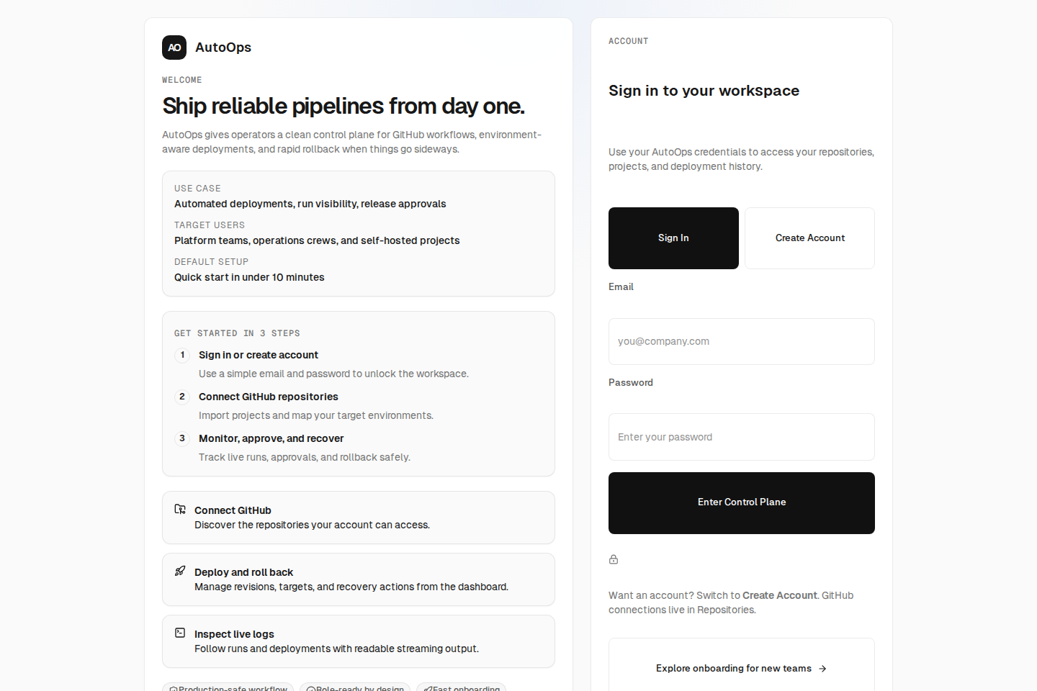
Build with control. Deploy with confidence.
→ Full CI/CD loop: webhook intake, build, test, deploy, healthcheck, and rollback.
→ Operator-first dashboard with triage, approval gates, and recovery actions.
→ Clean monorepo architecture ready to extend with new deployment targets.
Live demo • github.com/autoops • Questions?
Notes:
SPEAKER: Anshuman Tiwari
To wrap up — AutoOps already covers the full CI/CD lifecycle: webhook intake, build, test, deploy, healthcheck, and rollback.
It's an operator-first dashboard with triage, approval gates, and recovery actions — not just a deployment log.
And the clean monorepo architecture means it's ready to extend with new deployment targets, frameworks, and observability tools.
Thank you for your time. We'd be happy to answer any questions.

