Slide 1
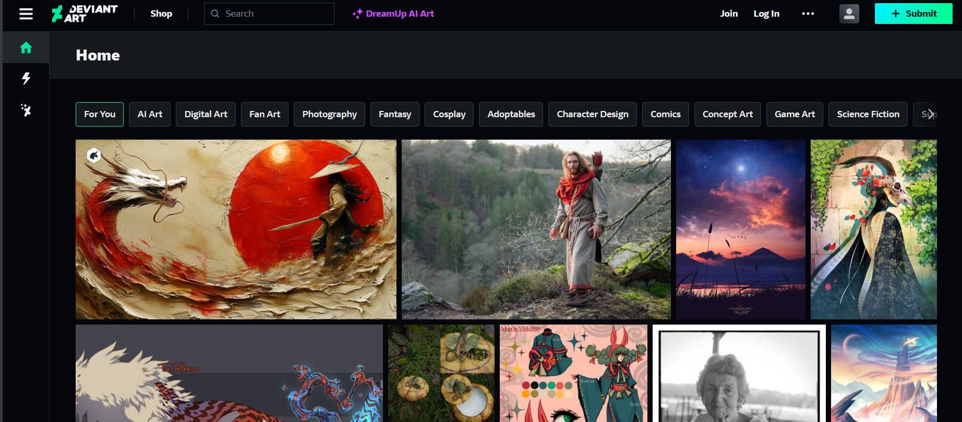
DeviantArt - The Largest Online Art Gallery and Community

