Slide 1
Assembly Language
Important Instructions and Syntax
Dr. WONG
The information presented in this PPT is written with MASM. You are supposed to use Visual C/C++ inline assembler to program. As such the declaration of data elements is different but the concepts and instruction sets are the same.

Slide 2
Translating Languages
English: Display the sum of A times B plus C.
C++: cout << (A * B + C);
Assembly Language:
mov eax,A
mul B
add eax,C
call WriteInt
Intel Machine Language:
A1 00000000
F7 25 00000004
03 05 00000008
E8 00500000

Slide 3
General-Purpose Registers
Named storage locations inside the CPU, optimized for speed.

Slide 4
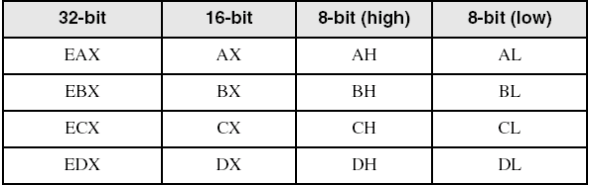
Accessing Parts of Registers
Use 8-bit name, 16-bit name, or 32-bit name
Applies to EAX, EBX, ECX, and EDX

Slide 5
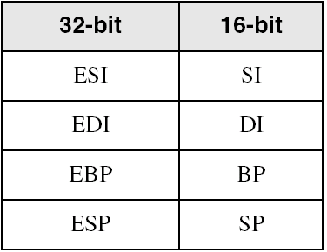
Index and Base Registers
Some registers have only a 16-bit name for their lower half:

Slide 6
Some Specialized Register Uses (1 of 2)
General-Purpose
EAX – accumulator
ECX – loop counter
ESP – stack pointer
ESI, EDI – index registers
EBP – extended frame pointer (stack)
Segment
CS – code segment
DS – data segment
SS – stack segment
ES, FS, GS - additional segments

Slide 7
Some Specialized Register Uses (2 of 2)
EIP – instruction pointer
EFLAGS
status and control flags
each flag is a single binary bit

Slide 8
Instructions
Assembled into machine code by assembler
Executed at runtime by the CPU
We use the Intel IA-32 instruction set
An instruction contains:
Label (optional)
Mnemonic (required)
Operand (depends on the instruction)
Comment (optional)

Slide 9
Labels
Act as place markers
marks the address (offset) of code and data
Follow identifer rules
Data label
must be unique
example: myArray (not followed by colon)
Code label
target of jump and loop instructions
example: L1: (followed by colon)

Slide 10
Mnemonics and Operands
Instruction Mnemonics
memory aid
examples: MOV, ADD, SUB, MUL, INC, DEC
Operands
constant
constant expression
register
memory (data label)
Constants and constant expressions are often called immediate values

Slide 11
Comments
Comments are good!
explain the program's purpose
when it was written, and by whom
revision information
tricky coding techniques
application-specific explanations
Single-line comments
begin with semicolon (;)
Multi-line comments
begin with COMMENT directive and a programmer-chosen character
end with the same programmer-chosen character

Slide 12
Instruction Format Examples
No operands
stc ; set Carry flag
One operand
inc eax ; register
inc myByte ; memory
Two operands
add ebx,ecx ; register, register
sub myByte,25 ; memory, constant
add eax,36 * 25 ; register, constant-expression

Slide 13
MOV Instruction
Move from source to destination. Syntax:
MOV destination,source
No more than one memory operand permitted
CS, EIP, and IP cannot be the destination
No immediate to segment moves
.data
count BYTE 100
wVal WORD 2
.code
mov bl,count
mov ax,wVal
mov count,al
mov al,wVal ; error
mov ax,count ; error
mov eax,count ; error

Slide 14
Your turn . . .
Explain why each of the following MOV statements are invalid:
.data
bVal BYTE 100
bVal2 BYTE ?
wVal WORD 2
dVal DWORD 5
.code
mov ds,45
mov esi,wVal
mov eip,dVal
mov 25,bVal
mov bVal2,bVal
immediate move to DS not permitted
size mismatch
EIP cannot be the destination
immediate value cannot be destination
memory-to-memory move not permitted

Slide 15
Zero Extension
When you copy a smaller value into a larger destination, the MOVZX instruction fills (extends) the upper half of the destination with zeros.
mov bl,10001111b
movzx ax,bl ; zero-extension
The destination must be a register.

Slide 16
Sign Extension
The MOVSX instruction fills the upper half of the destination with a copy of the source operand's sign bit.
mov bl,10001111b
movsx ax,bl ; sign extension
The destination must be a register.

Slide 17
XCHG Instruction
XCHG exchanges the values of two operands. At least one operand must be a register. No immediate operands are permitted.
.data
var1 WORD 1000h
var2 WORD 2000h
.code
xchg ax,bx ; exchange 16-bit regs
xchg ah,al ; exchange 8-bit regs
xchg var1,bx ; exchange mem, reg
xchg eax,ebx ; exchange 32-bit regs
xchg var1,var2 ; error: two memory operands

Slide 18
INC and DEC Instructions
Add 1, subtract 1 from destination operand
operand may be register or memory
INC destination
Logic: destination ← destination + 1
DEC destination
Logic: destination ← destination – 1

Slide 19
INC and DEC Examples
.data
myWord WORD 1000h
myDword DWORD 10000000h
.code
inc myWord ; 1001h
dec myWord ; 1000h
inc myDword ; 10000001h
mov ax,00FFh
inc ax ; AX = 0100h
mov ax,00FFh
inc al ; AX = 0000h

Slide 20
Your turn...
Show the value of the destination operand after each of the following instructions executes:
.data
myByte BYTE 0FFh, 0
.code
mov al,myByte ; AL =
mov ah,[myByte+1] ; AH =
dec ah ; AH =
inc al ; AL =
dec ax ; AX =
FFh
00h
FFh
00h
FEFF

Slide 21
ADD and SUB Instructions
ADD destination, source
Logic: destination ← destination + source
SUB destination, source
Logic: destination ← destination – source
Same operand rules as for the MOV instruction

Slide 22
ADD and SUB Examples
.data
var1 DWORD 10000h
var2 DWORD 20000h
.code ; ---EAX---
mov eax,var1 ; 00010000h
add eax,var2 ; 00030000h
add ax,0FFFFh ; 0003FFFFh
add eax,1 ; 00040000h
sub ax,1 ; 0004FFFFh

Slide 23
NEG (negate) Instruction
Reverses the sign of an operand. Operand can be a register or memory operand.
.data
valB BYTE -1
valW WORD +32767
.code
mov al,valB ; AL = -1
neg al ; AL = +1
neg valW ; valW = -32767
Suppose AX contains –32,768 and we apply NEG to it. Will the result be valid?

Slide 24
NEG Instruction and the Flags
The processor implements NEG using the following internal operation:
SUB 0,operand
Any nonzero operand causes the Carry flag to be set.
.data
valB BYTE 1,0
valC SBYTE -128
.code
neg valB ; CF = 1, OF = 0
neg [valB + 1] ; CF = 0, OF = 0
neg valC ; CF = 1, OF = 1

Slide 25
Implementing Arithmetic Expressions
HLL compilers translate mathematical expressions into assembly language. You can do it also. For example:
Rval = -Xval + (Yval – Zval)
Rval DWORD ?
Xval DWORD 26
Yval DWORD 30
Zval DWORD 40
.code
mov eax,Xval
neg eax ; EAX = -26
mov ebx,Yval
sub ebx,Zval ; EBX = -10
add eax,ebx
mov Rval,eax ; -36

Slide 26
Flags Affected by Arithmetic
The ALU has a number of status flags that reflect the outcome of arithmetic (and bitwise) operations
based on the contents of the destination operand
Essential flags:
Zero flag – set when destination equals zero
Sign flag – set when destination is negative
Carry flag – set when unsigned value is out of range
Overflow flag – set when signed value is out of range
The MOV instruction never affects the flags.

Slide 27
Concept Map
CPU
part of
executes
executes
ALU
conditional jumps
arithmetic & bitwise operations
attached to
used by
provide
affect
status flags
branching logic
You can use diagrams such as these to express the relationships between assembly language concepts.

Slide 28
Zero Flag (ZF)
The Zero flag is set when the result of an operation produces zero in the destination operand.
mov cx,1
sub cx,1 ; CX = 0, ZF = 1
mov ax,0FFFFh
inc ax ; AX = 0, ZF = 1
inc ax ; AX = 1, ZF = 0
Remember...
A flag is set when it equals 1.
A flag is clear when it equals 0.

Slide 29
Sign Flag (SF)
The Sign flag is set when the destination operand is negative. The flag is clear when the destination is positive.
mov cx,0
sub cx,1 ; CX = -1, SF = 1
add cx,2 ; CX = 1, SF = 0
The sign flag is a copy of the destination's highest bit:
mov al,0
sub al,1 ; AL = 11111111b, SF = 1
add al,2 ; AL = 00000001b, SF = 0

Slide 30
OFFSET Operator
OFFSET returns the distance in bytes, of a label from the beginning of its enclosing segment
Protected mode: 32 bits
Real mode: 16 bits
The Protected-mode programs we write use only a single segment (flat memory model).

Slide 31
OFFSET Examples
Let's assume that the data segment begins at 00404000h:
.data
bVal BYTE ?
wVal WORD ?
dVal DWORD ?
dVal2 DWORD ?
.code
mov esi,OFFSET bVal ; ESI = 00404000
mov esi,OFFSET wVal ; ESI = 00404001
mov esi,OFFSET dVal ; ESI = 00404003
mov esi,OFFSET dVal2 ; ESI = 00404007

Slide 32
Relating to C/C++
The value returned by OFFSET is a pointer. Compare the following code written for both C++ and assembly language:
// C++ version:
char array[1000];
char * p = array;
; Assembly language:
.data
array BYTE 1000 DUP(?)
.code
mov esi,OFFSET array

Slide 33
TYPE Operator
The TYPE operator returns the size, in bytes, of a single element of a data declaration.
.data
var1 BYTE ?
var2 WORD ?
var3 DWORD ?
var4 QWORD ?
.code
mov eax,TYPE var1 ; 1
mov eax,TYPE var2 ; 2
mov eax,TYPE var3 ; 4
mov eax,TYPE var4 ; 8

Slide 34
LENGTHOF Operator
The LENGTHOF operator counts the number of elements in a single data declaration.
.data LENGTHOF
byte1 BYTE 10,20,30 ; 3
array1 WORD 30 DUP(?),0,0 ; 32
array2 WORD 5 DUP(3 DUP(?)) ; 15
array3 DWORD 1,2,3,4 ; 4
digitStr BYTE "12345678",0 ; 9
.code
mov ecx,LENGTHOF array1 ; 32

Slide 35
SIZEOF Operator
The SIZEOF operator returns a value that is equivalent to multiplying LENGTHOF by TYPE.
.data SIZEOF
byte1 BYTE 10,20,30 ; 3
array1 WORD 30 DUP(?),0,0 ; 64
array2 WORD 5 DUP(3 DUP(?)) ; 30
array3 DWORD 1,2,3,4 ; 16
digitStr BYTE "12345678",0 ; 9
.code
mov ecx,SIZEOF array1 ; 64

Slide 36
Spanning Multiple Lines (1 of 2)
A data declaration spans multiple lines if each line (except the last) ends with a comma. The LENGTHOF and SIZEOF operators include all lines belonging to the declaration:
.data
array WORD 10,20,
30,40,
50,60
.code
mov eax,LENGTHOF array ; 6
mov ebx,SIZEOF array ; 12

Slide 37
Spanning Multiple Lines (2 of 2)
In the following example, array identifies only the first WORD declaration. Compare the values returned by LENGTHOF and SIZEOF here to those in the previous slide:
.data
array WORD 10,20
WORD 30,40
WORD 50,60
.code
mov eax,LENGTHOF array ; 2
mov ebx,SIZEOF array ; 4

Slide 38
LABEL Directive
Assigns an alternate label name and type to an existing storage location
LABEL does not allocate any storage of its own
Removes the need for the PTR operator
.data
dwList LABEL DWORD
wordList LABEL WORD
intList BYTE 00h,10h,00h,20h
.code
mov eax,dwList ; 20001000h
mov cx,wordList ; 1000h
mov dl,intList ; 00h

Slide 39
JMP Instruction
JMP is an unconditional jump to a label that is usually within the same procedure.
Syntax: JMP target
Logic: EIP ← target
Example:
top:
.
.
jmp top
A jump outside the current procedure must be to a special type of label called a global label (see Section 5.5.2.3 for details).

Slide 40
LOOP Instruction
The LOOP instruction creates a counting loop
Syntax: LOOP target
Logic:
ECX ← ECX – 1
if ECX != 0, jump to target
Implementation:
The assembler calculates the distance, in bytes, between the offset of the following instruction and the offset of the target label. It is called the relative offset.
The relative offset is added to EIP.

Slide 41
LOOP Example
The following loop calculates the sum of the integers 5 + 4 + 3 +2 + 1:
offset machine code source code
00000000 66 B8 0000 mov ax,0
00000004 B9 00000005 mov ecx,5
00000009 66 03 C1 L1: add ax,cx
0000000C E2 FB loop L1
0000000E
When LOOP is assembled, the current location = 0000000E (offset of the next instruction). –5 (FBh) is added to the the current location, causing a jump to location 00000009:
00000009 ← 0000000E + FB

Slide 42
Nested Loop
If you need to code a loop within a loop, you must save the outer loop counter's ECX value. In the following example, the outer loop executes 100 times, and the inner loop 20 times.
.data
count DWORD ?
.code
mov ecx,100 ; set outer loop count
L1:
mov count,ecx ; save outer loop count
mov ecx,20 ; set inner loop count
L2: .
.
loop L2 ; repeat the inner loop
mov ecx,count ; restore outer loop count
loop L1 ; repeat the outer loop

Slide 43
Summing an Integer Array
The following code calculates the sum of an array of 16-bit integers.
.data
intarray WORD 100h,200h,300h,400h
.code
mov edi,OFFSET intarray ; address of intarray
mov ecx,LENGTHOF intarray ; loop counter
mov ax,0 ; zero the accumulator
L1:
add ax,[edi] ; add an integer
add edi,TYPE intarray ; point to next integer
loop L1 ; repeat until ECX = 0

Slide 44
Copying a String
The following code copies a string from source to target:
.data
source BYTE "This is the source string",0
target BYTE SIZEOF source DUP(0)
.code
mov esi,0 ; index register
mov ecx,SIZEOF source ; loop counter
L1:
mov al,source[esi] ; get char from source
mov target[esi],al ; store it in the target
inc esi ; move to next character
loop L1 ; repeat for entire string
good use of SIZEOF

Slide 45
Stack Operations
Runtime Stack
PUSH Operation
POP Operation
PUSH and POP Instructions
Using PUSH and POP
Example: Reversing a String
Related Instructions

Slide 46
Runtime Stack
Imagine a stack of plates . . .
plates are only added to the top
plates are only removed from the top
LIFO structure

Slide 47
Runtime Stack
Managed by the CPU, using two registers
SS (stack segment)
ESP (stack pointer) *
* SP in Real-address mode

Slide 48
PUSH Operation (1 of 2)
A 32-bit push operation decrements the stack pointer by 4 and copies a value into the location pointed to by the stack pointer.

Slide 49
PUSH Operation (2 of 2)
Same stack after pushing two more integers:
The stack grows downward. The area below ESP is always available (unless the stack has overflowed).

Slide 50
POP Operation
Copies value at stack[ESP] into a register or variable.
Adds n to ESP, where n is either 2 or 4.
value of n depends on the attribute of the operand receiving the data

Slide 51
PUSH and POP Instructions
PUSH syntax:
PUSH r/m16
PUSH r/m32
PUSH imm32
POP syntax:
POP r/m16
POP r/m32

Slide 52
Using PUSH and POP
Save and restore registers when they contain important values. PUSH and POP instructions occur in the opposite order.
push esi ; push registers
push ecx
push ebx
mov esi,OFFSET dwordVal ; display some memory
mov ecx,LENGTHOF dwordVal
mov ebx,TYPE dwordVal
call DumpMem
pop ebx ; restore registers
pop ecx
pop esi

Slide 53
Example: Nested Loop
When creating a nested loop, push the outer loop counter before entering the inner loop:
mov ecx,100 ; set outer loop count
L1: ; begin the outer loop
push ecx ; save outer loop count
mov ecx,20 ; set inner loop count
L2: ; begin the inner loop
;
;
loop L2 ; repeat the inner loop
pop ecx ; restore outer loop count
loop L1 ; repeat the outer loop

Slide 54
TEST Instruction
Performs a nondestructive AND operation between each pair of matching bits in two operands
No operands are modified, but the Zero flag is affected.
Example: jump to a label if either bit 0 or bit 1 in AL is set.
test al,00000011b
jnz ValueFound
Example: jump to a label if neither bit 0 nor bit 1 in AL is set.
test al,00000011b
jz ValueNotFound

Slide 55
CMP Instruction (1 of 3)
Compares the destination operand to the source operand
Nondestructive subtraction of source from destination (destination operand is not changed)
Syntax: CMP destination, source
Example: destination == source
mov al,5
cmp al,5 ; Zero flag set
Example: destination < source
mov al,4
cmp al,5 ; Carry flag set

Slide 56
CMP Instruction (2 of 3)
Example: destination > source
mov al,6
cmp al,5 ; ZF = 0, CF = 0
(both the Zero and Carry flags are clear)

Slide 57
CMP Instruction (3 of 3)
The comparisons shown here are performed with signed integers.
Example: destination > source
mov al,5
cmp al,-2 ; Sign flag == Overflow flag
Example: destination < source
mov al,-1
cmp al,5 ; Sign flag != Overflow flag

Slide 58
Conditional Jumps
Jumps Based On . . .
Specific flags
Equality
Unsigned comparisons
Signed Comparisons
Applications
Encrypting a String
Bit Test (BT) Instruction

Slide 59
Jcond Instruction
A conditional jump instruction branches to a label when specific register or flag conditions are met
Specific jumps:
JB, JC - jump to a label if the Carry flag is set
JE, JZ - jump to a label if the Zero flag is set
JS - jump to a label if the Sign flag is set
JNE, JNZ - jump to a label if the Zero flag is clear
JECXZ - jump to a label if ECX = 0

Slide 60
Jcond Ranges
Prior to the 386:
jump must be within –128 to +127 bytes from current location counter
x86 processors:
32-bit offset permits jump anywhere in memory

Slide 61
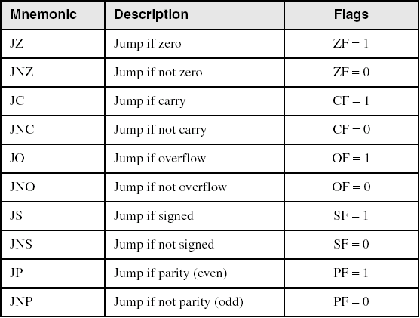
Jumps Based on Specific Flags

Slide 62
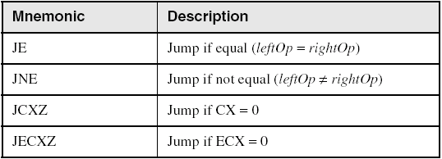
Jumps Based on Equality

Slide 63
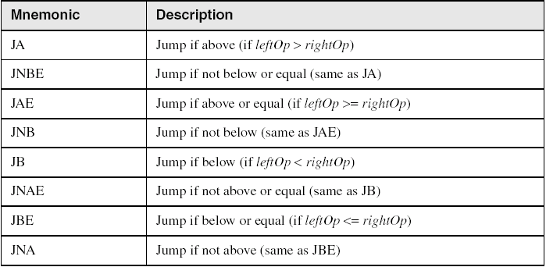
Jumps Based on Unsigned Comparisons

Slide 64
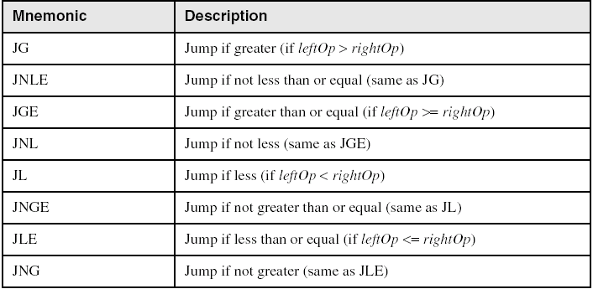
Jumps Based on Signed Comparisons

Slide 65
Applications (1 of 5)
Task: Jump to a label if unsigned EAX is greater than EBX
Solution: Use CMP, followed by JA
cmp eax,ebx
ja Larger
Task: Jump to a label if signed EAX is greater than EBX
Solution: Use CMP, followed by JG
cmp eax,ebx
jg Greater

Slide 66
Applications (2 of 5)
Jump to label L1 if unsigned EAX is less than or equal to Val1
cmp eax,Val1
jbe L1 ; below or equal
Jump to label L1 if signed EAX is less than or equal to Val1
cmp eax,Val1
jle L1

Slide 67
Applications (3 of 5)
Compare unsigned AX to BX, and copy the larger of the two into a variable named Large
mov Large,bx
cmp ax,bx
jna Next
mov Large,ax
Next:
Compare signed AX to BX, and copy the smaller of the two into a variable named Small
mov Small,ax
cmp bx,ax
jnl Next
mov Small,bx
Next:

Slide 68
Applications (4 of 5)
Jump to label L1 if the memory word pointed to by ESI equals Zero
cmp WORD PTR [esi],0
je L1
Jump to label L2 if the doubleword in memory pointed to by EDI is even
test DWORD PTR [edi],1
jz L2

Slide 69
Applications (5 of 5)
Task: Jump to label L1 if bits 0, 1, and 3 in AL are all set.
Solution: Clear all bits except bits 0, 1,and 3. Then compare the result with 00001011 binary.
and al,00001011b ; clear unwanted bits
cmp al,00001011b ; check remaining bits
je L1 ; all set? jump to L1

Slide 70
Conditional Loop Instructions
LOOPZ and LOOPE
LOOPNZ and LOOPNE

Slide 71
LOOPZ and LOOPE
Syntax:
LOOPE destination
LOOPZ destination
Logic:
ECX ← ECX – 1
if ECX > 0 and ZF=1, jump to destination
Useful when scanning an array for the first element that does not match a given value.
In 32-bit mode, ECX is the loop counter register. In 16-bit real-address mode, CX is the counter, and in 64-bit mode, RCX is the counter.

Slide 72
LOOPNZ and LOOPNE
LOOPNZ (LOOPNE) is a conditional loop instruction
Syntax:
LOOPNZ destination
LOOPNE destination
Logic:
ECX ← ECX – 1;
if ECX > 0 and ZF=0, jump to destination
Useful when scanning an array for the first element that matches a given value.

Slide 73
LOOPNZ Example
The following code finds the first positive value in an array:
.data
array SWORD -3,-6,-1,-10,10,30,40,4
sentinel SWORD 0
.code
mov esi,OFFSET array
mov ecx,LENGTHOF array
next:
test WORD PTR [esi],8000h ; test sign bit
pushfd ; push flags on stack
add esi,TYPE array
popfd ; pop flags from stack
loopnz next ; continue loop
jnz quit ; none found
sub esi,TYPE array ; ESI points to value
quit:

Slide 74
Comparing Arrays
Use a REPE (repeat while equal) prefix to compare corresponding elements of two arrays.
.data
source DWORD COUNT DUP(?)
target DWORD COUNT DUP(?)
.code
mov ecx,COUNT ; repetition count
mov esi,OFFSET source
mov edi,OFFSET target
cld ; direction = forward
repe cmpsd ; repeat while equal

Slide 75
Example: Comparing Two Strings (1 of 3)
This program compares two strings (source and destination). It displays a message indicating whether the lexical value of the source string is less than the destination string.
.data
source BYTE "MARTIN "
dest BYTE "MARTINEZ"
str1 BYTE "Source is smaller",0dh,0ah,0
str2 BYTE "Source is not smaller",0dh,0ah,0
Source is smaller
Screen output:

Slide 76
Example: Comparing Two Strings (2 of 3)
.code
main PROC
cld ; direction = forward
mov esi,OFFSET source
mov edi,OFFSET dest
mov ecx,LENGTHOF source
repe cmpsb
jb source_smaller
mov edx,OFFSET str2 ; "source is not smaller"
jmp done
source_smaller:
mov edx,OFFSET str1 ; "source is smaller"
done:
call WriteString
exit
main ENDP
END main

Slide 77
Example: Comparing Two Strings (3 of 3)
The following diagram shows the final values of ESI and EDI after comparing the strings:

Slide 78
Sorting Integer Arrays
Bubble Sort
A simple sorting algorithm that works well for small arrays

Slide 79
Bubble Sort
Each pair of adjacent values is compared, and exchanged if the values are not ordered correctly:

Slide 80
Bubble Sort Pseudocode
N = array size, cx1 = outer loop counter, cx2 = inner loop counter:
cx1 = N - 1
while( cx1 > 0 )
{
esi = addr(array)
cx2 = cx1
while( cx2 > 0 )
{
if( array[esi] < array[esi+4] )
exchange( array[esi], array[esi+4] )
add esi,4
dec cx2
}
dec cx1
}

Slide 81
Bubble Sort Implementation
BubbleSort PROC USES eax ecx esi,
pArray:PTR DWORD,Count:DWORD
mov ecx,Count
dec ecx ; decrement count by 1
L1: push ecx ; save outer loop count
lea esi,pArray ; point to first value
L2: mov eax,[esi] ; get array value
cmp [esi+4],eax ; compare a pair of values
jge L3 ; if [esi] <= [edi], skip
xchg eax,[esi+4] ; else exchange the pair
mov [esi],eax
L3: add esi,4 ; move both pointers forward
loop L2 ; inner loop
pop ecx ; retrieve outer loop count
loop L1 ; else repeat outer loop
L4: ret
BubbleSort ENDP

Slide 82
The End

