Slide 1
A technique report about drawing Sankey diagrams in Java
XuChen 2257453

Slide 2
Introduction
In the realm of data visualization, three key points merit attention:
----Data Cleaning: Before embarking on data visualization,it’s crucial to ensuring the dataset is clean and accurate.
----Interactivity of Charts: Users should have the ability to select different subsets of data to meet diverse analytical needs. Also, detailed information should be provided which can enhance users’ understanding. Allowing users to adjust chart parameters facilitates a better exploration of different aspects of the data.
----Aesthetic Value: Consideration should be given to the reasonable use of color and labels’ size.

Slide 3
Introduction
When creating a Sankey diagram, two key points are worth considering:
----Data Flow should be affected by numbers and attributes: Ensure that the Sankey diagram clearly illustrates the flow of data, emphasizing relationships between different components through variations in width and color.
----Clear Labels and Annotations: Clear labels and annotations should be added to the nodes and flow lines of the Sankey diagram to explain elements in the chart, aiding the audience in understanding key information.

Slide 4
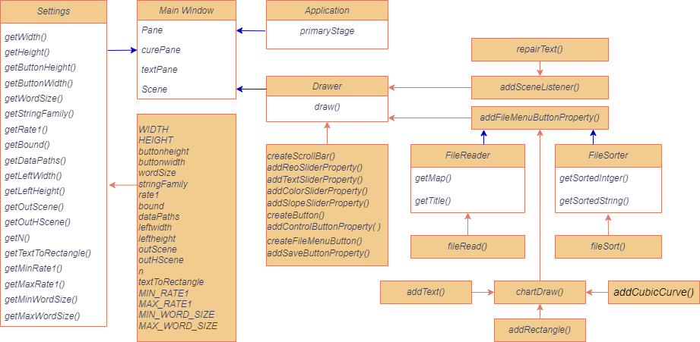
Code Design combining with Objective-oriented Principles

Slide 5
The analysis of Code Design in Object-oriented Principles
Encapsulation
----In Settings class, we set all the initial number as private ,which can not be obtained by users and users can only get the value using various getter function that is designed to be static. What’s more ,in order to ensure that the picture is appropriate and it can be adjusted by button,we don’t need to write setter function.
----In Main Window class, it just run the final code ,so there is no encapsulation in it ,which just call public function.

Slide 6
The analysis of Code Design in Object-oriented Principles
Encapsulation
----In FileReader and FileSorter class, we will get the local path or the map. In FileReader,We set the function that deal with the path and output the map as private function,which can keep the map to be safe.Also,We set the sorting function to be private in FileSorter.Whats more,we just set getter function as public and set the storage of inputs as private to keep the value of inputs cannot be easily changed.
----In Drawer class, only the draw function is public and the others handling functions are private just avoid be used by other classes and keep the code safe.

Slide 7
The analysis of Code Design in Object-oriented Principles
Inheritance and Polymorphism
The only inheritance in this code is the Main Window extends from javafx Application.
The aim of this is to override the start function to show the diagram.
The reason why we just need to create a Drawer class in drawing .
----We just instantiate the several class in javafx:Button,ScrolBar,MenuButton,Text, Rectangle and so on. What we need to do is to ensure the hierarchy of the function to avoid duplicate information. According to OOP principles, combinations are better than inheritance and the function here is sequential and linear, so there is no need to set a super class and override the function again and again.

Slide 8
The analysis of Code Design in Object-oriented Principles
Inheritance and Polymorphism
Therefore,Drawer does not have inheritance.For FileReader and FileSorter class , they achieve different task, inheriting will destroy the dependency and FileSorter does not need title.
There is no Polymorphism in this code,as written before :combinations are better than inheritance in OOP design and the code just has one inheritance.

Slide 9
The analysis of Code Design in Object-oriented Principles
Abstraction
From figure , we can see the code design has done lots of abstraction.Except the Main Window,no class else have access to the true value, which are replaced variable. Also,in Drawer class, we can see the large code is separated by small steps with hierarchy associated with its task meaning ,which make complex concepts into simpler representations.
The use of abstraction enhances code readability and comprehensibility.

Slide 10
The analysis of Code Design in Object-oriented Principles
Modularity and Dependency
From figure ,It’s easy to see that the code is designed in modularity that each function and class achieve some meanings.
For dependency, we can see each module is a one-to-many relation and single row with others,which means each of the module have deterministic task and there doesn’t exist Circular Dependency problems in this code.

Slide 11
The analysis of Code Design in Object-oriented Principles
Class Design
Above all ,we can admit that my code class design is reasonable. The structure is clear and useful.What’s more ,you can add other property into this class without destroy the relationship ,which means the class design is maintainable and extendable.

Slide 12
Code Clarity
I will introduce the Naming method here. All the classes are words combined with upper case in first letter and its solution function is just lower the first letter. To catch the private value, we all use “get+...” naming way. For methods, they are words combined with upper case except the first one. All the name is named according to its actual meaning.

Slide 13
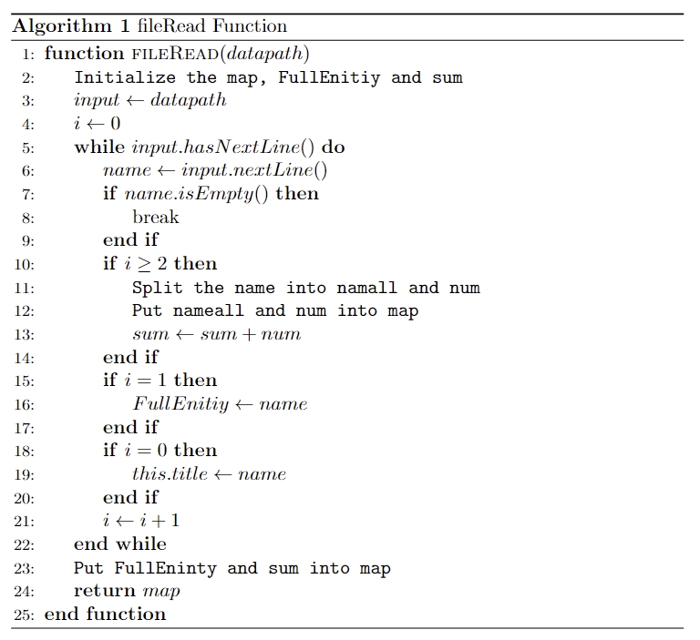
The Algorithm about file read
The class FileReader accept one argument: String datapath and have two private variable : String title and Map<String, Integer> map ,two public function:getMap() and getTitle() and one private function:fileRead().The map and title are defined when executing the private function.

Slide 14
The Algorithm about file read
How does fileRead() function works? Please watch Figure 10.There are somethings need to make up: The pseudo code does not show the error message sending but it does exist in true code. Most importantly, name.isEmpty() is to prevent some example that have several lines with nothing.Without this step,many code will not run successfully.

Slide 15
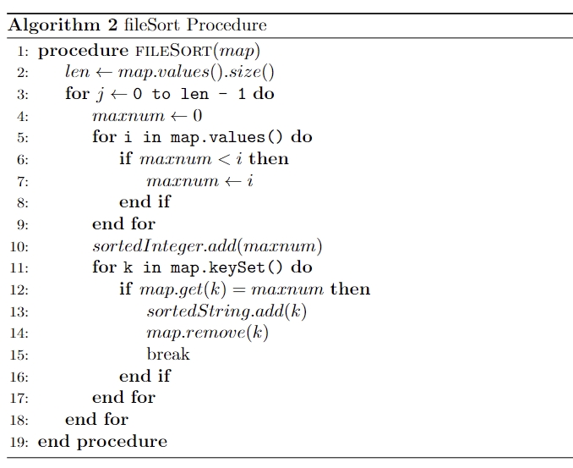
The Algorithm about file sort
The class FileSorter accept one argument: Map<String, Integer> map and have two private variable : List<Integer> sortedInteger and List<String> sortedString ,two public function: getSortedInteger() and getSortedString() and one private function: fileSort().The sortedInteger and sortedString are defined when executing the private function. Additionally,I need to mention that after the fileSort() execution,the map is {},which can save the space.

Slide 16
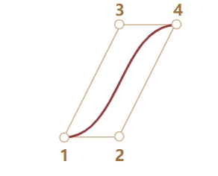
How to draw curves ?
In our program we need to make sure the start point 1 and control point 2 have the same height,so as the end point 4 and control point 3 ,which can ensure that the diagram is vertical when we set the stroke width.
The function accept four arguments addCubicCurve(Pane pane,Double startY,Double endY,Double startRectangle,Double Rate_leftright) and return a CubicCurve class. We set each of the 4 point location and it will not like the actual one as we set stroke width which is a square,that means the point deviate what we see by eyes. What’s more we set the color ,and make sure the setfill function is opacity to avoid problems.

Slide 17
The way to draw Rectangle and Text
In addRectangle function ,it accepts arguments: DoubleBinding xProperty, DoubleBinding yProperty,DoubleBinding wProperty,DoubleBinding hProperty and return a Rectangle class. We set the location and its width and height.Also,we set the color ,but make sure the stroke and filling have the same color to make diagram more clear. In addText function, it accepts arguments: String textString,DoubleBinding xProperty,DoubleBinding yProperty and return a Text class. We set the location and make sure that it is bold and italic . Most importantly , we compute the textWidth in this function and subtract in xProperty,so we just need input the end width location of text.

Slide 18
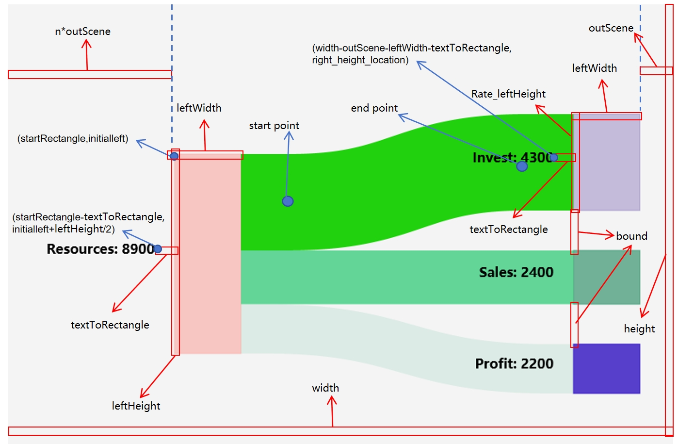
The way to combine all the above and draw the chart
Variable setting: width:Scene width height:Scene height outScene : a ditance to keep the recatngle away from scene. n: a rate in left to ensure the text is among the scene startRectangle:n*outScene Initialleft:the yproperty of left rectangle leftWidth: the width of all rectangles leftHeight: the height of left rectangles rate: the rate of right rectangle values/ left rectangle values Rate_leftHeight: rate*leftHeight bound: the bound of right rectangles

Slide 19
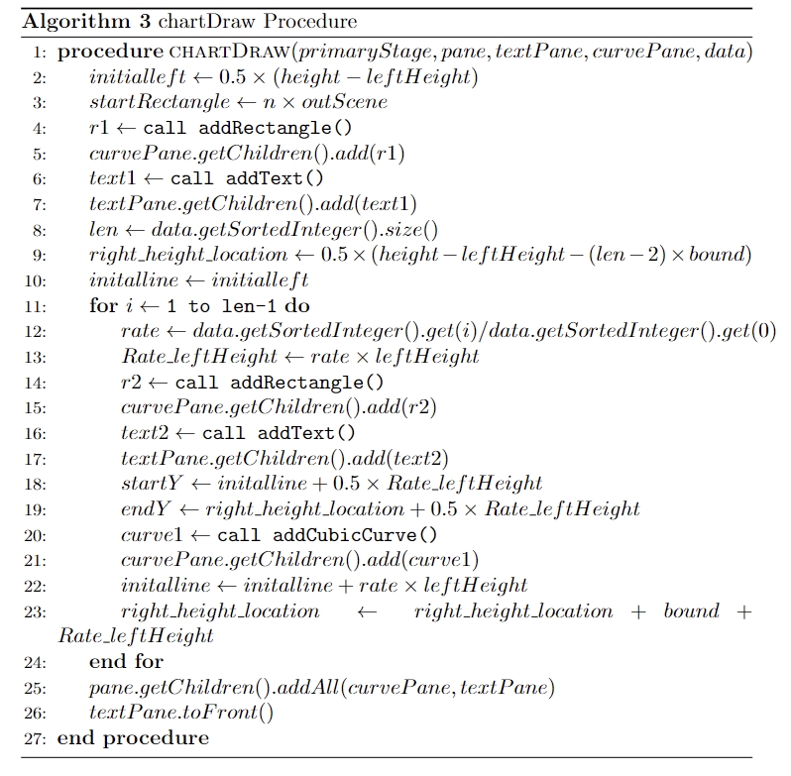
The way to combine all the above and draw the chart
CubicCurve location computing: ---Start point: Initialine: each left-upper height of curve X: startRecatngle+leftWidth+Rate_leftHeight/2 Y:initalline+0.5*Rate_leftHeight ----End point: right_height_location:each right-upper height of curve X:width-leftWidth-outScene-Rate_leftHeight/2 Y:right_height_location+0.5*Rate_leftHeight

Slide 20
Display while Resizing Algorithm
In chartDraw, we use bind() combined with pane.widthProperty() and pane.heightProperty() to reach the resization of location and magnitude of recatangles and curves and the resiztion of location of text. We know all of the variable have been set as “a*width/height” except the text wordsize. So we need to compute and change it into the pattern “a*width/height+b” pattern and compute them use add() .

Slide 21
Display while Resizing Algorithm
In repairText , we first compute the scaleFactor,which is a min{newVal/width, newVal/height} and newVal comes from monitor. Then, we use the (maxWordSize+minWordSize) /2 * scaleFactor to update the word size.Although we change the word size,the old text location hasn’t been change so we need to add this gap just in “b” pattern.

Slide 22
ADDITIONAL FEATURES: Adjust Button
We first set the location of sliders use createScrollBar function,which accepts aarguments:String tooltip, DoubleBinding layoutX, DoubleBinding layoutY, double min, double max, double value.Then,each of them is designed to add property ( curve slope adjust slider, rectangle adjust opacity slider,test size adjust slider,curve opacity adjust slider) function to change the variable directly in node of related pane.After that,we use createButton to create adjust button and execute setOnAction to remove or add sliders into the pane.

Slide 23
ADDITIONAL FEATURES: File Menu Button
The createFileMenuButton method creates a MenuButton object with the location and make sure the page is opened to upper direction. The addFileMenuButtonProperty method adds functionality to the fileMenuButton. It creates MenuItem objects for each file, assigns an action to each menu item, and adds them to the fileMenuButton's list of items. The action performed when a menu item is clicked includes removing certain elements from the pane, clearing other panes, reading data from a file, and updating the chart and window title.

Slide 24
ADDITIONAL FEATURES: Save Image Button
We can reuse the createButton to create the save image button and the addSaveButtonProperty method adds functionality to the button. When the button is clicked, it hides certain elements such as the control button, sliders, and file menu button. It then takes a snapshot of the specified pane using the snapshot method and opens a file chooser dialog to allow the user to select where to save the image. The method checks that the file extension is valid and saves the image to the selected file using the write() method. Finally, the method shows the hidden elements again.

Slide 25
Exception Handling
In FileReader class, it will handle the exception and stop execute by System.exit(0) If the format is wrong,such as no value in lines ,it will output "Data format exception at line " + (i + 1) If the number in lines is negative or 0 ,it will output "Data must be positive" If the number in lines has two values or more with space (which means it not a title combined with number) ,it will out put"Data overflow" If the code cannot get the file ,it will output a IOException.

Slide 26
Code Run Display

Slide 27
Thank you for watching this presentations

