Slide 1
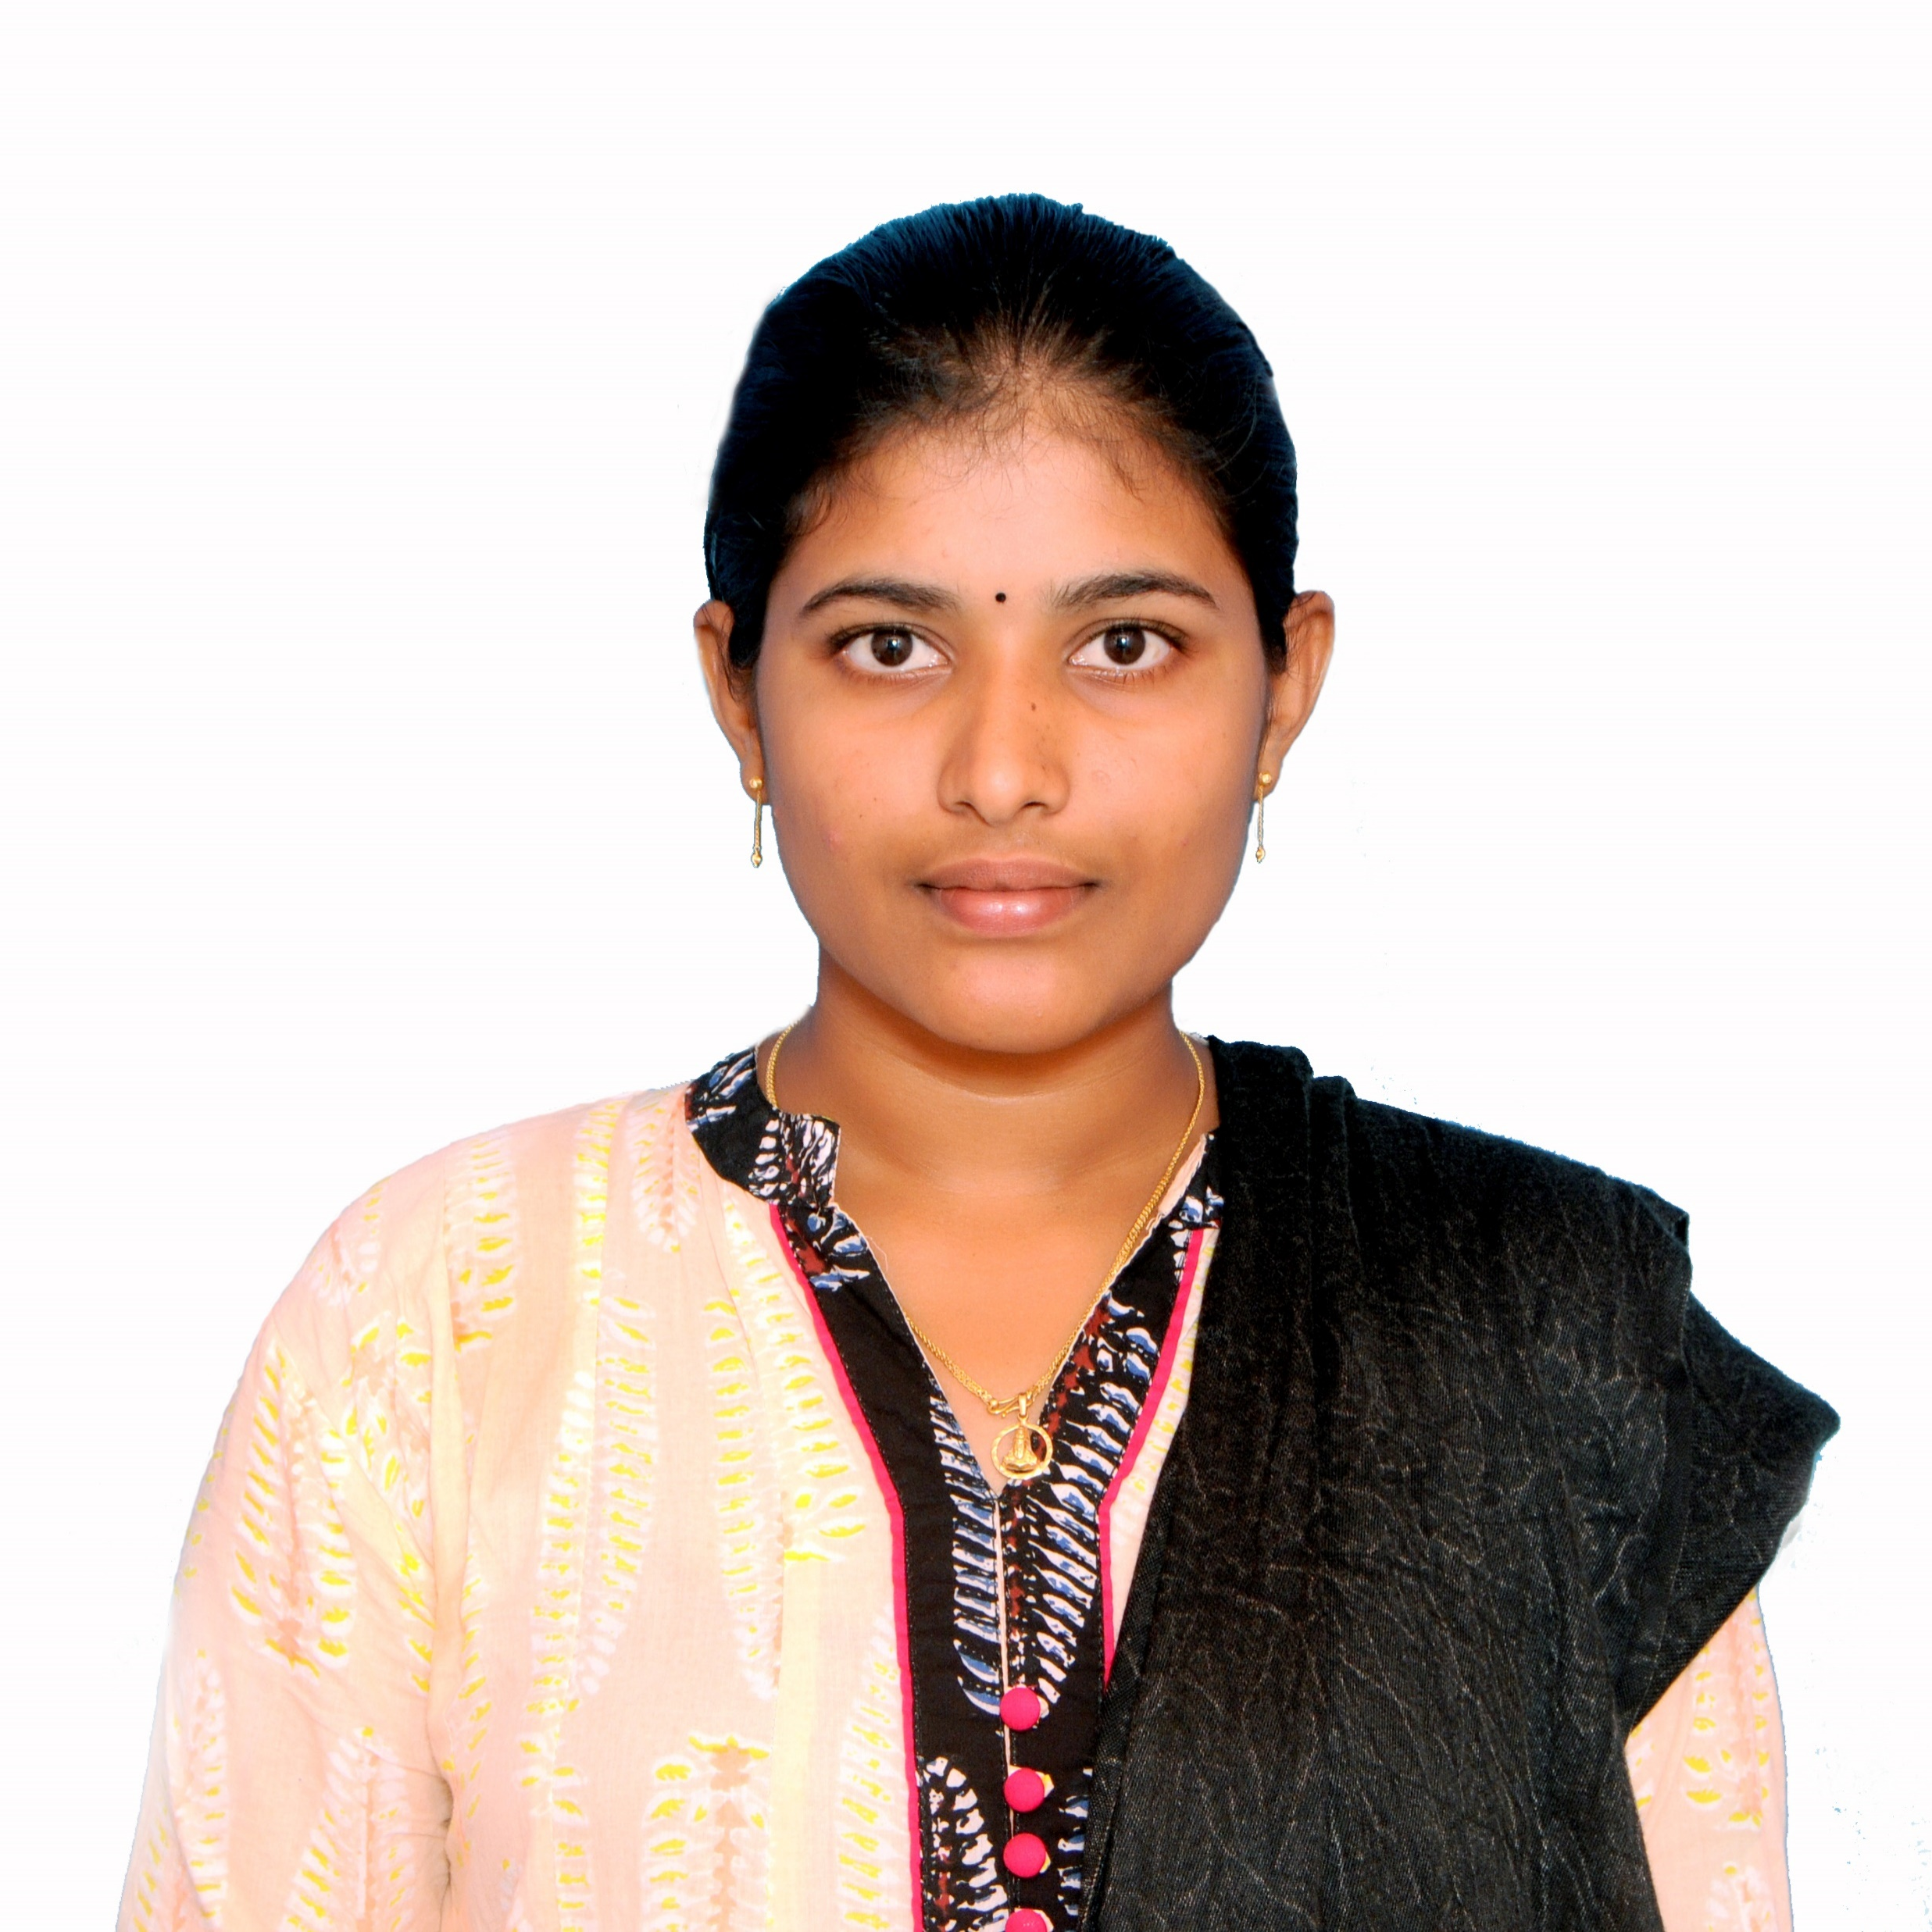


Dharani Chiratla
Analyst/Software Engineer
Bachelor of Engineering
Electronics and Communication Engineering : 2018 – 2021
Skills c#
html
Sql
Css
angular
Azure fundamentals (AZ-900)
AZ-204
Database:
SQL database
Web Technologies
HTML5
CSS3
Javascript/TypeScript
Additional Details:
Leadership
Quick Learner
Team management
Areas of intrest and hobbies:
Playing kho-Kho
Listening to music
cycling
Bangalore
dharani.chiratla@capgemini.com
9381650316
A4
Software Engineer who is Strong in design and integration with intuitive problem-solving skills. Passionate about implementing and launching new projects.
Ready to learn new technologies and implement them to further improve my knowledge.
Eager to work in a team of dedicated people and serve a key role in the enhancement and development of the project.
A team player with good communication skill always ready to work for the enrichment of knowledge.
I have knowledge on SQL, .NET , angular and HTML,CSS and Azure (AZ-900,az-204) on an intermediate level.
Microsoft Azure Certified:
I achieved AZ-900 Microsoft Azure Certification.
I achieved AZ-204 Microsoft Azure Certification
I achieved Agile Software Development Certification
Completed Azure beginner assessment-fresher as the part of Ocean program

