Slide 1
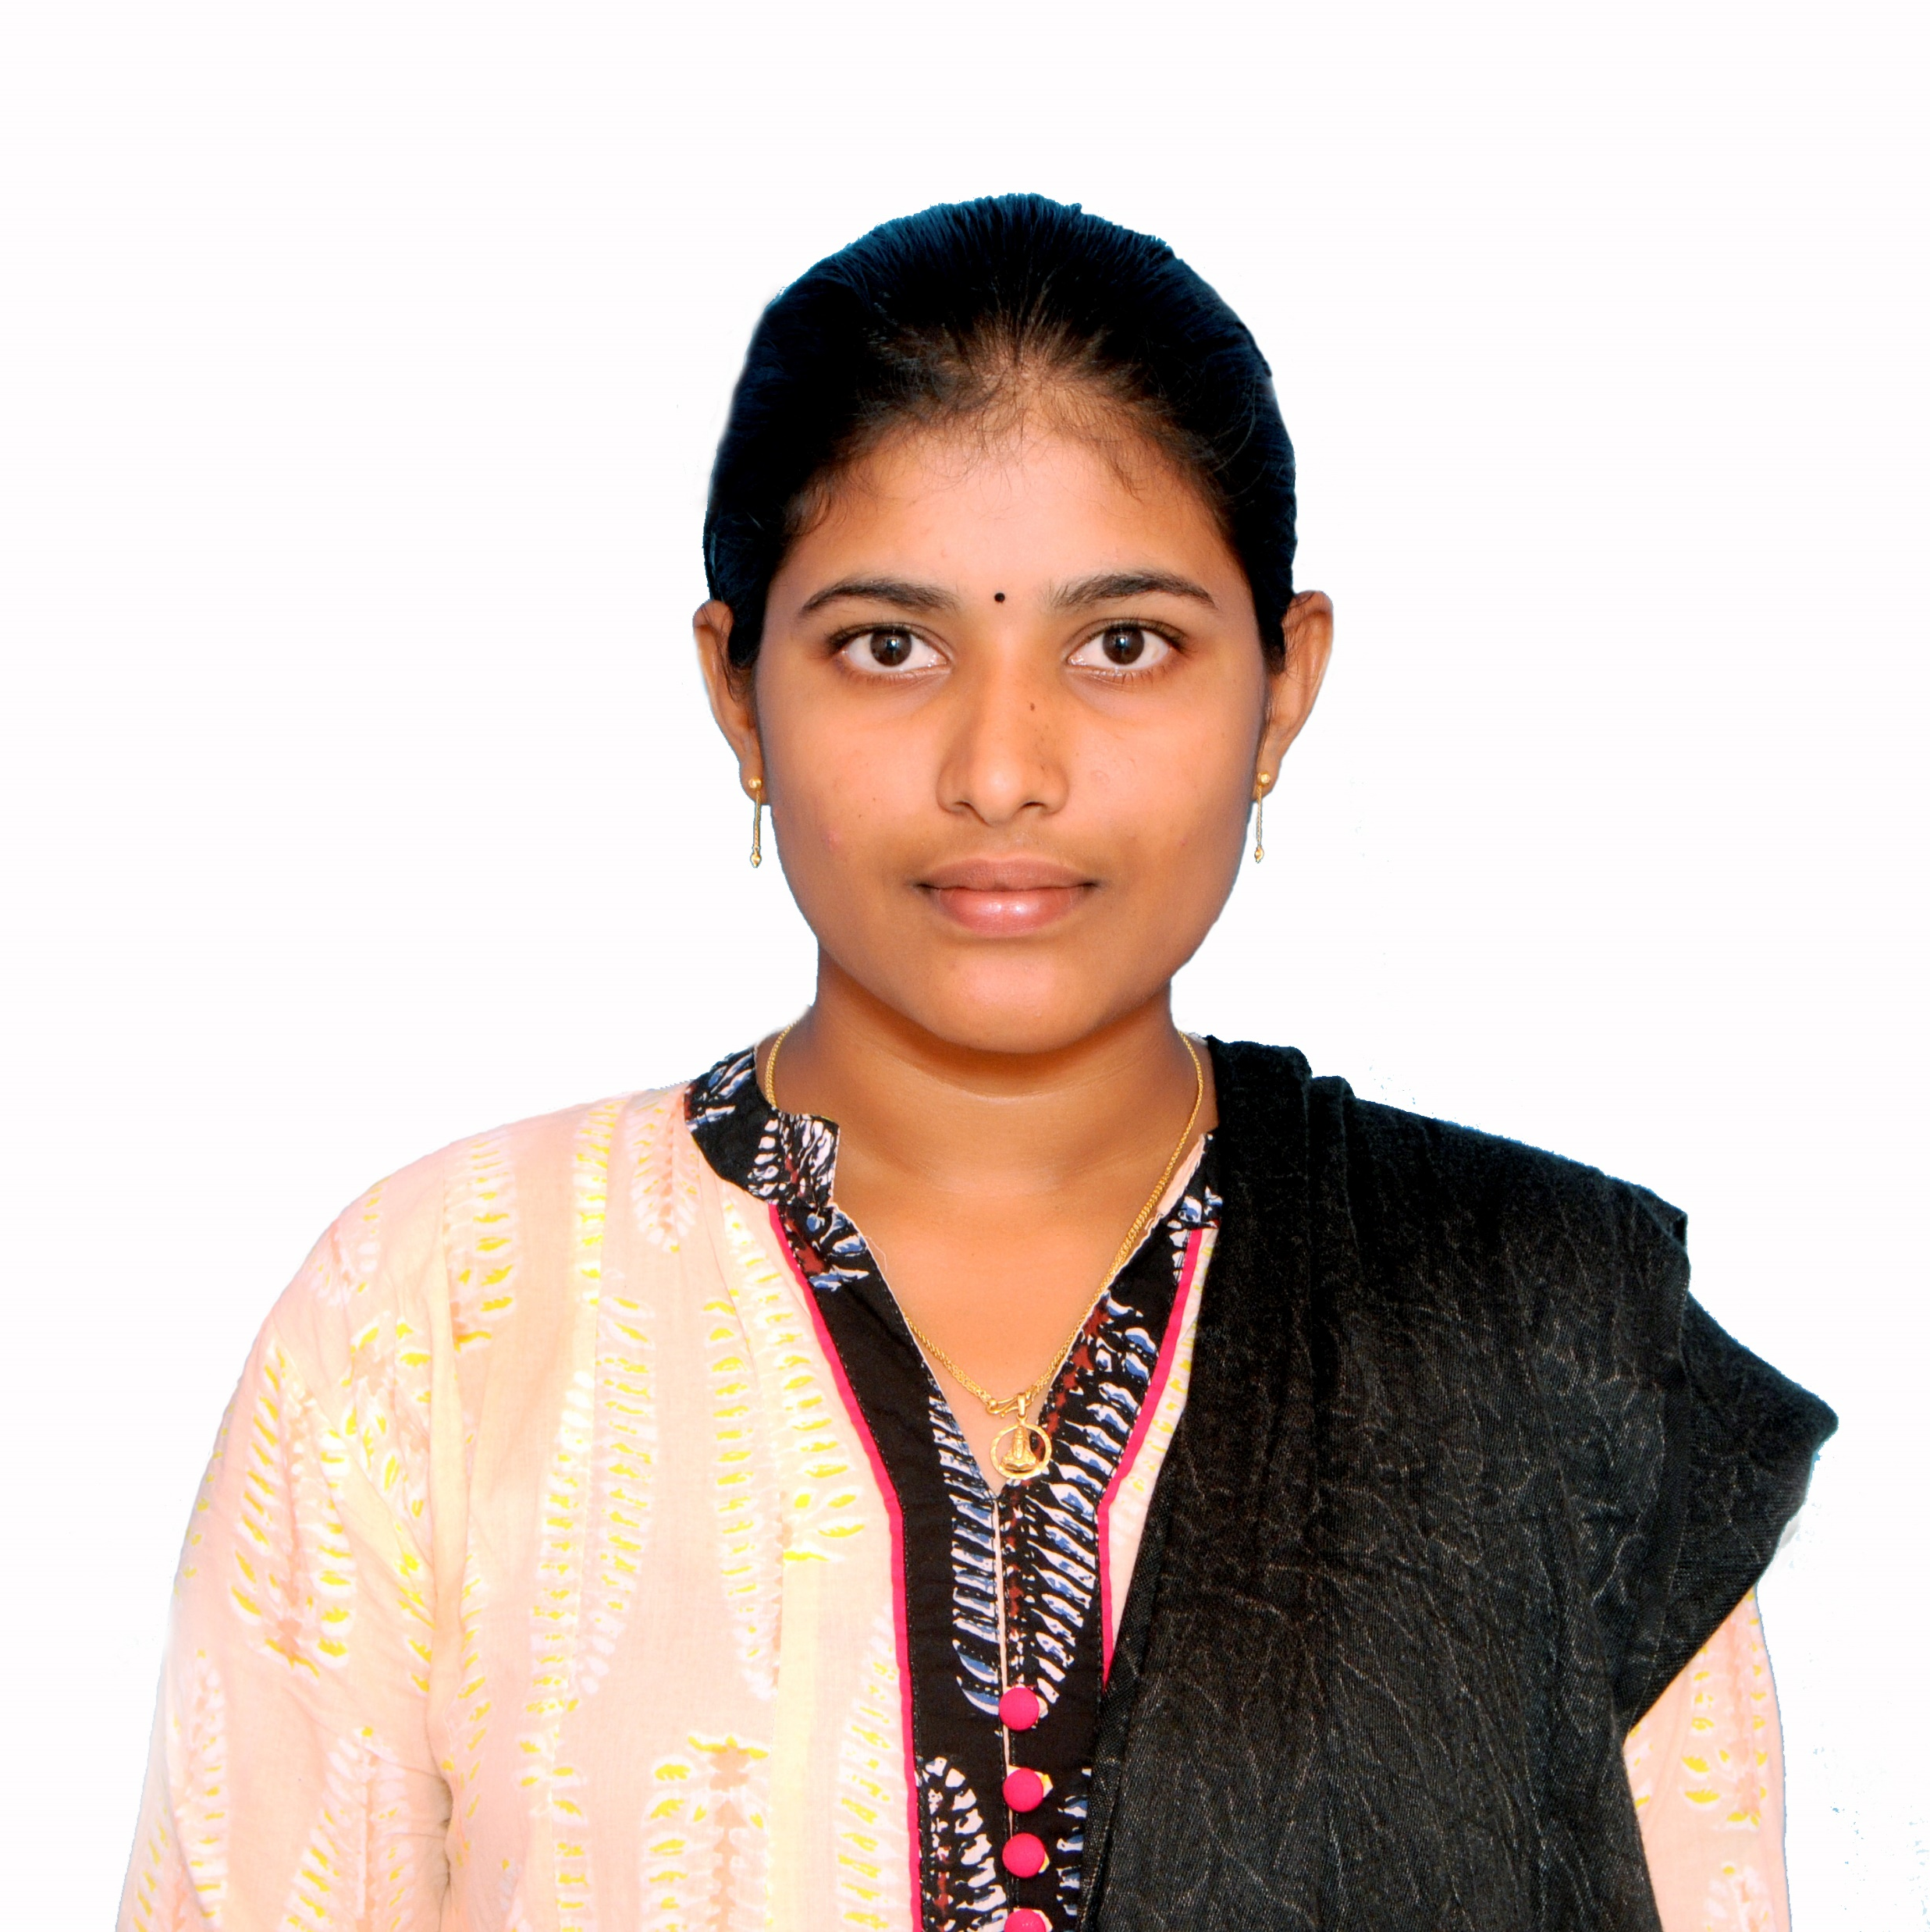


Dharani Chiratla
Analyst/Software Engineer
Bachelor of Engineering
Electronics and Communication Engineering : 2018 – 2021
Skills c#
html
Sql
Azure fundamentals (AZ-900)
Database:
SQL database
Additional Details:
Leadership
Quick Learner
Team management
Areas of intrest and hobbies:
Playing kho-Kho
Listening to music
cycling
Bangalore
dharani.chiratla@capgemini.com
9381650316
A4
Software Engineer who is Strong in design and integration with intuitive problem-solving skills. Passionate about implementing and launching new projects.
Ready to learn new technologies and implement them to further improve my knowledge.
Eager to work in a team of dedicated people and serve a key role in the enhancement and development of the project.
I have knowledge on SQL, .NET and HTML and Azure (AZ-900) on an intermediate level.
Microsoft Azure Certified:
I achieved AZ-900 Microsoft Azure Certification.
Completed Introduction to Microsoft Azure Cloud Services in Coursera platform.

