Slide 1
Right to Bear Arms Game Pitch Document
presented by:
Andrew Perrault
November 7, 2014

Slide 2
Abstract of game story
Alien trophy hunters have invaded Earth!
The aliens are collecting tiger tails, elephant ears, cow lips and bear arms...
You play as Cuddles the bear
You must fight the aliens to get back the stolen limbs

Slide 3
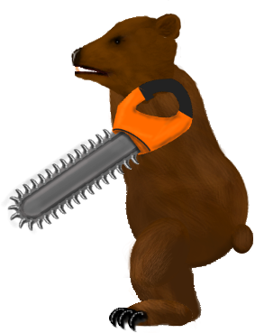
Abstract of game story
Cuddles wakes up in the zoo and realizes his arms are missing
He kicks in the door of the nearest maintenance shed to get a weapon
He straps chainsaws to his stumps and goes looking for aliens

Slide 4
Gameplay and Mechanics
Single player side scrolling action beat-em-up
Similar to Kung Fu for NES/C64
Simple controls usable from a phone touchscreen
One button for all attacks
One gamepad to control run, jump and duck
Attacks require timing the button clicks as enemies run at you
Different attacks and combos will happen based on the distance between Cuddles and the enemy

Slide 5
Metagame
Players collect points by killing enemies
Points are converted to currency to buy temporary upgrades that can be used the next time you play
Playing well on the first level will get you enough currency to get at least some basic upgrades when you play again
Revenue is based on in-app purchases of the game currency
All content will be available to all players

Slide 6
Development and Distribution
Built in Unity
Quick development time
Easy to build for multiple platforms
Distributed through mobile app stores
Windows App Store
Google play
iTunes

Slide 7
Summary
Memorable theme that people will talk about
Simple but challenging gameplay will be fun from the 1st play to the 100th
Multiple platforms and free should allow for wide distribution
In-app purchases should allow significant revenue

Slide 8


