Slide 1
Right to Bear Arms
Game Proposal
presented by:
Andrew Perrault
November 7, 2014

Slide 2
Abstract of game story
Alien trophy hunters have invaded Earth!
The aliens are collecting tiger tails, elephant ears, cow lips and bear arms...
You play as Cuddles the bear and you must fight the aliens to get back the stolen limbs

Slide 3
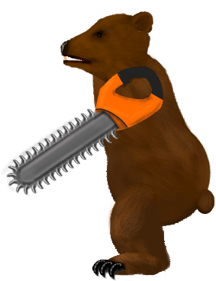
Abstract of game story
Cuddles wakes up in the zoo and realizes his arms are missing
He kicks in the door of the nearest maintenance shed to get a weapon
He straps chainsaws to his stumps and goes looking for aliens

Slide 4
Gameplay and Mechanics
Single player side scrolling action beat-em-up
  Similar to Kung Fu for NES/C64
Simple controls usable from a phone touchscreen
  One button for all attacks
  One gamepad to control run, jump and duck
Attacks require timing the button clicks as enemies run at you
Different attacks and combos will happen based on the distance between Cuddles and the enemy

Slide 5
Pregame Upgrades
At the start of each match you can spend your currency on temporary upgrades
Upgrades to Damage or Armour
Upgrades are disposable and only work on the next play through
Currency is easy to acquire and even with low levels of skill you can acquire basic upgrades
To max out armour and damage you will need to play a few games and save up or buy currency through the in game store

Slide 6
Win/Loss Conditions
The game will consist of 4 levels plus and end boss level
Enemies will spawn off screen and constantly run at you
You begin each level at one end and need to walk to the other end to win
When your health is reduced to zero the game will end
At the end of each level you will be presented with a screen congratulating and your health will be restored for the start of the next level

Slide 7
Enemies
Robot Drones
  These are the normal enemies that will take one hit to kill
  Spawn constantly on every level
  Run right at you and do damage as long as they are touching you
Spider mines
  Run right at the player and explode
  Jump over them to avoid
Energy beam drones
  Shoot energy beam that you must duck to avoid
  Few attacks to kill
Little green men
  Run onto the screen. Shoot. Run away.
  Difficult but rewarding and satisfying to kill
Tiny Flying Saucer
  Move around the screen and try to zap you with electricity
  Much more difficult to kill than other enemies
  Boss of level 1 but regular enemies of levels 3-4

Slide 8
Metagame
Players collect points by killing enemies
Points are converted to currency to buy temporary upgrades that can be used the next time you play
Playing well on the first level will get you enough currency to get at least some basic upgrades when you play again
Revenue is based on in-app purchases of the game currency
All content will be available to all players

Slide 9
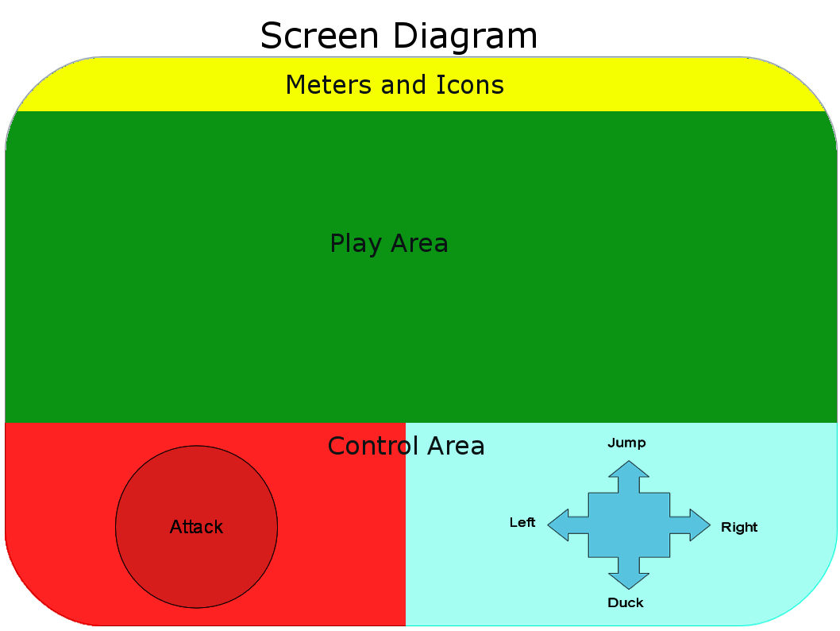
Player Interaction
Pressing the attack button will cause Cuddles to do an attack animation
If an enemy is in range then the enemy will be hit
Many enemies will die from a single hit
Enemies that do not die will generally be knocked back
Attacking while in the air will be required to hit some enemies
Attacking while ducked will be required to hit some enemies

Slide 10
Development and Distribution
Built in Unity
  Quick development time
  Easy to build for multiple platforms
Distributed through mobile app stores
  Windows App Store
  Google play
  iTunes

Slide 11
Summary
Memorable theme that people will remember
Simple but challenging gameplay will be fun from the 1st play to the 100th
Multiple platforms and free should allow for wide distribution
In-app purchases should allow significant revenue

