Slide 1
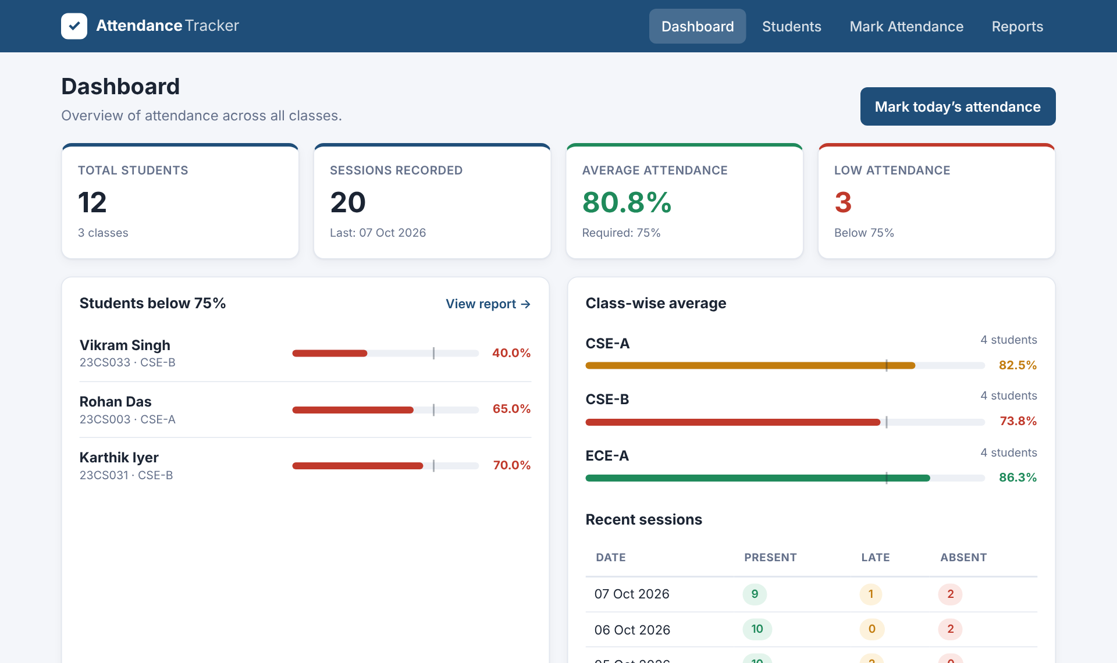
Student Attendance Tracker
ReactJS Project
A ReactJS application to record attendance, calculate percentages and flag low attendance
Presented by: ____________ · Roll No: ________
Notes:
Introduce the project: a responsive ReactJS app for teachers to record daily attendance, see each student's percentage and quickly find students below the required attendance.

Slide 2
Problem statement and objectives
1
Record
Mark Present / Late / Absent for any class and date, with bulk actions.
The problem
Paper registers make it slow to total attendance and easy to miss students who fall below the required percentage until it is too late.
2
Calculate
Compute each student's attendance percentage automatically.
75%
3
Flag
List students below the threshold and how many classes they need.
typical minimum attendance rule the app checks against (adjustable)
4
Manage
Add, edit, delete, search and filter students with validation.
Notes:
Explain why manual attendance is error-prone and list the four objectives of the application.

Slide 3
Technologies and React concepts used
Components & JSX
useState
useEffect
Pages and reusable parts: Navbar, StudentForm, StatCard, ProgressBar, ConfirmDialog, Toast
Form values, errors, filters, search text, attendance marks, threshold
Save data to localStorage, auto-hide toasts, Escape key for dialog, load existing marks
React Router
Context API
HTML5 · CSS3 · ES6
Four pages: Dashboard, Students, Mark Attendance, Reports (+ 404 page)
AttendanceContext shares students, records and actions across pages
Semantic forms, CSS Grid/Flexbox, media queries; arrow functions, destructuring, spread, modules
Notes:
Walk through where each required React concept is used in the code.

Slide 4
Application structure
main.jsx → BrowserRouter + AttendanceProvider
AttendanceContext
students[ ] – roll no, name, class, email
records{ date: { studentId: P | L | A } }
threshold – required %
add / update / delete student, save attendance
useEffect → localStorage on every change
App.jsx (Navbar · Routes · Toast)
Dashboard
Students
Mark
Attendance
Reports
Shared components: StudentForm · StatCard · ProgressBar · ConfirmDialog · EmptyState
Notes:
main.jsx wraps the app in the router and the context provider. Pages read and update the shared state through the useAttendance() hook.

Slide 5
Application workflow
1
2
3
4
5
Add students
Roll no, name, class, email with validation
Choose date & class
Today by default; future dates blocked
Mark P / L / A
Per student or All present, then save
Calculate %
(Present + Late) ÷ Total × 100
Review reports
Low-attendance list, filters, CSV export
Every save updates React state → percentages and the dashboard re-render instantly → useEffect persists the data to localStorage.
Notes:
Demonstrate this flow live: add a student, mark today's attendance, then open the Reports page.

Slide 6
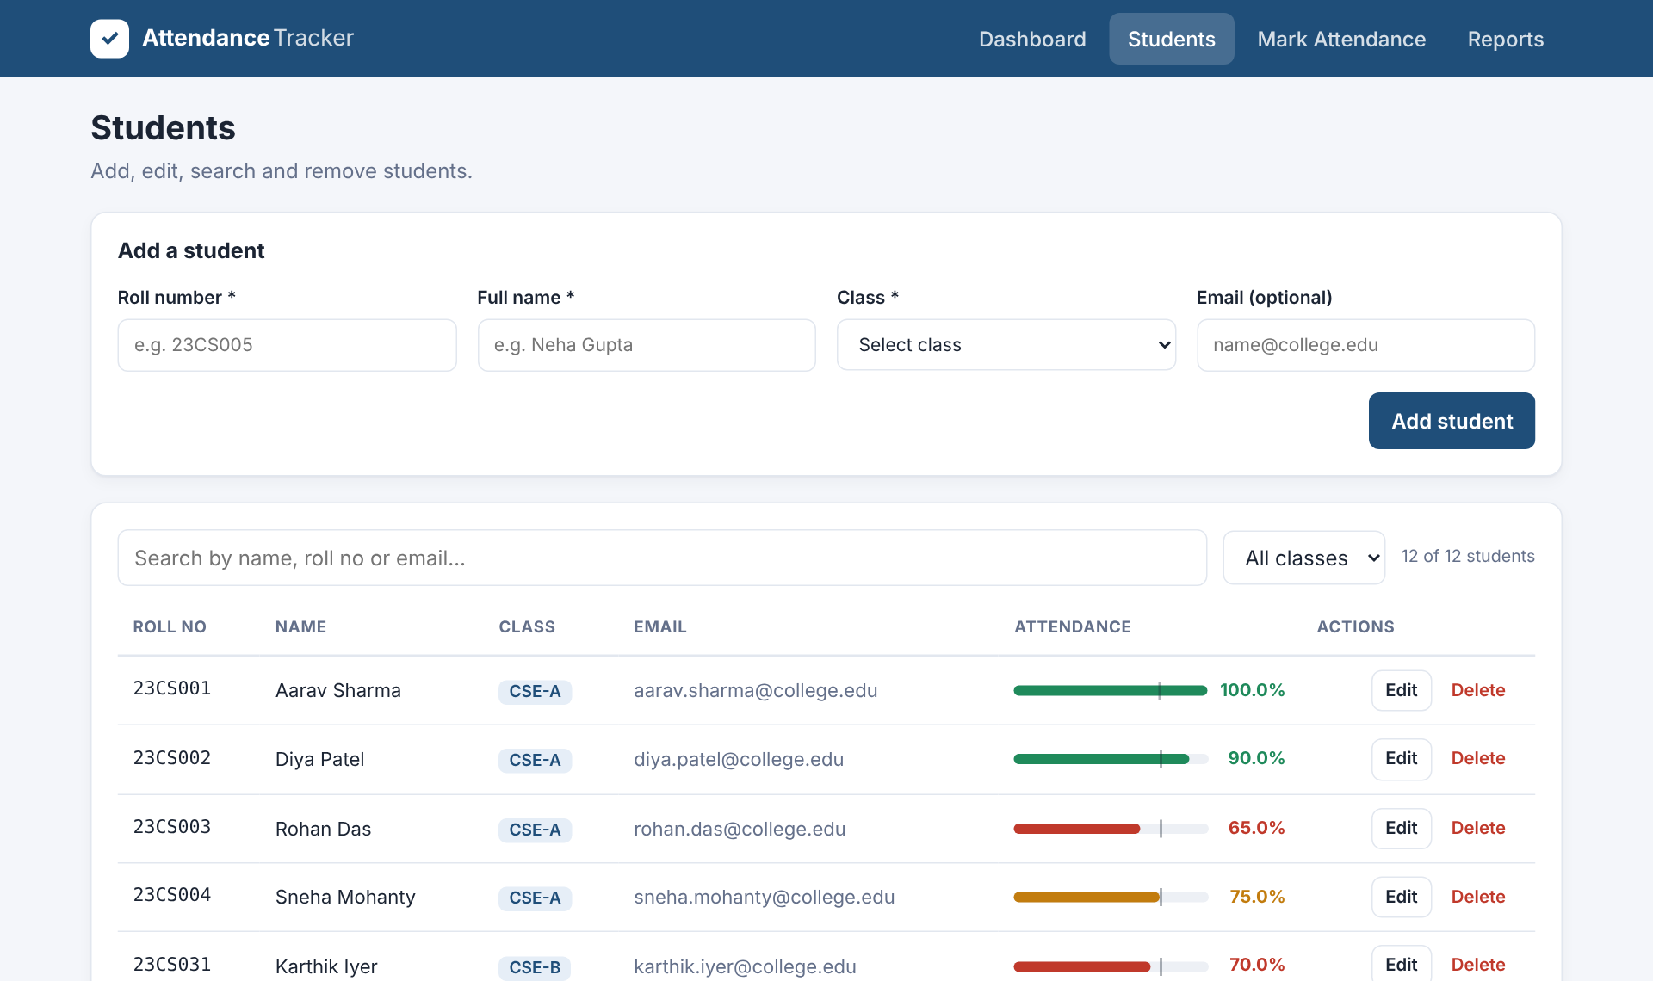
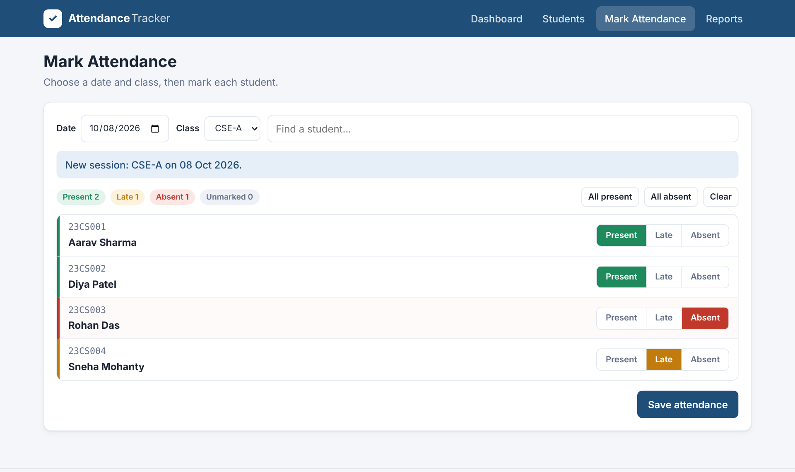
Managing students and marking attendance
Students: add / edit / delete with confirmation; search and class filter; inline validation errors
Mark Attendance: Present / Late / Absent toggles, live counts, bulk actions, edit a saved session
Notes:
Show validation: duplicate roll number, invalid name, missing class, wrong email. Then mark a class.

Slide 7
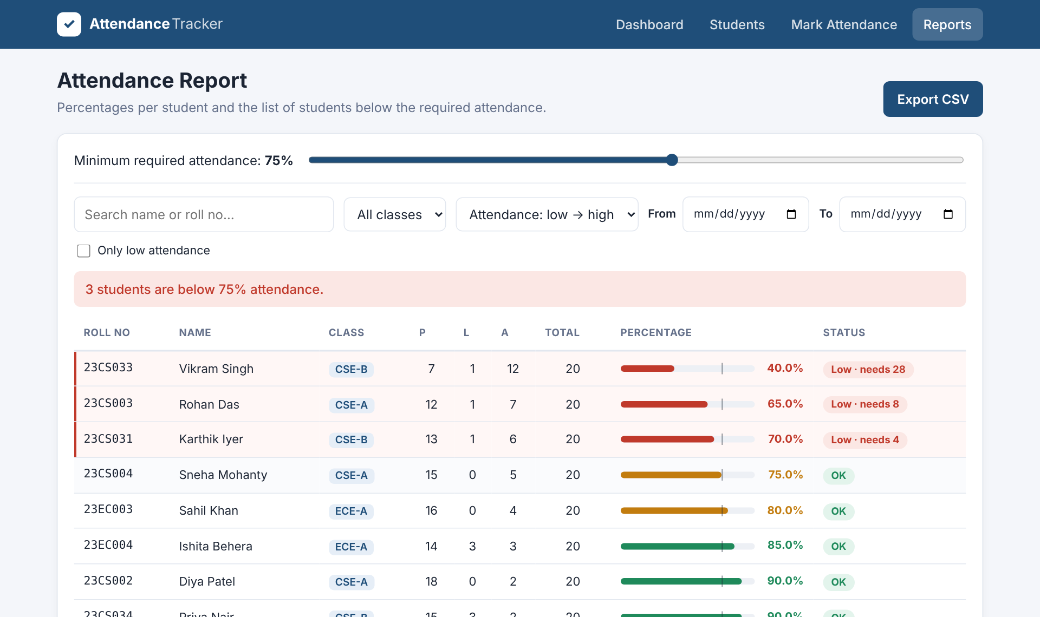
Percentages and low-attendance report
Formula
% = (Present + Late) ÷ Total × 100
3 of 12
demo students fall below 75%
Threshold slider (50–95%)
Only-low filter, class and date range
“Needs N” classes to recover
Export to CSV
Notes:
Move the threshold slider during the demo to show the low-attendance list updating instantly.

Slide 8
Conclusion and future scope
Future enhancements
Backend database (Node.js / Firebase)
Teacher login and roles
SMS / email alerts for low attendance
Subject-wise attendance and charts
QR-code self check-in
A complete, responsive React app that meets every requirement: 4 routed pages, CRUD, search and filter, validation, and automatic percentage calculation.
GitHub: github.com/<your-username>/student-attendance-tracker
Notes:
Summarise and invite questions. Replace the GitHub link with your repository URL.

