Slide 1

Optimizers and Training Dynamics
Razvan Ciuca
Related blog post:
https://github.com/RazCiuca/nn_loss_landscape

Slide 2
Goals for today
Understanding how modern LLMs are optimized during pre-training.
Going beyond the simple mental picture of a ball rolling down a mountain.
Building toy mathematical models of the optimization process
Notes:
Plan for this lecture
Modern Llama3 LLM optimizers: we will see why each part of this schedule is useful
Gradient Descent, the naive visualizable way: this is not what happens in modern networks, Geoffrey Hinton quote
SGD, momentum, Adam, AdamW
Mysteries of training modern networks
Review of Hessians, Taylor-approximation second-order, and diagonalisation
Applications on simple quadratic function at given learning rate, proofs and graphs
Modern networks don’t converge to Minima!!! Even local ones
What does the hessian look like of modern transformers? Power-law spectrum
Why Is learning rate decay useful? A heuristic arguments
Learning rate warmups and decay
Weird Phenomena: Edge of Stability, narrowing valley visualization

Slide 3
Modern Training: Llama 3: “Large Language Model Meta AI”
“We pre-train Llama 3 405B using AdamW with a peak learning rate of 8 × 10−5 , a linear warm up of 8,000 steps, and a cosine learning rate schedule decaying to 8 × 10−7 over 1,200,000 steps. “
Quote from Llama 3 paper: https://arxiv.org/pdf/2407.21783
Who or what is AdamW ?
How is the peak learning rate set ?
Why is there a linear warm up ?
Why is there a decay schedule ?

Slide 4
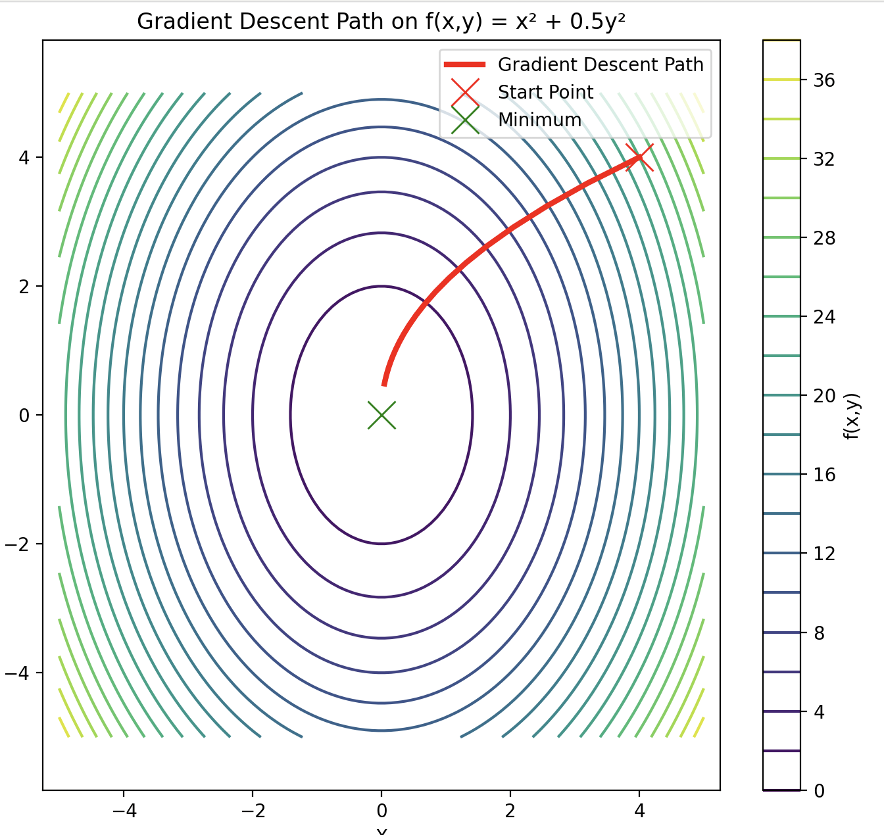
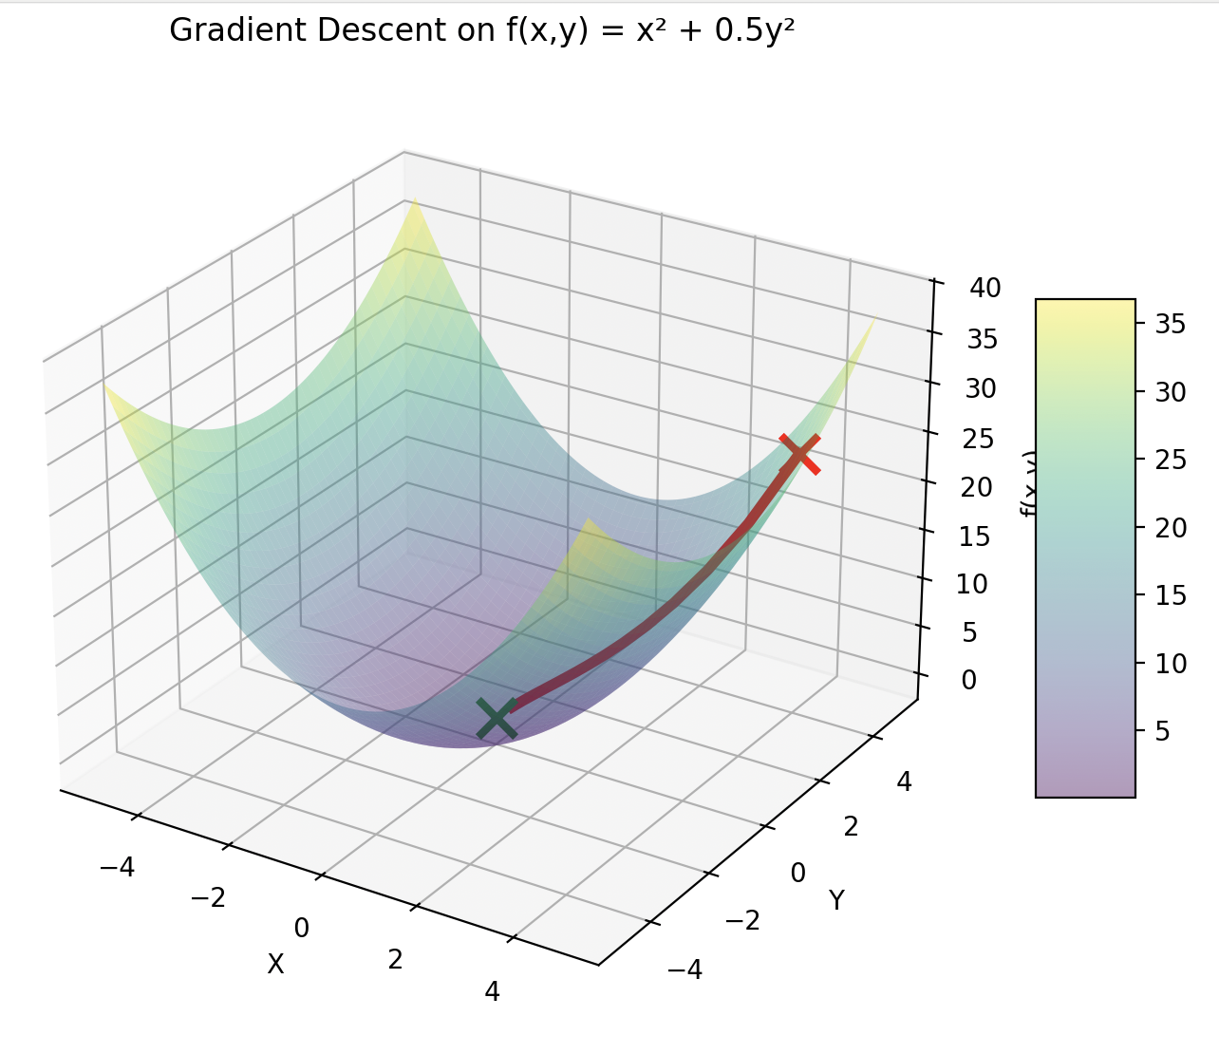
Gradient Descent: The Naive Mental Picture

Slide 5
How do you visualize 10^12 dimensional landscapes?
You Don’t
“To visualize a 14 dimensional space, you image a 3D space and say “Fourteen!” to yourself very strongly”
Geoffrey Hinton

Slide 6
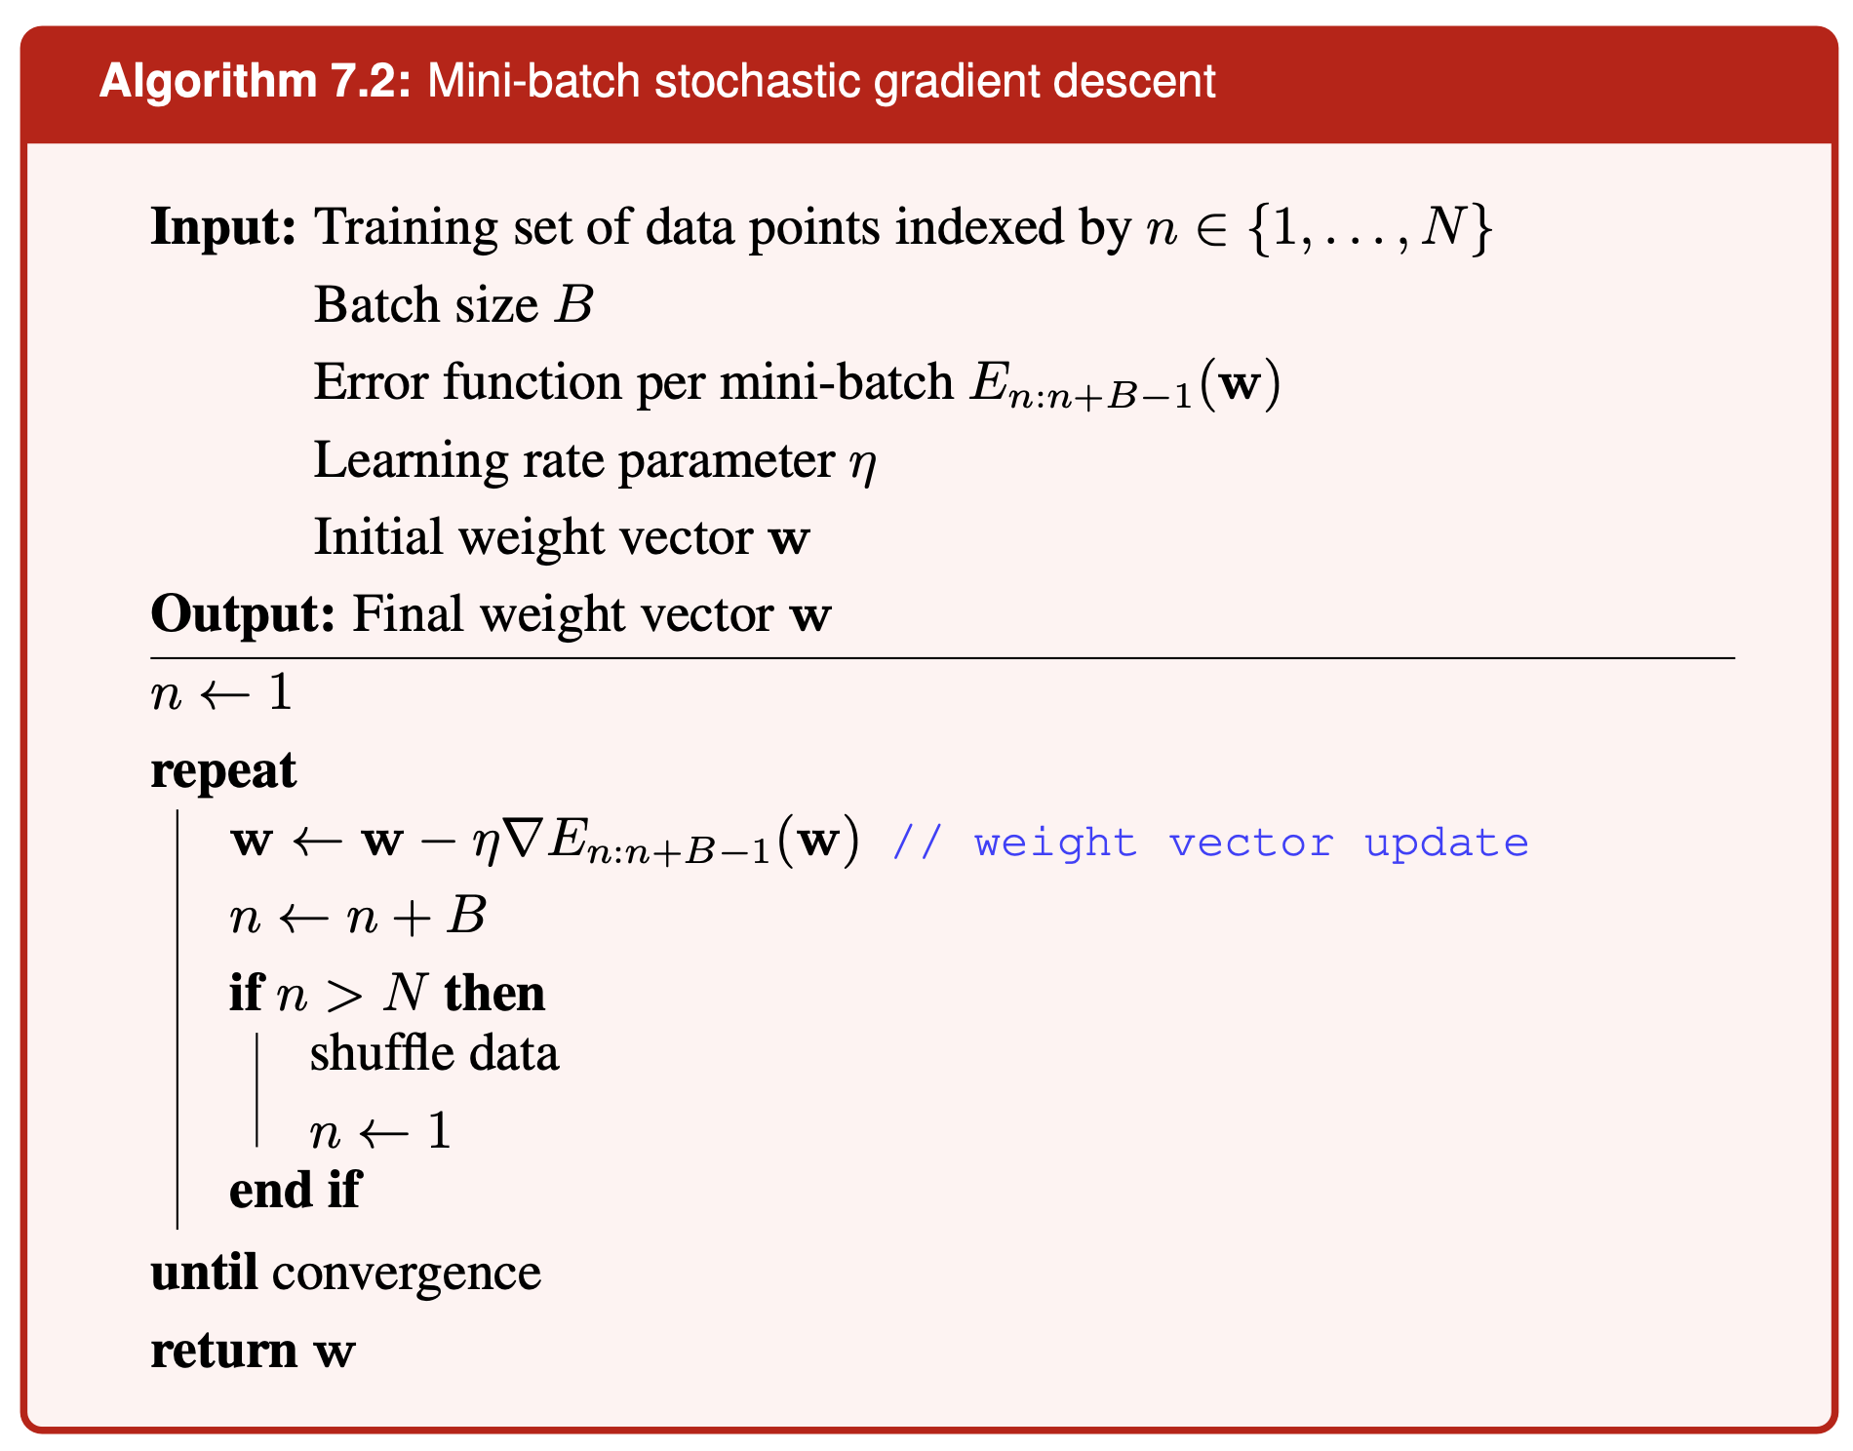
Stochastic Gradient Descent
From Bishop & Bishop: Deep Learning Foundations and Concepts, 2023, Springer

Slide 7
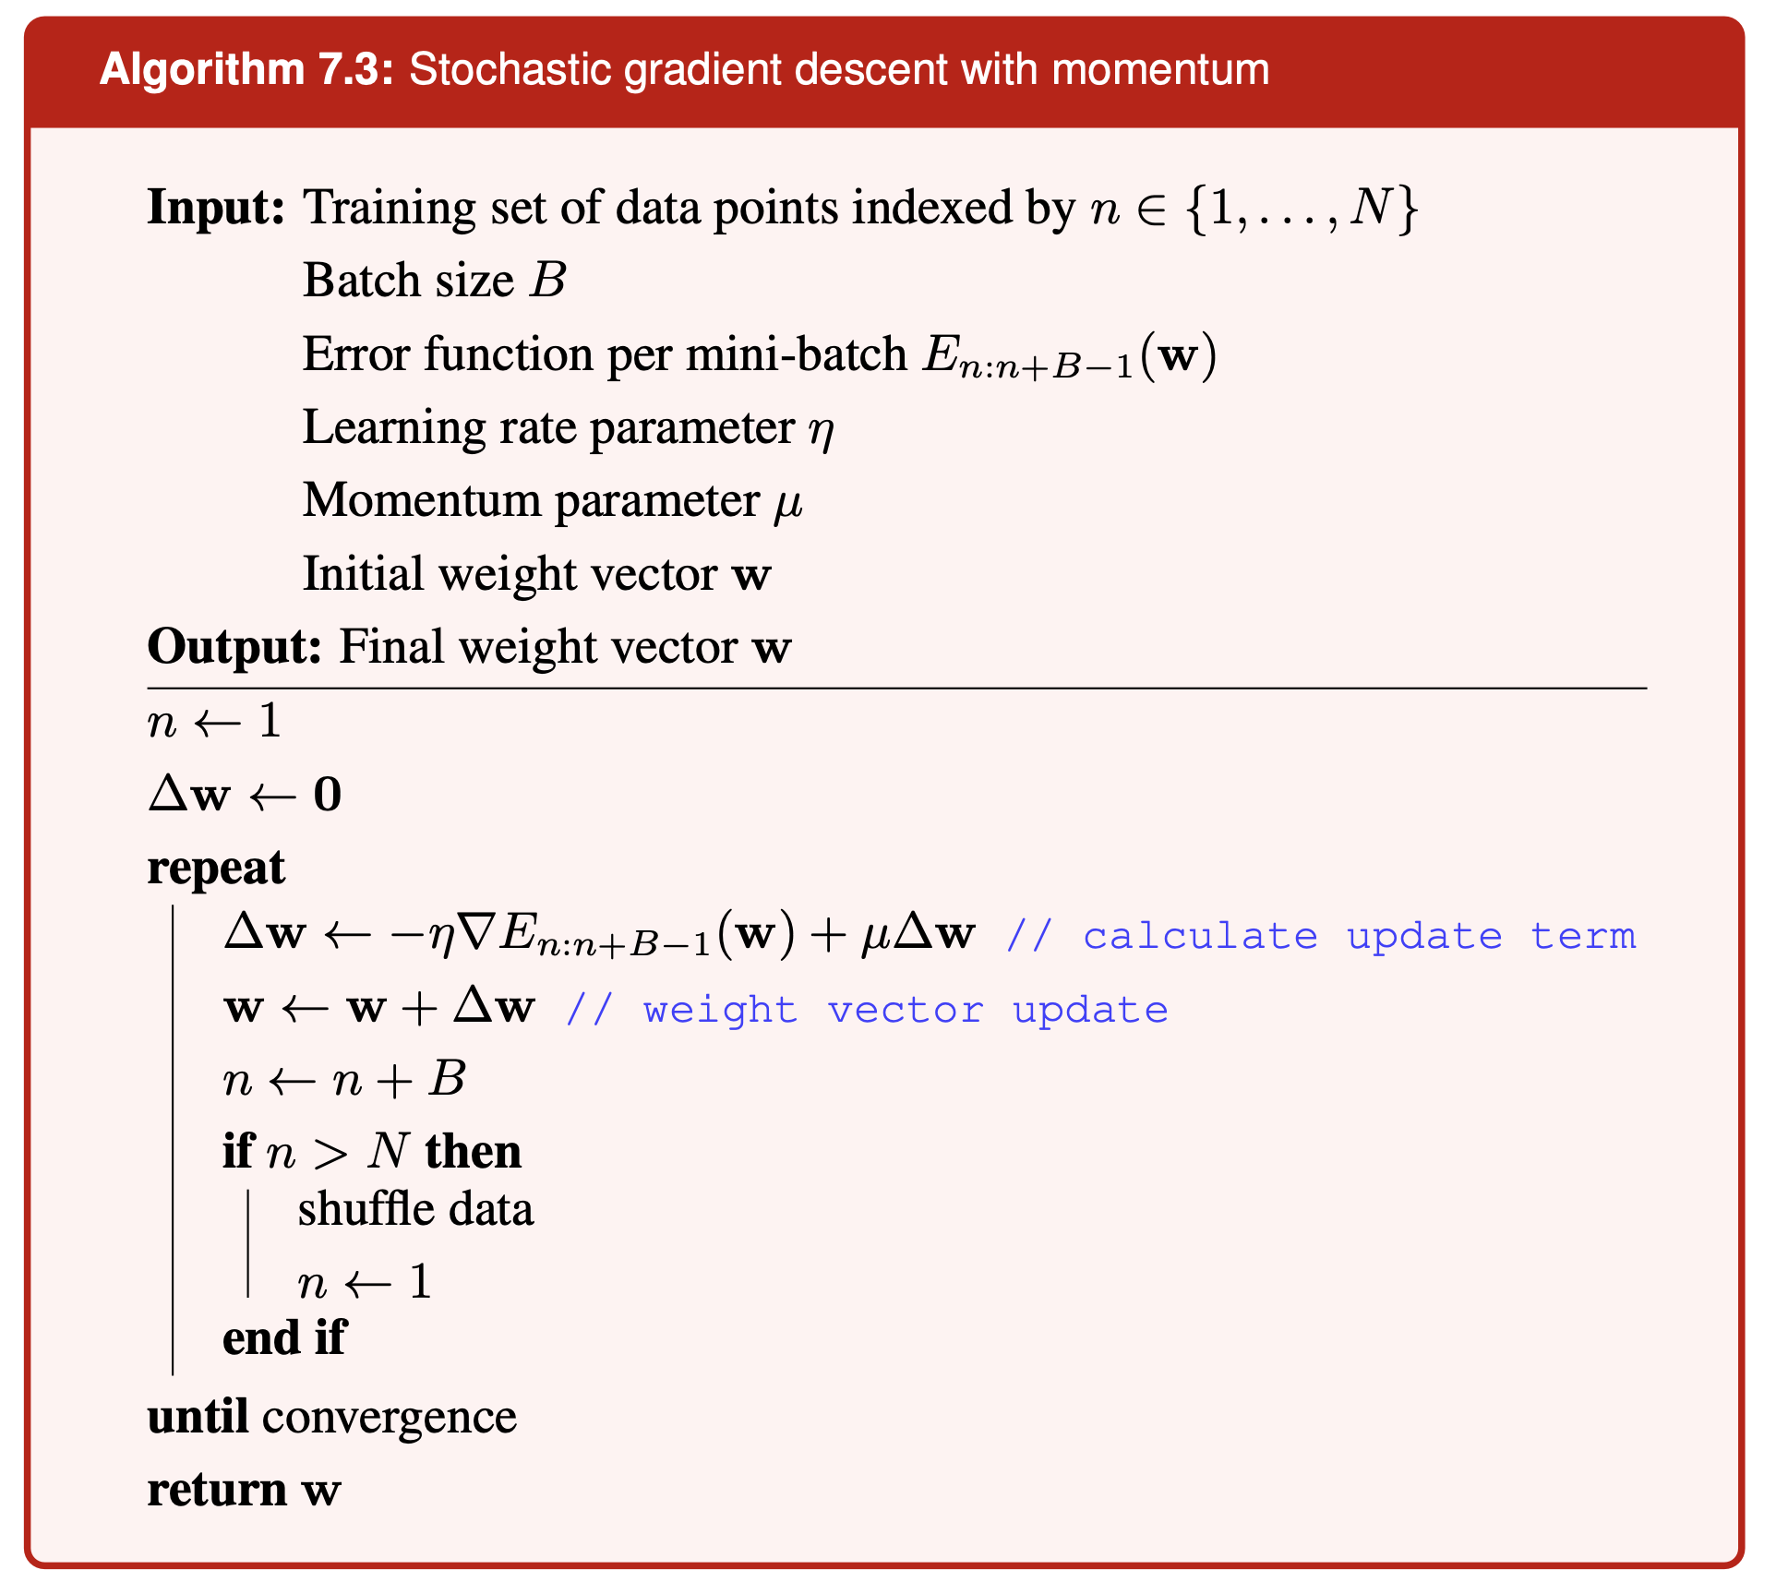
SGD with Momentum
From Bishop & Bishop: Deep Learning Foundations and Concepts, 2022, Springer

Slide 8
SGD with Nesterov Momentum
When we enter an iteration, we already mostly know the momentum direction, so let’s use it.
Evaluate Gradient at w + Δw
From Bishop & Bishop: Deep Learning Foundations and Concepts, 2022, Springer

Slide 9
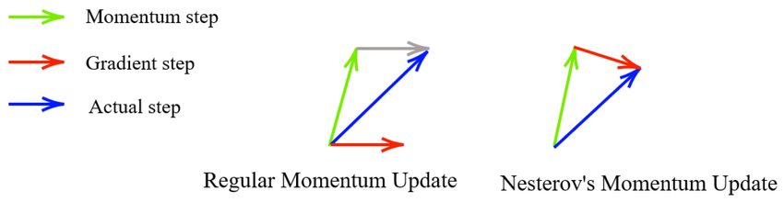
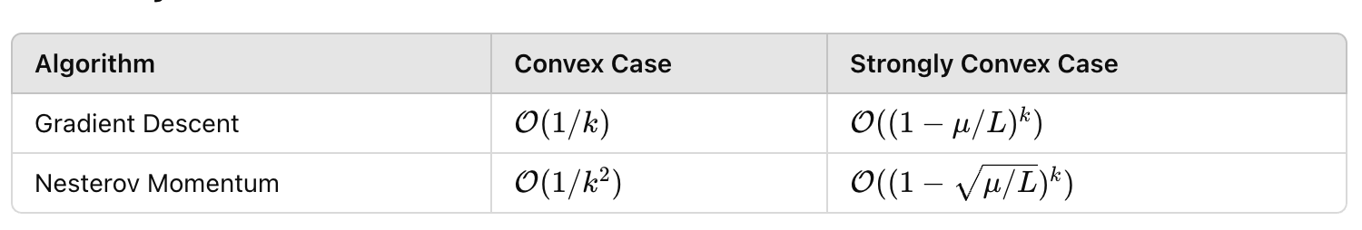
SGD with Nesterov Momentum
Better Guarantees!

Slide 10
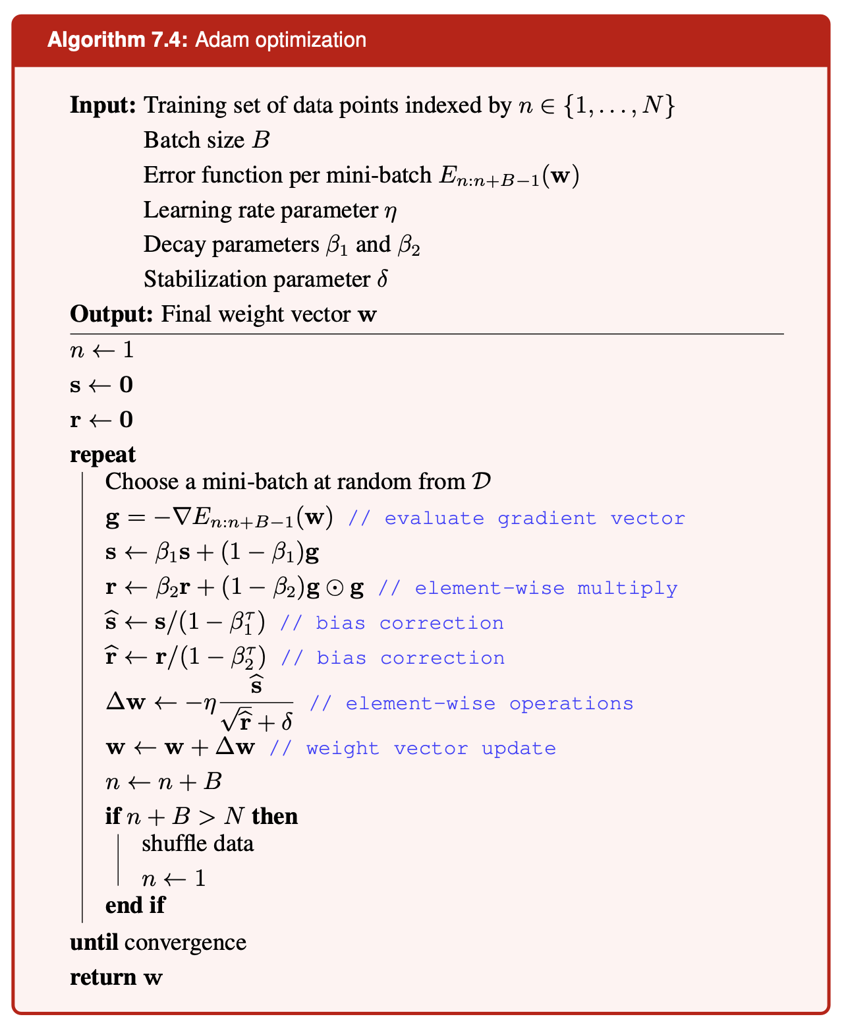
Adam: Adaptive Moments Estimation
We Compute 2 Quantities:
Exponential moving average of gradients: same as momentum
Exponential moving average of squared gradients
Then, element-wise normalization of the momentum vector by the EMA of squared gradients.
From Bishop & Bishop: Deep Learning Foundations and Concepts, 2022, Springer

Slide 11
AdamW: Changing the Weight-Decay Behavior of Adam
Weight Decay can be viewed as doing either:
Adding - αw to the gradient
Shrinking the weights by a factor of (1-α)
Adam
Add shrinking step here to implement AdamW
AdamW
From Bishop & Bishop: Deep Learning Foundations and Concepts, 2022, Springer

Slide 12
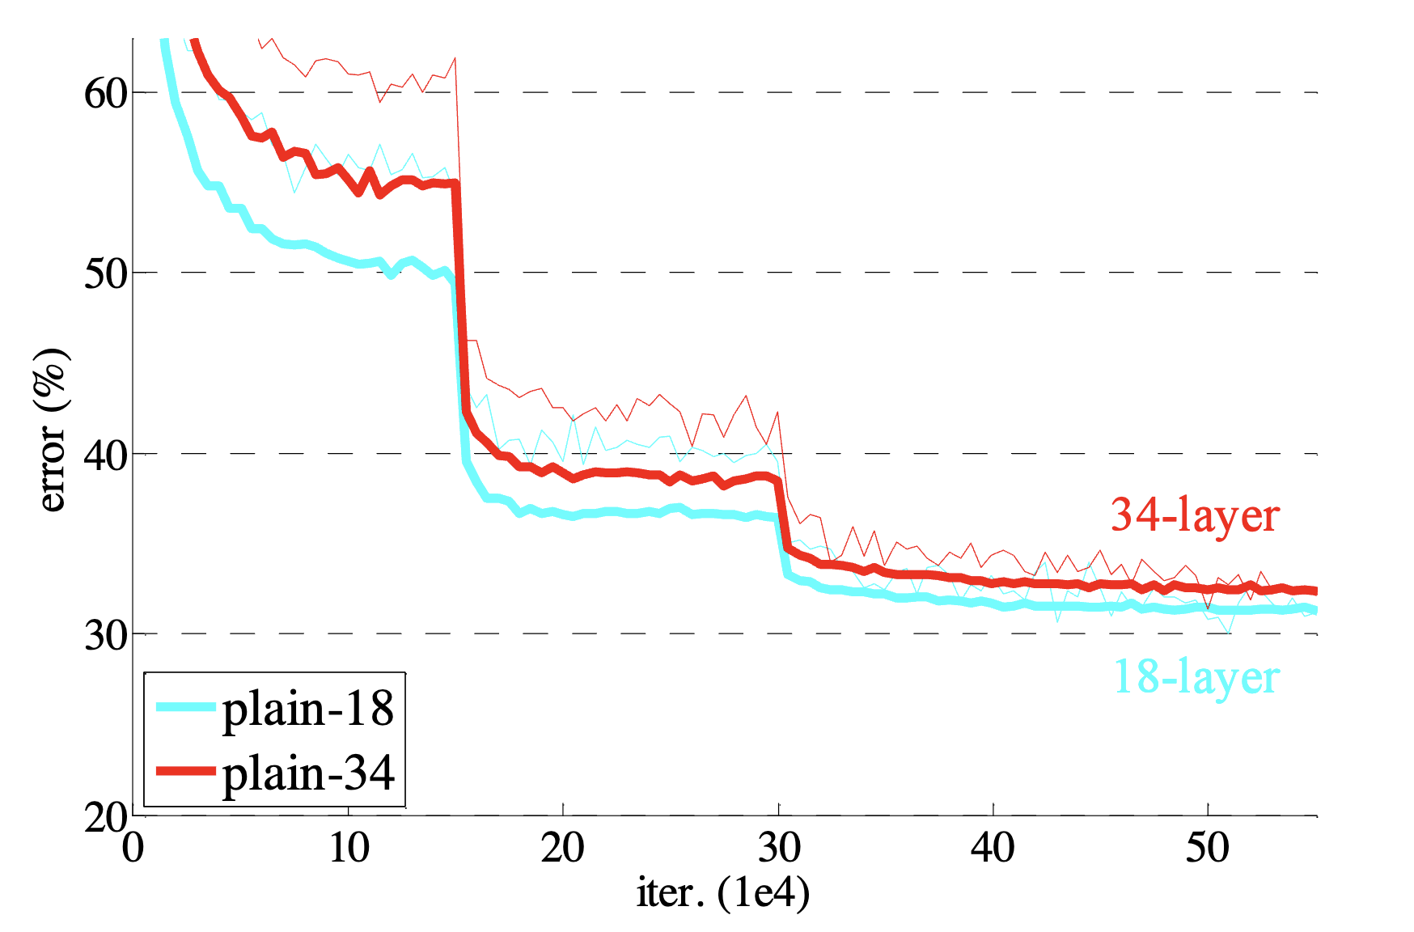
Mysteries of Training Neural Networks #1
What happens here?
Two Empirical Observations about NN training:
Halving the learning rate has the same effect as doubling the batch size
Sudden learning rate decreases cause sudden loss drops
From He et. al. 2015: https://arxiv.org/pdf/1512.03385
“Ball going down a hill” mental model can’t make sense of this.

Slide 13
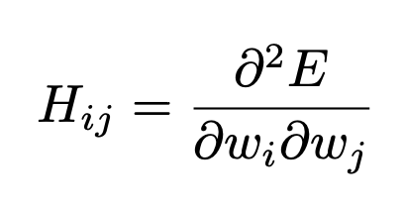
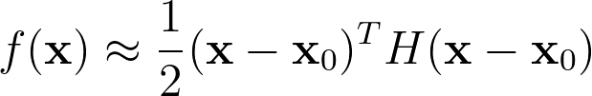
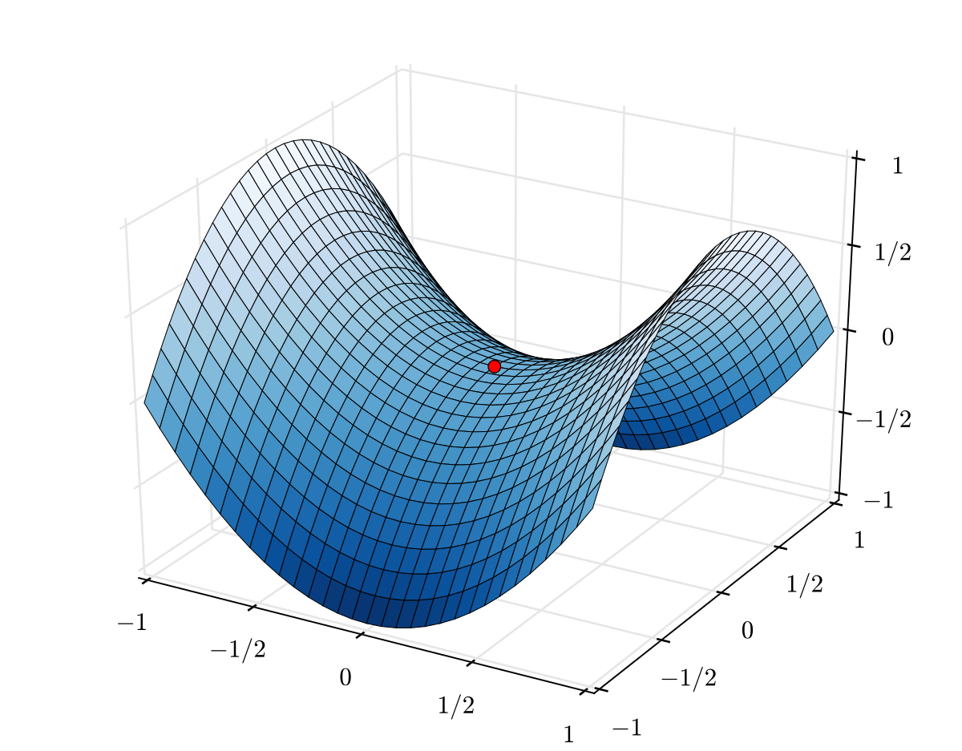
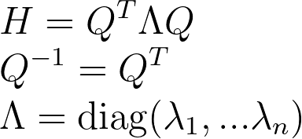
Blazing Fast Linear Algebra Review
Any function (and in particular the loss landscape of a network) can be locally approximated to second order:
Example of a function whose Hessian has one positive and one negative eigenvalue
The matrix H is the “Hessian”, and it can be diagonalized:
The columns of Q are the Eigenvectors of H. The set of eigenvalues of H is called its “spectrum”.

Slide 14
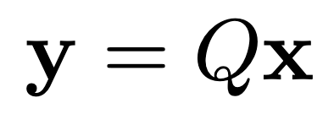
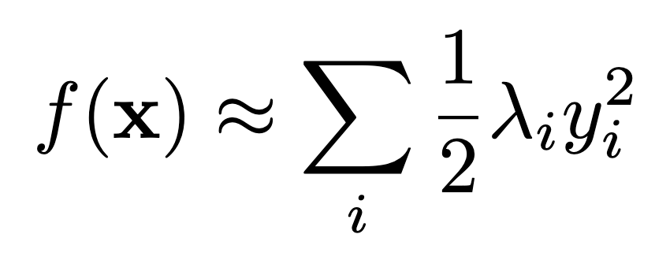
Sum of independent quadratics is a good proxy model
Gradient Descent in the eigenbasis disentangles the optimization.
This means understanding the 1-dimensional case can tell us something about the general case.
Change Variables to

Slide 15
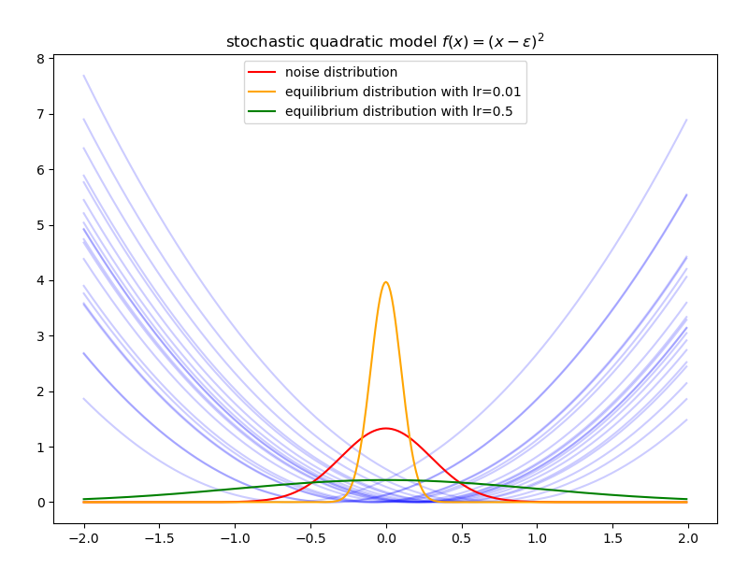
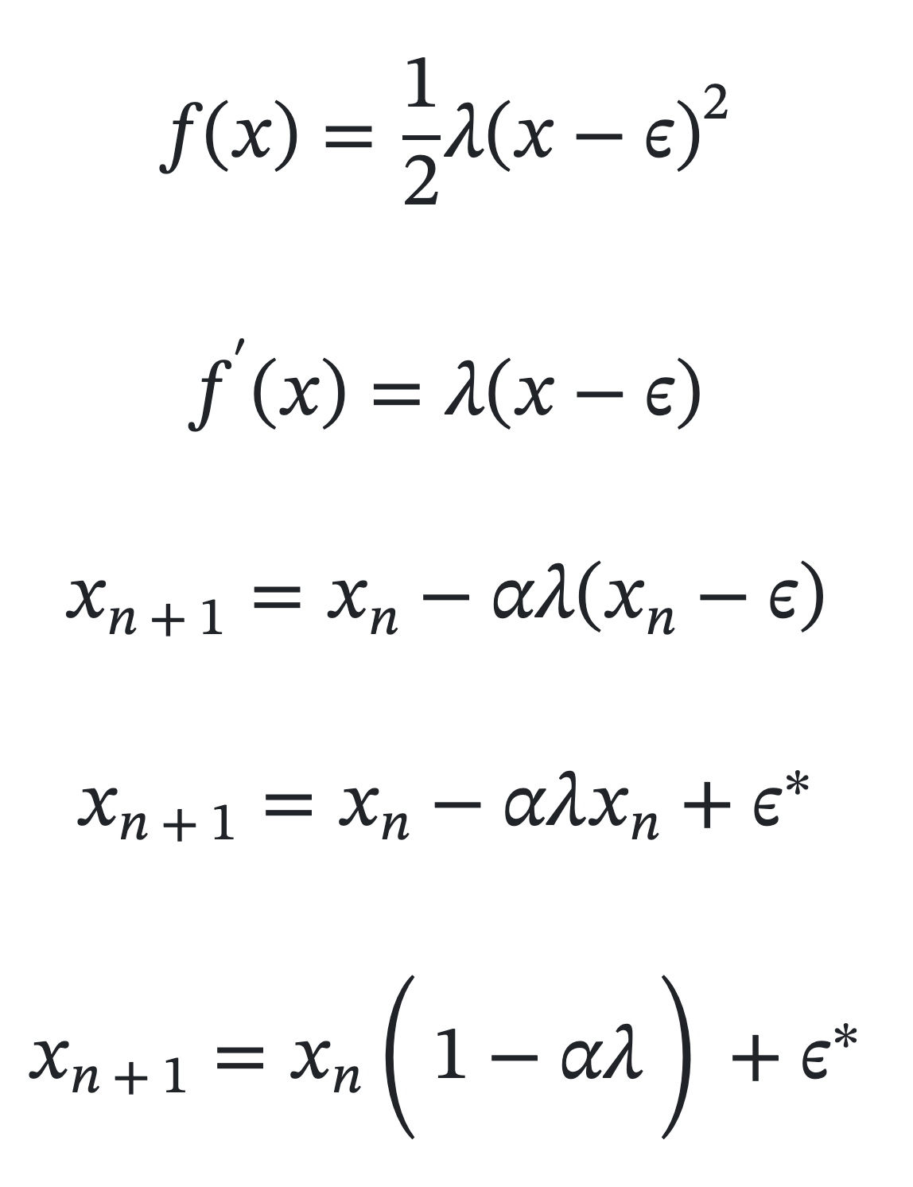
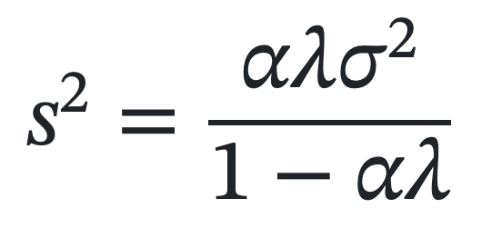
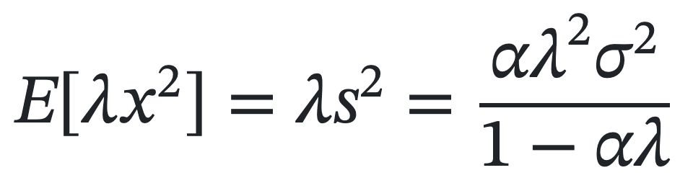
Adding Noise: SGD on Stochastic Quadratic
Model: Treat the loss landscape as a quadratic with a noisy minimum location, of variance sigma^2
At Equilibrium, x_n is gaussian with the following variance:

Slide 16
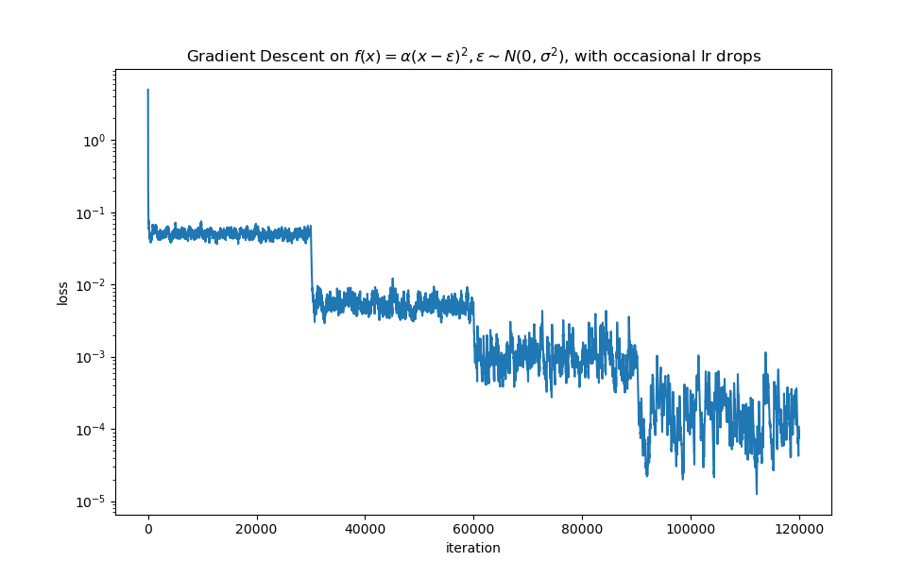
Stochastic Quadratic: Suddenly Lowering learning rate
The equation above gives us the expected function value at equilibrium under SGD.
We have an almost linear dependence on the learning rate α, cutting it in half cuts the loss in half.

Slide 17
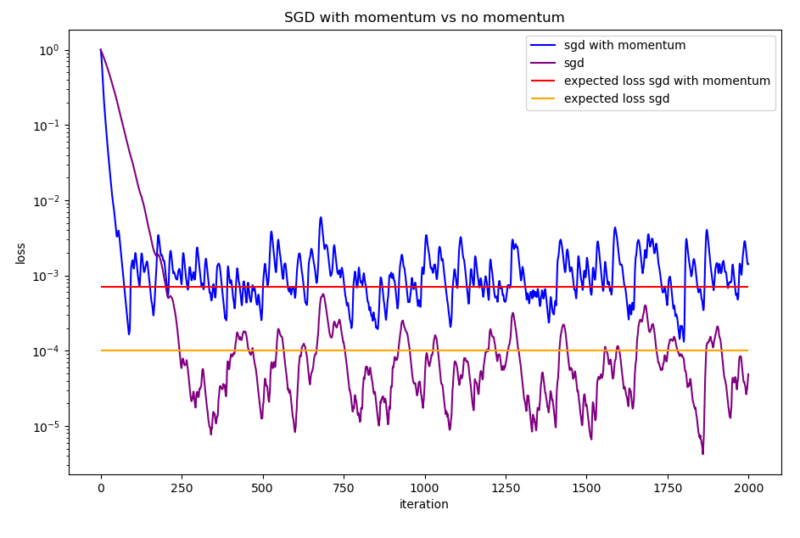
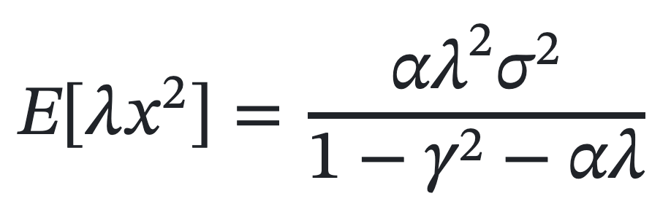
Stochastic Quadratic: What happens with momentum?
Expected Loss at equilibrium with SGD:
Expected Loss at equilibrium with momentum:
Momentum converges faster at the same learning rate, but at higher loss level than pure SGD!

Slide 18
Mysteries resolved
Two Empirical Observations about NN training:
Halving the learning rate has the same effect as doubling the batch size
Sudden learning rate decreases cause sudden loss drops
Doubling batch size reduces the gradient variance σ^2 in two.
Optimization settles quickly to a new equilibrium loss.

Slide 19
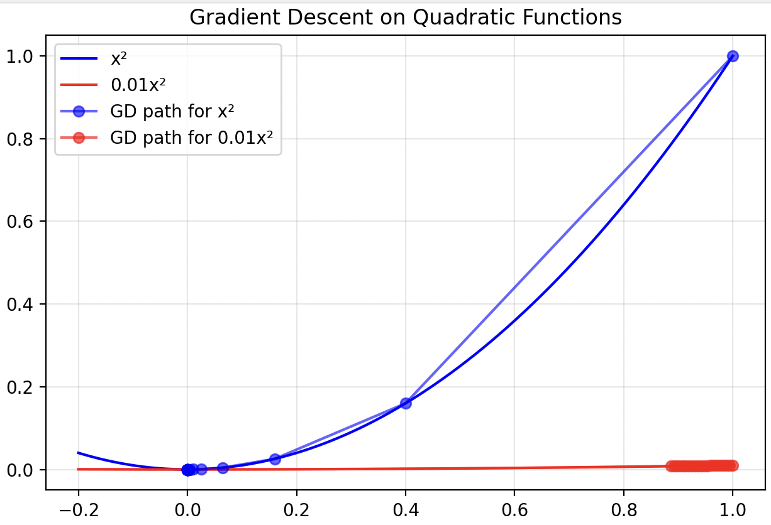
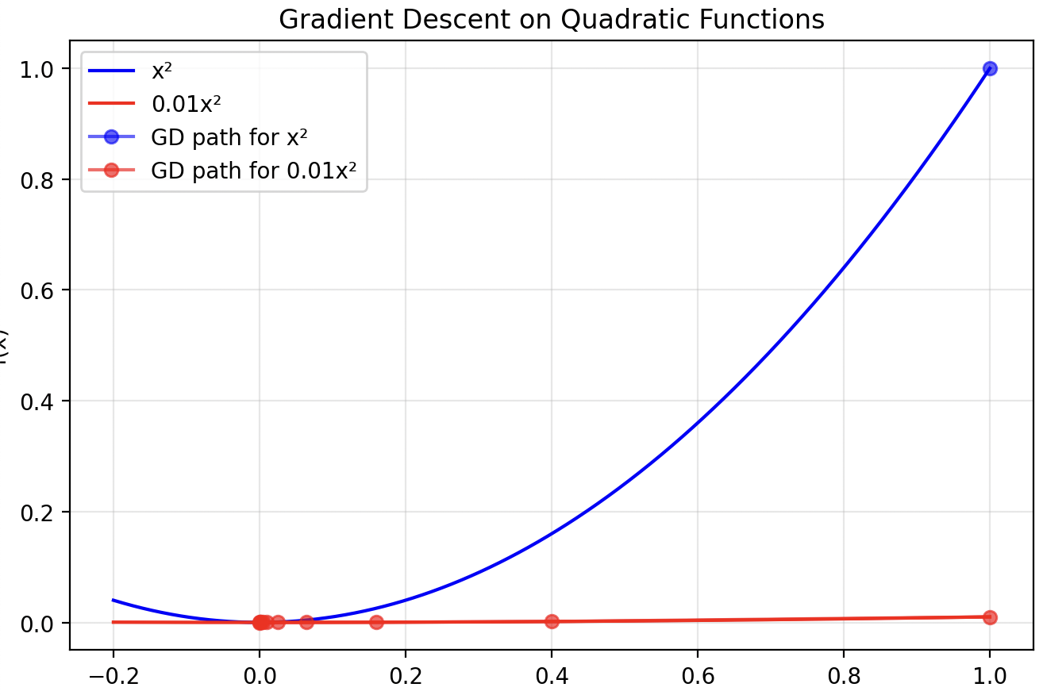
Fundamental Tension between high LR and low LR
Learning rate = 0.3
Learning rate = 30
Blue goes off-screen after 1 iteration

Slide 20
Why is decreasing the learning rate useful?
We need High LR to make meaningful progress along shallow directions
We need Low LR to decrease the equilibrium loss along sharp directions
Solution: slowly decrease the learning rate to 0 during training, starting from the largest stable value

Slide 21
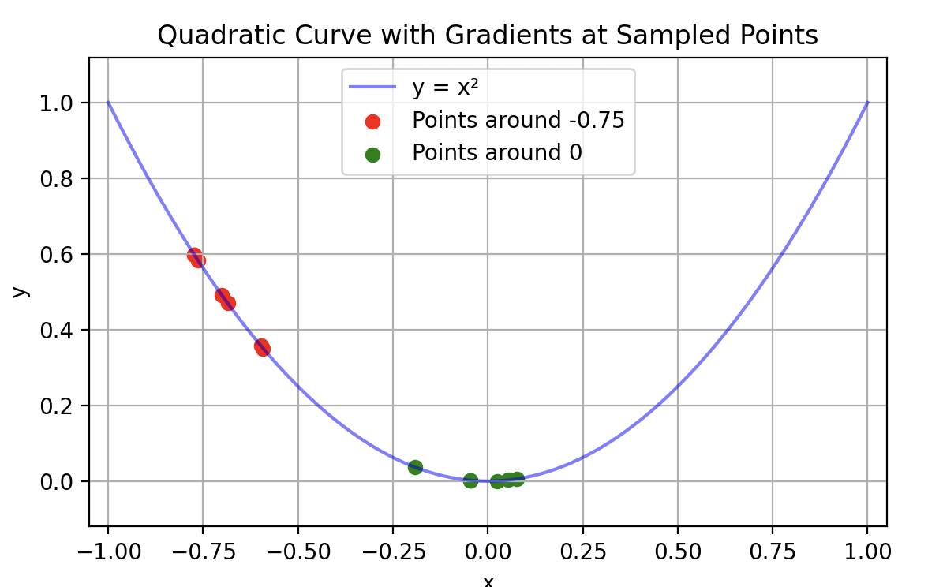
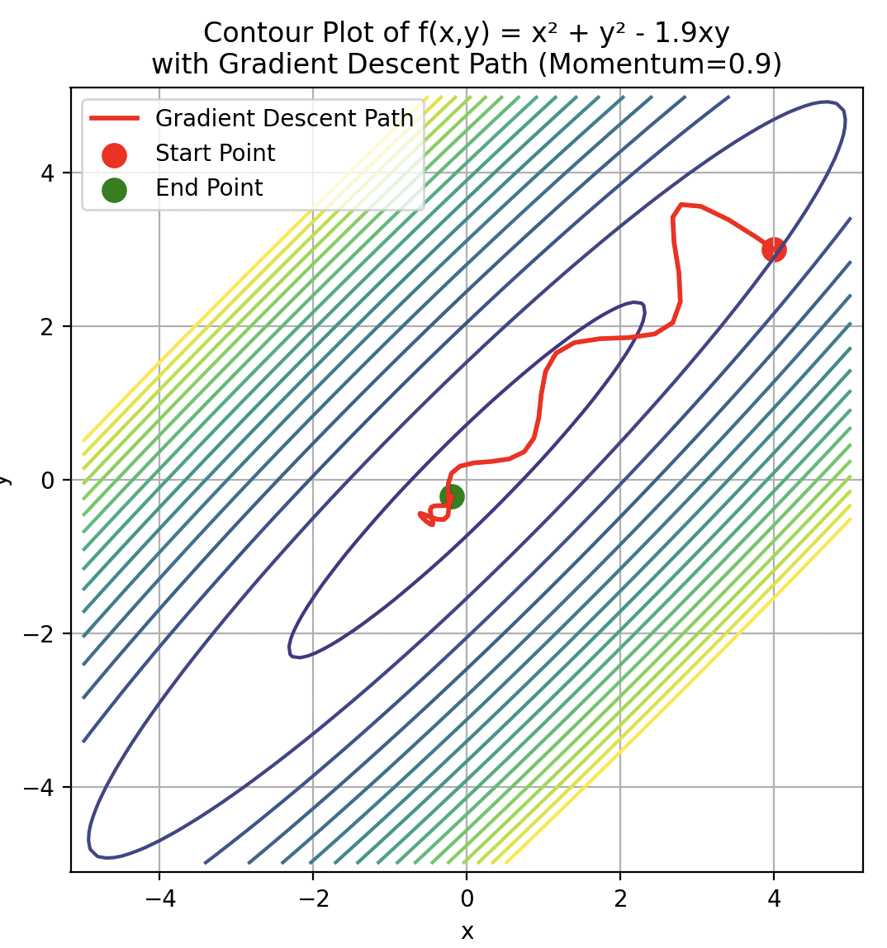
Adam’s adaptive learning rates
In simple 1D case: when far from minimum, all gradients are aligned -> Adam has a large learning rate.
When close to minimum, high gradient variance: low learning rate
In high dimensions this gets more complicated: Adam is not rotation invariant
Non-axis aligned directions of covariance will not be captured by the adaptation of learning rates

Slide 22
Eigenvalue Spectrum of the GPT2 Hessian
From Zhang et. al. 2024 https://arxiv.org/pdf/2402.16788v4
Two Observations:
Spectrum has a power-law structure: clustering around 0
Negative Eigenvalues are present at end of training

Slide 23
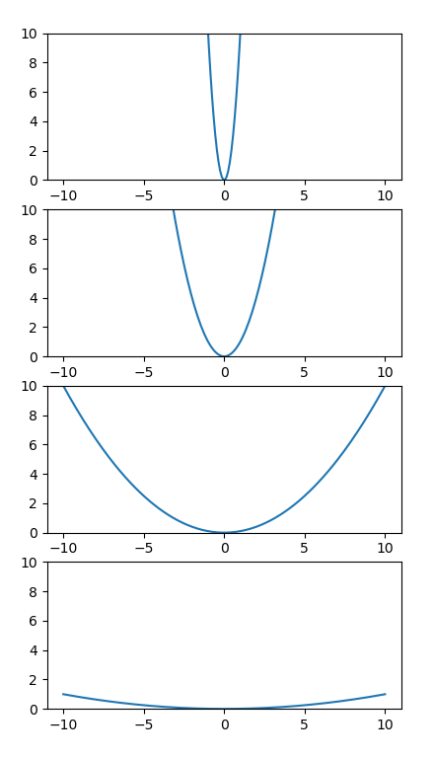
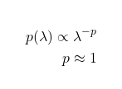
Implications of a power-law spectrum
1 x
Assuming all directions have the same variance at initialization, then different scales contribute to the total loss equally.
10 x
100 x
Hence: all eigenvalue scales are important! We can’t afford to throw away directions
1000 x

Slide 24
Training Never Converges: negative eigenvalues even at end
Negative Values!
If we had the compute budget to take more steps and get to a minimum: better to train a larger model. See scaling laws

Slide 25
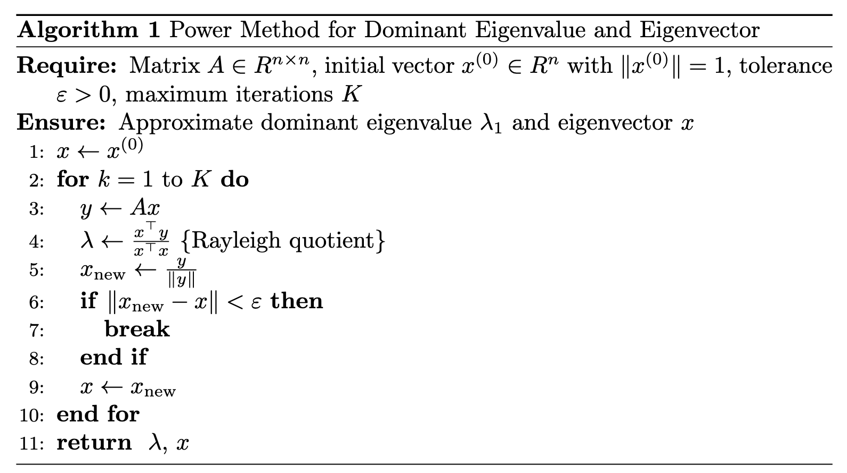
Computing the top eigenvalue: Power Method
Computing full Hessian is hard, but Hessian-Vector product is easy.
To find dominant eigenvalue:
Initialize random x
Set x to Hx
Normalize x to unit norm
Repeat from 2

Slide 26
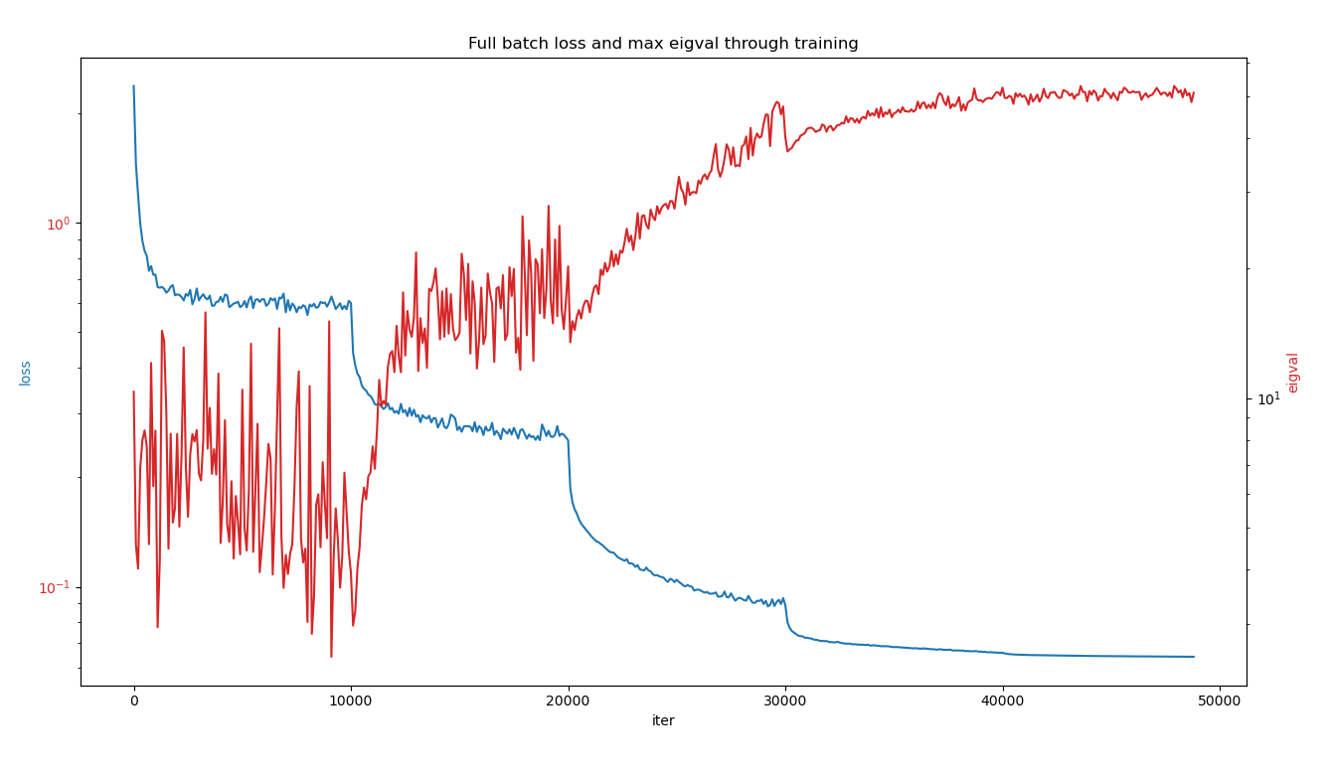
Another Mystery, the “Edge Of Stability”: Landscape gets sharper as we decrease the LR
BLUE: training loss
RED: largest Eigenvalue
Dotted lines are points at which LR was decreased
Resnet on CIFAR10

Slide 27
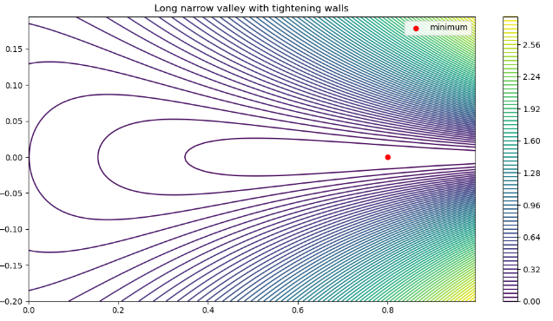
Loss Landscapes are Stochastic Narrowing Valleys

Slide 28
What about the learning rate warmup?
Less well understood, see Kalra & Barksheli 2024 https://arxiv.org/pdf/2406.09405
Places the network in better-behaved regions of the landscape
Can build up to a higher initial stable LR than if we’d started at that value
Warm-up schedules are mostly found through trial-and-error. A cosine schedule is popular.

Slide 29
Recap: Overall Picture of Deep Learning Optimization
Loss is approximately a sum of stochastic quadratics
Some Quadratics are shallow, some are sharp
Many more shallow directions than sharp, we can’t neglect them
At equilibrium of SGD, the loss is roughly LR * Gradient Variance
We need high LR to optimise the shallow directions
Need low LR to settle into lower losses for the sharp directions
Hence: slowly decrease the learning rate, starting from high values

