Slide 1
Graph-RAG Assistant
Yousef Abdelmegeed
Youssef Medhat
Yousef Awara
Mohab Essam

Slide 2
Motivation & Problem Statement
Goal of the project:
Combine symbolic reasoning (Knowledge Graph) with statistical reasoning (LLMs)
Reduce hallucinations
Increase interpretability and trust
Key challenge:
LLMs alone hallucinate
KG alone lacks semantic flexibility
Solution:
Graph-RAG: KG-grounded retrieval + LLM reasoning

Slide 3
System Overview
High-level pipeline:
1. User Query
2. Intent Classification
3. Entity Extraction
4. KG Retrieval
Baseline (Cypher)
Embeddings
Hybrid
5. LLM Grounded Answer
6. Streamlit UI

Slide 4
Knowledge Graph (From Milestone 2)
KG Contents:
Products
Categories
Reviews
Sellers
Customers
States
Delivery data
Why Neo4j?
Explicit relationships
Explainable retrieval
Deterministic querying

Slide 5
Input Preprocessing
Intent Classification
Examples:
PRODUCT_BY_CATEGORY
REVIEWS_FOR_PRODUCT
SEMANTIC_SEARCH
DELIVERY_INSIGHTS
Entity Extraction
Extracted entities:
Category
Rating thresholds
Delivery delays
Product IDs
Purpose:
Route query to correct retrieval strategy

Slide 6
Baseline Retrieval (Cypher Only)
What it does:
Deterministic structured retrieval
Exact filtering using KG properties
What it shows:
Executed Cypher query
Parameters
Raw KG results
+ Reliable
- No semantic flexibility

Slide 7
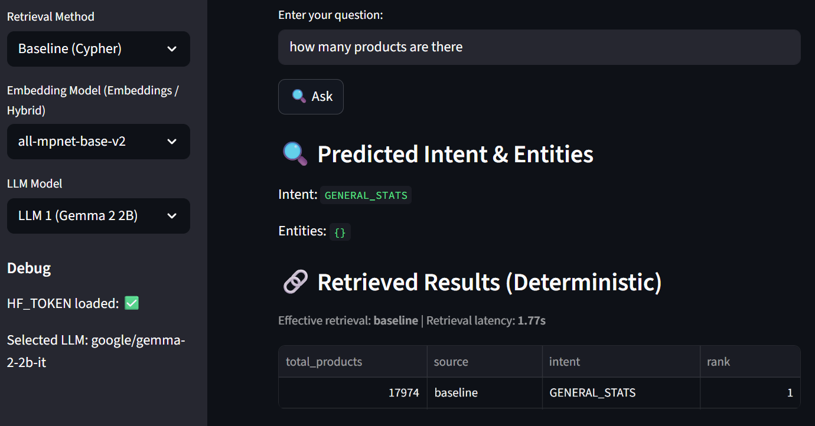

Slide 8
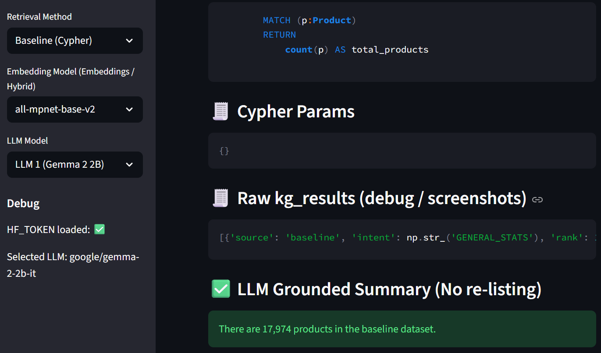

Slide 9
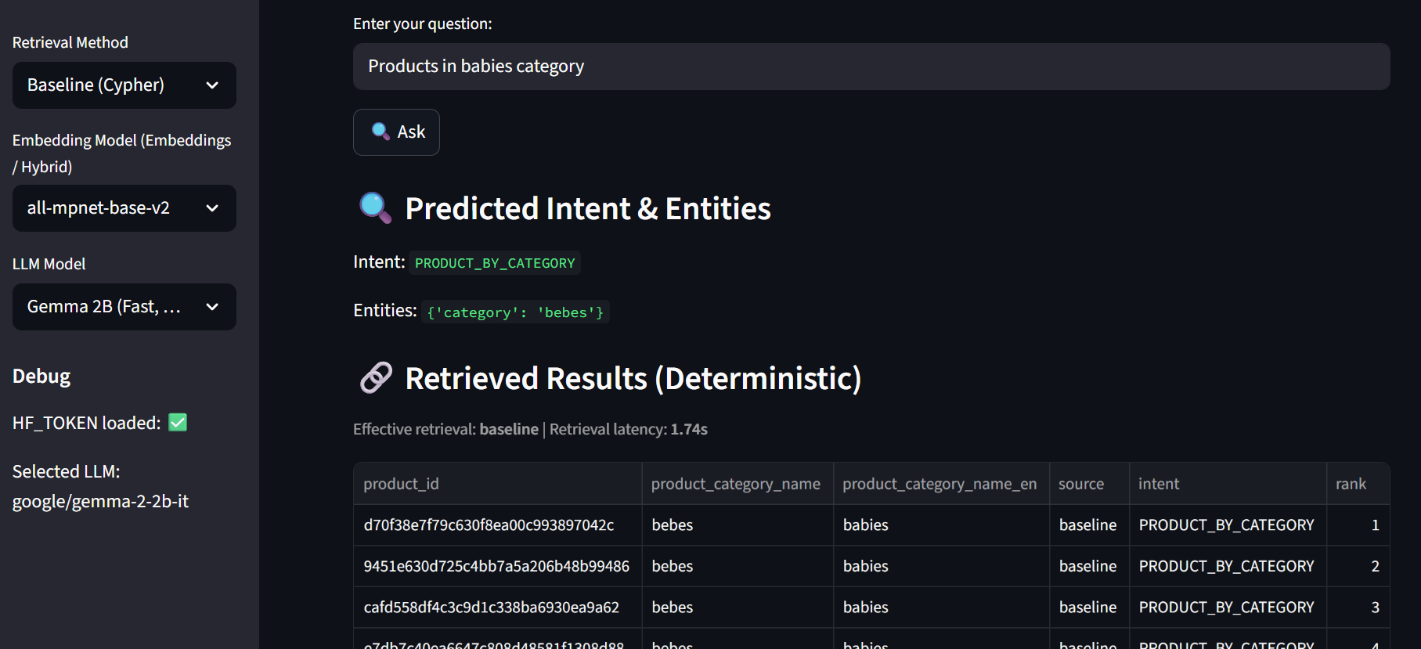

Slide 10
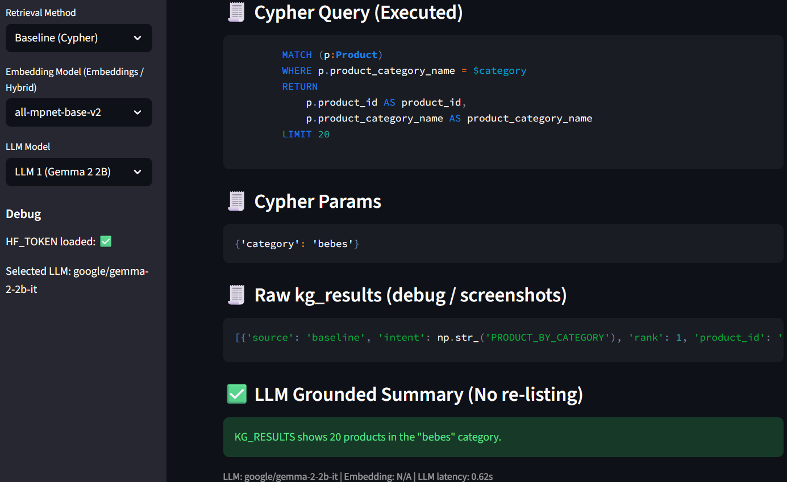

Slide 11
Embedding-Based Retrieval
Why embeddings?
Handle vague / semantic queries
“similar items”, “recommend”, “related”
Approach used:
Feature vector embeddings
Stored in Neo4j vector index
Semantic similarity search
Semantic Query Example:
“Similar items to stroller”

Slide 12
Embedding Models Tested
Models compared:
all-MiniLM-L6-v2
all-mpnet-base-v2
Why two?
Required by rubric + performance comparison

Slide 13
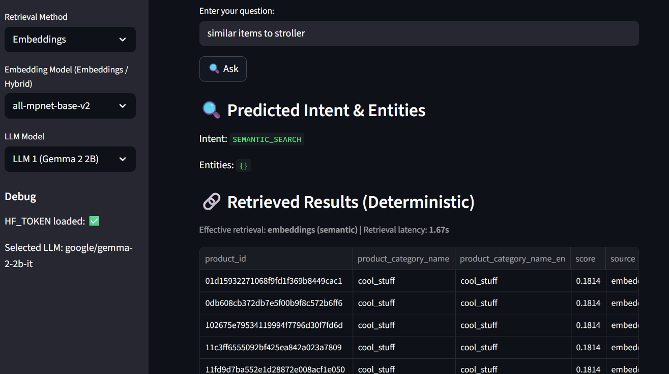


Slide 14
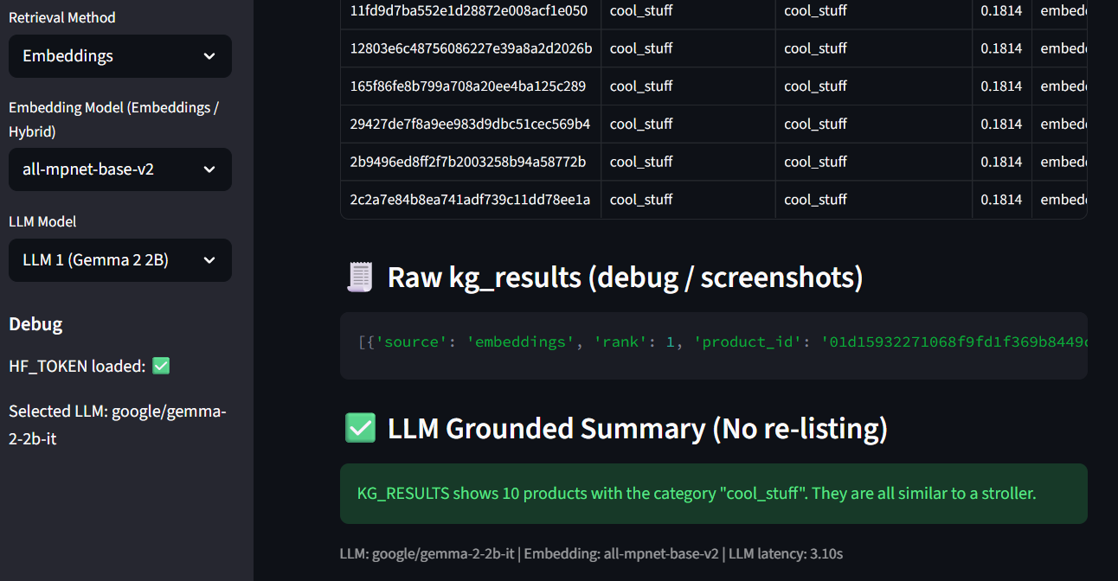

Slide 15
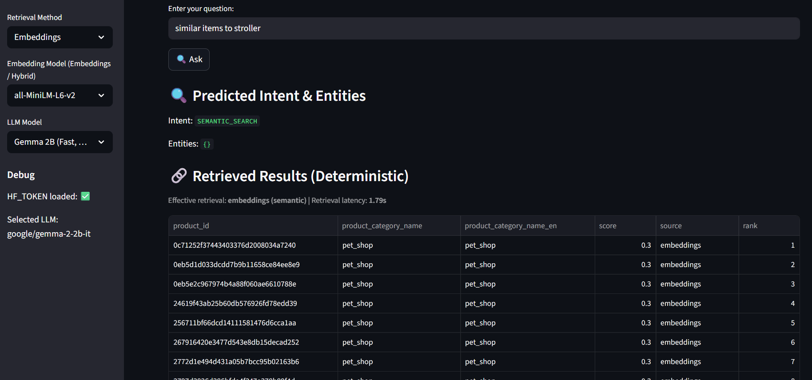


Slide 16
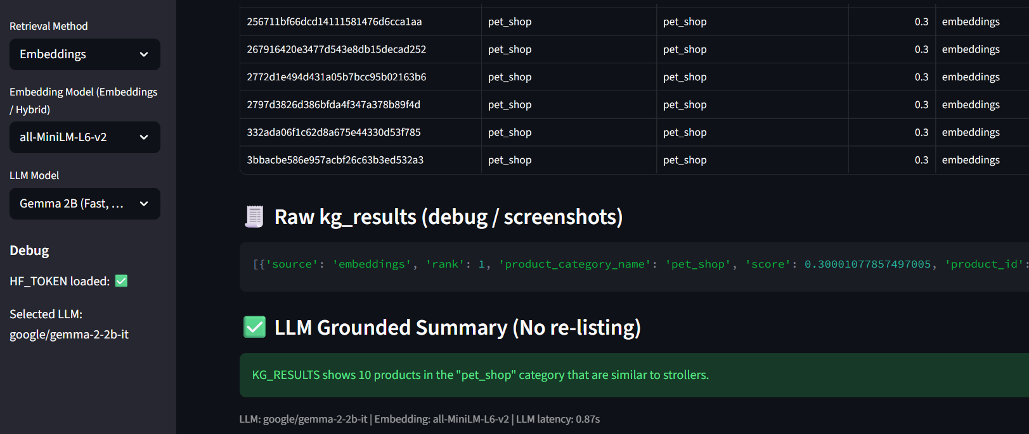

Slide 17
Embedding Model Comparison
Model | Latency (s) | Behavior
MiniLM-L6-v2 | ~0.87 | Faster, broader matches
MPNet-base-v2 | ~0.89 | More selective, precise
Qualitative Observations
MiniLM → higher recall
MPNet → better semantic discrimination

Slide 18
Hybrid Retrieval (Baseline + Embeddings)
Hybrid strategy:
1. Run Cypher query
2. Run embedding similarity search
3. Merge results
4. Deduplicate
5. Rank
Why Hybrid?
Combines precision + semantic flexibility

Slide 19
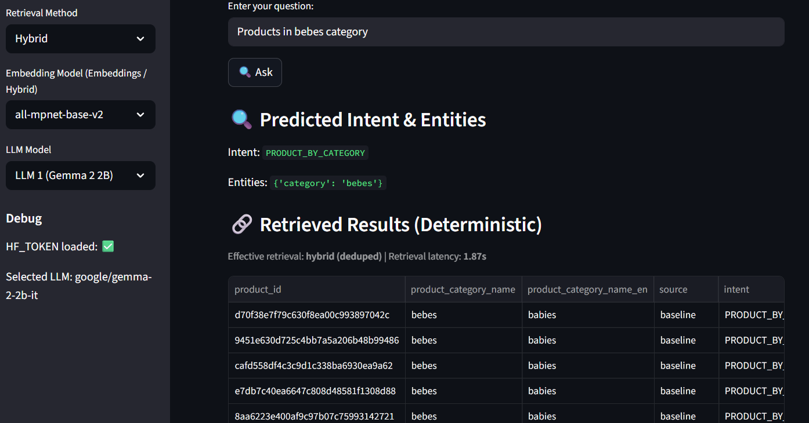

Slide 20
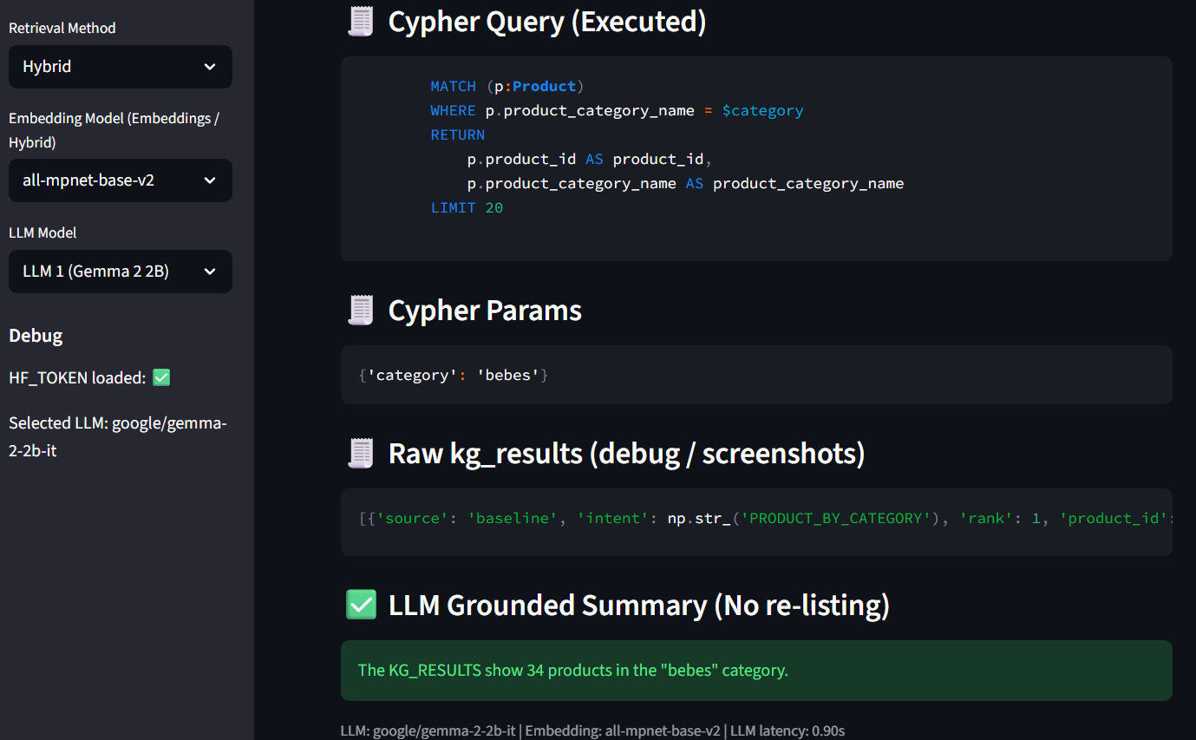

Slide 21
LLM Layer
LLM role:
Does NOT retrieve
ONLY summarizes KG context
Prevents hallucination
Prompt Structure:
Context: KG results
Persona: E-commerce assistant
Task: Answer using only provided data

Slide 22
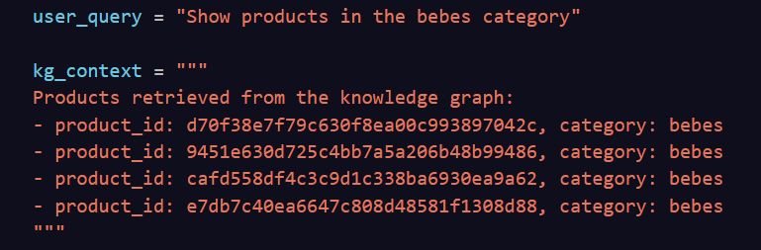
LLM Models Compared
Models tested:
Gemma 2B
LLaMA 3 8B
Mistral 7B (attempted)

Slide 23
LLM Quantitative Comparison
Model | Latency (s) | Availability
Gemma 2B | ~1.75 | Stable
LLaMA 3 8B | ~0.93 | Stable
Mistral 7B | X | Not supported (free tier)

Slide 24
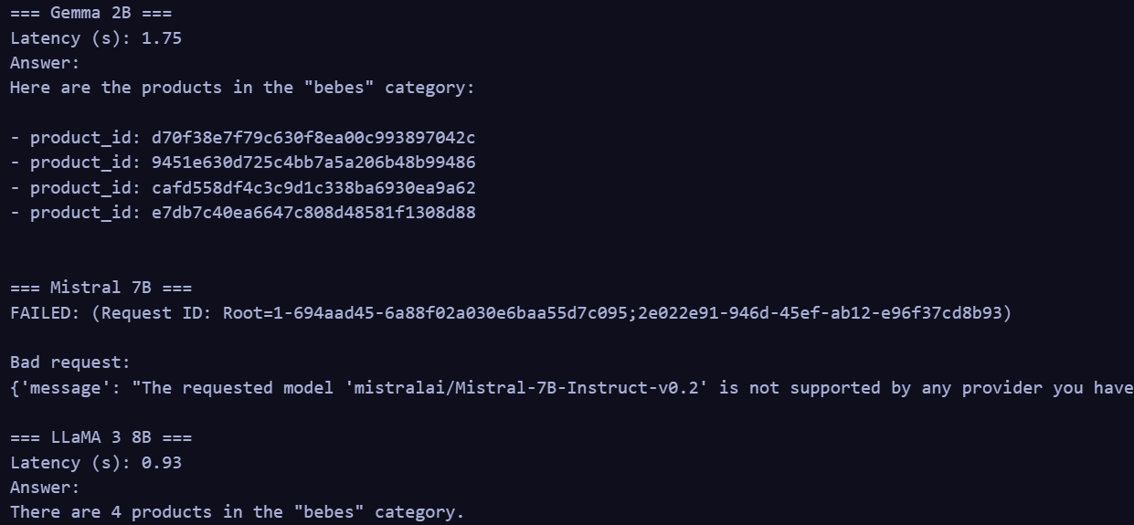

Slide 25
LLM Qualitative Comparison
Gemma 2B
Clear
Explicit listing
Very grounded
LLaMA 3 8B
Concise
Abstracted summaries
Faster response
Mistral 7B
Not evaluated due to provider limitations

Slide 26
Error Analysis
Observed Issues
Mistral unavailable on free HF inference
Semantic embeddings sometimes return broad categories
Some categories are noisy due to sparse metadata
Why it happens
Provider constraints
Limited product descriptions

Slide 27
Improvements Added
Hybrid retrieval
Deduplication logic
Category translation (Portuguese → English)
Intent override for semantic queries
UI transparency (raw KG results)

Slide 28
Remaining Limitations
No fine-tuned embeddings
Limited textual descriptions
Free LLM provider constraints
No explicit ranking model

Slide 29
Conclusion and Future Work
What this project demonstrates:
Graph-RAG reduces hallucination
KG improves trust and explainability
Hybrid retrieval is superior to single-method retrieval
Future Work:
Fine-tuned embeddings
Reranking models
Paid LLM APIs
Sentiment-aware retrieval
Recommendation explanations

Slide 30
Thank you
Any questions?

