Slide 1
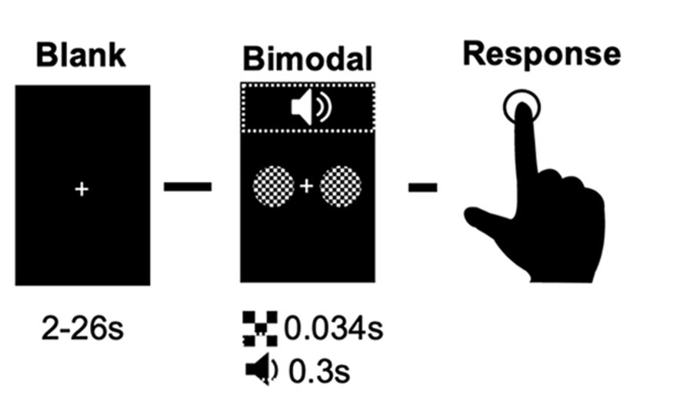
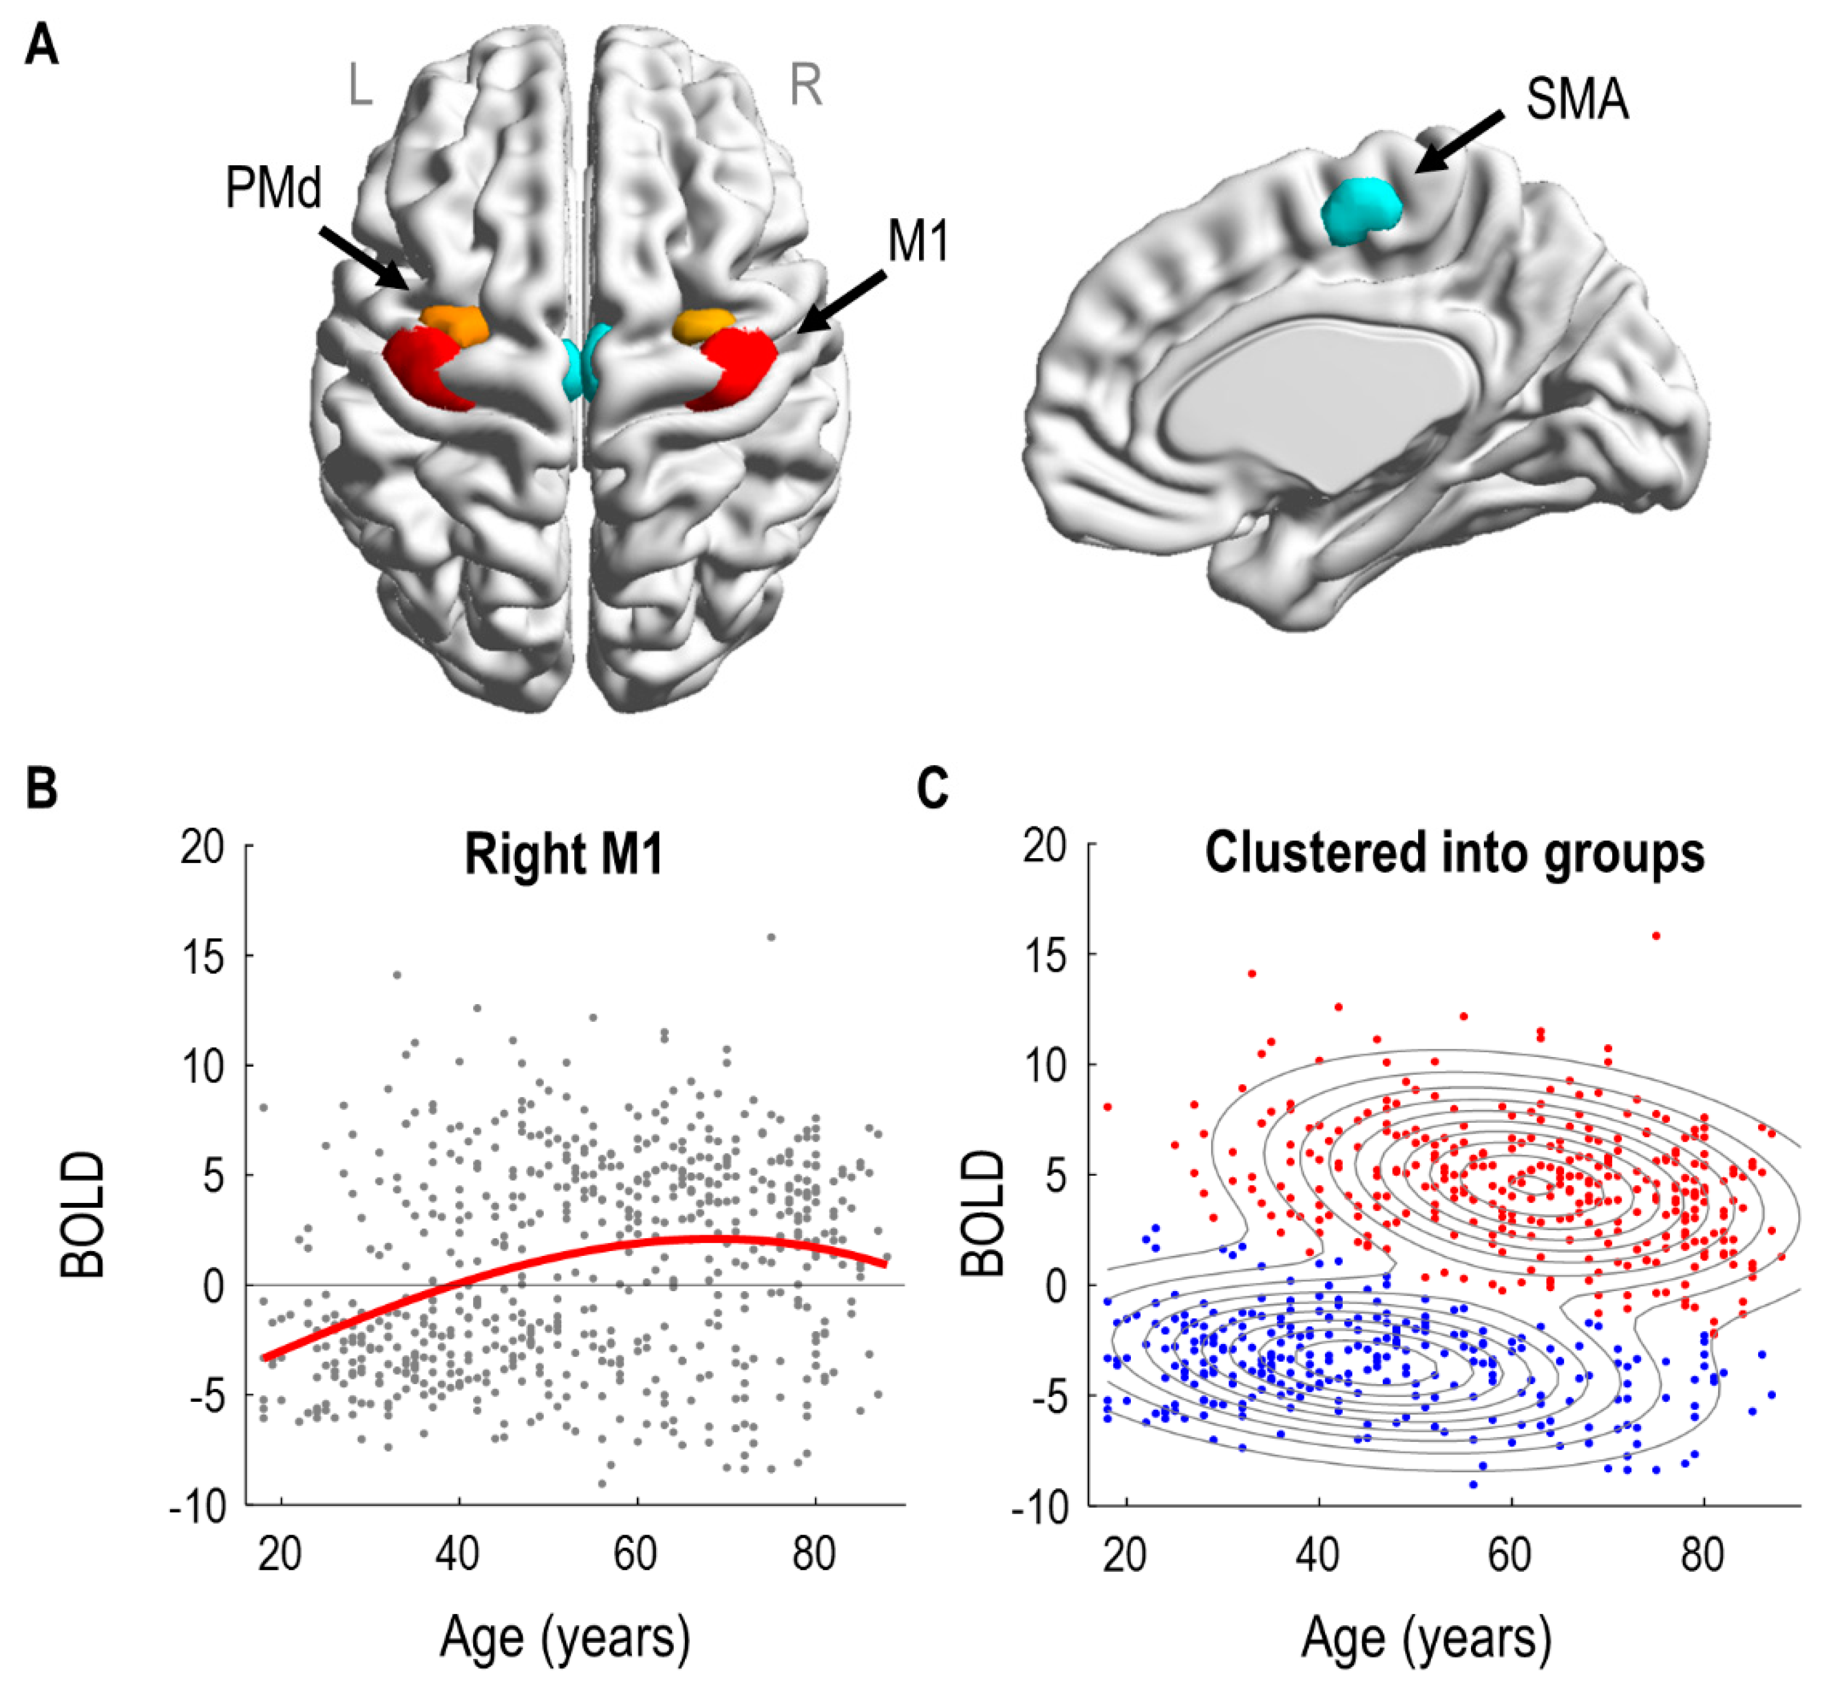
Task
Negative BOLD in right M1
BOLD

Slide 2
1
lPMd
rPMd
2
3
lM1
rM1
4

Slide 4
M1: Inter-hemispheric
M2: Intra-hemispheric
1
rPMd
rPMd
2
1
rPMd
rPMd
2
3
lM1
rM1
4
3
lM1
rM1
4
M3: Self-connection
M4: None
1
rPMd
rPMd
2
1
rPMd
rPMd
2
3
lM1
rM1
4
3
lM1
rM1
4

Slide 5
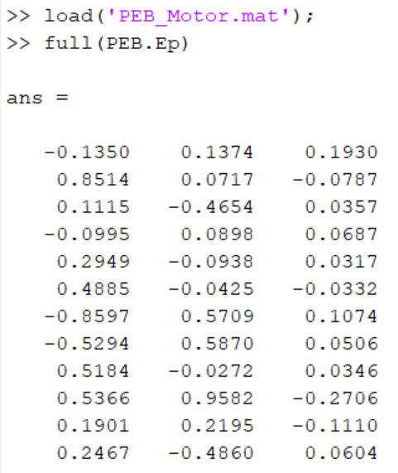

Slide 6
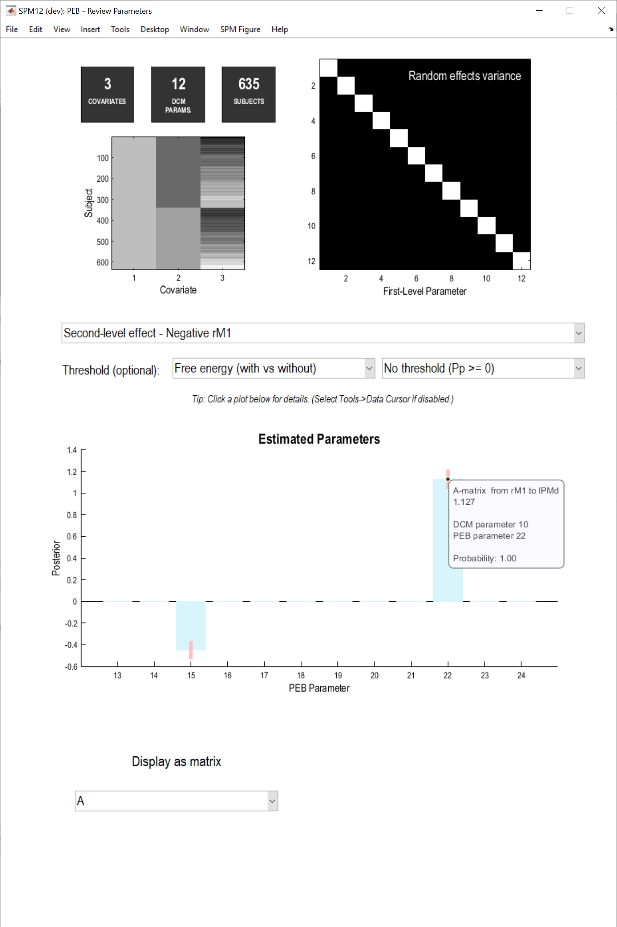
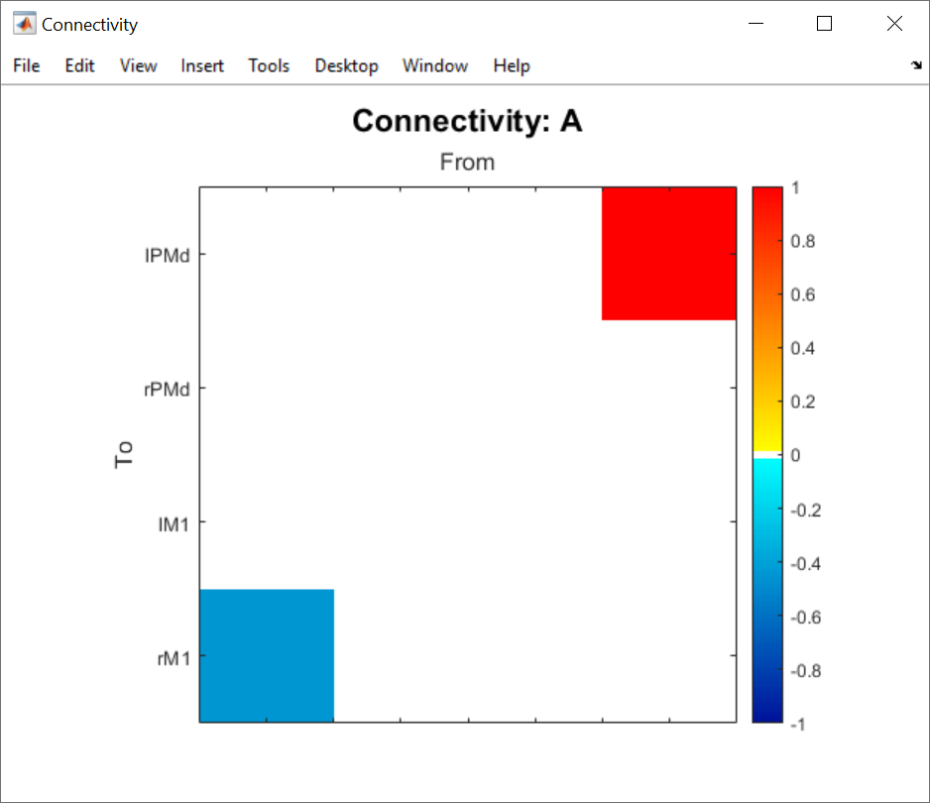

Slide 7
Group average
Group difference
(Negative > positive rM1 BOLD)
rPMd
rPMd
rPMd
rPMd
0.15Hz
1.1Hz
-0.45Hz
0.49Hz
lM1
rM1
lM1
rM1
M2: Intra-hemispheric
M1: Inter-hemispheric

