Slide 1

+

Slide 2
Forward
Backward
SPC
SPC
Attention
V5
V5
Motion
Motion
Attention
V1
V1
Photic
Photic
Matrix A
Matrix B (modulatory)
Matrix C (driving)

Slide 3

Photic
Motion
Attention
fMRI
images

Slide 5
Backward
SPC
Attention
V5
Motion
Matrix A
Matrix B (modulatory)
V1
Matrix C (driving)
Photic

Slide 6
Forward
SPC
V5
Motion
Matrix A
Attention
V1
Matrix B (modulatory)
Matrix C (driving)
Photic

Slide 7
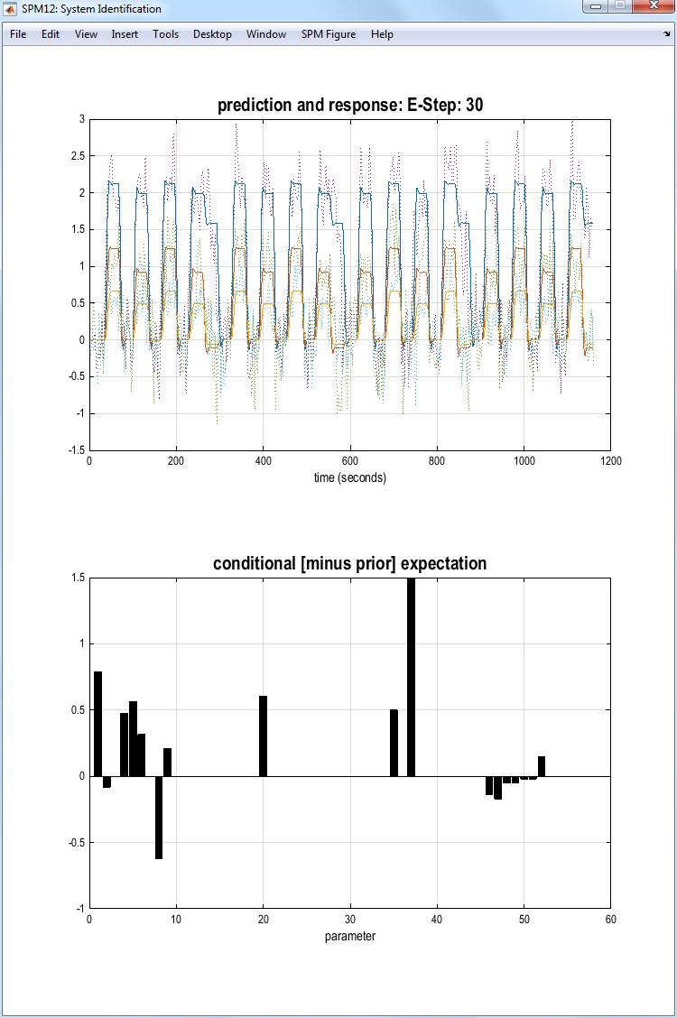

Slide 8
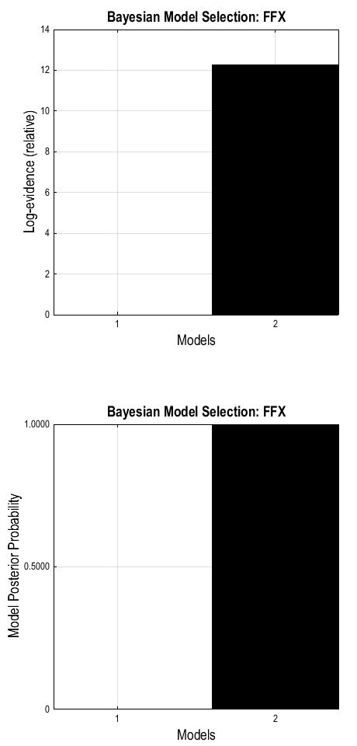

Slide 9
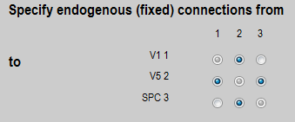
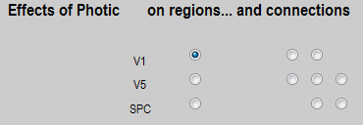
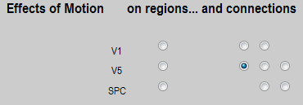
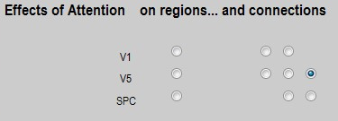
A-matrix connections
C-matrix (driving)
B-matrix (modulatory)
C-matrix (driving)
B-matrix (modulatory)
C-matrix (driving)
B-matrix (modulatory)

