Slide 1
Model specification
Estimation
Group-level modelling
Bayesian model comparison
Predictive validity
Variational
Laplace (VL)
Parametric Empirical Bayes (PEB)
Cross-validation

Slide 2

pyramid
palm tree
oak tree

Slide 3

Full model (m1)
Ventral model (m2)
ldF
rdF
ldF
rdF
lvF
rvF
lvF
rvF
$$A_{I}$$
$$A_{E}$$
$$B_{I}^{(PICTURES)}$$
$$B_{I}^{(WORDS)}$$
$$C$$
Dorsal model (m3)
Null model (m4)
ldF
rdF
ldF
rdF
lvF
rvF
lvF
rvF

Slide 4
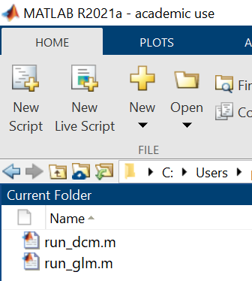
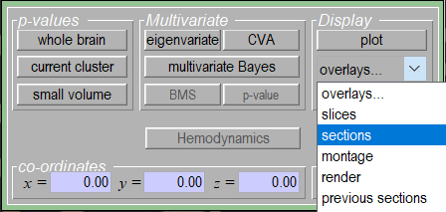
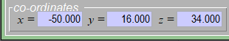
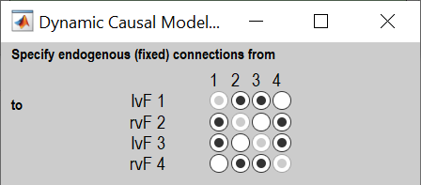
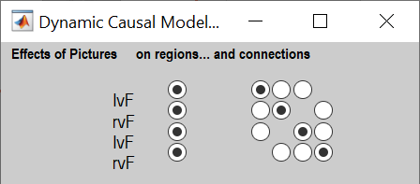

Slide 5

Full model (m1)
$$A_{I}$$
$$A_{E}$$
$$B_{I}^{(PICTURES)}$$
$$B_{I}^{(WORDS)}$$
$$C$$
ldF
rdF
lvF
rvF

Slide 7
