Slide 1
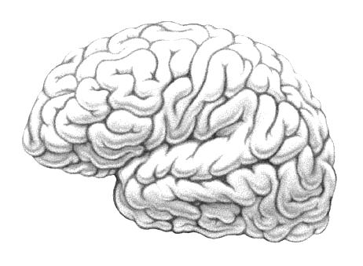
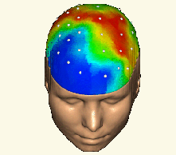
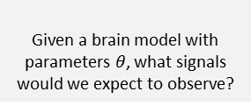
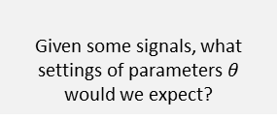

Stimuli
Neural activity
Measurements
$$u$$
$$x$$
$$y$$
(no stimuli in resting state)
Forward model
Given a brain model with parameters $θ$, what signals would we expect to observe?
Inverse problem
Given some signals, what settings of parameters $θ$ would we expect?

