Slide 1
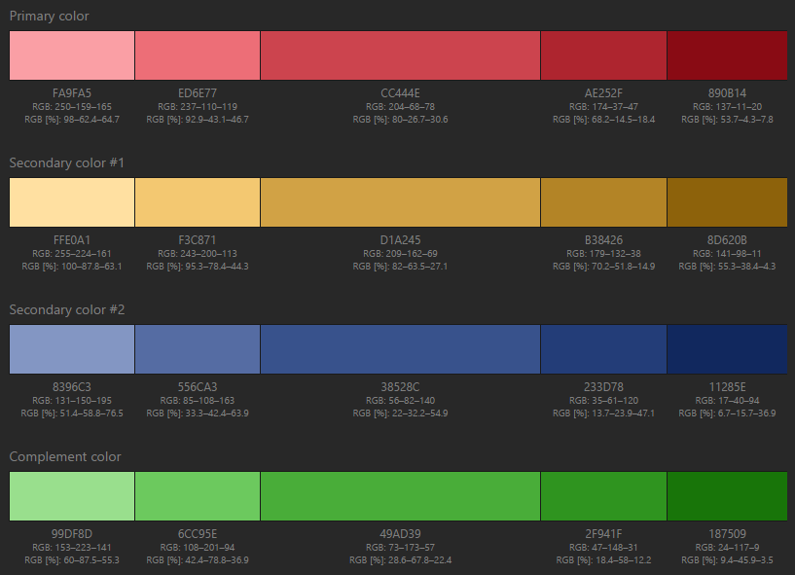
Colour scheme
http://paletton.com/#uid=75A0+0kloqebKE5h6utphmqtrhH

