Slide 1
개인프로젝트
20191562 양혜정

Slide 2
목 차
소스코드

Slide 3
1. 소스코드
Index.html(1)
<!DOCTYPE html>
<html lang="en">
<head>
<meta charset="UTF-8">
<meta name="viewport" content="width=device-width, initial-scale=1.0">
<link rel="stylesheet" href="css/style.css">
<link href="https://fonts.googleapis.com/css2?family=Praise&display=swap" rel="stylesheet">
<link href="https://fonts.googleapis.com/css2?family=Nanum+Gothic&display=swap" rel="stylesheet">
<link href="https://fonts.googleapis.com/css2?family=Gugi&display=swap" rel="stylesheet">
<title>쇼핑몰</title>
<script src="https://kit.fontawesome.com/1b5a5bad3c.js" crossorigin="anonymous"></script>
<script defer src="js/site.js"></script>
</head>
<body>
<div class="main">
<nav>
<div class="search">
<input type="text" class="search_insert" placeholder="검색">
<i class="fas fa-search"></i>
</div>
<div class="radio">
<input type="radio" id="tab1" name="tab" checked>
<label for="tab1" class="tabMenu">카테고리</label>
<input type="radio" id="tab2" name="tab">
<label for="tab2" class="tabMenu"> 게시판</label>
<div class="category">

Slide 4
1. 소스코드
Index.html(2)
<ul>
<li><a href="#">상의</a></li>
<li><a href="#">아우터</a></li>
<li><a href="#">팬츠</a></li>
<li><a href="#">셔츠/블라우스</a></li>
<li><a href="#">원피스</a></li>
<li><a href="#">스커트</a></li>
</ul>
</div>
<div class="board">
<ul>
<li><a href="#">공지사항</a></li>
<li><a href="#">문의게시판</a></li>
<li><a href="#">리뷰</a></li>
</ul>
</div>
</div>
</nav>
<div class="main_contents">
<header>
<div class="main_logo"><a href="index.html">HyeJung</a></div>
</header>
<div class="section">
<section>
<div class="new">

Slide 5
1. 소스코드
Index.html(3)
<div class="new_logo">
<span>신상템</span>
</div>
<div class="new_preview">
<div class="new_contents">
<div class="img">
</div>
<span><a href="#">신상템1</a></span>
</div>
<div class="new_contents">
<div class="img">
</div>
<span><a href="#">신상템2</a></span>
</div>
<div class="new_contents">
<div class="img">
</div>
<span><a href="#">신상템3</a></span>
</div>
<div class="new_contents">
<div class="img">
</div>
<span><a href="#">신상템4</a></span>
</div>

Slide 6
1. 소스코드
Index.html(4)
<div class="new_contents">
<div class="img">
</div>
<span><a href="#">신상템5</a></span>
</div>
<div class="new_contents">
<div class="img">
</div>
<span><a href="#">신상템6</a></span>
</div>
</div>
</div>
<div class="best">
<div class="best_logo">
<span>베스트 아이템</span>
</div>
<div class="best_preview">
<div class="best_contents">
<div class="img">
</div>
<span><a href="#">베스트 아이템1</a></span>
</div>
<div class="best_contents">
<div class="img">
</div>
<span><a href="#">베스트 아이템2</a></span>
</div>

Slide 7
1. 소스코드
Index.html(5)
<div class="best_contents">
<div class="img">
</div>
<span><a href="#">베스트 아이템3</a></span>
</div>
<div class="best_contents">
<div class="img">
</div>
<span><a href="#">베스트 아이템4</a></span>
</div>
<div class="best_contents">
<div class="img">
</div>
<span><a href="#">베스트 아이템5</a></span>
</div>
<div class="best_contents">
<div class="img">
</div>
<span><a href="#">베스트 아이템6</a></span>
</div>
</div>
</div>
</section>
</div>
</div>
</div>

Slide 8
1. 소스코드
Index.html(6)
<div class="sideBar">
<div class="button">
<i class="fas fa-long-arrow-alt-left"></i>
</div>
<div class="info">
<div class="login">
<span class="singIn"><a href="login.html">로그인</a></span>
<span class="create"><a href="join.html">회원가입</a></span>
</div>
<div class="my">
<div class="myPage">
<i class="fas fa-user"></i>
<span><a href="./jsp/infoModi_check.jsp">정보 수정</a></span>
</div>
<div class="cart">
<i class="fas fa-shopping-cart"></i>
<span><a href="#">장바구니</a></span>
</div>
</div>
<div class="order">
<a href="#"><i class="fas fa-clipboard-list"></i></a>
<span><a href="#">주문조회</a></span>
</div>
</div>
</div>
</body>
</html>

Slide 9
1. 소스코드
join.html(1)
<script>
$(function(){
$('#id_input').blur(function(){
$.ajax({
type:"POST",
url:"./jsp/checkId.jsp",
data:{
"id":$('#id_input').val()
},
success:function(data){
if($.trim(data)=="YES"){
$('#checkId').html('<b stlye="font-size:14px; color:blue">사용 가능한 아이디입니다</b>');
$('#joinBtn').attr('disabled',false);
} else{
$('#checkId').html('<b style="font-size:14px; color:red">이미 등록되어있는 아이디입니다</b>');
$('#joinBtn').attr('disabled',true);
}
}
});
});
});
</script>

Slide 10
1. 소스코드
join.html(2)
<script defer src="js/join.js"></script>
</head>
<body>
<div class="container">
<header>
<div class="logo">
<span><a href="index.html">HyeJung</a></span>
</div>
</header>
<div class="join">
<form action="jsp/join.jsp" method="post">
<div class="join_idpw">
<div class="id">
<span class="text">아이디</span>
<input id="id_input" type="text" name="id" autocomplete="off" autofocus>
<span id="checkId"></span>
</div>
<span class="error">필수 정보입니다.</span>
<div class="pw">
<span class="text">비밀번호</span>
<input id="pw_input" type="password" name="passwd">
<!-- <i class="far fa-eye"></i> -->
<i class="far fa-eye-slash"></i>
</div>
<span class="error">필수 정보입니다.</span>
<div class="pw_check">
<span class="text">비밀번호 확인</span>

Slide 11
1. 소스코드
join.html(2)
<input id="pwCheck_input" type="password">
<!-- <i class="far fa-eye"></i> -->
<i class="far fa-eye-slash"></i>
</div>
<span class="error">필수 정보입니다.</span>
<span class="pw_error">비밀번호가 일치하지 않습니다.</span>
</div>
<div class="join_info">
<div class="name">
<span class="text">이름</span>
<input type="text" id="name_input" name="name" autocomplete="off">
</div>
<span class="error">필수 정보입니다.</span>
<div class="gender">
<span class="text">성별</span>
<select name="gender" id="gender_sel">
<option value selected>성별</option>
<option value="M">남자</option>
<option value="F">여자</option>
</select>
<div class="dropBtn">
<i class="fas fa-caret-down"></i>
</div>
</div>
<span class="error">필수 정보입니다.</span>

Slide 12
1. 소스코드
join.html(2)
<script defer src="js/join.js"></script>
</head>
<body>
<div class="container">
<header>
<div class="logo">
<span><a href="index.html">HyeJung</a></span>
</div>
</header>
<div class="join">
<form action="jsp/join.jsp" method="post">
<div class="join_idpw">
<div class="id">
<span class="text">아이디</span>
<input id="id_input" type="text" name="id" autocomplete="off" autofocus>
<span id="checkId"></span>
</div>
<span class="error">필수 정보입니다.</span>
<div class="pw">
<span class="text">비밀번호</span>
<input id="pw_input" type="password" name="passwd">
<!-- <i class="far fa-eye"></i> -->
<i class="far fa-eye-slash"></i>
</div>
<span class="error">필수 정보입니다.</span>
<div class="pw_check">
<span class="text">비밀번호 확인</span>

Slide 13
1. 소스코드
join.html(2)
<script defer src="js/join.js"></script>
</head>
<body>
<div class="container">
<header>
<div class="logo">
<span><a href="index.html">HyeJung</a></span>
</div>
</header>
<div class="join">
<form action="jsp/join.jsp" method="post">
<div class="join_idpw">
<div class="id">
<span class="text">아이디</span>
<input id="id_input" type="text" name="id" autocomplete="off" autofocus>
<span id="checkId"></span>
</div>
<span class="error">필수 정보입니다.</span>
<div class="pw">
<span class="text">비밀번호</span>
<input id="pw_input" type="password" name="passwd">
<!-- <i class="far fa-eye"></i> -->
<i class="far fa-eye-slash"></i>
</div>
<span class="error">필수 정보입니다.</span>
<div class="pw_check">
<span class="text">비밀번호 확인</span>

Slide 14
1. 소스코드
join.html(2)
<script defer src="js/join.js"></script>
</head>
<body>
<div class="container">
<header>
<div class="logo">
<span><a href="index.html">HyeJung</a></span>
</div>
</header>
<div class="join">
<form action="jsp/join.jsp" method="post">
<div class="join_idpw">
<div class="id">
<span class="text">아이디</span>
<input id="id_input" type="text" name="id" autocomplete="off" autofocus>
<span id="checkId"></span>
</div>
<span class="error">필수 정보입니다.</span>
<div class="pw">
<span class="text">비밀번호</span>
<input id="pw_input" type="password" name="passwd">
<!-- <i class="far fa-eye"></i> -->
<i class="far fa-eye-slash"></i>
</div>
<span class="error">필수 정보입니다.</span>
<div class="pw_check">
<span class="text">비밀번호 확인</span>

Slide 15
1. 소스코드
join.html(2)
<script defer src="js/join.js"></script>
</head>
<body>
<div class="container">
<header>
<div class="logo">
<span><a href="index.html">HyeJung</a></span>
</div>
</header>
<div class="join">
<form action="jsp/join.jsp" method="post">
<div class="join_idpw">
<div class="id">
<span class="text">아이디</span>
<input id="id_input" type="text" name="id" autocomplete="off" autofocus>
<span id="checkId"></span>
</div>
<span class="error">필수 정보입니다.</span>
<div class="pw">
<span class="text">비밀번호</span>
<input id="pw_input" type="password" name="passwd">
<!-- <i class="far fa-eye"></i> -->
<i class="far fa-eye-slash"></i>
</div>
<span class="error">필수 정보입니다.</span>
<div class="pw_check">
<span class="text">비밀번호 확인</span>

Slide 16
1. 소스코드
join.html(2)
<script defer src="js/join.js"></script>
</head>
<body>
<div class="container">
<header>
<div class="logo">
<span><a href="index.html">HyeJung</a></span>
</div>
</header>
<div class="join">
<form action="jsp/join.jsp" method="post">
<div class="join_idpw">
<div class="id">
<span class="text">아이디</span>
<input id="id_input" type="text" name="id" autocomplete="off" autofocus>
<span id="checkId"></span>
</div>
<span class="error">필수 정보입니다.</span>
<div class="pw">
<span class="text">비밀번호</span>
<input id="pw_input" type="password" name="passwd">
<!-- <i class="far fa-eye"></i> -->
<i class="far fa-eye-slash"></i>
</div>
<span class="error">필수 정보입니다.</span>
<div class="pw_check">
<span class="text">비밀번호 확인</span>

Slide 17
1. 소스코드
join.html(2)
<script defer src="js/join.js"></script>
</head>
<body>
<div class="container">
<header>
<div class="logo">
<span><a href="index.html">HyeJung</a></span>
</div>
</header>
<div class="join">
<form action="jsp/join.jsp" method="post">
<div class="join_idpw">
<div class="id">
<span class="text">아이디</span>
<input id="id_input" type="text" name="id" autocomplete="off" autofocus>
<span id="checkId"></span>
</div>
<span class="error">필수 정보입니다.</span>
<div class="pw">
<span class="text">비밀번호</span>
<input id="pw_input" type="password" name="passwd">
<!-- <i class="far fa-eye"></i> -->
<i class="far fa-eye-slash"></i>
</div>
<span class="error">필수 정보입니다.</span>
<div class="pw_check">
<span class="text">비밀번호 확인</span>

Slide 18
7. 예제1(1)
소스코드 이름을 쓰세요(abc.java)(1)
#요인분석
rm(list=ls(all=TRUE))
Data1 = read.delim("/home/kdhongx/rdata/Data1.txt", header=T)
tset1 = subset(Data1, select=c("Q1","Q2","Q3","Q4","Q5","Q6","Q7","Q8","Q9","Q10","Q11","Q12","Q13","Q14","Q15","Q16","Q17","Q18","Q19","Q20"))
fa.out1 = factanal(tset1, factors=4, rotation="promax") # 요인수를 지정하지 않으면 자동으로 수행
print(fa.out1, cutoff=0.2, sort=TRUE)
#신뢰성 분석
library(psych)
Qset1 = subset(Data1, select=c("Q6","Q7","Q8","Q9","Q10")) #Q6,7,8,9,10 동일 요인
alpha(Qset1)
Qset2 = subset(Data1, select=c("Q11","Q12","Q13","Q14","Q15")) #Q11,12,13,14,15 동일 요인
alpha(Qset2)
#요인은 몇 개로? → 주성분 분석 → 상관(cor)계수의 아이겐 밸류
ft = cor(tset1)
eigen(ft)
p_cor = princomp(tset1,cor=TRUE)
summary(p_cor)
library(graphics)
biplot(p_cor)
screeplot(p_cor,npcs=2,type="lines")
screeplot(p_cor,type="lines",main="scree plot") #스크리그래프

Slide 19
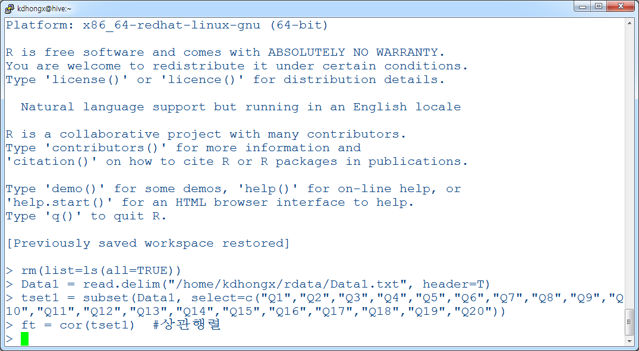
7. 예제1(2)
화면표시

