Slide 1
Country211 Image Classification Using ResNet-18
A Deep Learning Project
Presented by: Yagnik Donda
Date: 15th Aug 2024

Slide 2
Introduction
Project Objective: • To classify images from the Country211 dataset using a deep learning model.
Problem Statement: • Image classification is crucial in various applications like object recognition and facial recognition.

Slide 3
Dataset Description
Dataset Overview: – Country211 dataset contains images of 211 countries.
Dataset Structure: – Split into training, validation, and test sets.

Slide 4
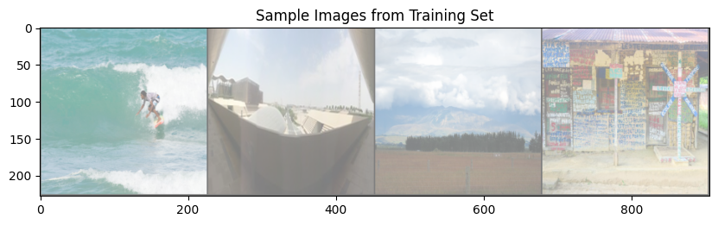
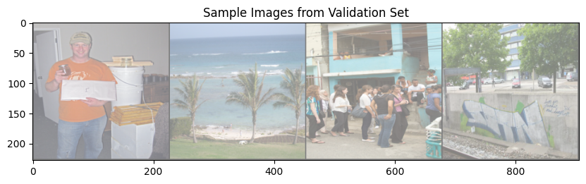
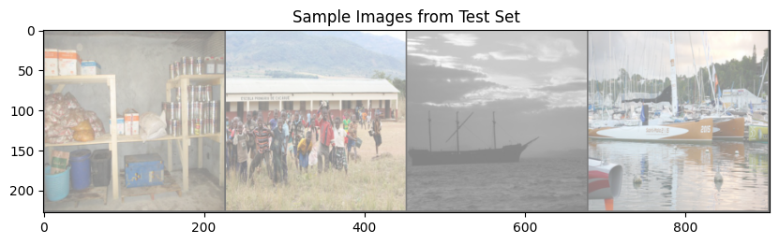

Slide 5
Model Architecture
Model Choice: ► ResNet 18 was selected for its effectiveness in complex tasks.
Model Details: ► Includes residual connections and convolutional layers.

Slide 6
Training Process
Training Setup: • 10 epochs, batch size of 32, Adam optimizer.
Early Stopping: • Implemented to prevent overfitting.
Challenges: • Overfitting and significant training time.

Slide 7
Evaluation Results
Model Performance: – Evaluated using accurac
Validation Accuracy : 45%
Test Accuracy : 48%

Slide 8
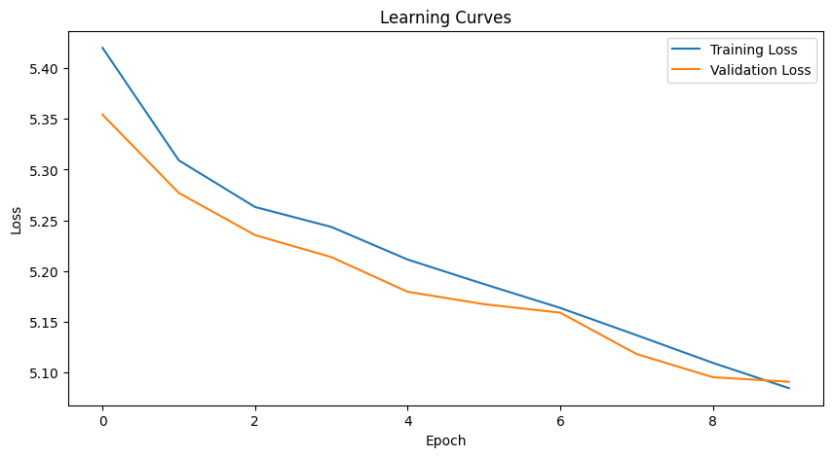

Slide 9
Insights and Conclusion
Key Insights: ► Fair performance due to data augmentation.
Conclusion: ► Successfully applied deep learning for image classification.
Limitations: ► Challenges with similar classes and poor quality images.

Slide 10
Future Work
Next Steps: • Explore deeper architectures like ResNet• 50 or EfficientNet.
Advanced Techniques: • Consider transfer learning, more data, and hyperparameter tuning.

Slide 11
Challenges and Lessons Learned
Challenges: – Overfitting, managing large datasets, model fine– tuning.
Lessons Learned: – Importance of regularization, careful model tuning, and managing training times.

Slide 12
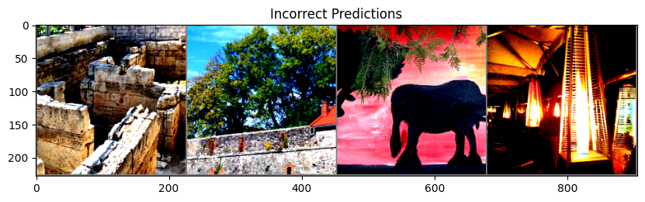
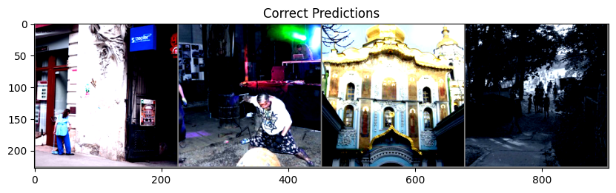

Slide 13
Q&A
Thank you! Any questions?

