Slide 1

Acoustic Keylogger
Aviad Shalom Tzemah
Yuval Levy

Slide 2
Today’s agenda
We are going to present to you a side channel attack called Acoustic Keylogger.
We’ll explain how it is implemented.
We’ll show some experiments we conducted and their results.
We’ll present a way to leverage on the attack to make it more powerful.
Final thoughts and questions.

Slide 3
So, what is a keylogger?
According to Wikipedia: Keystroke logging, often referred to as keylogging or keyboard capturing, is the action of recording (logging) the keys struck on a keyboard, typically covertly, so that a person using the keyboard is unaware that their actions are being monitored. Data can then be retrieved by the person operating the logging program. A keystroke recorder or keylogger can be either software or hardware.
Notes:
For further reading: https://en.wikipedia.org/wiki/Keystroke_logging

Slide 4
What is a side-channel attack?
According to Wikipedia: In computer security, a side-channel attack is any attack based on extra information that can be gathered because of the fundamental way a computer protocol or algorithm is implemented, rather than flaws in the design of the protocol or algorithm itself…
Notes:
For further reading: https://en.wikipedia.org/wiki/Side-channel_attack

Slide 5
Acoustic keylogger
So, we can understand that an acoustic keylogger, is a keylogger (gathers the keystrokes typed by a victim) which uses the acoustic emanations of a keyboard to deduce what was typed (side-channel of keyboards).

Slide 6
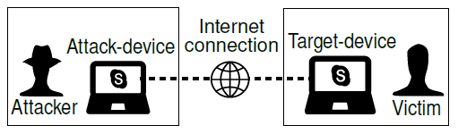
How is it implemented?
There are several proposals for different kinds of acoustic keyloggers out there.
We focused on the implementation proposed by SPRITZ Research Group called “Don’t Skype & Type!”
Notes:
The paper of the method: https://arxiv.org/abs/1609.09359
Implementation of the method: https://github.com/SPRITZ-Research-Group/Skype-Type

Slide 7
3 Attack Scenarios:
Complete Profiling: the victim unwittingly provides some text samples. attacker profiles the victim on target device.
User Profiling: the attack collects training data via social engineering techniques. profiles victim’s typing style on device of the same model.
Model Profiling: No information at all.

Slide 8
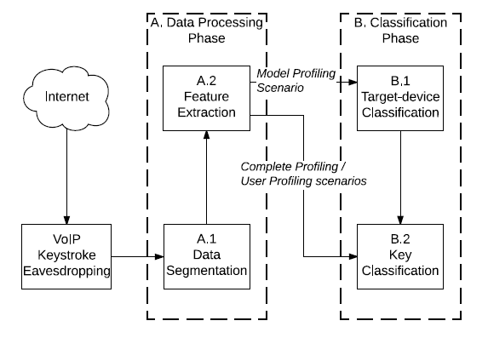
Attack Scheme:

Slide 9
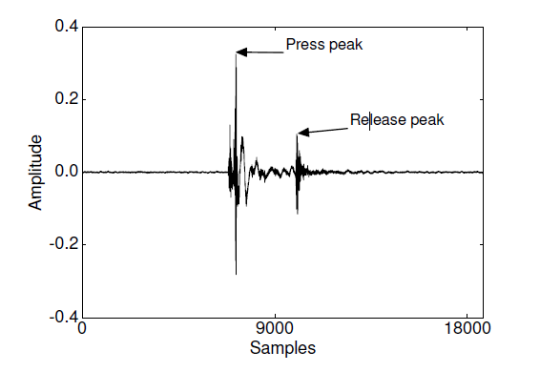
Pre-processing (1):
Yields automatic isolation of keystrokes.
Use only press peaks, release peaks are ignored.

Slide 10
Pre-processing (2):
Amplitude normalization: RMS = 1.
Sum of FFT Coefficients in 10ms windows -> energy of each window.
Set a threshold parameter: ε
For each window:
If energy > ε:
Keystroke_event = 1
Extract the subsequent 100ms

Slide 11
Multiclass Classification:
Model features: MFCC.
Target-Device Classification: K-NN (K=10).
Key Classification: logistic regression.

Slide 12
Let’s see it in action!
After we trained a model, we gave it some .wav files to get the hang of how the method works.
For each keystroke the model detected, it performed a classification and gave the top 10 labels it was confident in, in a descending order.
Let’s see some examples…

Slide 13
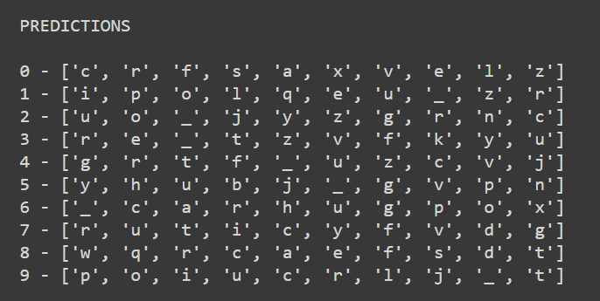
How well it predicts the answer to life, the universe and everything?

Slide 14
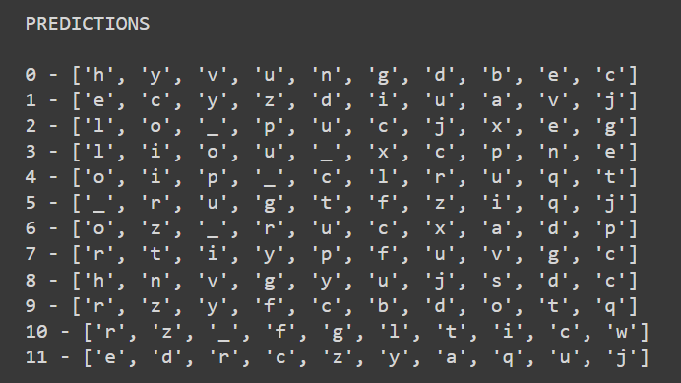
What about a popular greeting?

Slide 15
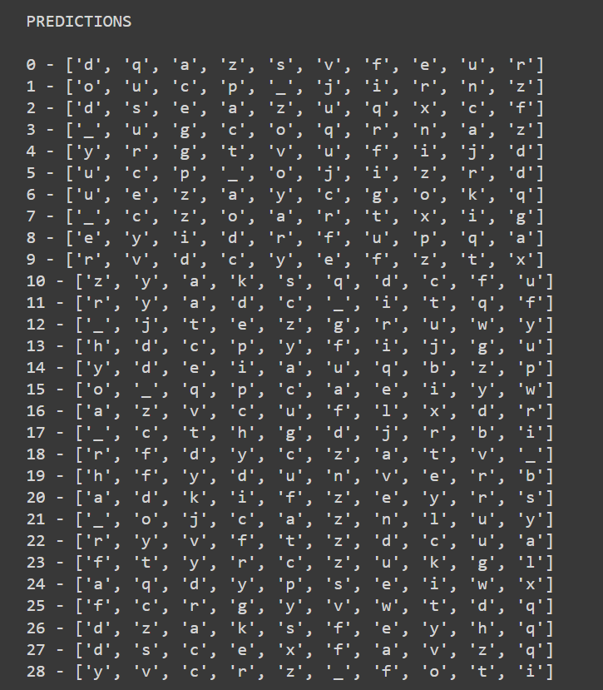
And famous tragedies?

Slide 16
Let’s show some experiments
We conducted several experiments on the method on different settings and conditions.
We wanted to check how robust the method is, and what is its flaws.
The first two tests were conducted on a laptop Asus GL-502VS.
The last test was conducted on a desktop computer with Keychron Q1 keyboard with Gateron Phantom Red switches and the built-in michrophone of a Bose QuietComfort 35 II.

Slide 17
First test
We wanted to check how well the method performs, if the attack will happen in a different setting from the one the training data was gathered in.
Meaning, what if an attacker gathered the training data on a victim when he was in his room but gathers the keystrokes he wants to predict when the victim is in a different room.
We trained a model on all the English alphabet where each letter has 10 samples (recordings) in the train set plus 10 space samples.
We let the model predict the same random 10 strings of letters in each of the rooms and calculated the average accuracy at each top-N value.

Slide 18
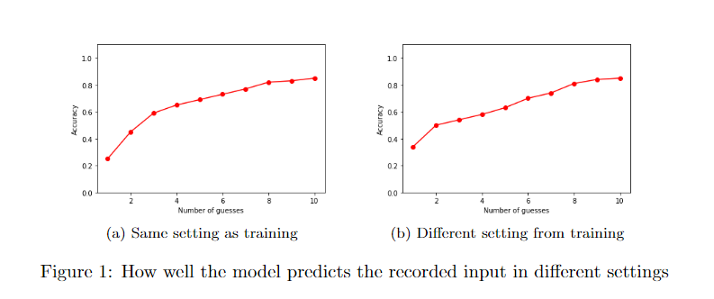
First test results

Slide 19
Second test
For the second test we wanted to check how a more realistic data set would affect the performance of the model.
As we saw in the previous test, the training set consisted of all the English alphabet where each characters had 10 samples.
But in a real situation the attacker would collect training set which is mostly texts in a natural language meaning, not every character is going to have the same number of samples in the train set.

Slide 20
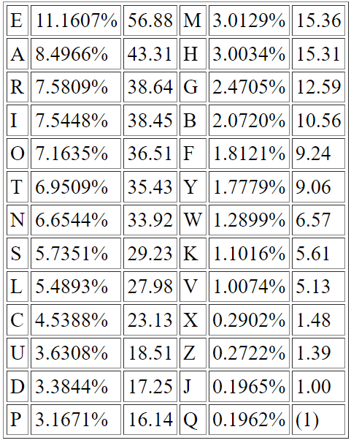
Second test cont.’
We arranged the train set so it would follow (to some extent) the frequency of letters in the following chart presenting the frequency of letters in English in the Concise Oxford Dictionary (9th edition, 1995).
We can see in the chart that if we take the letter Q (which is the least frequent character) as the base (1). The letter E is 56.88 times more frequent.
We ended up with 115 samples of letters and we added a space sample for every 5 samples because the average word length in English is around 5.
Notes:
Chart taken from: https://www3.nd.edu/~busiforc/handouts/cryptography/letterfrequencies.html
Average word length in English: https://www.wolframalpha.com/input/?i=average+english+word+length

Slide 21
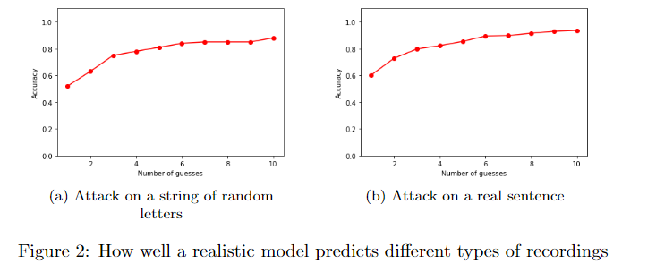
Second test results

Slide 22
Third and last test
Since the last two tests we conducted on a laptop, we wanted to see how the method performs on a desktop victim.
The difference between a desktop and a laptop, is that desktop computers usually don’t have a built-in microphone and the recordings for the attack usually will come from a headset which its position relative to the victim’s keyboard can vary all the time.
We trained a model on all the letters of the English alphabet as we did for the first test but on the desktop.
Then we obtained the test (attack) recordings from two microphone positions:
The position as training one.
The microphone moved to the left relative to the training position.

Slide 23
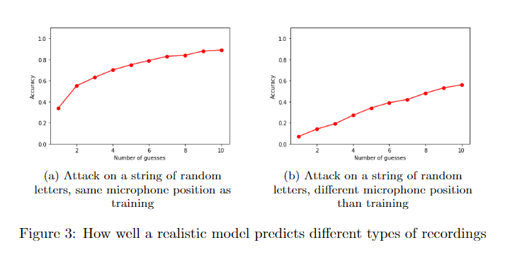
This test results

Slide 24
Ok. So, all we get is a bunch of letter predictions, what does that give to an attacker?
This is where we leverage on the method we presented.
We chained the output of the model on a recording with a spell checker and got what possible words the victim wrote.

Slide 25
How we did it
We took the predictions of the model for a given recording.
Cut the predictions at a predefined point. Meaning, spliced the top-10 predictions for each keystroke predictions at a top-N point (which is an argument passed to method which does the attack.
Calculate all the combinations of these spliced arrays to get all the different possible strings.
Applied a fast spell checker called SymSpell on these combinations and got all the possible words the victim might have written based on a preloaded dictionary of 82,765 English words and their frequencies in the language.
Notes:
Original implementation of SymSpell in C#: https://github.com/wolfgarbe/SymSpell
The python port we used: https://github.com/mammothb/symspellpy

Slide 26
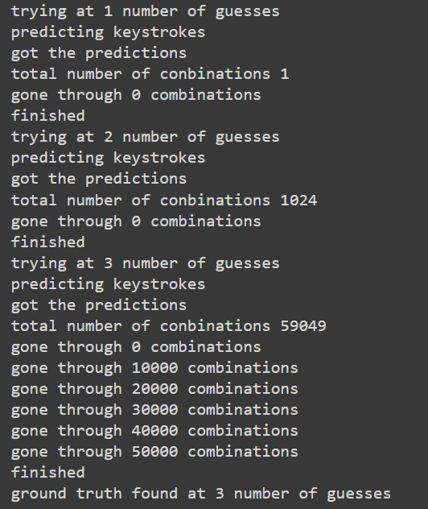
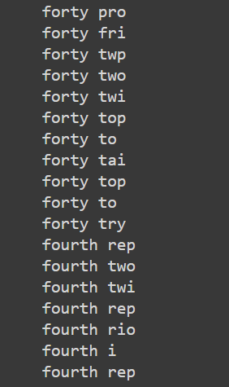
The results for “forty two”
Terminal output of how long it took to find the ground truth:
A subset of the output:

Slide 27
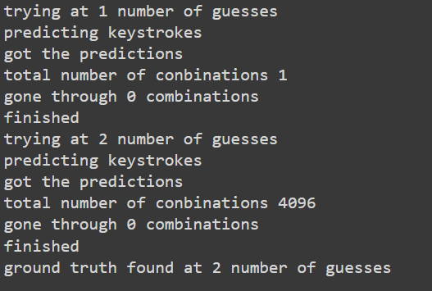
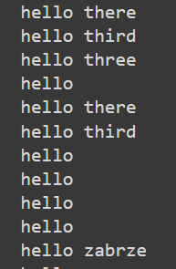
The results for “hello there”
Terminal output of how long it took to find the ground truth:
A subset of the output:

Slide 28
Final thoughts
We think that acoustic keyloggers are a viable threat everyone should worry about.
We saw that the attack works quite well on laptop computers because of the fixed position of the microphone relative to the keyboard.
But doesn’t quite work when the victim can move around his microphone.
Furthermore, We saw that chaining the attack with a spell checker can make the life of the attacker easier when trying to understand what the victim wrote. And we think if the attacker would use more sophisticated NLP models to try and figure out what the victim wrote it might yield even better results, but further research is required.
To conclude, don’t skype (or another VoIP application) and type! We recommend to mute when you do so ;)

Slide 29
Questions?

