Slide 1

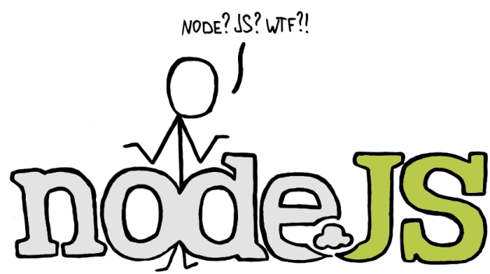
Introduction to Node JS

Slide 2



Who I Am?
Yulia Tenincheva
E-mail: yulia.ten@dezigner.ru GitHub: Y-Lyn-10

Slide 3
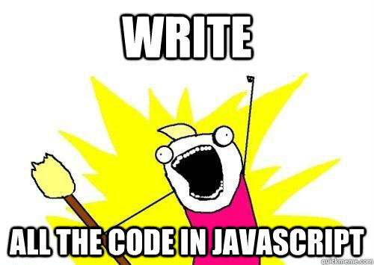
Why not?
If you already can write JavaScript in the browser, why can’t you write JavaScript on the server then?

Slide 4
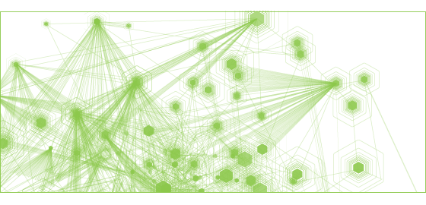

Who & When ?
Node.js was created and first published for Linux use in 2009
NPM, a package manager for Node.js libraries, was introduced in 2011.
In June 2011, Microsoft partnered with Joyent to create a native Windows version of Node.js. One month later, it was released

Slide 5
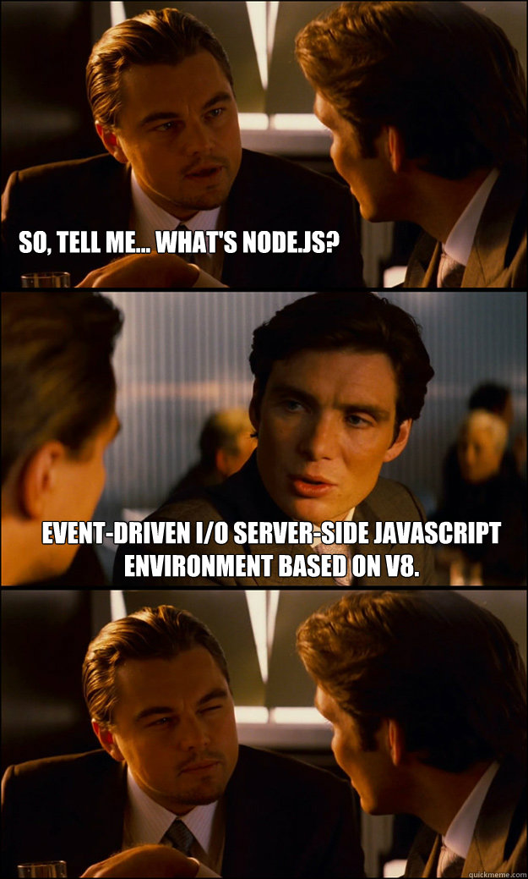
What is NodeJS?
Open source, cross-platform runtime environment for server-side and networking applications.
Provides an event-driven architecture and non-blocking I/O API that optimizes an application's throughput and scalability.
Uses the Google V8 JavaScript Engine to execute code

Slide 6
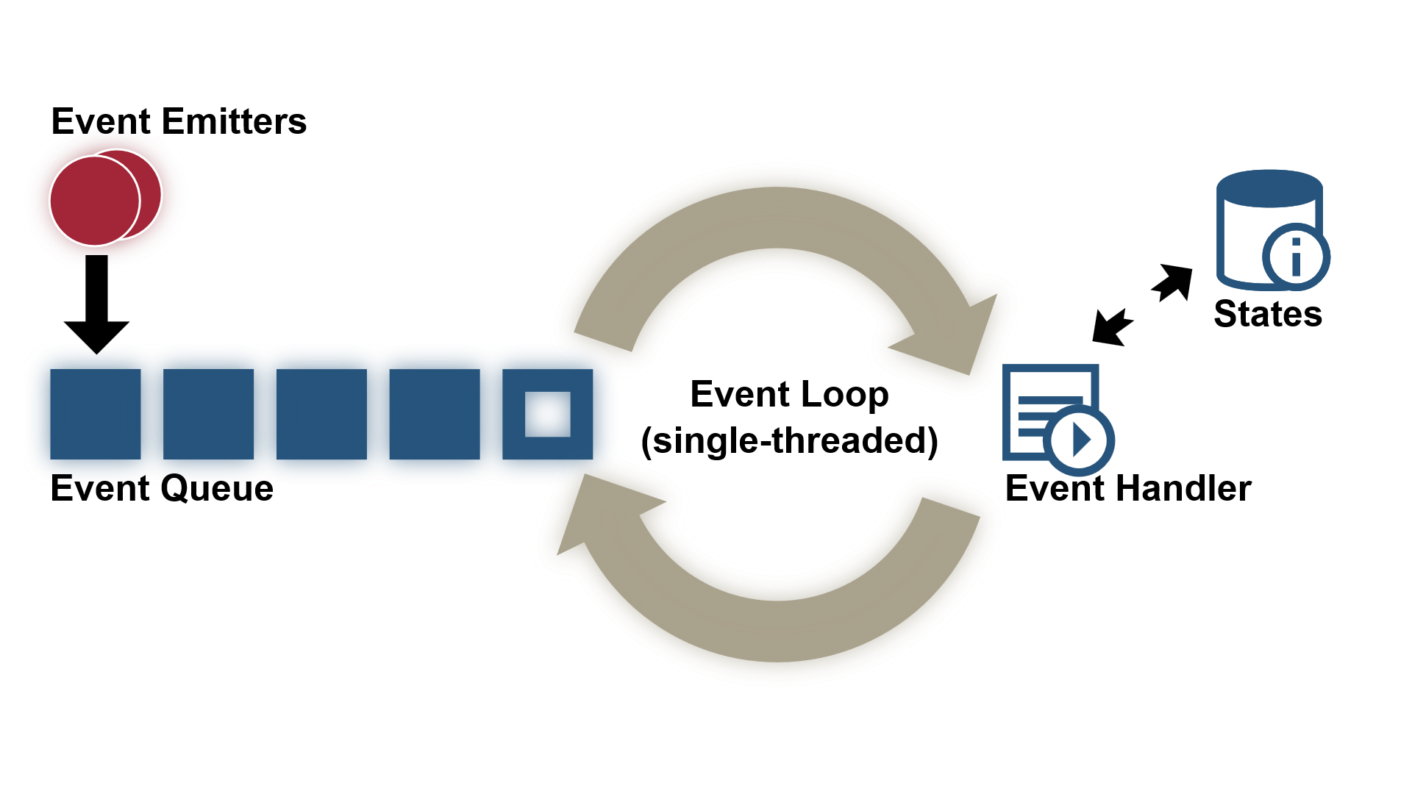
How it works?

Slide 7
Blocking vs. Non-Blocking
Reading file example in C#
Reading file is a blocking operation!
System.IO.StreamReader myFile =
new System.IO.StreamReader("c:\\test.txt");
string myString = myFile.ReadToEnd();
myFile.Close();
Console.WriteLine(myString);

Slide 8
Blocking vs. Non-Blocking
Reading file example in Node.js
But not in Node.js!
var fs = require('fs') ;
fs.readFile('/etc/hosts', 'utf8', function (err, data) {
if (err) {
return console.log(err);
}
console.log(data);
});
console.log(‘Read file example’);

Slide 9
Let’s do it!
LIVE DEMO
Thinking sync in async world

Slide 10

Get started!
var documentation = ‘http://nodejs.org/documentation/’;
var goodBook = ‘http://it-ebooks.info/book/3747/’;
var resources = [documentation, goodBook];
learnJavaScript(‘practice’, function(err, resources){
if(err) {
console.log(‘Try again’); } else {
console.log(resources); }
});
learnJavaScript();

Slide 11

Any questions?

