Slide 1
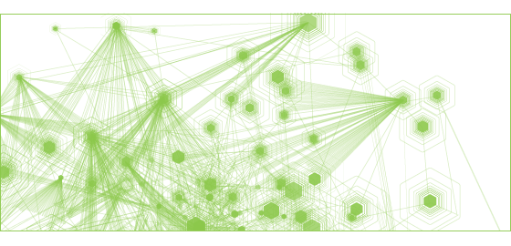

Yulia Tenincheva
Server-side NodeJS Developer
GitHub : Y-LyN-10
Twitter : @3thelfleda

Slide 2

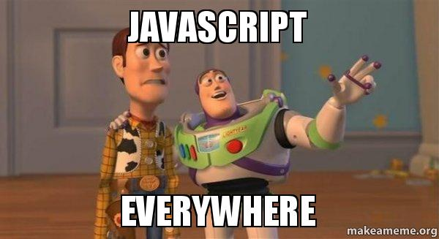
Yulia Tenincheva
Server-side NodeJS Developer
GitHub : Y-LyN-10
Twitter : @3thelfleda

Slide 3

NodeJS
The Tricky Parts

Slide 4
NodeJS
Why so popular?

Slide 5
It’s easy to learn – they said

Slide 6
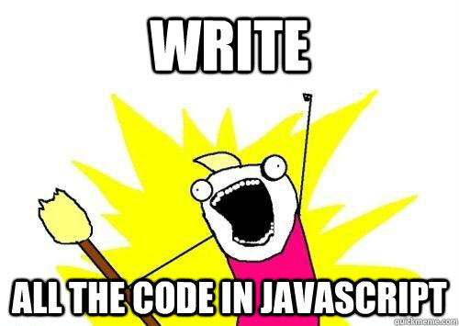

Slide 7
Well, that’s not the only reason

Slide 8
Really fast
NodeJS is fast

Slide 9
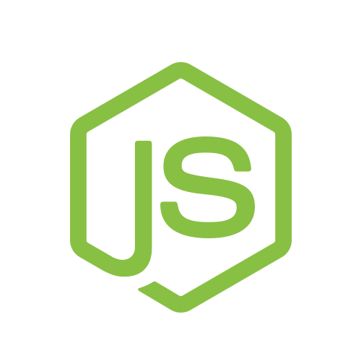
Uses the Google V8
JavaScript Engine
to execute code
Event-driven
architecture and
non-blocking I/O

Slide 10
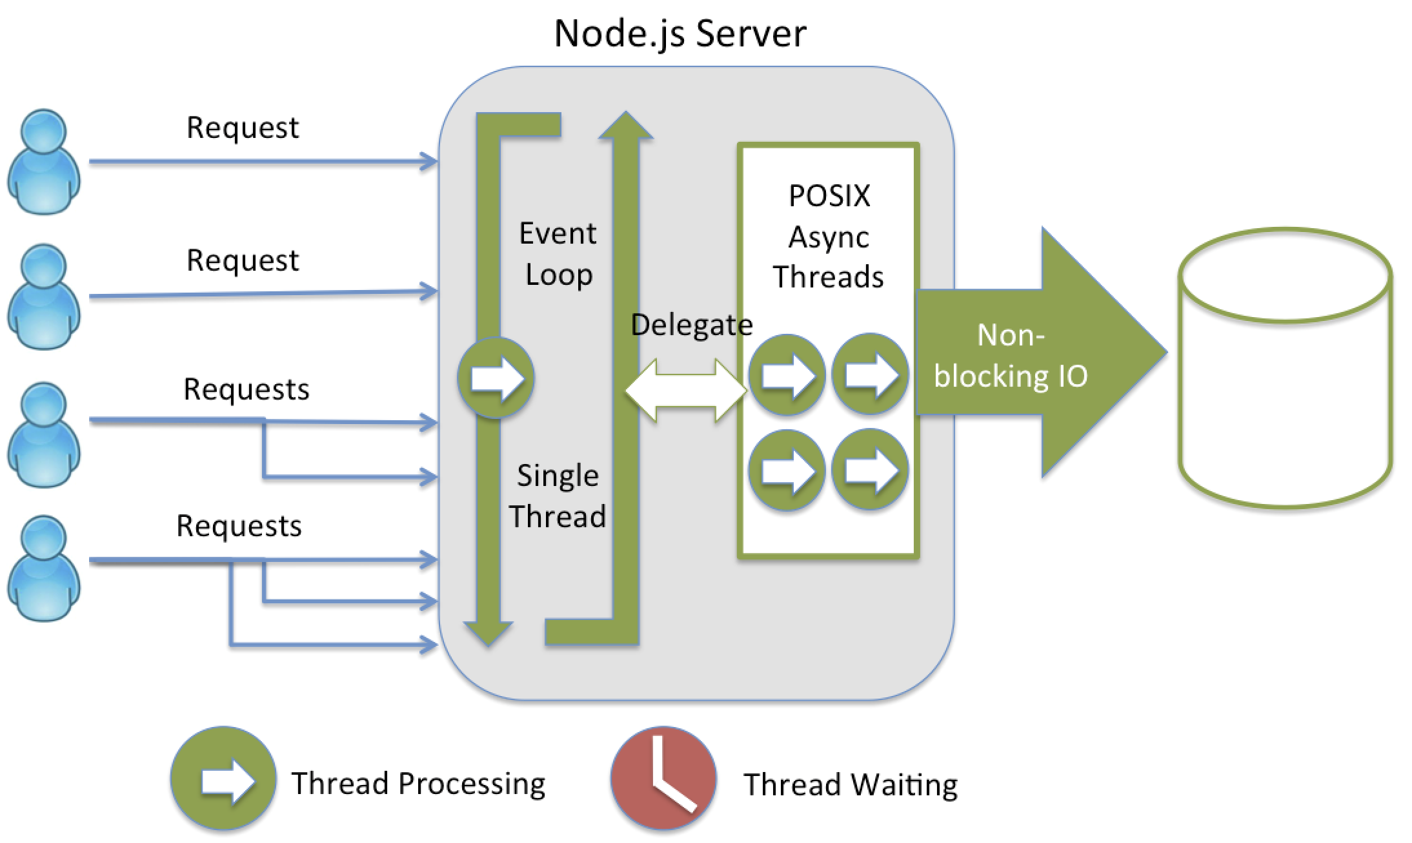

Slide 11

NodeJS is like
Starbucks

Slide 12
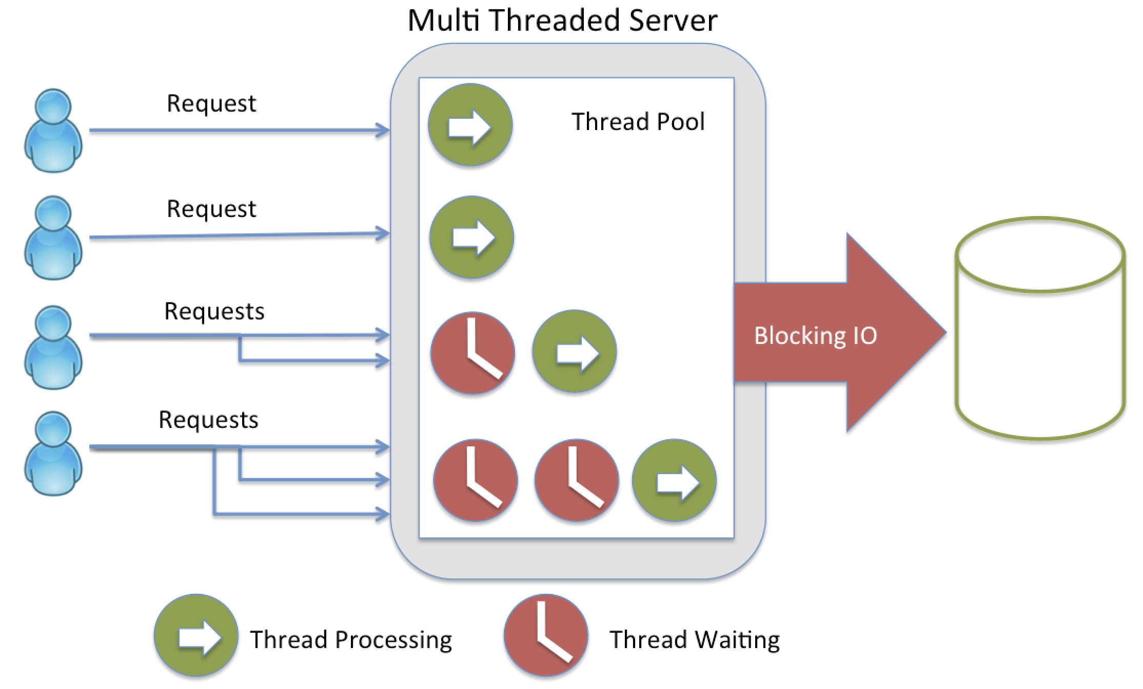

Slide 13
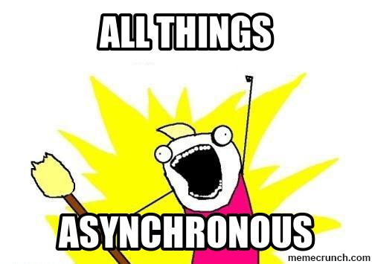

Slide 14

Community

Slide 15


Open source, Cross-platform runtime environment for server-side and networking applications.

Slide 16
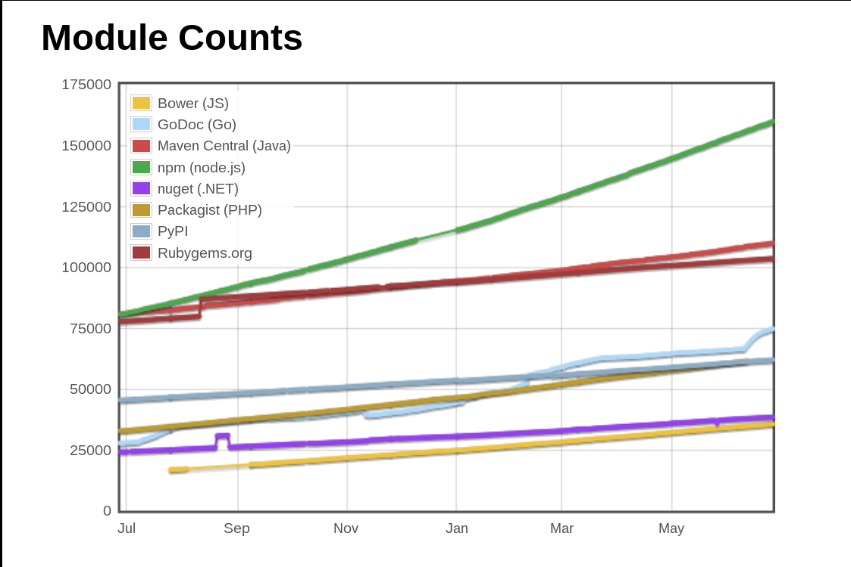
(last year)
Average growth / day
NPM (nodejs) : 263
GoDoc (Go): 207
Packagist (PHP): 87
Maven Central (Java): 82
Bower (JS): 64
RubyGems (ruby): 52
http://www.modulecounts.com/

Slide 17
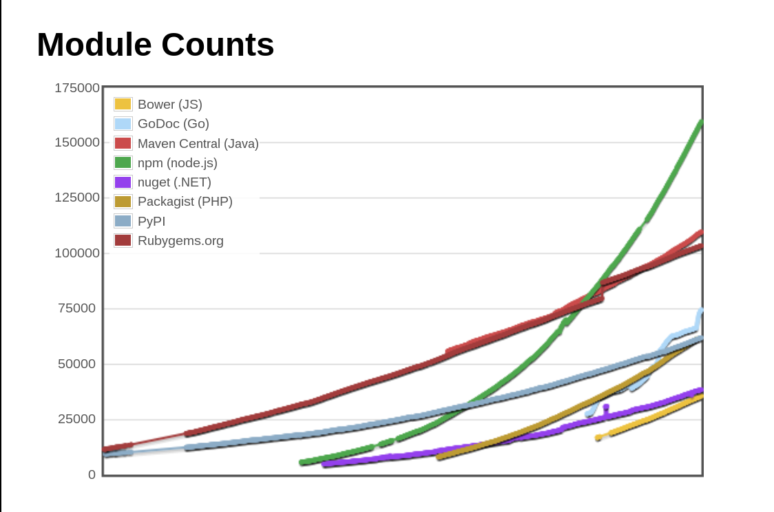
(all time)
Total NPM Modules today: 160190
http://www.modulecounts.com/

Slide 18

Dependency management
$ npm install lodash --save

Slide 19
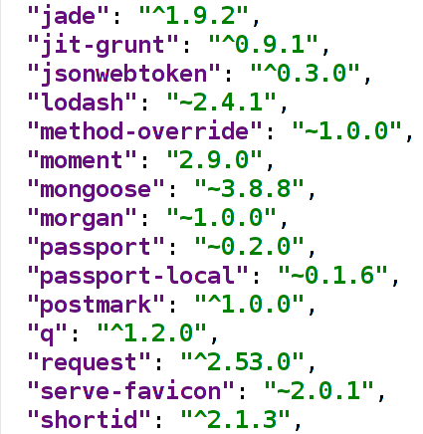
Keep track of outdated dependencies

Slide 20
Check your modules for security
NodeJS Security Project
$ npm i nsp -g
$ npm I grunt-nsp-package –save-dev
$ nsp package
$ grunt validate-package

Slide 21
Well, JavaScript on the server
Is it the same?
What’s the difference?

Slide 22
Lots of JS
problems go away
in NodeJS

Slide 23
Well, you have to know…
Frameworks (Express, KOA…)
Networking & WebSockets
ORMs and databases
Working with the file system
And others things…

Slide 24
Maintainable Server-side Code

Slide 25
Use static analysis tools
JSHint, JSLint

Slide 26
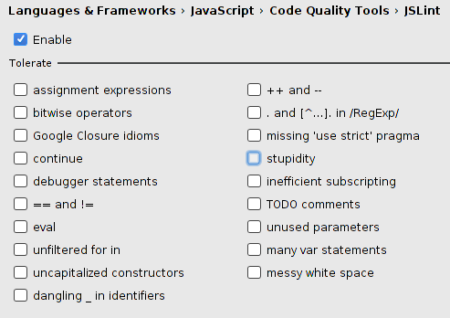
Avoid
global scope,
use strict mode
and just
don’t do stupid things

Slide 27
Frameworks

Slide 28
Application Frameworks can encourage more maintainable codebases, but it's ultimately up to the developers to do the right thing

Slide 29
Modular JavaScript
Single unit of work.
Small, reusable, testable,
discrete, loosely coupled

Slide 30
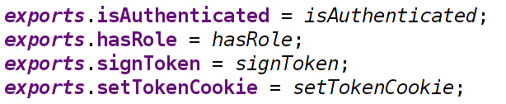

Slide 31
Smart Asynchrony
Promises, Async, Generators

Slide 32
Executing a callback multiple times
Executing a callback multiple times

Slide 33
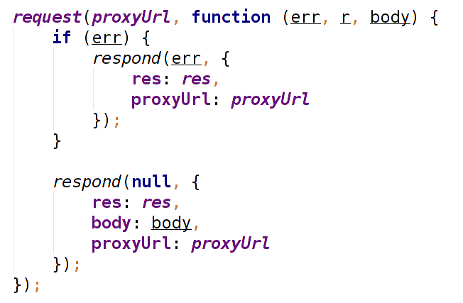
Wrong callbacks execution

Slide 34
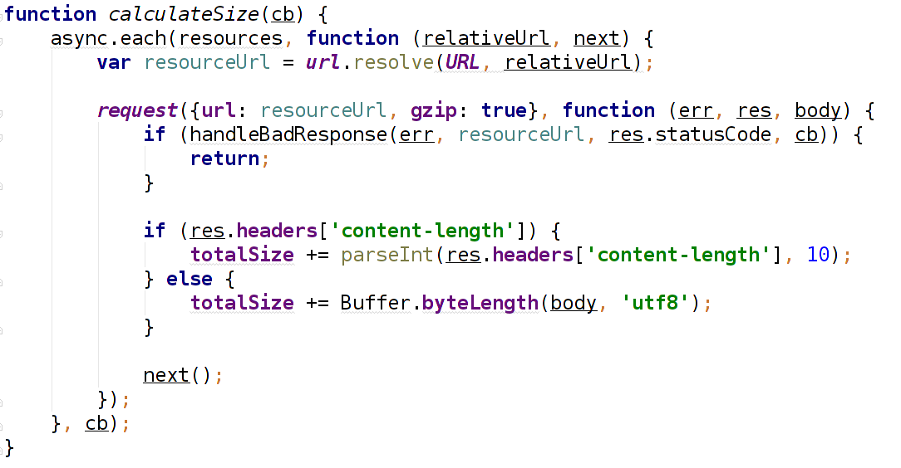
Async

Slide 35
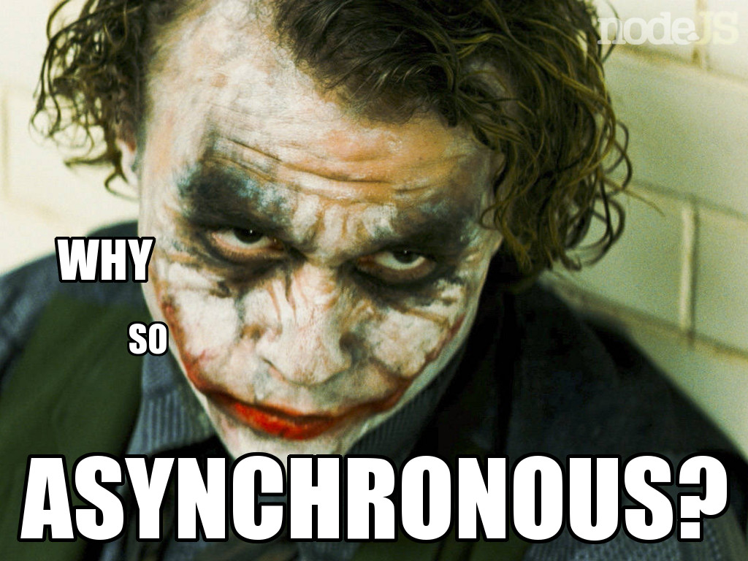

Slide 36
Your ticket to hell
Debugging with console.log()
Poor logging
Zero monitoring or profiling

Slide 37
Error handling in NodeJS
Catch ‘em all!

Slide 38
Well, who write tests?

Slide 39
No excuse for that
Testing frameworks: mocha, jasmine, tape and others
Assertion modules: chai, should.js
Modules for mocks, spies, stubs or fake timers such as sinon
Code coverage tools: istanbul, blanket

Slide 40
Summary
Recipe to fail
Monolithic applications
Sloppy code
Wrong dependency choices & tools
Poor logging
No tests
Bad (no) project management

Slide 41

Any questions?

Slide 42
Thank you

Slide 43


