Slide 1
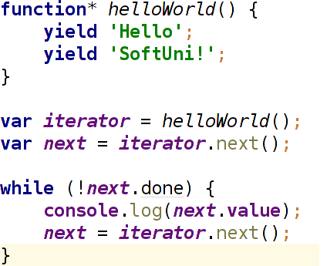
?
Looks-like a function, behaves like an iterator

Slide 2
Generators
The Paradigm
Why?
Solve old problems in a new way

Slide 3
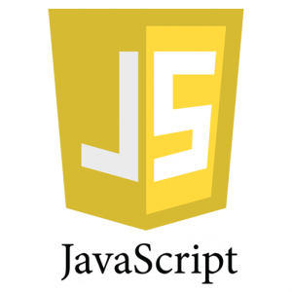


About me
Yulia Tenincheva
Server-side NodeJS Developer
GitHub : Y-LyN-10
Twitter : @3thelfleda

Slide 4
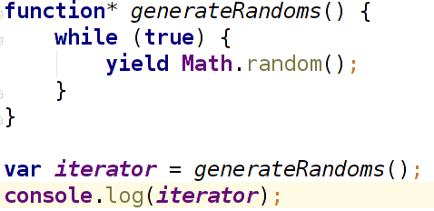
The Paradigm
Demo

Slide 5
The Paradigm
The Paradigm
Iterator
Definition
An object is an iterator when it knows how to
access items from a collection one at a time, while
keeping track of its current position within that sequence.
In JavaScript an iterator is an object that
provides a next() method which returns the next item
in the sequence. This method returns an object with
two properties: done and value.
Demo

Slide 6
The Paradigm
Definition
Generators
Generators are functions which can be exited
and later re-entered. Their context (variable
bindings) will be saved across re-entrances.

Slide 7
The Paradigm
Definition
Definition
.next()

Slide 8
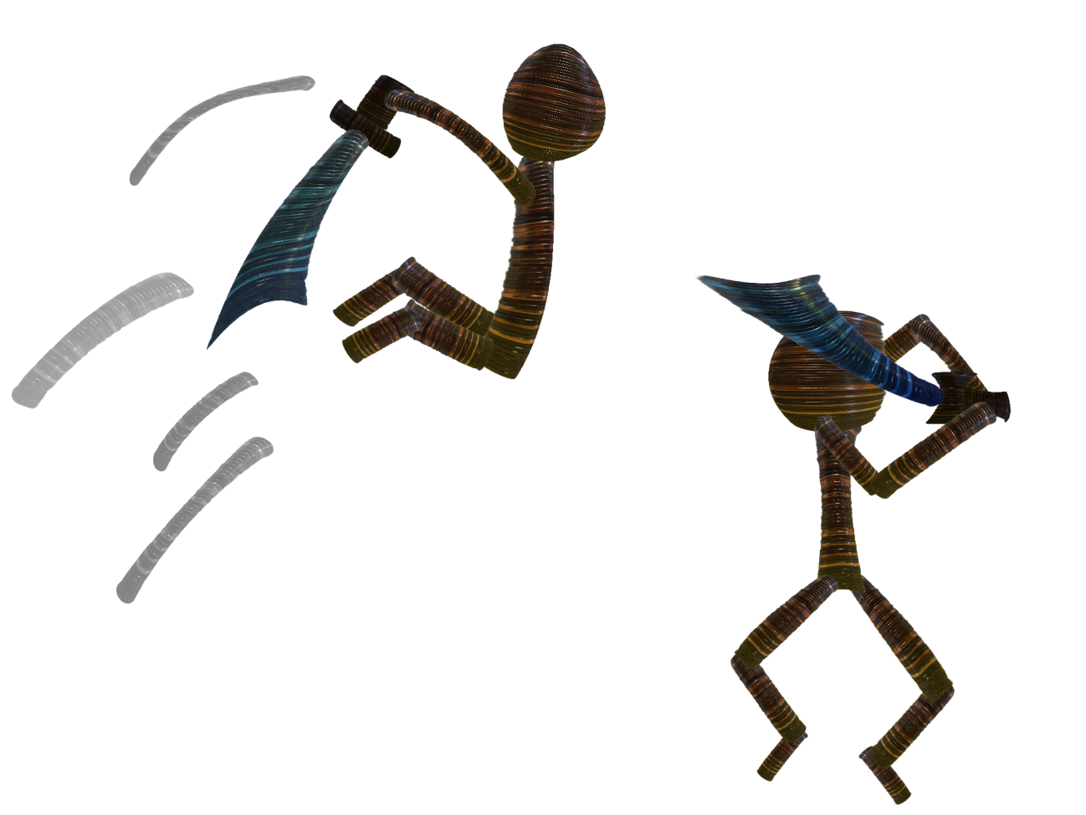
The Paradigm
Definition
.next()
.next()
“Feeding”
return vs. yield

Slide 9
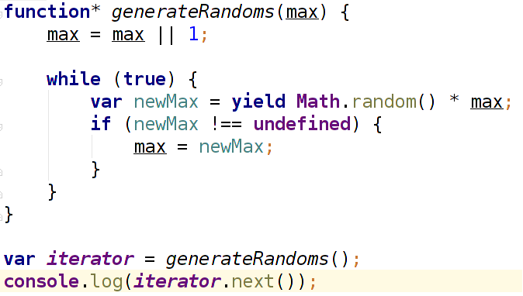
The Paradigm
Definition
.next()
“Feeding”
Demo

Slide 10
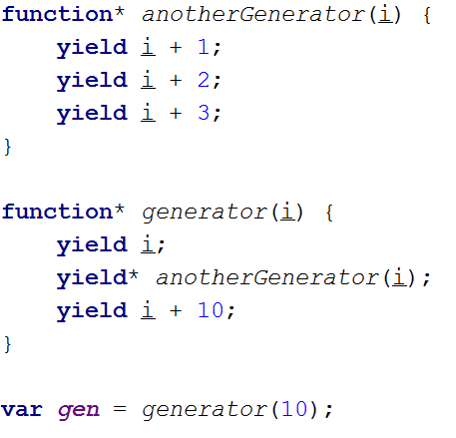
The Paradigm
Definition
.next()
“Feeding”
“Feeding”
Delegates
Demo

Slide 11
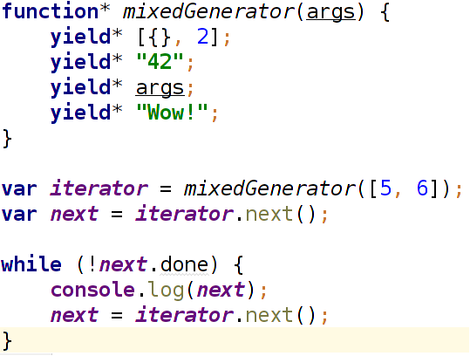
The Paradigm
Definition
.next()
“Feeding”
Delegates
Delegates
Iterables
Demo

Slide 12
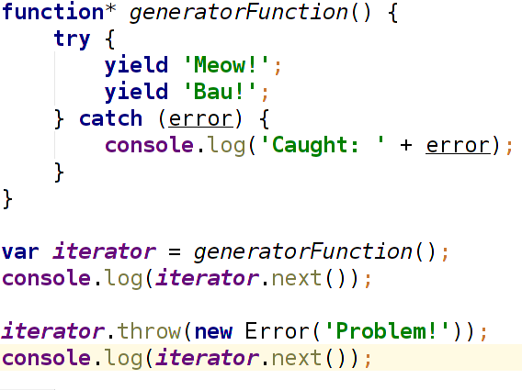
The Paradigm
Definition
.next()
“Feeding”
Delegates
Iterables
Iterables
Exceptions
Demo

Slide 13
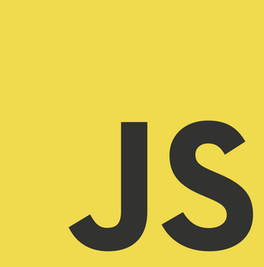
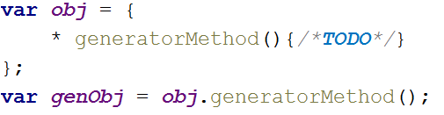
1. Via a generator function declaration:
2. Via a generator function expression:
3. Via a generator method definition in an object literal:
Syntax
Ways of creating generators in JavaScript

Slide 14




$ node –-harmony
Generators in ES6
$ npm install regenerator
$ npm install co
How to use them now?

Slide 15
