Slide 1


Slide 2
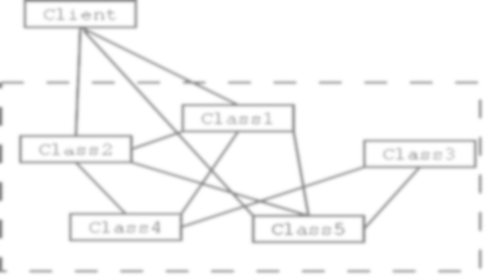


A Beginner's Guide to Design Patterns

Slide 3


Slide 4

What is a Design Pattern?
And why they are important?
- Solutions to common programming problems.
Not a finished solution!
- It is a description or template for how to solve a problem that can be used in many different situations.
- Show relationships and interactions between classes or objects
- Used in any programming Language

Slide 5
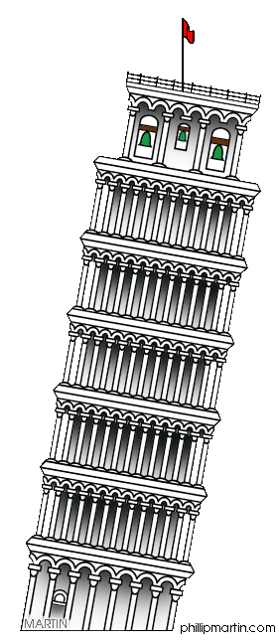
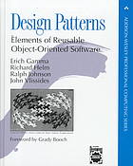
Some history...
Who made our life harder (or easier?)
Patterns originated as an architectural concept by Christopher Alexander (1977)
Gained popularity in computer science after the book Design Patterns: Elements of Reusable Object-Oriented Software by the “Gang Of Four”

Slide 6
Back to programming...
Design patterns have four essential elements :
A descriptive and unique name that helps in identifying and referring to the pattern.
1 Name
A scenario consisting of a problem and a context in which this pattern can be used used.
2 Problem
A description of an implementation of the pattern.
3 Solution
A description of the results, side effects, and trade offs caused by using the pattern.
4 Consequences

Slide 7
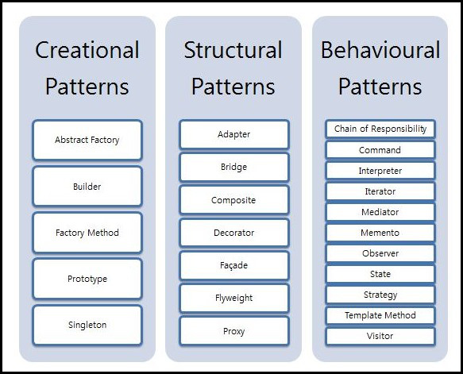
Types of design patterns

Slide 8
Types of Design Patterns
Provide instantiation mechanisms, making it easier to create objects in a way that suits the situation.
1. Creational
Deal with relationships between entities, making it easier for these entities to work together.
2. Structural
Deal with dynamic interactions among societies of classes and objects
3. Behavioral

Slide 9

So... when and how to use them?

Slide 10
Creational Design Patterns
Creational design patterns are composed of two dominant ideas.
Encapsulating knowledge about which concrete classes the system uses.
Another is hiding how instances of these concrete classes are created and combined.

Slide 11

Creational Design Patterns
Factory
Deal with the problem of creating objects without specifying the exact class of object that will be created.
Builder
Unlike the factory patterns, whose intention is to enable polymorphism, the intention of the builder pattern is to find a solution to the telescoping constructor anti-pattern.

Slide 12
Creational Design Patterns
Restricts the instantiation of a class to one object. When exactly one object is needed to coordinate actions across the system.
Singleton
Used when the type of objects to create is determined by a prototypical instance, which is cloned to produce new objects.
Prototype

Slide 13
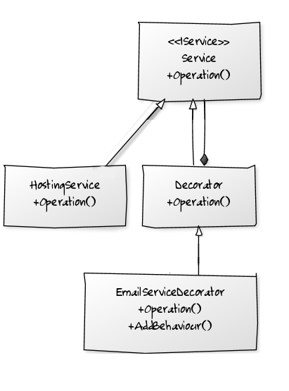
Structural Design Patterns
Adapter
Helps two incompatible interfaces to work together.
Provide a surrogate or placeholder for another object to control access to it.
Proxy
A flyweight is an object that minimizes memory use by sharing as much data as possible with other similar objects.
Flyweight
Allows behaviour to be added to an individual object, either statically or dynamically, without affecting the behaviour of other objects from the same class.
Decorator

Slide 14

Behavioral Design Patterns
Memento
Iterator
Mediator
Observer
State
Strategy

Slide 15
Well... STOP!

Slide 16
Live Demo
Finally some code… Hmm, not finally, eventually…

Slide 17

Summary
Now you know (I hope)
What is a Design Pattern
Why are they so important
What types of design patterns are there
Some useful patterns for different problems
When they are used
So... Now all you need is... Practice!

Slide 18
Thank you!
Presented by Yulia Tenincheva – yulia.ten@dezigner.ru

